Slide 1

How to Grow a CL Service: A Workshop Sponsored by the ACLP CL Directors’ SIG
Priya Gopalan, MD
Associate Professor of Psychiatry and OB-GYN
Medical Director, Psychiatry Consultation-Liaison Service
Chief of Psychiatry, Magee-Womens Hospital

Slide 2

Current Trends in Health Care

Slide 3

Question
What surprises you about the health care system that you didn’t know in medical school?

Slide 4
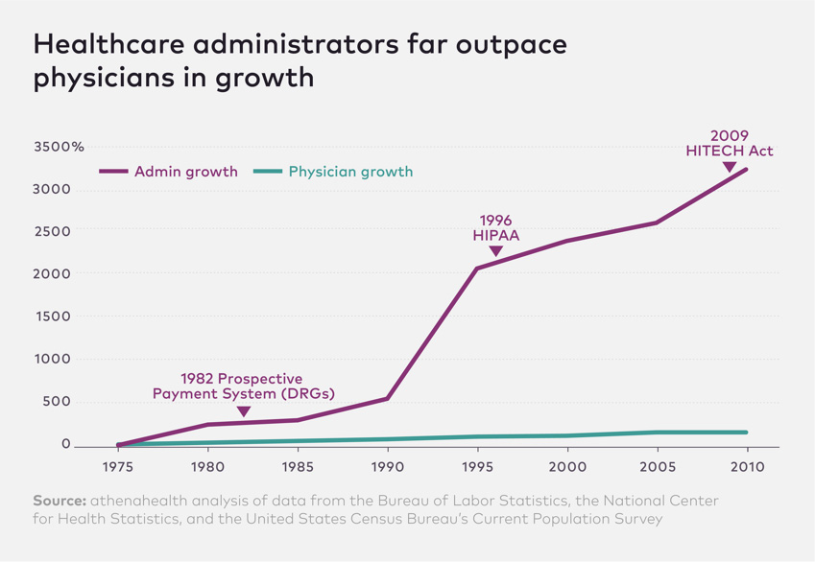

Slide 5


Payer Providers
By-product of shift to value-based care
73% of the 22 insurance products launched in the 1st quarter of 2018
22% of partnerships were joint ventures or co-branded in 2014
https://www.darkdaily.com/payer-provider-partnerships-accelerating-as-insurers-and-healthcare-networks-look-to-improve-care-quality-and-reduce-costs/

Slide 6
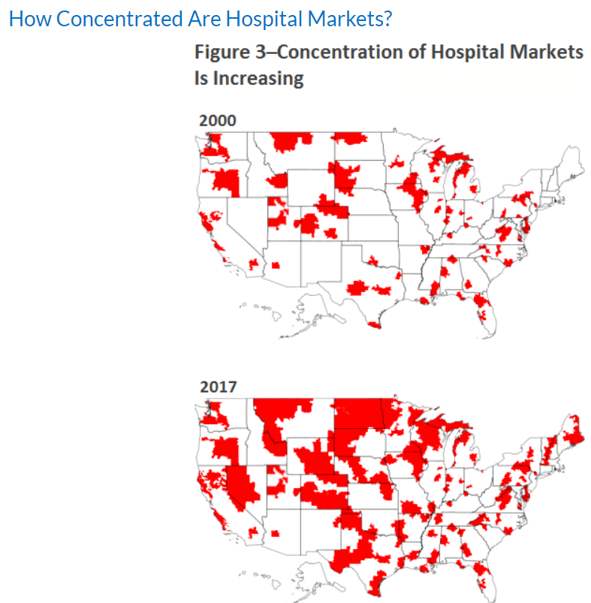
Consolidation of Large Systems
Began in the 1990s
Horizontal (acquisition of hospitals) versus vertical (hospitals buying physician practices)
ACA’s outpatient shift has incentivized hospitals towards buying more practices
https://www.ncci.com/Articles/Pages/II_Insights_QEB_Impact-of-Hospital-Consolidation-on-Medical-Costs.aspx

Slide 7
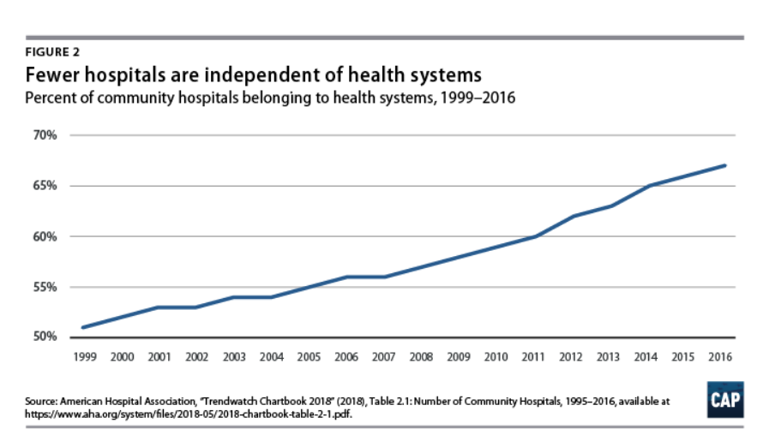

Slide 8
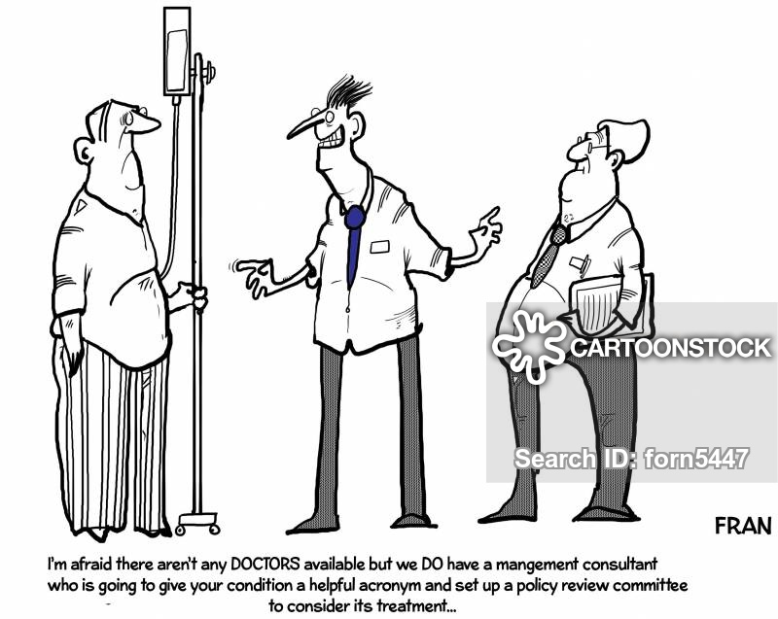
Physician Shortage
2019 study conducted for the AAMC
Predicted US will face shortage of 46,900-121,900 physicians by 2032
Both primary and specialty care
https://news.aamc.org/for-the-media/article/gme-funding-doctor-shortage/
Notes:
by IHS Markit

Slide 9
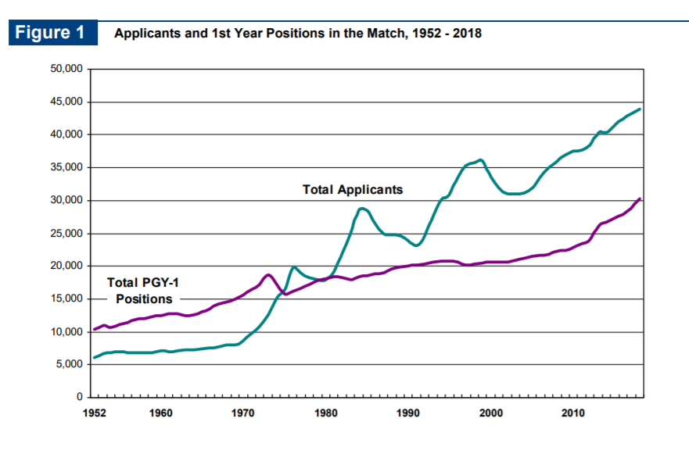
Physician Shortage (aka Residency Shortage)
What has happened to residency positions in this time?

Slide 10
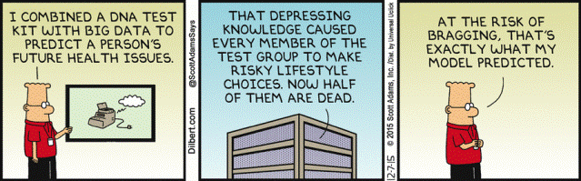
Innovative Models of Care

Slide 11
Consider This Scenario
You are approached by your boss with a request.
Your hospital system has purchased a rural hospital 2 hours away.
You are asked to “take over” their consult service, as the hospital president has heard about the good work that is happening at your primary site.

Slide 12

Case Study: Adding a CL Service to a Hospital
What considerations would a medical director face?
  Staffing
  Recruitment
  Culture
  Budget

Slide 16
Large Systems are Siloed
UPMC hospital system is enormous (40+ hospitals)
Each hospital has budgets for each subdivision (e.g., service lines)
Each service line has staff and physician budgets

Slide 17

Telepsychiatry for Access (and Scale)
Retain core model
Clinician on the ground
Cultural considerations
Consider weekends and coverage

Slide 18

Scalability and Core Values
Clinical excellence
Quality assurance/control
Career development
Job satisfaction
Professional development

Slide 19
Subspecialty Integrated Care
Oncology
Transplant
Neurology
Hepatology
Obstetrics-Gynecology
Gastrointestinal Disorders
HIV
Pain

Slide 22
Future Directions
Addition of other hospitals
Tele-CL “carve out” services (e.g., perinatal)
Best practices

Slide 23
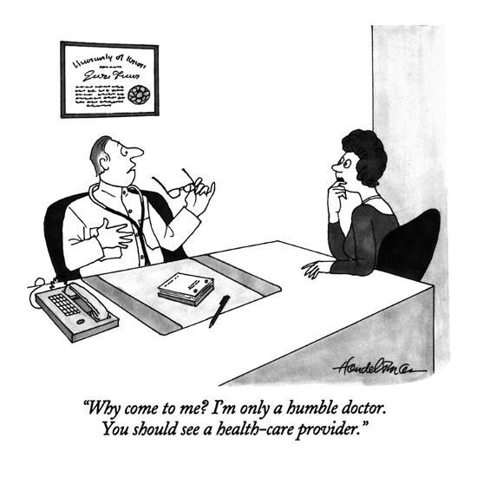
Physician as Leader

Slide 24
Considerations
Current personnel
Required personnel/recruitment Staff Physician
Budget parameters
Coverage questions
Weekdays versus weekends
Local culture & community
Liaison work & “marketing”
Electronic medical record & technology
Sustainability

