Slide 1
Growth of C-L Services Through Multidisciplinary Expansion ACLP 2021
Brian D. Bronson, MD
Vice-Chair for Clinical Strategy
Director of Consultation-Liaison Psychiatry
Director of Fellowship in Consultation-Liaison Psychiatry
Clinical Associate Professor of Psychiatry and Behavioral Health
Renaissance School of Medicine at Stony Brook University

Slide 2
ACLP 2021 Disclosure: Brian Bronson, MD
With respect to the following presentation, there has been no relevant (direct or indirect) financial relationship between the party listed above (and/or spouse/partner) and any for-profit company in the past 24 months which could be considered a conflict of interest.

Slide 3
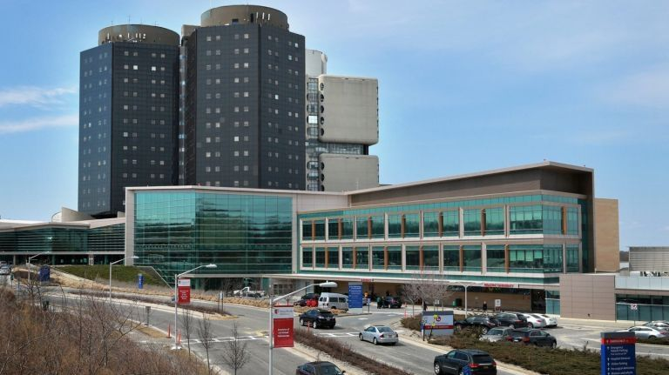
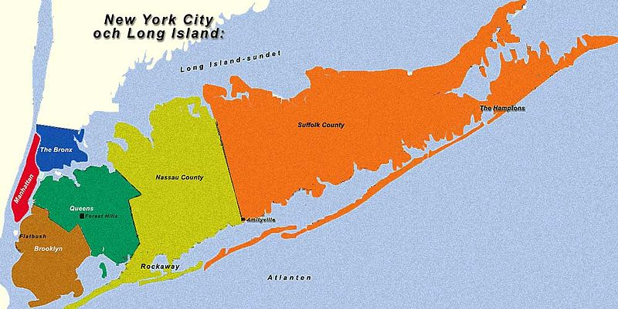
Stony Brook Medicine Recruited as C-L Director, 2013
600 Bed University Hospital
Suffolk County, 1.5 M

Slide 4
C-L Table of Organization 2012-2013
2012-Pre-Hire
2013-On-Hire
1 Psychiatrist
2 CNS
2 Psychiatrists
1 CNS
CL Director

Slide 5
2013-2020 Growth of Services through Value Driven Innovation and Interdisciplinary Collaboration
Traditional
Consult on Demand
2013
Medicine
Proactive C-L Pilot
2015
Expansion of Proactive C-L
Services
2016
C-L Psychologists
2018-19
C-L Social Workers
2019-20
Crisis Prevention Team
2020-21
Crisis Intervention Pilot
2014

Slide 6
2014 Needs Assessment
Half of Hospital Medicine Patients have an Active Psychiatric or Substance Use Dx
A Psychiatric or Substance Use Dx Increases Hospital Length of Stay by 60%
Length of Stay (days)
Based on coding for a psychiatric primary or secondary diagnosis during that admission. Source: Cerner / UHC Clinical Data Base; n=4775, Jan – June 2013
units 12S, 15N, 15S, 16N, 13N
Source: Cerner/UHC Clinical Database
Discharges, July-Dec 2013, All Units

Slide 7
Proposal for Proactive Consultation Liaison Hospital Medicine
Existing Reactive CL Model
Proactive CL Model to
Reduce LOS
Day 1
Medical Evaluation
Day 2-6
Psychiatric Consultation
Day 4+
Discharge Planning
Day 2-6
Hospitalist Identifies Need for Psychiatric Care
Day 1
Psychiatric/SUDs Screening/Case Finding
Day 1
Shared Medical & Psychiatric Management
and Discharge Planning

Slide 8
Proactive C-L Pilot - One-Year Results

Slide 9
132% = Return on Investment
“..dedicated psychiatric services on hospital medicine units aimed at early case finding and intervention, interdisciplinary communication and discharge planning, lowers length of stay for persons receiving psychiatric consultation more than does usual psychiatric consultation upon request. This appears to be particularly true in patients with a LOS <=30 days”
Bronson BD, Alam A, Schwartz JE, et al, Psychosomatics. 2019

Slide 10
C-L Table of Organization 2015
CL Director
2 Psychiatrists
2 Proactive Psychiatrists
2 Proactive NPs
1 CNS

Slide 11
C-L Psychology
Psychology Consortium Training Program
C-L Post Doc
2017
C-L Psychologist Line
2018
Employee Wellness Movement, COVID
2019-2021
Approval for 2nd C-L Psychologist, 2021
Emerging Director of Psychology
2016
C-L User Satisfaction Surveys:
“More Emotional Support”
2014 & 2015

Slide 12
C-L Table of Organization 2019
Director of Psychology
1 Psychiatrist/Director
1 Psychologist
2 Psychiatrists
2 Proactive Psychiatrists
(4 Medicine Units)
2 Proactive NPs
1 CNS

Slide 13
C-L Social Work
Met with Director of SW during Recruitment
2013
Inability of Medical Unit SWs to Make Psychiatry Appointments
2013-2019
Continued Meetings with SW
A ‘Single Standard’ for high-risk cases
Suicide Prevention
Joint Commission National Patient Safety Goal 2019
Director of Psychiatric Social Work Position Created
2019
C-L Social Work Position Established 2019
C-L User Satisfaction Surveys
“More Discharge Planning”
2014,2015
Second Social Worker Added 2020

Slide 14
C-L Table of Organization 2019
Director of Psychology
Director of CL
1 Psychologist
2 Psychiatrists
2 Proactive Psychiatrists
1 CNS
Director of Psych. SW
2 Proactive NPs
2 C-L Social Workers

Slide 15
Crisis Prevention Team
Crisis Intervention Team Pilot
Directors of C-L, Nursing, Security, Crisis Response Training
2015
Growing Hospital Attention to Disruptive Behaviors, Demands for Support and Training, Involvement of AD Nursing-Psychiatry
2018-2020
Crisis Prevention Team
2020
“Manpower Code” Hospital Security
2013
Regulatory Pressure
Associate Director for Operations - Neurosciences
Crisis Prevention Trainer Lines Established
2019

Slide 16
C-L Table of Organization 2021
C-L Director
Director of Psychiatric Social Work
2 Psychiatrists
1 Clinical Nurse Specialist
2 Social Workers
AD Operations Neurosciences
5- Member Crisis Prevention Team
BCBA, NAs, PhDs
AD Nursing Psychiatry
Director of Psychology
2 Psychologists
2 Proactive Psychiatrists
(Medicine)
2 Proactive NPs

Slide 17
2021 Peer Recovery Specialist Pilot
Opioid Epidemic in Long Island
NIH `Healing Communities Study –Increase MAT for OUDs
Regulatory Need for Peers in NYS OASAS licensed facilities
1-year pilot funding
C-L Peer Pilot
CASACS in ED

Slide 18
C-L Table of Organization 2022?
C-L Director
Director of Psychiatric Social Work
2 Psychiatrists
1 Clinical Nurse Specialist
2 Social Workers
ADO Neurosciences
5- Member Crisis Prevention Team
BCBA, NAs, PhDs
ADN Psychiatry
Residents & Fellows
Medical and PA Students
Peer Specialist Pilot (pending)
Director of Psychology
2 Psychologists
Psychology Trainees
2 Proactive Psychiatrists
(Medicine)
2 Proactive NPs
NP Residents

Slide 19
Lessons Learned

Slide 20
Who are your potential allies in growth?
DEPARTMENT
*Chair (& Vice Chairs) Administrator
HOSPITAL C-Suite (CEO, CFO, COO, CMO, CNO)
Associate Leads
DATA
IT
Reporting
Quality
Strategic Analytics
Department/Practice
CARE MANAGEMENT
SOCIAL WORK
NURSING

Slide 21
How are new lines approved at your institution?
Whose support is needed?
Chair, CEO, CFO, Committee?
Who Pays for the Line?
Department vs Hospital Hire?

Slide 22
Align Objectives & Timing
Institutional & Department Strategic Plans
Financial – Cost and ROI
External Pressures/Regulatory
Internal Pressures & Political Climate
Timing of Ask, Squeaky Wheel, Patience

