Slide 1
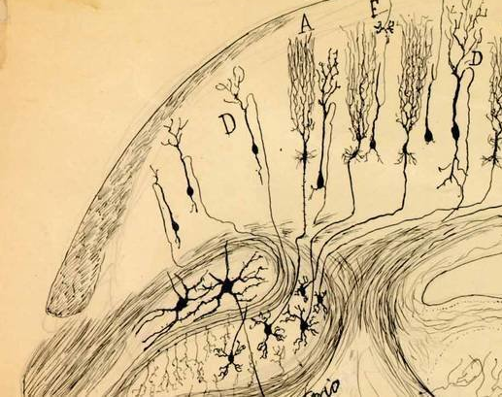
Down Syndrome Regression Disorder: An emerging neuropsychiatric disorder
Jonathan D. Santoro, MD
Director, Neuroimmunology & Demyelinating Disorders
Assistant Professor of Pediatrics and Neurology
Children’s Hospital Los Angeles and Keck School of Medicine of USC

Slide 2
Brief Case
A high functioning 16-year-old male with DS presents to clinic with two years of mutism, catatonia, anorexia, encephalopathy, and insomnia. The patient developed these symptoms over roughly two months and there was no clear preceding trigger.
He has had a normal MRI and blood work. An EEG shows global slowing. A variety of psychotropics (SSRI, antipsychotics, memantine, etc.) have not yielding any clinical improvement. The patient has recently tried ECT which improved symptoms modestly although the effect was not sustained.
Repeat blood work and neuroimaging is normal. He has a lumbar puncture which reveals elevated CSF protein and restricted oligoclonal bands. He is administered empiric IVIg for presumed blood-brain barrier disruption causing symptoms. Two weeks later, the patient can speak, walk, and communicate with family although displays OCD-like behavior and aggression.

Slide 3
Video used with parental consent (5/26/2021)

Slide 4
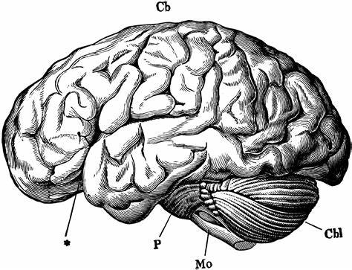
What is Regression?
Regression is a term for the loss or previously acquired developmental skills in an individual.
This can be activities (toileting, dressing oneself, or eating independently), language (loss of words, loss of ability to community, changes or regression in word structure), motor function (inability to walk, climb or run as previously able), or social interaction.
Regression can be caused by many things.

Slide 5
Symptoms of Regression
Social withdrawal from friends, family, and school/classmates
Loss or diminished language
Decreased speaking, loss of certain word use, sentence structure changes, “baby talk”
Loss of previously acquired developmental milestones
Loss of independence in activities (e.g., can no longer toilet independently)
New features concerning for autism
Decreased eye contact, decreased empathy/emotions, anger/frustration and behavioral outbursts, stereotypy (repetitive hand or body movements), lack of interest in others
Changes in motor activity (stiffness, slow movements, freezing, tics and/or extra movements that are not purposeful)
Anorexia (not wanting or not having interest in eating),
Insomnia and difficulty sleeping,
Obsessive compulsive thoughts and activities (e.g., lining up toys, rigidity with routines not previously present),

Slide 6
Neurologic Regression?
In some patients, symptoms may point more towards a neurologic cause for regression. These include:
Subacute onset (<3 months from onset to nadir of symptoms)
Insomnia
Catatonia or bradykinesia (slow movements)
Mutism and loss of language
Social withdrawal
Changes to diet (often anorexia)

Slide 7
What Causes Regression in DS?
At this time, it appears that there may be several causes of regression in persons with Down syndrome.
Our understanding at this time is that regression is a cluster of symptoms that often doesn’t describe the etiology although multiple causes may yield similar phenotypes
Timing matters!
Acute or sub-acute (<12 weeks) from the start of symptoms may be different then chronic or slowly changing symptoms

Slide 8
Regression
Immunologic (Immune System)
Genetic
Neurologic (Brain)
Psychiatric
Endocrinologic (Hormones)
Nutritional
Environmental
Stress
Pain

Slide 9
Psychiatric Etiologies
Persons with DS are known to have higher rates of depression, anxiety, autism spectrum disorders, and attention-deficit disorder than neurotypical persons.
The presence of these psychiatric diseases in an individual with DS is complicated by the fact that intellectual disability is nearly always present, limiting an individual’s ability to express what is going on.
One hypothesis of regression is that it is triggered by or a result of psychiatric disease. This has been observed in persons with Down syndrome who have a prominent life stressor that is temporally associated with (triggers) regression.
Some examples of life stressors include loss of a loved one, change in school, moving to a new home, divorce of family members and/or a physical accident).

Slide 10
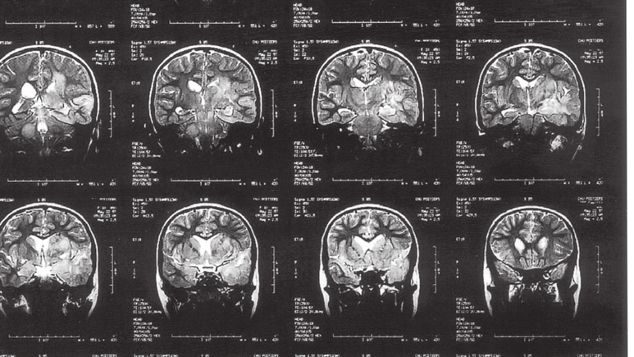
Neurologic Etiologies
Persons with DS are at risk for multiple neurologic diseases.
Ruling out common entities like seizure (also sometimes called epilepsy), dementia (Alzheimer’s disease), stroke, mitochondrial disease, and obstructive sleep apnea. Given the high rates of these disorders, we recommend that all persons with DS experiencing regression be evaluated by a neurologist.
Testing includes EEG (which evaluates for seizures/epilepsy or cortical dysfunction), MRI (done with and without contrast to evaluate for structural or inflammatory causes of regression) and lumbar puncture which helps evaluate for inflammation and infection. To rule out cerebrovascular disease, an MRA may also be utilized
Some families have been told that their loved one with Down syndrome has “early onset Alzheimer’s disease”. This is very rare in persons less than 40 years old and should be ruled out with other tests as above.

Slide 11
Neuroimmunologic Etiologies
In a subset of induvial with DS and regression, inflammation has been identified. This is typically recognized in review of CSF and neuroimaging studies.
If inflammation is found there is some evidence to support the use of immune-based therapy. Several case reports (and data to be shown subsequently) support the role of IVIg and other second line immunotherapeutics to treat this condition.
The causes of inflammation are variable and sometimes the term “autoimmune encephalitis” may be applied. Testing for specific pathologic antibodies as noted above is often helpful in cases where there is a suspicion for neuro-immunologic phenomenon.

Slide 12
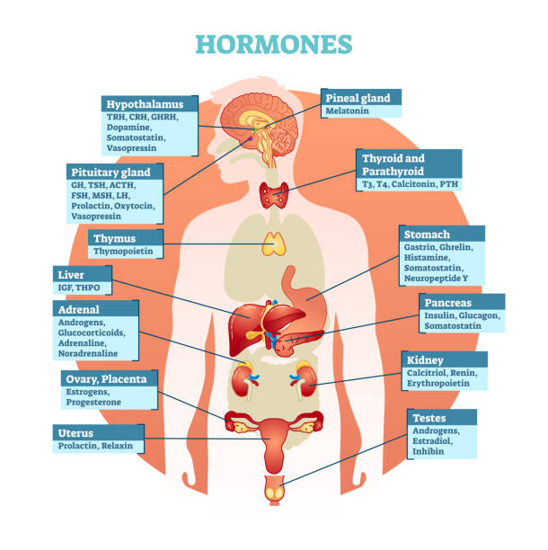
Immunologic & Endocrine Etiologies
Persons with DS are at risk for a host of inflammatory and endocrine disorders like thyroid disease, celiac disease, rheumatologic conditions (especially inflammatory skin disease), and diabetes.
Although these are less linked to longstanding regression, ruling in/out these diseases is of value as they are treatable.
NOTE: hormone or immunologic dysregulation may make other causes or regression worse at certain times (e.g., neuroimmunologic or pain related issues can look worse during an individual’s menses)

Slide 13
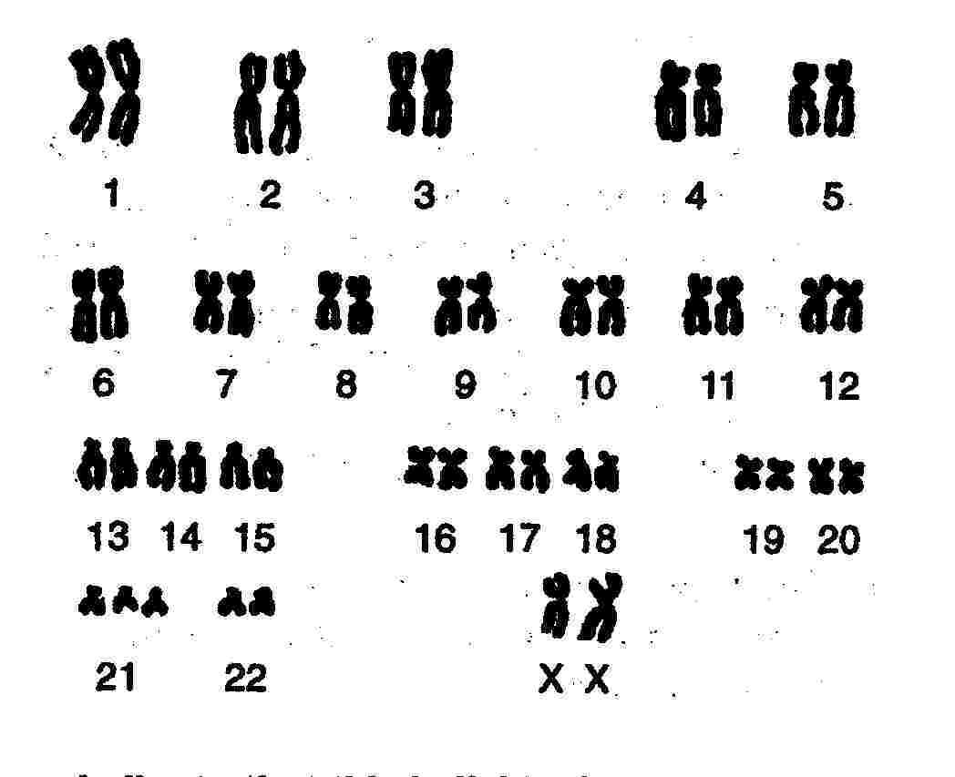
Genetic Etiologies (?)
Persons with DS have trisomy (three copies) of chromosome 21. However, the possibility of having more than one gene mutation is well-established.
There are some patients with regression who may warrant an extended genetic work up as part of their evaluation.
Depending on symptoms, testing my included a targeted panel or broad analysis known as whole exome sequencing.

Slide 14
So, what should we do?

Slide 15
Concern for Regression in a Person with Down Syndrome
Chronic (>6 months)
Subacute (2 Weeks – 6 months)
Acute or Intermittent
Tier 1 (At Consultation) Serum Testing:
If concern for metabolic disorder: ammonia, lactate, pyruvate, plasma amino acids, acylcarnitine profile, free and total carnitine, very long-chain fatty acids
Any appropriate studies from “subacute” area and/or lead level
Consider obtaining authorization for Fragile X or chromosomal microarray
Tier 1 (At Consultation) Serum Testing:
All: CBCd, CMP, ESR, CRP, neopterin, TSH, T4, ANA, dsDNA, anti-phospholipid antibodies, IgG, IgM, IgA, TPO antibodies, anti-thyroglobulin antibodies, Celiac screen, HIV, RPR, mayo autoimmune encephalitis panel, vitamin D 25-OH, ASO, anti-DNAse B, C3, C4, cytokine panel (ARUP)
If anorexia/restricted oral intake: B1, B6, B12, methylmalonic acid, ceruloplasmin, zinc, copper, and vitamin E
If history of diabetes: HbA1c
If concern for systemic inflammatory process: D-dimer, aldolase, LDH, uric acid, triglycerides, ferritin, NK cell function, CD107a mobilization study, sIL-2 receptor, rheumatoid factor, Von Willenbrand Factor antigen, lupus anticoagulant and SSA/SSB
Symptoms (5-60+ min):
Weakness
Slurring
Facial asymmetry
Language changes
Syncope/fall
Symptoms (<5 min):
Jerking
Confusion/post-ictal
Behavioral arrest
Language changes
Seizure
Urgent MRI w/wo Contrast with MRA Head and Neck
DDx: moyamoya or cebrovascular disease
EEG (routine, 60 minutes, preferably with capture of sleep)
DDx: Epilepsy/seizure
Tier 2 (Post-Consultation):
MRI brain (w/wo contrast)
> Rule out structural/inflammatory defect
EEG (routine, 60 minute)
> Rule in/out seizure disorder or epileptic syndrome (must capture sleep)
Fragile X (if male) and/or chromosomal microarray. Targeted gene panel based on symptoms if indicated.
> Rule in/out dual genetic etiology
If negative
If negative
If no clear etiology
Any new focal neurologic finding on exam
If unclear etiology, partially meeting Graus et al (2016) or Celluci et al (2020) criteria for autoimmune encephalitis or strong concern for neuroinflammation
Tier 3 (May Need Coordination with MRI if Sedation Needed - Cerebrospinal Fluid):
Cell count w/differential, protein, glucose, oligoclonal bands, IgG synthesis rate, myelin basic protein, neopterin, T/B cell subsets, mayo autoimmune encephalitis panel (CSF)
If chronic symptoms or with epilepsy (and normal MRI): amino acids, lactate/pyruvate, sialic acid, alpha-aminoadipic acid, succinyladenosine, 5-methyltetrahydrofolate
If movement disorder/catatonia (and normal MRI and normal autoimmune encephalitis panel): neurotransmitter metabolites and tetrahydrobiopterin.
If no etiology and family interested in additional testing
Ancillary Tests Based on Clinical Symptoms Only
> Polysomnogram, audiologic evaluation, vision testing, biotinidase enzyme activity, psychiatric assessment, Lyme or bartonella screening, MECP2 gene testing, phytanic acid, plasmalogens, urine glycosaminoglycans, urine oligosaccharides, urine sialic acid, carbohydrate deficit transferrin, porphyria testing, nickel, thallium, manganese, magnetic resonance spectroscopy
Tier 4: Whole Exome Sequencing

Slide 16
Identification
Diagnosis
Management

Slide 17
Diagnosis
There are no definitive criteria for the diagnosis of DSRD and thus symptom clusters have been used to evaluate for the possibility of having the disease.
However, when analyzing symptoms, significant overlap between the DSRD symptom cluster and autoimmune/inflammatory disorders of the brain begin to emerge, specifically autoimmune encephalitis, which is often characterized by subacute onset of movement disorders, alterations in behavior and other neuropsychiatric issues.
When used as a “disease construct” as opposed to a disease, AE can provide us a basis for neurodiagnostic investigation

Slide 18
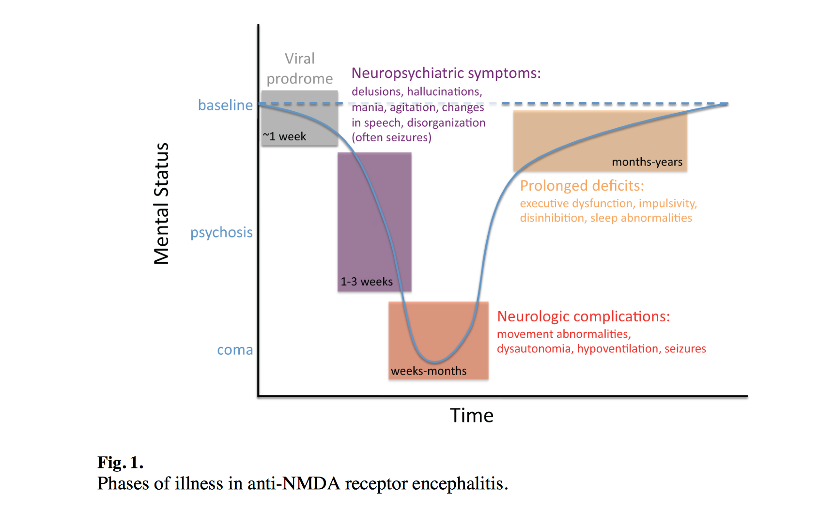
“Classic” disease course in individuals with anti-NMDAr encephalitis

Slide 19
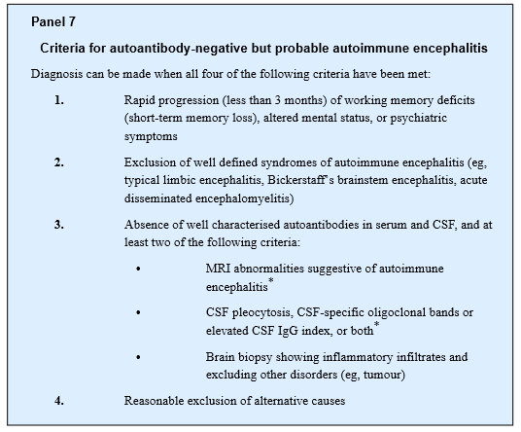
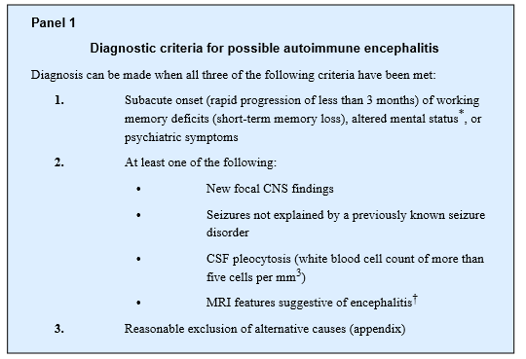
So… is this autoimmune encephalitis?
Graus et al., A clinical approach to diagnosis of autoimmune encephalitis. Lancet Neurol, 2016, Apr;15(4):391-404

Slide 20
Differential Diagnosis?
Systemic/Metabolic: thyroid dysfunction, nutritional deficiency (folate, B6, B12, vitamin D-25-OH), Celiac disease, constipation/pain, sensorineural hearing issues, vision issues (cataracts/corneal ulceration)
Neurologic: stroke/moyamoya disease/TIA, seizure/epilepsy, Landau-Kleffner, autoimmune encephalitis, early onset Alzheimer’s (very rare), autism spectrum disorder (without regression)
Psychiatric: depression, anxiety, stress or change to home environment
Pulmonary: obstructive sleep apnea
Infectious/immunologic: HIV, syphilis, Lyme, HHV-6 etc.
Genetic: dual genetic diagnosis (fragile X, Rett (MECP2), microdeletion/duplication syndrome), co-morbid neurometabolic disease (porphyria, glycosylation disorder, lysosomal disorder, Lesch-Nyhan, aminoacidopathies, organic acidurias)

Slide 21
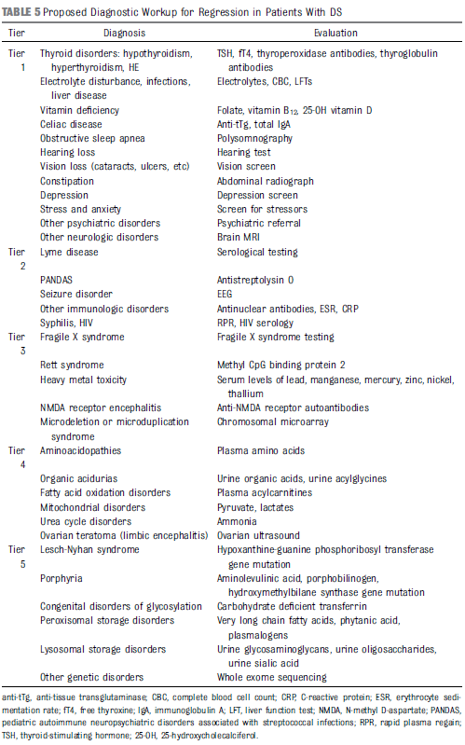
Work up?
Unfortunately, there is no definitive work up advised given the infrequency of this disorder and the relatively new (5 years) large scale reporting from multiple centers.
Jacobs et al (2016) advised ruling out all possible etiologies in a tiered manner although the work up for this is costly and time consuming
We have tried to be a bit more targeted…
Jacobs J, et al. Rapid clinical deterioration in an individual with Down syndrome. Am J Med Genet A. 2016;170(7):1899–1902

Slide 22
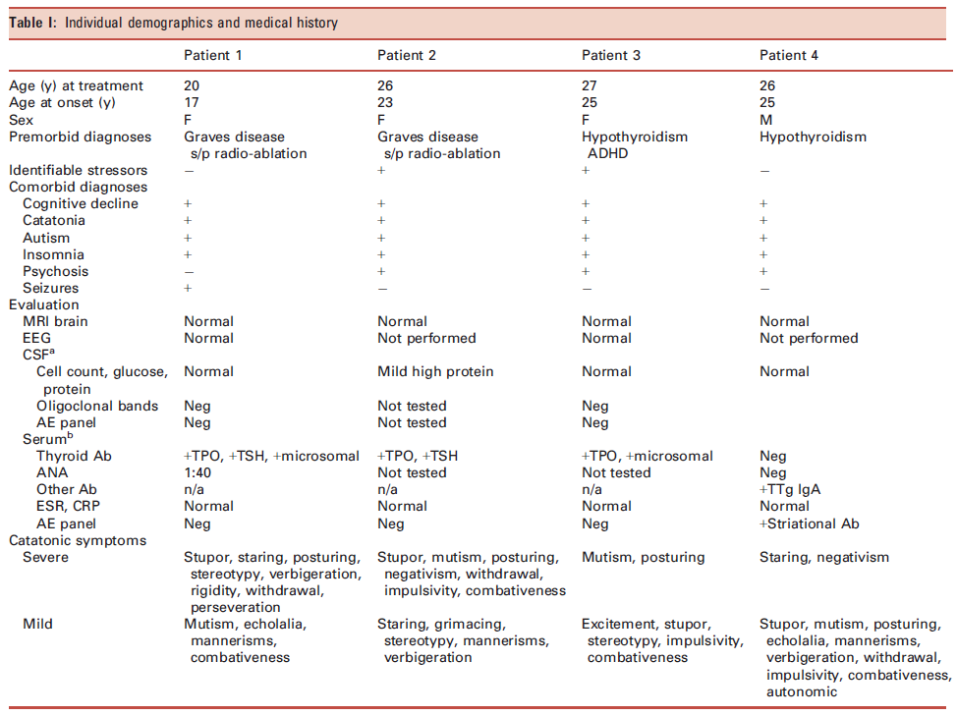
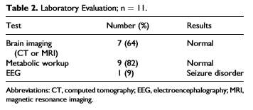
Diagnostic Study Results
Thus far, no studied have thoroughly reviewed the results of serum results or neurodiagnostic results in any significant detail.
Cardinale et al. (2019) reported on four patients with DSRD that responded to immunotherapy. Worley et al (2015) provided a much more limited data set.
Cardinale et al., Immunotherapy in selected patients with Down syndrome disintegrative disorder. Dev Med Child Neurol, 2019
Worley G, et al. Down syndrome disintegrative disorder: new-onset autistic regression, dementia, and insomnia in older children and adolescents with Down syndrome. J Child Neurol. 2015.

Slide 23
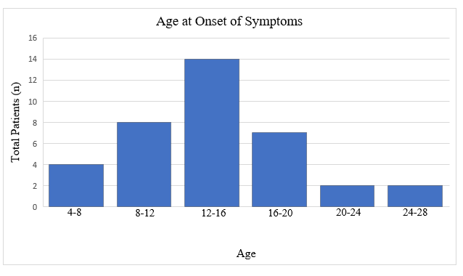
Age Distribution

Slide 24
Demographics
 | DSRD (n= 48) | DS (n= 1217) | p value | 95% CI
Sex Male Female | 25 (52%) 23 (48%) | 578 (47.5%) 638 (52.5%) | 0.54 | 0.67-2.13
Race Caucasian Hispanic Asian Black | 41 (86%) 35 (73%) 4 (8%) 3 (6%) | 1058 (87%) 370 (35%) 109 (9%) 49 (4%) | 0.76 <0.001 0.88 0.45 | 0.39-1.99 4.52-26.03 0.33-2.62 0.48-5.29
Medical History Obstructive sleep apnea (n= 46) Congenital heart disease Autoimmune disease (any) Thyroid disease | 27 (59%) 26 (54%) 25 (52%) 12 (25%) | 523 (43%) 548 (45%) 426 (35%) 182 (15%) | 0.07 0.21 0.02 0.06 | 0.95-3.05 0.81-2.57 1.13-3.59 0.97-3.71
Age at Onset (median, IQR) | 13.5 (11-17) | 11 (7-15) | < 0.001 | 1.59-12.64

Slide 25
Clinical Phenotypes
Preceding Trigger Infection Change in school/work/home environment Loss of family/caregiver/friend Change in residence Abuse Death in immediate social network Medical change | 25 (52%) 11 (23%) 4 (8%) 3 (6%) 2 (4%) 2 (4%) 2 (4%) 1 (2%)
Months to Symptom Peak (median, IQR) | 3 (1-6)
Clinical Symptoms Social withdrawal Loss of acquired skills Autistic features Diminished eye contact Apathy (n= 46) Impaired attention Anxiety Mutism/Expressive language regression Anorexia Whispered speech Confusion/disorganization Insomnia Memory impairment Catatonia Freezing/bradykinesia Emotional lability (n= 39) Abulia/avolition (n= 47) Stereotypy Incontinence (urine/feces) Inappropriate/mirthless laughter (n=41) New obsessive-compulsive tendencies Aggression/agitation (n= 47) Tics (n = 45) Hyperactivity Autonomic dysfunction (n= 23) Persistent focal neurologic deficits Seizure (n= 47) Transient neurologic deficits/TIA | 48 (100%) 48 (100%) 48 (100%) 46 (96%) 43 (94%) 43 (90%) 41 (85%) 39 (81%) 37 (77%) 37 (77%) 37 (77%) 36 (75%) 36 (75%) 35 (73%) 33 (69%) 25 (64%) 30 (64%) 25 (52%) 24 (50%) 20 (49%) 15 (31%) 12 (25%) 11 (24%) 8 (17%) 5 (15%) 2 (4%) 1 (2%) 1 (2%)

Slide 26
Serum Analysis
Study | DSRD Results Abnormal (n, %) | DS Results Abnormal (n/N, %) | p Value | 95% CI
ANA | 8 (17%) | 21/422 (5%) | 0.003 | 1.59-9.18
Anti-DnaseB | 0 (0%)
ASO (n = 34) | 5 (14%)
B12 level | 1 (2%)
Celiac panel | 4 (8%)
Complete metabolic panel | 0 (0%)
CRP (n= 38) | 4 (10%)
dsDNA (n= 37) | 0 (0%)
ESR (n= 42) | 10 (24%)
Infectious screenª | 0 (0%)
Neopterin (n= 18) | 7 (39%)
Methylmalonic acid (n= 27) | 1 (4%)
Neurometabolic studies* (n= 32) | 0 (0%)
Thyroid function | 1 (3%) | 160/842 (19%) | P= 0.03 | 0.02-0.82
TPO antibodies (n= 43) | 17 (39%) | 110/478 (23%) | p= 0.06 | 0.98-3.44
Thyroglobulin antibodies (n= 42) | 13 (31%) | 107/465 (23%) | p= 0.06 | 0.63-2.43
Vitamin D (median, IQR) | 24 (15-34) | 39 (32-47) | p< 0.001 | 10.57-16.9
Cytokine analysis (n= 21) sIL-2 receptor IL-10 IL-6 | 11 (42%) 7 (64%) 3 (27%) 1 (9%)

Slide 27
Neurodiagnostic Abnormalities
Neurodiagnostic Studies
EEG Abnormalities Epileptiform discharges in frontal/temporal lobes Diffuse slowing (non-focal) Focal slowing | 13 (27%) 5 (38%) 4 (31%) 4 (31%)
Neuroimaging Abnormalities Punctuate T2 hyperintensities (grey/white junction) Basal ganglia calcifications T2 signal prolongation in the temporal lobes Both T2 hyperintensities and calcifications Contrast enhancing lesions | 11 (23%) 9 (82%) 1 (9%) 1 (9%) 1 (9%) 0
CSF Abnormalities WBC RBC Glucose Protein Oligoclonal bands (n= 36) IgG index (n = 36) Mayo autoimmune encephalitis panel (n= 35) Neopterin (n= 19) | 8 (17%) (n, %, median if abnormal) 3 (6%, 6) 0 0 9 (19%, 68) 1 (3%, 2) 5 (14%, 0.70) 0 4 (21%, 45)
Any abnormal neurodiagnostic study? >2 abnormal studies | 21 (44%) 7 (33%)

Slide 28
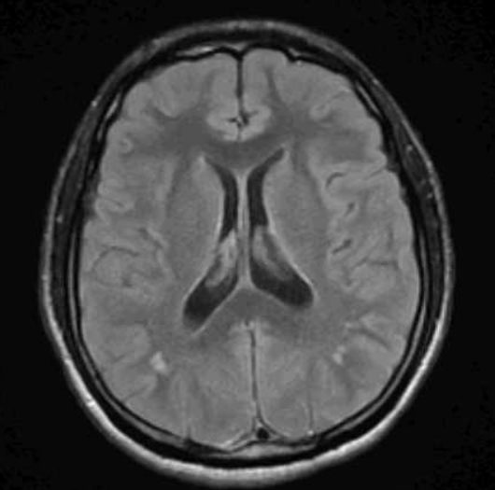
Punctuate T2 hyperintensities (grey/white junction)

Slide 29
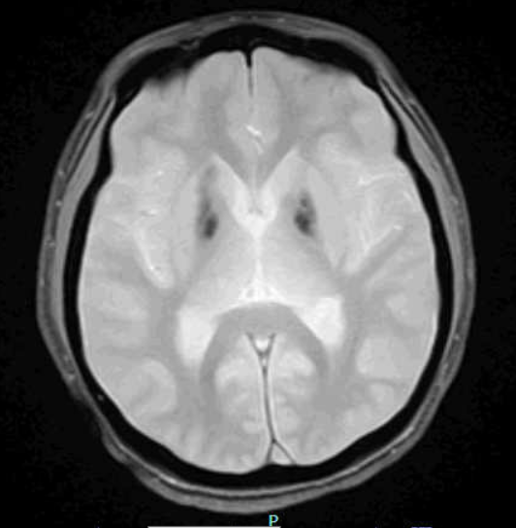
Basal ganglia calcifications

Slide 30
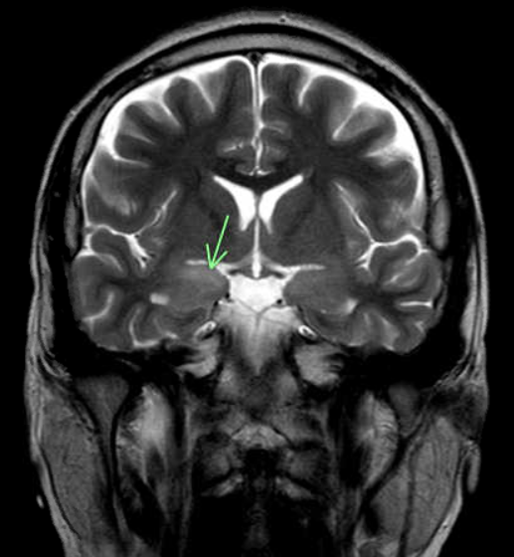
Temporal Lobe T2 Signal Prolongation

Slide 31
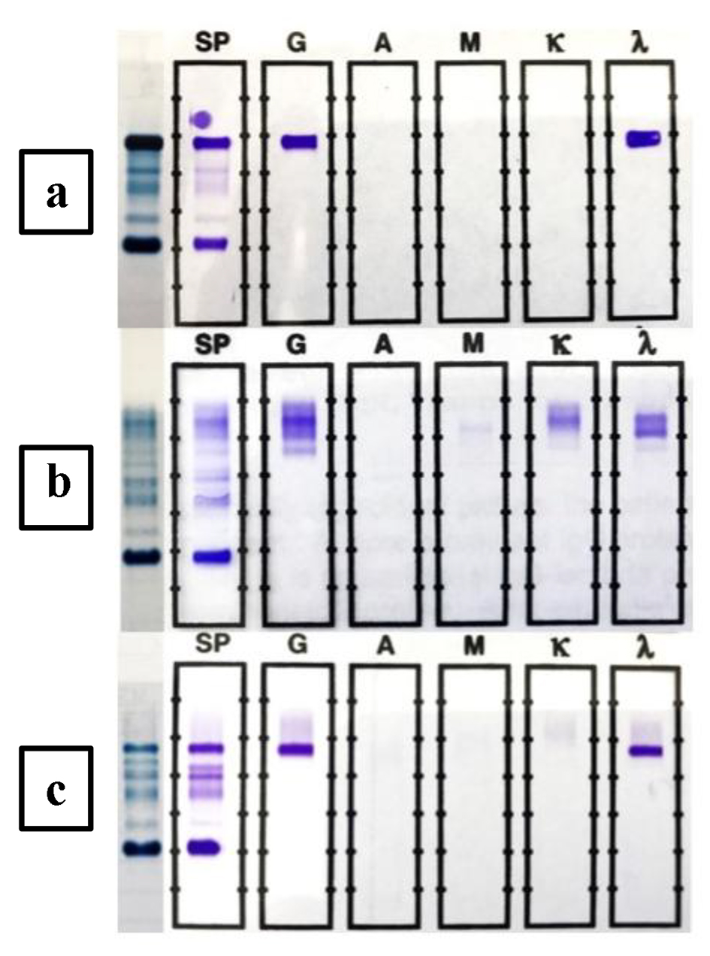
Control
Patient
After therapy
Oligoclonal Banding

Slide 32
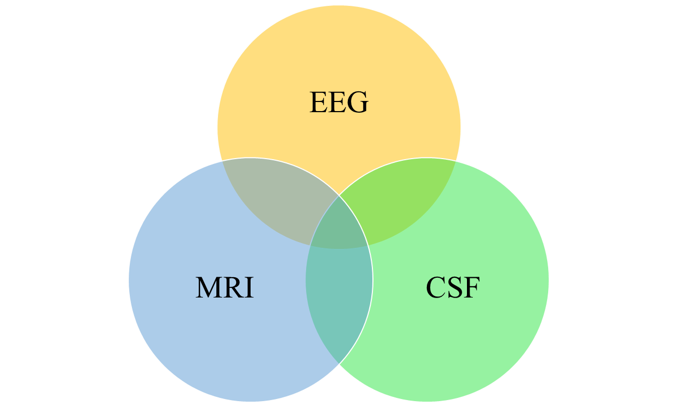
13
7
4
4
6
11
8
Santoro JD et al., unpublished (2021)

Slide 33
Are all of these tests needed?
Probably not
Neurodiagnostic studies should be utilized in the context of the disease presentation which is why it may be best to classify symptom clusters into smaller groups
Acute/subacute onset: higher likelihood of neurologic, immunologic or psychiatric etiology
Prior stressor or environmental change that is temporally associated with onset: higher likelihood of psychiatric disease
Intermittent symptoms with short duration (<60-120s): higher concern for seizure or transient ischemic attack
Intermittent symptoms with external trigger: concern for psychiatric
Catatonia/movement disorder: increased likelihood of neuroimmunologic or psychiatric etiology
Chronic onset: higher likelihood of genetic, metabolic or psychiatric condition
Although these breakdowns can be helpful, definitive results detailing specificity and sensitivity are lacking

Slide 34
Down Syndrome Regression Disorder
Antidepressants
Antipsychotics
Electroconvulsive Therapy
Immunotherapy
Cholinergic Agents
Benzodiazepines
Notes:
Although many unique therapies have proven to be efficacious in persons with DSRD, we will focus on immunotherapy in the context of neurodiagnostic abnormalities

Slide 35
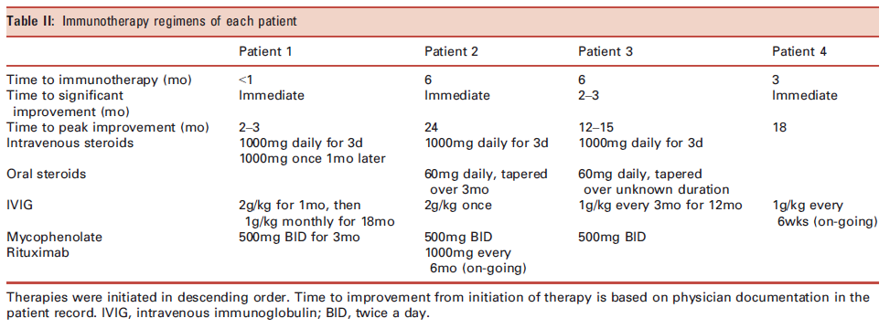
Treatment: Immunotherapy
Only one published study to date:
Cardinale et al., Immunotherapy in selected patients with Down syndrome disintegrative disorder. Dev Med Child Neurol, 2019

Slide 36
Immunotherapy:
Therapy Type | Utilization (n, %) | Effectiveness (n, %) |  |  |  | Any Neurodiagnostic Abnormality v Normal Work up
 |  | All Patients (n= 48) | CSF Abnormal (n= 8) | EEG and/or MRI Abnormal (n= 18) | EEG/MRI/CSF Normal (n= 27) | X² value | p Value | Odds Ratio (95% CI)
Antidepressant | 25 (52%) | 12 (48%) | 1/4 (25%) | 2/8 (25%) | 9/16 (56%) | 2.73 | 0.11 | 0.26 (0.05-1.33)
Antipsychotic | 39 (81%) | 25 (64%) | 2/6 (33%) | 9/15 (60%) | 15/22 (68%) | 1.12 | 0.22 | 0.47 (0.14-1.59)
ECT | 32 (67%) | 25 (78%) | 2/4 (50%) | 6/10 (60%) | 19/22 (86%) | 3.89 | 0.04 | 0.21 (0.04-1.06)
Nutritional Therapy | 19 (39%) | 0 (0%) | 0/2 (0%) | 0/8 (0%) | 0/11 (0%) | 0 | 1.0 | n/a
Immunotherapy Steroids IVIg Anti-CD20 MMF/AZ | 27 (56%) 23 (85%) 27 (100%) 12 (44%) 13 (48%) | 25 (93%) 7 (30%) 24 (89%) 6 (50%) 10 (77%) | 21/27 (78%) 4/8 (50%) 8/9 (89%) 5/5 (100%) 4/5 (80%) | 19/30 (63%) 3/11 (27%) 10/11 (91%) 2/4 (50%) 4/4 (100%) | 8/21 (38%) 0/6 (0%) 7/8 (88%) 0/4 (0%) 1/3 (33%) | 6.67 1.22 0.04 4.38 3.70 | 0.01 0.27 0.85 0.04 0.08 | 3.8 (1.34-10.90) - 1.29 (0.10-16.53) - 16.0 (0.69-383.0)
Santoro JD et al., unpublished (2021)

Slide 37
Prognosis
Video used with parental consent (09/03/2021)

Slide 38
Thank you!
Jonathan D. Santoro, MD
Division of Neurology
Children’s Hospital Los Angeles
4650 Sunset Blvd, MS82, Los Angeles, CA 90027
Phone: 323-361-2471 | Fax: 323-361-1109
Email: jdsantoro@chla.usc.edu and dsresearch@chla.usc.edu

