Slide 1
Long COVID: Psychiatrist Perspective
Brandon Hamm, MD, MS; Northwestern University
Andrew Coulter, MD, MA; Cleveland Clinic
Equal authorship

Slide 2
Disclosures
Brandon Hamm and Andrew Coulter have nothing to disclose
Graphics royalty free/public domain

Slide 3
Should a psychiatrist think of “long COVID” like...
Chemobrain?
Chronic fatigue syndrome/myalgic encephalomyelitis?
An encephalopathy episode with a prolonged delirium course?
Psychiatric disorder due to another medical condition?
A psychosocial stressor?
A somatic symptom disorder?
A functional neurological disorder?

Slide 4
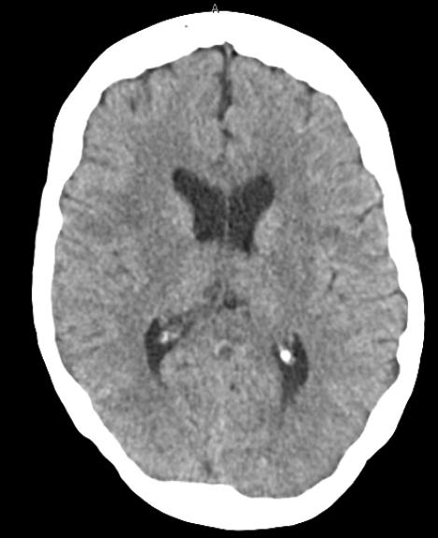
Lung Transplant Candidacy
62-year-old female
Remote mild depression episode
NO pre-COVID cognitive impairment Hx
COVID-19 onset 4 months prior (s/p AIR), c/b pulmonary fibrosis and pulmonary HTN
“feels tension… with the perceived high stakes of being able to remember and focus on what the doctors were talking about.”
MMSE: 0/5 on serial sevens, though able to spell WORLD backwards; slow processing
Clock Drawing: mild number crowding, unable to figure out where to place hands
Plan:
No psychiatric contraindication to transplant
Increased sertraline by 25 mg
Written information and discussion in chunks
Fish oil 1-2 grams qd and curcumin 250 mg bid

Slide 5
CASE 2: Resolved long COVID, lingering psychosocial sequelae
Middle aged professional with suicide attempt via overdose in the setting of alcohol intoxication
COVID-19 hospitalization 8 months PTA
Long COVID brain fog and severe fatigue lingered ~ 5-6 months
Several months medical leave → high tensions w/ employer/colleagues
Relapsed on alcohol after years of sobriety, s/p rehab months PTA
Divorce, different state, new job, rebuilding life
Brain fog and fatigue resolved 1-2 months prior to the suicide attempt
Denies recent major depressive episode, PTSD symptoms, insomnia

Slide 6
COVID Fog
Similar deficit profile to chemobrain
Study of post- COVID-19 hospitalization at an acute inpatient rehabilitation center (n =57)
1 week after d/c from COVID-19 hospitalization
Brief Memory and Executive Test
81% with cognitive deficits
Working memory (55%)
Set-shifting (47%)
Divided attention (46%)
Processing speed (40%)
Delayed memory (24%)
NO relationship with duration on mechanical ventilation
Jaywant A, et al. Frequency and profile of objective cognitive deficits in hospitalized patients recovering from COVID-19. Neuropsychopharmacology 2021; https://doi.org/10.1038/s41386-021-00978-8

Slide 7
Chronic fatigue syndrome/Myalgic encephalomyelitis
Features
Post-exertional malaise
Unrefreshing sleep disturbance
Orthostatic intolerance
Diffuse aches
Mood or cognitive symptoms
6-month duration for Dx
Management approach:
Symptomatic interventions
Treat psychiatric comorbidities
Lifestyle education/wellness
Self-assessed limitations in reconditioning (low impact, short duration)
No longer recommended in CBC/NICE guidelines: graded exercise therapy, CBT for all patients

Slide 8
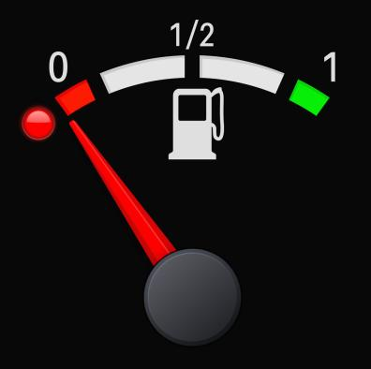
Long COVID-19 Fatigue
Most consistently reported symptom
Severe COVID-19 illness → more incidence
Non-hospitalized patients also!
Decreases over time
Can persist for 6+ months
Accompanied by breathlessness, cough, deconditioning
Disabling:
Reduced functional capabilities
May delay or prevent return to work
Impairs ability to perform normal functional activities
Screen for and treat insomnia and depression
Can treat these!

Slide 9
Post-intensive care unit syndrome (PICS), Prolonged delirium
Prolonged ICU stay →
Persistent cognitive dysfunction
Muscle weakness
Post-traumatic stress symptoms
Delirium can take days to weeks to months to resolve to a cognitive baseline after the deliriogenic etiology is resolved
Very plausible element of long COVID for hospitalized patients, but mild infections without ICU care, or even without hospitalization can cause long COVID, so not the full picture

Slide 10
Psychiatric disorder due to another medical condition?
New onset of psychiatric symptoms + existing disorder exacerbations
Depression, anxiety, PTSD, insomnia increase in the long COVID phase
Heterogeneous studies!
Measures
Assessment timing
COVID-19 severity
ICU care
Hospitalized without ICU care
Not hospitalized but symptomatic
Subjectively asymptomatic infection
Exclusion criteria
Systematic reviews: Schou et al 2021, Vanderlinda et al 2021

Slide 11
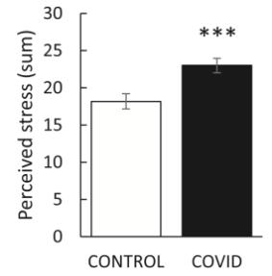
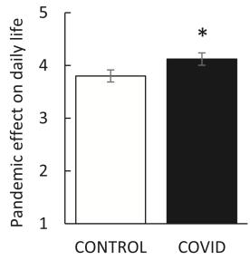
Psychiatric disorder due to another medical condition
Depression and anxiety increase not solely due to general pandemic stressors
Controls vs. prior COVID-19 diagnosis sample
Higher perception of life stress
Increased Perceived Stress Scale
Greater effect of the pandemic on day-to-day life
Increased Pandemic Stress Index
No difference: # life changes, # days social distancing, # days interacting with others, # days in isolation
Inflammatory hypothesis for mood disorders and psychotic disorders for decades
Lamontagne SJ, et al. Post-acute sequelae of COVID-19: Evidence of mood & cognitive impairment. Brain, Behavior, & Immunity 2021;17:100347.

Slide 12
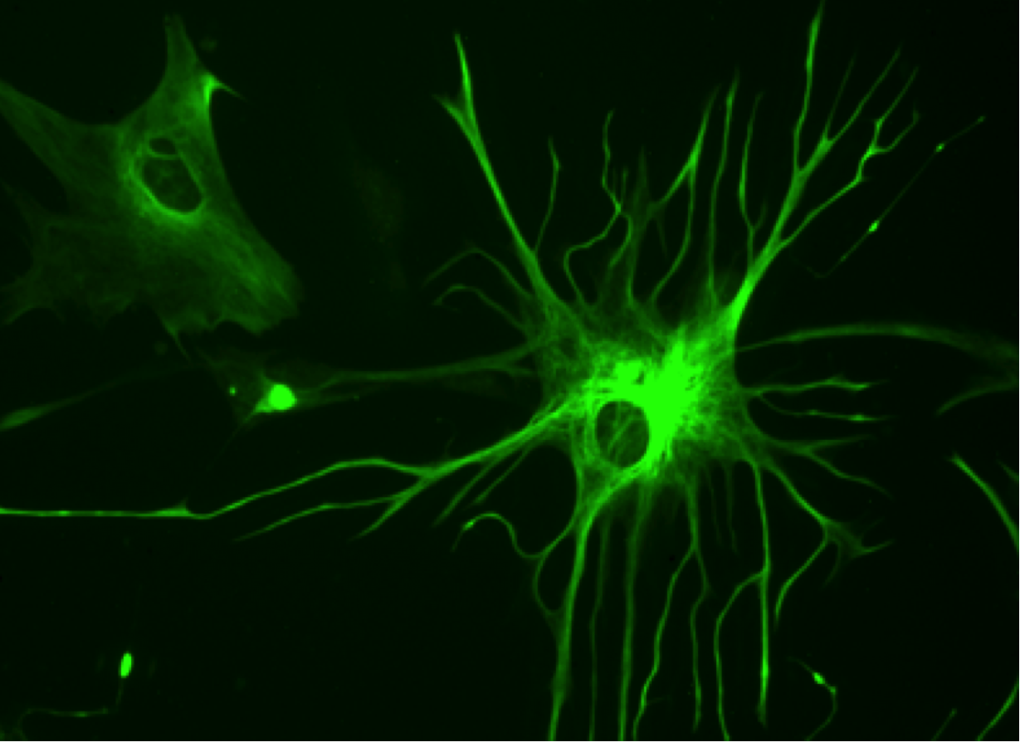
CNS anti-inflammatory psychiatric interventions
IL-6 increased:
COVID-19 cytokine storm
Psychotic episodes of schizophrenia
Major depressive episodes of MDD
Anti-inflammatory mechanism agents with evidence of benefit in MDD/schizophrenia:
Minocycline
Curcumin
Fish oil
Aspirin and celecoxib
Melatonin
Statins
N-acetyl cysteine
Not studied in long COVID yet
Lopresti AL, Drummond PD. Efficacy of curcumin, and a saffron/curcumin combination for the treatment of major depression: A randomised, double-blind, placebo-controlled study. J Affect Disorders 2017; 207:188-196.
Bao S, et al. Efficacy and safety of anti-inflammatory agents for the treatment of major depressive disorder: a systematic review and meta-analysis of randomised controlled trials. J Neurol Neurosurg Psychiatry 2020 Jan;91(1):21-32.
Jeppeson R, et al. Efficacy and safety of anti-inflammatory agents in treatment of psychotic disorders - A comprehensive systematic review and meta-analysis. Brain Behav Immun 2020;90:364-380.

Slide 13
Stigma Considerations
Stigma from healthcare professionals:
Feel ignored, dismissed
Frustrated by psychiatric care referral
Can prevent help-seeking
Stigma from others:
Feels blamed for symptoms
Fear of contagiousness
Shame for disability, decreased function
Support groups highly utilized
Ballering A, Olde Hartman T, Rosmalen J. Long COVID-19, persistent somatic symptoms and social stigmatization. J Epidemiol Community Health 2021;75:603–604.

Slide 14
Key Points
Breakthrough infections of vaccinated persons = half long COVID risk (Antonelli 2021)
GET VACCINATED!!!
Increased severity of COVID-19 infection associated with increased long COVID
COVID fog and fatigue seem to improve over time, BUT…
Debilitating
Stigmatizing
Increased incidence of anxiety, depression, PTSD, insomnia - improve over time
No clear “long COVID-19” neuropsychiatric treatments evidenced
Symptomatic psychiatric treatment
May consider negligible risk CNS anti-inflammatory augmentation – not yet studied
Awareness of phenomenon to aid patients in navigation
Supportive psychotherapy, CBT, mindfulness and diaphragmatic breathing, sleep hygiene
Antonelli M et al. Risk factors and disease profile of post-vaccination SARS-CoV-2 infection in UK users of the COVID Symptom Study app: a prospective, community-based, nested, case-control study. Lancet Infect Dis 2021; https://doi.org/10.1016/ S1473-3099(21)00460-6.

Slide 15
Cleveland Clinic and Long COVID
Challenges
Limited staffing
Shortage of outpatient time/physicians
CL staff tied heavily to inpatient service
Increase in outpatient management needs as pandemic continues:
Depression
Anxiety
Trauma
Brain fog
Solutions/Model
Integrated into CL Fellows’ Clinic
Screening via PHQ-9, GAD-7, PCL-5
One-time evaluation, and referral to PCP or to longitudinal provider

Slide 16
Cleveland Clinic and Long COVID
New influx of post-COVID patients seeking care
10/8/21 in Ohio: 1,324,411 people recovered from COVID-19
Multiple caregivers out for COVID sequelae (acute illness and long COVID)
Pulmonary-led reCOVer clinic for triage
Staffed by pulmonary APPs
Screen for symptoms then:
Lab, imaging, testing as indicated
PHQ-9, GAD7, PCL5
Referral to 18 care areas based on associated concerns
Widely utilized to rapidly refer to subspecialty management of post-COVID sequelae
Assess openness to referral for MH care
“Talk therapy” or psychology referral
“Medications” or psychiatry referral
→ reCOVer Psychiatry CarePath

Slide 17
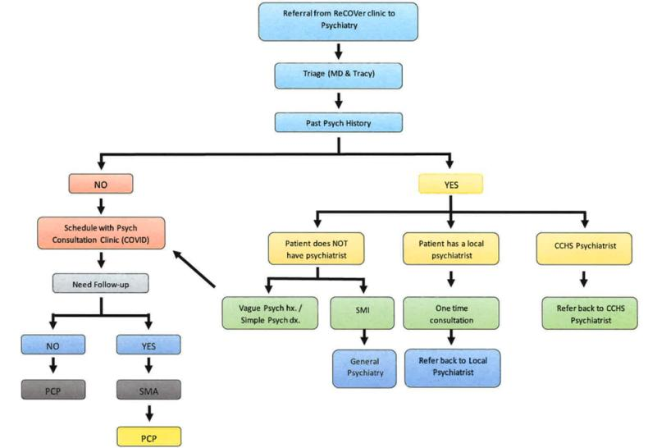
reCOVer Psychiatry CarePath

Slide 18
Adjunctive Management Care Paths
Brain Health
Neurology-based CarePath for cognitive concerns
Psychotherapy
CarePath 2 health psychologists
Functional Medicine
CarePath + shared medical appointments (SMA)
Significant patient interest in this approach

Slide 19
Treating both…
Primary Mood/Anxiety
Secondary Somatic
Rapid referral to psychiatry
Initiation of medication and provision of second/third line options
Shifting locus of care to PCP
Controlling testing through time-limited subspecialty referral

Slide 20
Lessons Learned
Mix of new onset and exacerbated pre-existing psychiatric illness – mainly mood and anxiety disorders
Navigation of staffing limitations:
Collaborative care, SMAs, consultation clinics
Consultation, then move management to a PCP or SMA setting
Trainee involved care
Nonpharmacological treatments are attractive to many patients with long COVID
Develop relationships with psychotherapists
Develop trusted integrative medicine resources
Enhance knowledge of CAM

Slide 21
Future Directions
Further collaboration with other departments
Increased integration with psychology
Education
Psychiatry residency creating SMA programing
Resident and fellow experience in reCOVer clinic
Building long COVID-specific templates
Long COVID psychiatric research group

Slide 22
reCOVer Group
Elias Khawam, MD
Adele Viguera, MD
Jack Owens, MD
Anna Shapiro-Krew, MD
Andrew Coulter, MD, MA
Tracy Sluka, CL Coordinator

Slide 23
References
Taquet M, Luciano S, Geddes JR, Harrison PJ. Bidirectional associations between COVID-19 and psychiatric disorder: a study of 62,354 COVID-19 cases. Lancet Psychiatry. 2020;S2215–0366: 30462–4.
Carfi A, Bernabei R, Landi F, et al. Persistent symptoms in patients after acute COVID-19. JAMA 2020;324(6):603–5.
Huang C, Huang L, Wang Y, et al. 6-month consequences of COVID-19 in pa- tients discharged from hospital: a cohort study. Lancet 2021. DOI: 10.1016/ S0140-6736(20)32656-8.
Logue JK, Franko NM, McCulloch DJ, et al. Sequelae in adults at 6 months after COVID-19 infection. JAMA Netw Open 2021; 4:e210830.
Graham EL, Clark JR, Orban ZS, et al. Persistent neurologic symptoms and cognitive dysfunction in non-hospitalized Covid-19 “long haulers”. Ann Clin Transl Neurol 2021; 8:1073–85.
Garrigues E, Janvier P, Kherabi Y, et al. Post-discharge persistent symptoms and health-related quality of life after hospitalization for COVID-19. J Infect. 2020;81(6):e4-e6.
Halpin SJ, McIvor C, Whyatt G, et al. Postdischarge symptoms and rehabilitation needs in survivors of COVID-19 infection: a cross- sectional evaluation. J Med Virol. 2021;93(2):1013-1022.
Liang L, Yang B, Jiang N, et al. Three-month follow-up study of sur- vivors of coronavirus disease 2019 after discharge. J Korean Med Sci. 2020;35(47):e418.
Liotta, et al. Frequent neurologic manifestations and encephalopathy-associated morbidity in Covid-19 patients. Annals of Translational Neurology.
Lamontagnea SJ, et al. Post-acute sequelae of COVID-19: Evidence of mood & cognitive impairment. Brain, Behavior, & Immunity 2021;17:100347.
Schou TM et al. Psychiatric and neuropsychiatric sequelae of COVID-19 – A systematic review. Brain Behav Immunity 2021;97:328–348.
Vanderlind WM, et al. A systematic review of neuropsychological and psychiatric sequalae of COVID-19: implications for treatment. Curr Opin Psychiatry 2021, 34:420–433.
Kyzar EJ. Anxiety, depression, insomnia, and trauma-related symptoms following COVID-19 infection at long-term follow-up. Brain Behav Immunity 2021;16:100315.
Tenforde MW, Kim SS, Lindsell CJ, et al. Symptom duration and risk factors for delayed return to usual health among outpatients with COVID-19 in a multistate health care systems network — United States, March–June 2020. MMWR Morb Mortal Wkly Rep 2020; 69(30):993–998. doi:10.15585/mmwr.mm6930e1. Ortelli P, Ferrazzoli

Slide 24
References
Sebastianelli L, Engl M, Romanello R, Nardone R, et al. Neuropsychological and neurophysiological correlates of fatigue in post-acute patients with neurological manifestations of COVID-19: Insights into a challenging symptom. J Neurol Sci. 2021;420:117271.
Wong TL, Weitzer DJ. Long COVID and Myalgic Encephalomyelitis/Chronic Fatigue Syndrome (ME/CFS)—A Systemic Review and Comparison of Clinical Presentation and Symptomatology. Medicina 2021; 57,418.
Almeria M, Cejudo JC, Sotoca J, Deus J, Krupinski J. Cognitive profile following COVID-19 infection: Clinical pre- dictors leading to neuropsychological impairment. Brain Behavior Imm Health. 2020;9:100163.
Mendez R, Balanz-Martınez V, Luperdi S. Short-term neuropsychiatric outcomes and quality of life in Covid-19 survivors. J Int Med 2021 [Epub ahead of print].
Jaywant A, et al. Frequency and profile of objective cognitive deficits in hospitalized patients recovering from COVID-19. Neuropsychopharmacology 2021; https://doi.org/10.1038/s41386-021-00978-8.
Barış Sancak B,Kiliç C. A psychiatrist’s own experience of long COVID: Looking beyond the psychosomatic perspective. Psychiatria Danubina 2021; 33(2):250-255.
Jaywant A, et al. Behavioral interventions in acute COVID-19 recovery: A new opportunity for integrated care. Gen Hosp Psychiatry 2021;69: 113–114.
Theoharides TH, et al. Long‐COVID syndrome‐associated brain fog and chemofog: Luteolin to the rescue. Biofactors 2021;47(2):232–241.
Patterson, Bourgeois, Martin. The Importance of Keeping Patients with Post-Acute Sequelae of SARS-CoV-2 Infection (Long COVID) Engaged in Work. American Family Physician
Ballering A, Olde Hartman T, Rosmalen J. Long COVID-19, persistent somatic symptoms and social stigmatization. J Epidemiol Community Health 2021;75:603–604.
Yong SJ. Long COVID or post-COVID-19 syndrome: putative pathophysiology, risk factors, and treatments. Infect Diseases 2021;0:1-18.
Lopresti AL, Drummond PD. Efficacy of curcumin, and a saffron/curcumin combination for the treatment of major depression: A randomised, double-blind, placebo-controlled study. J Affect Disorders 2017; 207:188-196.
Bao S, et al. Efficacy and safety of anti-inflammatory agents for the treatment of major depressive disorder: a systematic review and meta-analysis of randomised controlled trials. J Neurol Neurosurg Psychiatry 2020 Jan;91(1):21-32.
Jeppeson R, et al. Efficacy and safety of anti-inflammatory agents in treatment of psychotic disorders - A comprehensive systematic review and meta-analysis. Brain Behav Immun 2020;90:364-380.

