Slide 1
Ten Important Papers in C-L Psychiatry for the 2020-2021 Academic Year
Sarah Andrews, MD
O. Joseph (“Joe”) Bienvenu, MD, PhD
Carlos Fernandez-Robles, MD, MBA
Sahil Munjal, MD
Luis F Pereira, MD

Slide 2
CLP 2021
Disclosure: Joe Bienvenu
With respect to the following presentation, there has been no relevant (direct or indirect) financial relationship between the party listed above (and/or spouse/partner) and any for-profit company which could be considered a conflict of interest.

Slide 3
10 Important Papers in C-L Psychiatry 2020-2021
Describe the work of the Guidelines and Evidence-Based Medicine (GEBM) Subcommittee, focusing on annotated abstracts
Research and Evidence-Based Practice Committee
Research SIG
Research Subcommittee
GEBM Subcommittee

Slide 4
10 Important Papers in C-L Psychiatry 2020-2021
Annotated abstracts published quarterly on ACLP website
  Literature reviewed by GEBM Subcommittee members and invited consultants
  Topics include addiction, administrative issues, cardiac illness, catatonia, coronavirus and COVID-19, critical care, delirium, emergency psychiatry, gastrointestinal psychiatry, HIV psychiatry, infectious diseases, neuropsychiatry, palliative care, pediatrics and child/adolescent psychiatry, primary care and integrated behavioral health, psychodermatology, psychonephrology, psycho-oncology, somatic symptom disorders, suicide, transplant psychiatry, and women’s health
  Reviewers use a variety of search methods, including keyword searches in pertinent databases (e.g., PubMed), focused searches in high-impact journals, or reviews of public health and professional society guidelines

Slide 5























GUIDELINES & EVIDENCE-BASED MEDICINE Subcommittee
Scott Simpson, MPH, MD, Chair (1/2023) Joe Bienvenu, PhD, MD Vice Chair (1/2021) Sarah Andrews, MD (1/2022) Mary Burke, MD (1/2023) Jeylan Close, MD (1/2023) Serena Fernandes, MD (1/2022) Brandon Francis, MD, MPH (1/2023) Jai Gandhi, MD (1/2023) Maalobeeka Gangopadhyay, MD (2/2023) Liliya Gershengoren, MD, MPH (1/2023) Elie Isenberg-Grzeda, MDCM (2/2021) Richard Key, MD, FACLP (1/2023) Timothy Kiong, MD (1/2021) Walter Luchsinger, MD (2/2023) Sohail Mohammad, MD, MPH (1/2022) Sahil Munjal, MD (1/2021) Shehzad Niazi, MD, FRCPC, FACLP (2/2023) Luis Pereira, MD (1/2023) Jordan Rosen, MD (1/2022) Simon Sidelnik, MD (2/2021) Marie Tobin, MD, FACLP (1/2023) Audrey Walker, MD, FACLP (1/2021)
U Colorado
JHU
JHU
UCSF
U Penn
Boston Children’s
Michigan State
UW
Columbia
NYU
U Toronto
UT Austin
Kern
Yale
Mayo -R
Wake Forest
Mayo -J
Penn State
Columbia
BWH
NYU
U Chicago
Einstein
MGH

Slide 6

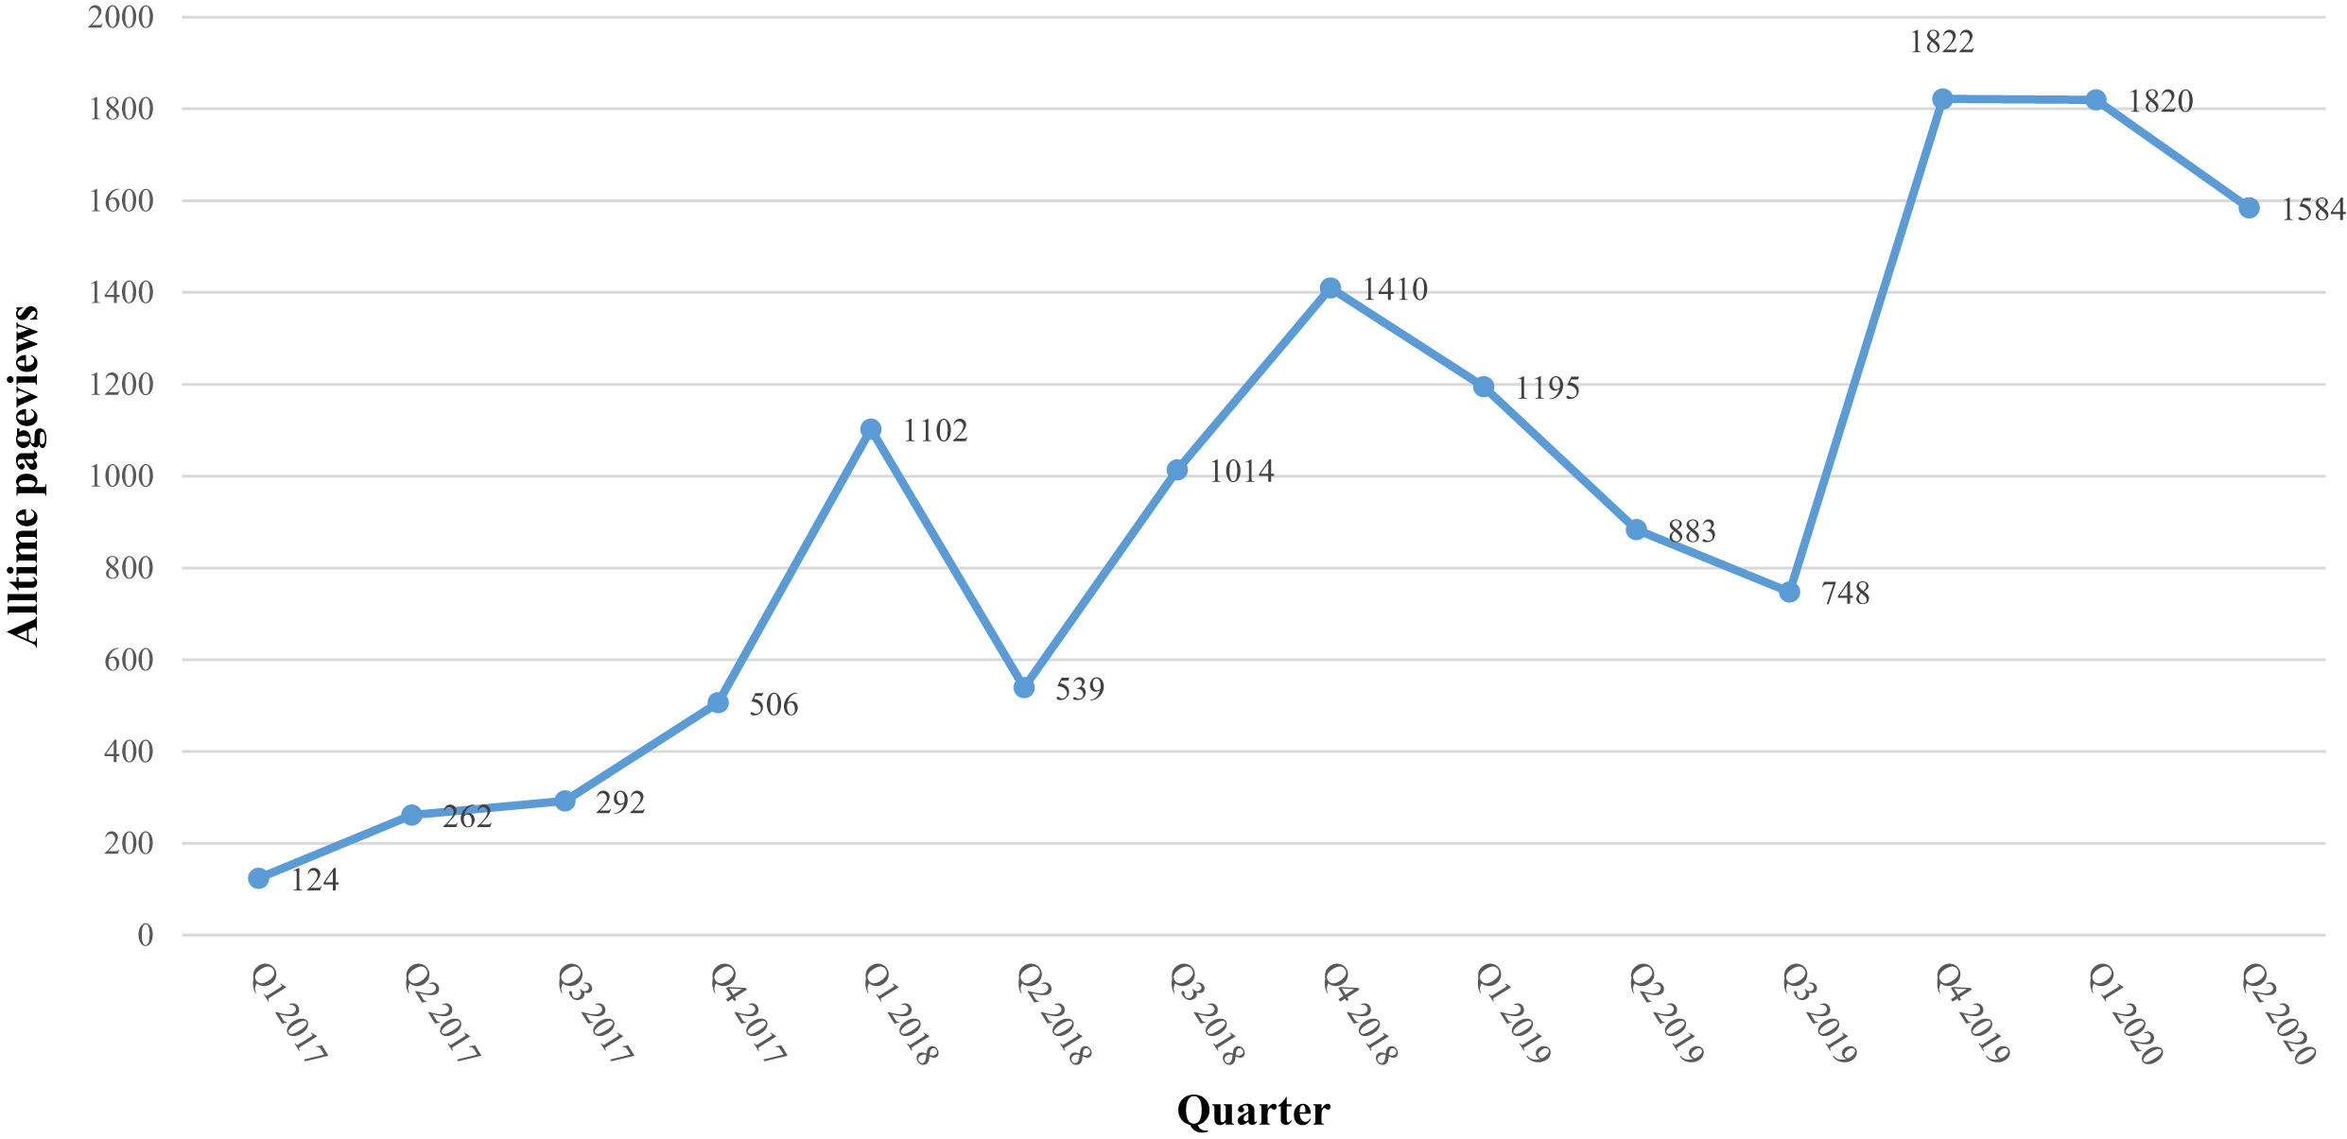
Annotated abstracts published quarterly on ACLP website
Simpson et al. The ten most important papers in consultation-liaison psychiatry in 2020. J Acad Consult Liaison Psychiatry. Sep-Oct 2021;62(5):493-500

Slide 7
Delirium severity trajectories and outcomes in ICU patients: defining a dynamic symptom phenotype
Lindroth et al. Ann Am Thorac Soc 2020 Sep;17(9):1094-1103
Aim: explore more dynamic delirium subtypes (beyond motoric) in critically ill patients, incorporating delirium severity (CAM-ICU-7) and duration information
  Relate to demographic and clinical correlates, including 30-day mortality
Methods: secondary analysis of data from 2 RCTs, n = 531
  ≥ 18 years, delirium
  RASS, CAM-ICU once or twice daily, missing data (34%) treated as MAR, comatose patients (RASS -4 or -5) scored as severely delirious (CAM-ICU-7 score = 7)
  Group-based trajectory modeling of CAM-ICU-7 scores in 7-day analysis period, optimal # (1-6) and shapes (constant, linear, quadratic, cubic, or quartic terms) selected using BIC
  ANOVA, multinomial regression to control for confounding, sensitivity analyses
Results: 531 delirious patients, mean age 60 yrs, 55% female, 46% AA, 73% MV
  5 trajectories: mild-brief, mild-accelerating, severe rapid- or slow-recovery, and severe nonrecovery

Slide 8
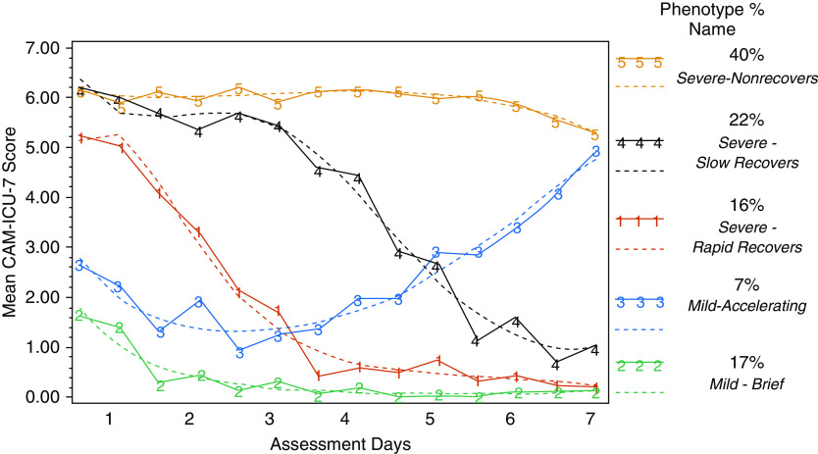
Delirium severity trajectories and outcomes in ICU patients: defining a dynamic symptom phenotype
More AA; more unsafe behaviors and days on MV, with bladder cath, and in restraints c/t mild-brief; 17% 30-day mortality
Slightly worse baseline cognition c/t mild-brief; 31% 30-day mortality
3% 30-day mortality

Slide 9
Delirium severity trajectories and outcomes in ICU patients: defining a dynamic symptom phenotype
Annotation
  Findings: While previous studies have shown that delirium duration and severity are independently correlated with morbidity and mortality, this study explored a combination of the two factors and described five delirium trajectories over time with varying demographic and clinical correlates and associations with 30-day mortality.
  Strength and weaknesses: This was a large (n = 531) , well-characterized sample of patients recruited from 3 ICUs in Indianapolis. The authors employed sophisticated statistical techniques to identify delirium severity trajectories, a more dynamic approach than simply categorizing by motoric subtypes. The findings may not generalize well to non-critically ill patients, and the group with the highest mortality (mild-accelerating) was relatively small.
  Relevance: If replicable, thoughtful phenotypic studies like this may help us understand the etiology and prognostic importance of acute brain dysfunction.

Slide 10
The effect of COVID-19 lockdown on the incidence of deliberate self-harm injuries presenting to the emergency room
Henry et al. Int J Psychiatry Med. 2021 Jul;56(4):266-277
Background: The UK introduced strict social distancing measures/full lockdown on 3/23/20, leading to a reduction of ED visits in a time of increased emotional distress.
Aim: To ascertain whether there was a significant rise in the incidence of deliberate self-harm presentations to the ED at a level I trauma center in Birmingham, UK
Method: Retrospective observational study (using EMR), comparing ED visits from 3/23 – 5/1/20 to the same period in 2019
Results: ED visits reduced from 2019 to 2020 (5198 and 3059 respectively). There was a significant increase in the total number of self-harm presentations between 2019 and 2020 (103 vs 113, p-value <0.001) as well as paracetamol, NSAID and opiate overdoses, with more cases requiring hospital admission in 2020 vs 2019.
Conclusions: These findings, in conjunction with other available literature, have implications for any future wave of disease or pandemic.

Slide 11
The effect of COVID-19 lockdown on the incidence of deliberate self-harm injuries presenting to the emergency room
Annotation:
  Findings: The COVID-19 pandemic has wrought challenges for mental health systems. One measure of the burden of illness and challenge of care delivery is the pandemic’s effect on ED utilization.
  Strengths and Weaknesses: The use of ED visits is valuable but limited. Many nonfatal overdoses occur at home, and the patients do not present for care. Data from poison centers and crisis lines will be invaluable for trying to develop a more complete picture of the mental health consequences of COVID-19 lockdowns.
  Relevance: While overall ED volumes appear to have decreased, mental health visits to the ED have persisted or even increased in some areas. Among those mental health ED visits there are higher rates of hospitalization and other sequelae of more serious illness. The reasons for these trends are undoubtedly complex and relate to many factors including the availability of outpatient services, widespread social isolation, and economic stressors. Behavioral health systems have needed to re-consider how to structure crisis systems, surveillance, and intensive outpatient services in a way that can address the growing public health burden.

