Slide 1
From Breadth to Depth: The Psychological Elements of Palliative Care Series
Daniel Shalev MD
CLP 2021 workshop
Notes:
Hello and thanks so much for tuning into our workshop. I’ve really enjoyed hearing the talks by my colleagues and I’m hoping this synergizes well with the work and wisdom that they’ve shared with us. My name is Dan Shalev and I am a consultation-liaison psychiatrist and hospice and palliative medicine specialist at Weill Cornell in New York City. Like Dr. Chammas and Dr. Jacobowski, I enjoy spending a significant portion of my time switching hats to figure out who I am and where I belong.
My colleagues have shared with you some of their approaches to clinical, institutional, and didactic aspects of building serious illness communication and psychological or psychotherapeutic frameworks in palliative care. I’m going to talk a little bit about a series of papers that is being published monthly in the journal of palliative medicine through which we are trying to introduce some psychological framework to communication in palliative care. I’ll talk a bit about the impetus for this—something you’ve already been hearing a lot about in the previous talks—and then share how this series came about, what the series is exactly and the approach we have taken, an exemplar table from one of our papers, and talk a little bit about the challenges and learning points of writing in at this interface.

Slide 2
CLP 2021 Disclosure: Daniel Shalev, MD
With respect to the following presentation, there has been no relevant (direct or indirect) financial relationship between the party listed above (and/or spouse/partner) and any for-profit company which could be considered a conflict of interest.
Notes:
I have no disclosures with respect to this presentation.

Slide 3
Communication is a common feature…
Notes:
I should however disclose that I am a big fan of memes and recently saw a few colleagues utilizing them for medical teaching. So I’m trying it out here. There’s no live audience, so I can hopefully get away being a bit corny without seeing the cringes.
In all seriousness, though, I want to start by pointing out that in the most fundamental sense, psychiatrists and other psychotherapists—but especially psychiatrists and especially, especially consultation-liaison psychiatrists—are kindred spirits with palliative care clinicians. We and our palliative care colleagues both use our communication skills as a really primary, integral clinical tool. I recognize this point may be somewhat redundant with the prior talks and with the experience of our viewers, but it’s an orientation that I think we need to remind ourselves of frequently. Insofar as medicine goes, we overlap a lot…Siblings do not always see eye-to-eye, of course, and that actually may be one of the reasons there have been “working with palliative care talks” every year in the ACLP the past few years in a way that we don’t necessarily see with, say, orthopedics.

Slide 4
But our foci are different…
Palliative Care
Psychiatry/Psychotherapy
Depth
Breadth
Caveat: I am, of course, speaking in broad strokes here and there are countless exceptions on both ends
Notes:
Because though we have that communication-as-intervention stance, our foci are incredibly different. I am speaking in broad strokes, of course, but as both a palliative care and a psychiatry clinician, I often conceptualize psychiatry-and-psychotherapy training as focused on deep knowledge and understanding whereas palliative care training is focused on what I am calling breadth—but really what I mean is disseminability, operationalization—and I’ll talk more about that idea.
As an entrée to it though, I will share an observation from my clinical training that my palliative care training differed from my psychotherapy training in that in palliative care, a lot of my communication training was oriented on preparing me to teach others. I was required to conduct didactics with medical students and residents on serious illness communication. This differed from my psychotherapy training which really tasked me to think deeply and longitudinally about my own work, but was relatively light on content regarding teaching psychotherapy to non-therapists.

Slide 5
Psychotherapeutic approaches to communication privilege depth
Depth of skills:
Relatively long training times
Focus on mechanistic understanding/models of the mind
Depth of content:
Roots of our work → psychic depth
Many modalities focus on insight, self-reflection, inner life
Notes:
And my experiences are very much in keeping with the general stances of these fields. There are of course manualized and otherwise more easily disseminated modalities of psychotherapy, but at it’s core, the psychotherapeutic approach to communication is really born from a sense of depth. Depth of skills—long training times with a focus on mechanistic understanding as evidenced by the models of the mind that underpin our work and teaching—and depth of content—starting of course with the psychoanalytic models of the unconscious and reflected in the many modalities we utilize focusing on insight, self-reflection, and inner life.

Slide 6
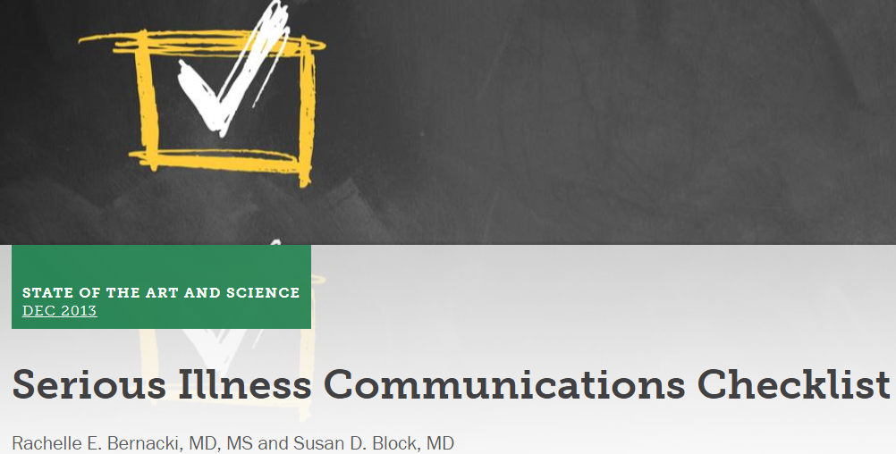
Palliative care communication privileges breadth
…maybe not the word I mean, exactly.
Dissemination may be a more appropriate term
Notes:
This is in real contrast to the focus on dissemination and operationalization that is reflected in the serious illness communication paradigm espoused by palliative care. And that’s not particularly surprising from a historical perspective. The traditional unit of treatment for psychotherapy has been the individual patient. Much of the communication work in palliative care was born as a response to the failures of the broader institution of medicine in areas like clarifying end-of-life wishes, sharing prognosis, and breaking bad news. As these shortcomings became more openly discussed—and studied—in the 1990s during the early years of palliative care’s mainstreaming, the movement towards serious illness communication was really born as a response to that. As such, from very early on, there has been a profound push in palliative care towards not merely conducting effective communication, but towards changing the overall practices in medicine more broadly.

Slide 7
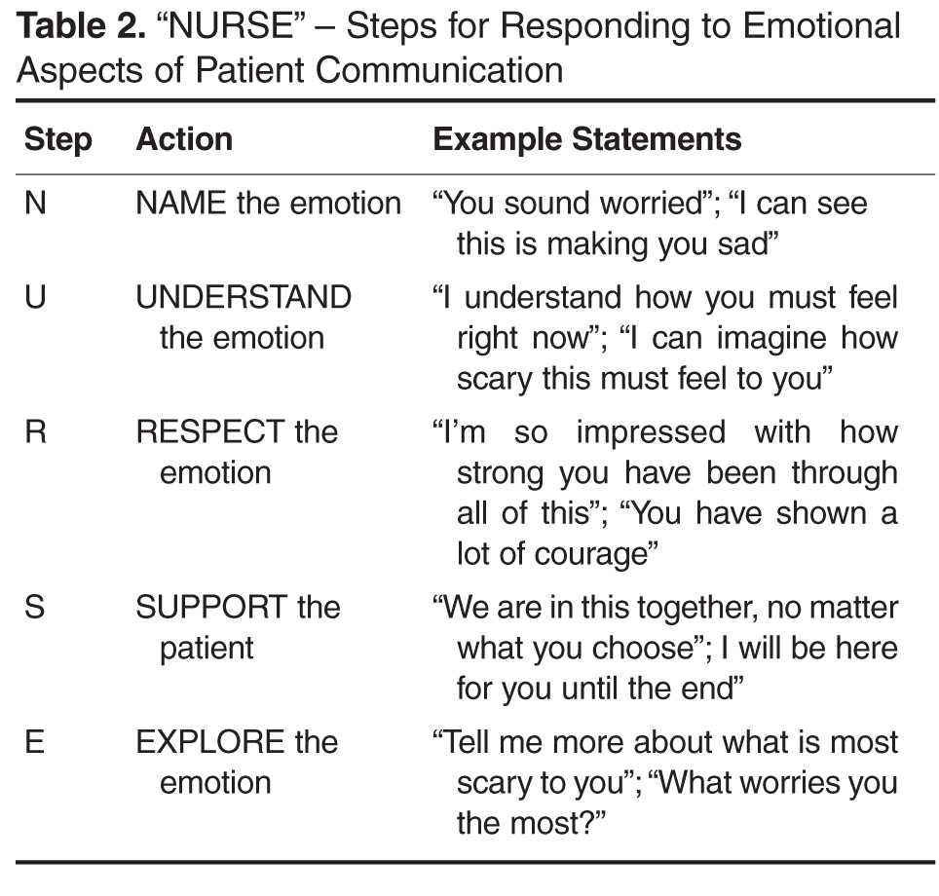
Primary Palliative Care
Primary palliative care is a major research focus (Duty and Loftus; Carroll et al.)
(February;22; Kaplan)
Notes:
This stance is very much reflected in the longstanding emphasis within palliative care practice, teaching, and scholarship on primary palliative care—palliative care delivered by a non-palliative care specialist like an oncologist or primary care doctor. And this is part of the reason for some of these communication acronyms that Dr. Jacobowski discussed during her talk and to which, as psychiatrists, we have a very visceral aversion I think.

Slide 8
Primary Palliative Care
Primary palliative care and operationalized communication meant to overcome workforce shortages
Significant need to extend palliative care services through non-specialist clinicians
Analogous to work being done in psychiatry—though more in realm of prescribing than psychotherapy
Notes:
Psychiatrists are familiar with the ethos driving the primary palliative care/serious illness communication paradigm. I consider it analogous in a way to the work our field has done trying to educate our colleagues on psychopharmacology. I’m sure you’re all very familiar with the many depression prescribing paradigms that exist for primary care clinicians. Such interventions are aimed at the insufficient mental health workforce. Likewise, there is a significant palliative care workforce shortage and many of the attempts to operationalize and disseminate communication tools make a lot of sense given the scarcity of expert palliative care clinicians which prompts a very real need to extend palliative care services through non-specialist clinicians including primary care doctors, oncologists, cardiologists, and so forth.

Slide 9
We could learn from each other.
Notes:
Despite—and often because of—our very different stances with respect to our communication-based interventions, psychiatrists and palliative care clinicians have a lot to learn from one another. Unfortunately, for such learning to be possible and effective, we need to be able to find a shared language. But more on this shortly…

Slide 10
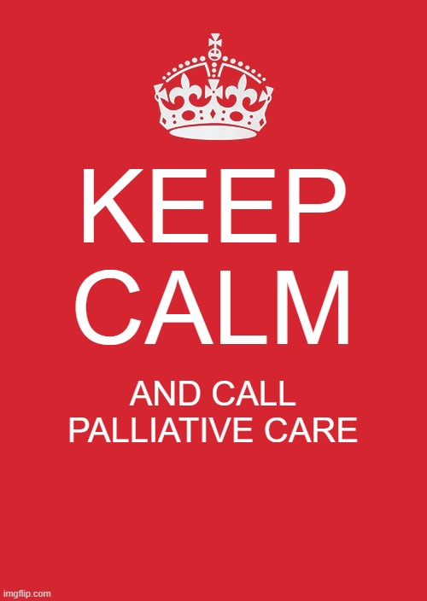
Needs differ
An oncologist learning to break bad news may benefit from an operationalized approach
But an expert palliative care clinician called in for the most psychosocially challenging serious illness cases in the hospital needs a bigger toolkit…
Notes:
One aspect of the palliative care serious illness communication work that I think has not been well accounted for is how much needs differ across clinicians. In many ways, the tools being taught by palliative care and used by our colleagues across other specialties don’t differ very much from those used by palliative care specialists. This—I think—is a problem. Palliative care clinicians are called in for complicated, difficult cases. On an individual level, many seasoned palliative care clinicians have incredible toolkits to deal with the psychological and interpersonal challenges in complex cases of serious or life-threatening illness. But operationally, the skills that these clinicians have are not routinely distilled and taught with the same efficacy that the basic skills have been.

Slide 11
Is there a space for “deeper” serious illness communication?
Thus far, serious illness communication has focused intensely on the “what” and the “how”
Necessary to teach wide numbers of clinicians across setting and specialty
However, as we know in psychiatry: one size does not fit all!
Algorithmic communication paradigms leave folks behind
Don’t address complex psychodynamic issues including setting a treatment frame, transference and countertransference, and so forth
Notes:
As a result, both clinicians and patients suffer. Existing paradigms don’t account for the needs of folks with pre-existing mental illness, complex psychodynamic issues that arise, and so forth. Clinicians may not feel equipped to deal with these situations—and anecdotally, I think this is something I experience often when I am working in a palliative care setting. Cases with complex dynamics around boundaries or countertransference can be very frustrating to navigate without a language to express these challenges.

Slide 12
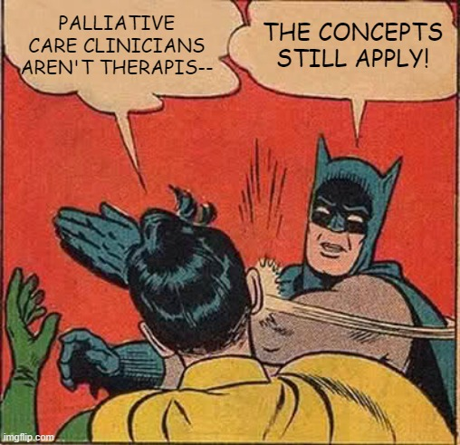
The Million Dollar Question
Can the framework we use to understand, communicate, and treat people in psychotherapy be applied to help improve serious illness communication?
Notes:
Many of these issues that I routinely see my colleagues in palliative care come up against are issues that we are very adept at explicitly engaging as psychiatrists trained in psychotherapy. And the impetus for our project really comes from the idea that the next level of palliative care communication really needs to draw from psychology, psychotherapy, and psychiatry to be deeper, more mechanistic, and more process oriented. As the image asserts, this doesn’t mean that I think palliative care clinicians need to have psychodynamic psychiatry training. Rather than some of the organizing principles that guide our approach can be adapted and applied to palliative care work in a mode that makes sense for palliative care clinicians in palliative care settings.

Slide 13
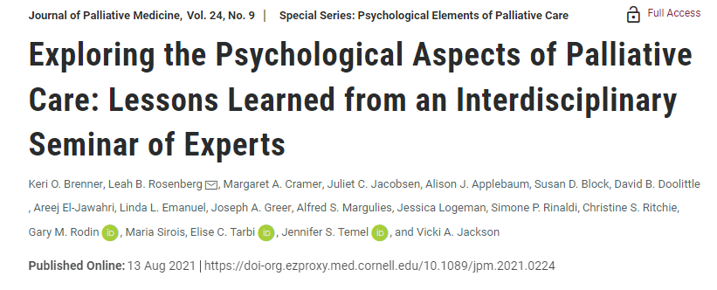
Psychological Elements of Palliative Care: The Origins…
2019: Interdisciplinary group of scholars at Massachusetts General Hospital hold “Healing Beyond the Cure: Exploring the Psychodynamic Aspects of Palliative Care” conference
2020: Our core group convenes and pitches the series to Journal of Palliative Medicine
Notes:
In recognition of some of these ideas, in 2019 a group of palliative care clinicians, psychoanalytically oriented therapists and psychiatrists, and researchers in related fields came together at the Radcliffe Institute for a conference to explore the psychological aspects of palliative care. I was not a member of this conference and so cannot speak to it in depth, though my understanding is that it was extremely generative, but also extremely challenging given the disciplinary siloing that shaped so much of each participant’s perspective.
In response to this conference, we formed a small group of clinicians in palliative care with a background in psychiatry, or with experience in the psychodynamic aspects of palliative care aiming to produce a framework for applying concepts from psychiatry, psychology, and psychotherapy to palliative care and began to brainstorm.

Slide 14
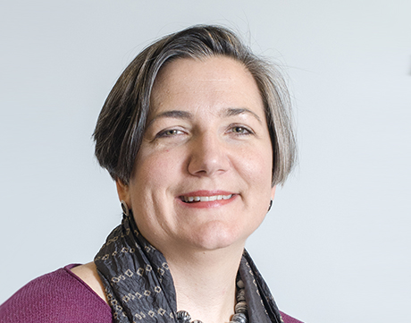
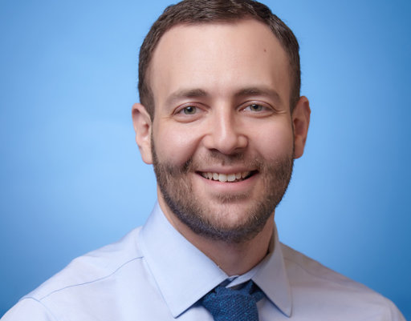
PEPC: The Core Group…
Vicki A. Jackson MD
Blum Family Endowed Chair in Palliative Care
Chief, Division of Palliative Care and Geriatric Medicine
Co-Director HMS Center for Palliative Care
Associate Professor of Medicine
Harvard Medical School
Leah B. Rosenberg MD
Assistant Professor of Medicine, Harvard Medical School
Division of Palliative Care and Geriatric Medicine, Massachusetts General Hospital
Daniel Shalev MD
Instructor of Medicine, Instructor of Psychiatry
T32, Behavioral Geriatrics
Division of Geriatrics and Palliative Medicine
Weill Cornell Medicine
Juliet C. Jacobsen MD DPhil
Associate Professor of Medicine, Harvard Medical School
Director, Continuum Project
Division of Palliative Care and Geriatric Medicine, Massachusetts General Hospital
Keri O. Brenner, MD MPA
Division of Palliative Medicine, Stanford
Clinical Assistant Professor of Medicine
Notes:
Our core group moved the project forward—though, as I will mention—our group relies heavily on outside contributors with expertise across a range of areas. Our group is led by Vicki Jackson who is directs palliative care at MGH and includes palliative care clinicians from multiple institutions with expertise in this area. Dr. Jackson and Dr. Jacobsen are both heavily steeped in communication research. Dr. Rosenberg is an internist who has pursued significant psychoanalytic supervision and training. And Dr. Brenner and myself are psychodynamically-oriented psychiatrists who did palliative care training. Because our core group is MD-based, we have drawn co-authors, consultants, and contributors from social work, psychology, nursing, and chaplaincy to reflect both the existing expertise already in palliative care and to meet the needs of palliative care clinicians across a range of disciplines.

Slide 15
Psychological Elements of Palliative Care
“Mechanism of action” of palliative care communication is the next frontier
Current Practice
Mechanisms
New Interventions
What & How
Why
Where
Notes:
Our thought was that having a mechanistic framework for serious illness communication would be powerful in a number of ways. First of all, utilizing some model to understand the why behind what we do in palliative care can help clinicians refine existing interventions and create new interventions.

Slide 16
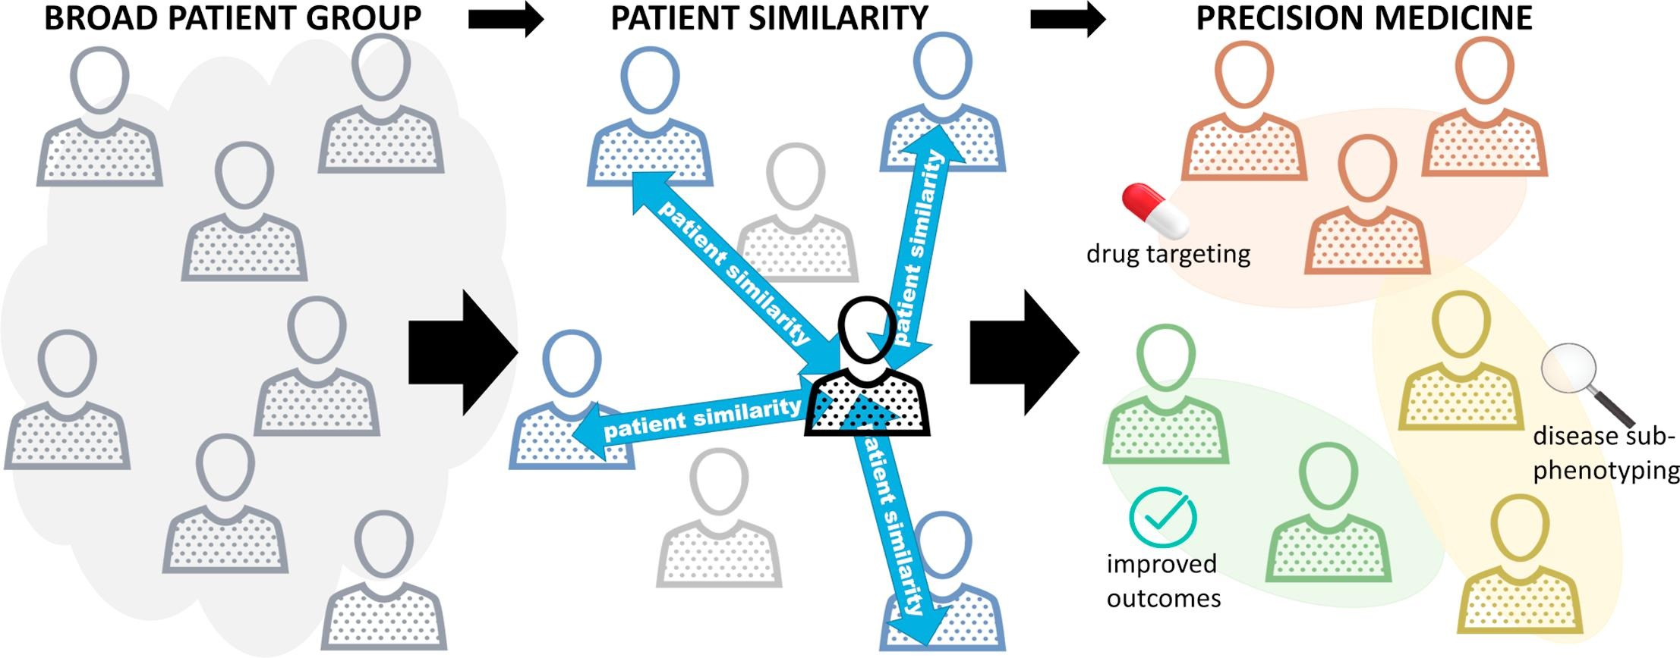
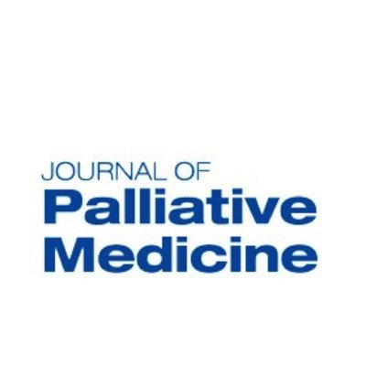
Psychological Elements of Palliative Care
Existing psychological concepts offer a foundation for understanding the relational and communicative aspects of palliative care
Parimbelli E, Marini S, Sacchi L, Bellazzi R: Patient similarity for precision medicine: A systematic review. Journal of Biomedical Informatics 2018; 83: 87–96. Doi: 10.1016/j.jbi.2018.06.001.
Notes:
Second of all, as with any treatment or therapy, using the communication strategies we have in palliative care do not work for everyone. There are patients that—for various reasons—fall through the cracks. Personally, I don’t think many of the tools we use work well in the setting of very significant psychopathology, severe interpersonal conflict, and so forth. Our hope is that a more mechanistic psychological framework underlying our communication interventions can help clinicians provide “precision” palliative care.
We believe that many of the ideas we would draw from can be applied to clinicians’ existing practice as opposed to replacing it. This is important to us because in order to be useful to our colleagues, we feel it has to augment clinical practice rather than ask our experienced colleagues to do something other than what they have already refined with extensive clinical experience.

Slide 17
What?
Each paper introduces a fundamental concept
Who?
Palliative care/serious illness clinicians
How?
Limited background of concepts
Case of Gloria—a mother and teacher with advanced lung cancer—and the team caring for her.
When?
Where?
Concepts build on one another
No background in psychiatry/psychology
…but papers stand alone!
Focus on outpatient, but cross-setting
8 papers
Application to palliative care
Monthly starting 2021
Journal of Palliative Medicine
Notes:
The paper series itself includes 8 papers running monthly in JPM starting in August of this year—I will briefly introduce the topics shortly. The papers are aimed at palliative care and serious illness care clinicians with comfort in communication but not necessarily with any background in psychotherapy or psychology. Probably the main focus of the papers is on the outpatient setting, however, we make a point of also addressing the inpatient and home hospice settings. Structurally, each paper introduces 1-2 concepts which are described with an eye towards simplicity and applicability. This has been particularly challenging because many of these concepts are rich and storied enough to produce many books; it has been a struggle to try to “do justice” to concepts in terms of explanation and citation, while also making them useful for palliative care clinicians who are unlikely to find theoretically dense, historically situated, psychoanalytically jargon-y work to be of interest. As such, we have worked hard to try to distill the essence of concepts as they might be useful to clinicians in palliative care spaces. Each concept is applied in the context of a longitudinal palliative care case that is fictional and used specifically as a narrative arc to the papers. Our fictional patient, Gloria, is a mother and a teacher who is first seen in palliative care clinic while she is undergoing outpatient treatment for advanced lung cancer. Over the course of 8 papers, the palliative care clinician, oncologist, and Gloria face her progressive illness together and these encounters provide an opportunity for us to illustrate some of the conceptual content we are sharing.

Slide 18
PEPC: The Paper Series
First paper is a summary of the conference
Subsequently, 7 papers with common framework
Significant time distilling concepts, debating, and deciding what would be included in the series
Topics based on the conference and our core authors’ experiences
Each paper has multiple non-core authors with expertise in topic
More on the process shortly…
Notes:
The first paper, on which I am not a co-author, is a summary of the 2019 conference and is structurally unrelated to the subsequent 7 papers. It’s sort of an over-view/introductory paper that pays homage to the initial impetus for this project.
I’ll discuss the topics shortly, but I will say this. Our group spent significant time distilling concepts, debating, and deciding what would be included in the series. We ultimately identified topics based on the conference and on the core authors’ experiences. Each paper has multiple additional co-authors beyond our core group with expertise in various topics and an interdisciplinary perspective.

Slide 19
Summary of the conference proceedings that fueled the rest of the series
Paper not in format of others
Notes:
The first paper, as mentioned; available on JPM’s website and in the August 2021 issue.

Slide 20
Upcoming Papers
Attunement
Attachment
Holding Environment for Referring Clinicians
Psychological Elements of Palliative Care and Clinician Wellness
Summary Paper
Transference and Countertransference
Frame and Formulation
Papers in the series…
Notes:
The second paper in the series—really the first adhering to the form and relating the case of Gloria as an achor—is on frame and formulation. Two very foundational concepts we think about all the time, but which I was surprised to note were really not concepts that were familiar for my palliative care colleagues.
The third paper on transference and countertransference is another really pivotal paper that we struggled to cut down and distill for our colleagues. This was written by Leah Rosenberg, who has a particular interest in this topic.
Our fourth paper is on attunement led by Juliet Jacobsen whose new book on the mechanisms of early integrated palliative care really digs deep into this.
Our fifth paper is Attachment which is something we in CL may be very familiar with, but which is profoundly pervasive in palliative care. By which I mean there are so many ways in which life-threatening illness activates attachment paradigms and that the clinician-patient relationship in palliative care is inflected by the attachment styles of both patients and clinicians.
Our sixth paper really delves into the psychology of the relationship we build with our referring clinicians—our oncology, cardiology, and other colleagues with whom we work so closely. This is a complement to a paper not in our series written a few years ago by Linda Emanuel—a psychoanalyst and palliative care clinician—on the holding environment in palliative care for patients.
Our seventh paper considers a psychologically informed approach to clinician wellness in palliative care. It very much draws from the concept of supervision and process groups—two very familiar modes of learning and support for us in psychiatry—for the palliative care clinician.
Finally, our eighth paper is a synthesis and summary of many of the topics we covered. In the eighth paper—spoiler alert!—Gloria is transitioning to home hospice care and the move to new clinicians allows us to recapitulate many of the concepts we shared in our prior papers.

Slide 21
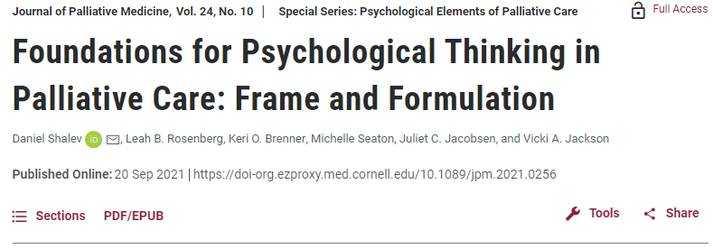
Notes:
I recognize that this much text on a slide is nigh impossible to read, but I wanted to give a chance to share a little bit of the content and style as an exemplar. This table is integrated in the paper on frame—the second paper. The table shares many aspects of the frame as it pertains to palliative care. Here we have role and professional boundaries—with two examples of why these matter, a patient who doesn’t understand the difference between palliative care and pain, and a patient who send a friend request. As you can see, we share very concrete, instrumental tips for clinicians in recognition that a theoretical or psychotherapeutic approach may not be appropriate for our readers.
So for our patient who doesn’t understand palliative care, we suggest revisiting and reinforcing what palliative care is—but only if appropriate. That is to say, we also recognize that it may be appropriate for a doctor meeting a patient once to adjust pain meds while covering for a colleague to be the pain management physician.

Slide 22
Notes:
I will share the rest of the table. Again, we tried to identify common palliative care issues. The family with whom the clinician engaged in goals of care meetings for many hours multiple times a week, where some very basic frame-setting such as starting with “we have 45 minutes today, let’s set an agenda” can make a huge difference. Below that, we talk about termination, which is a concept that tends not to be so explicitly familiar to our palliative care colleagues and can very much inflect care—even as people rotate on and off a service.

Slide 23
Notes:
Here we have issues like addressing how care can be continued between settings—this is very relevant to our palliative care patients who transition between home, the hospital, oncology, hospice and so forth. We address information sharing given how family-oriented palliative care discussions can be, and after hours coverage. All very concrete issues relating to treatment frame that we hope will resonate with our colleagues.

Slide 24
What are we learning in this process?
Tension: Simplicity or veracity!?
Language, language, language
Adding versus replacing
Pathologizing…and stigma
A lot of anxiety on PC side of calling something not normative
Notes:
This process has been a rewarding, educational, and profoundly challenging one. Even without our core group, our differing backgrounds and orientations are palpable.
One tension I have felt very acutely is how much to stick to the source material versus simplifying. I sometimes have the sense with these papers that we may be taking too many liberties with the theories, not giving any context for these ideas, presenting them in ways that are overly concrete and not theoretically completely on point. However, we are very aware of our readership and there is a strong effort to maintain a simplicity that will make those individuals unaccustomed to, or even skeptical of, some of these concepts consider integrating them.
This very much comes across in the language we use. We have a lively and ongoing dialogue about when, how, and if to use terms such as transference or holding environment. On one hand, our goal is to create a shared language that will allow for ongoing deeper collaboration between our fields. On the other hand, as our leader Vicki Jackson reminds us, people will be quick to close our papers if they are perceived as jargony.
We have also had to grapple carefully with how to situated ourselves with respect to the existing literature and practice of communication in palliative care in the interest of making this individually and academically palatable in a field that has dedicated such immense resources already to some incredible work in communication.
I also found it interested how sensitive my palliative care colleagues to the idea of pathologizing anything. This I think reflects some underlying stigma and anxiety about diagnosing mental illness that exists in palliative care. There is a strong urge to normalize or to assure clinicians that by taking a sensitive or nurturing stance towards a patient, underlying issues can be erased or ignored. So for instance, there was a lot of anxiety generated over concepts at the borderlands of or associated with pathology, such as insecure attachment paradigms which I felt my colleagues wanted to normalize to an extent that precluded discussing the real risks that such attachment styles may confer to individuals with serious illness.

Slide 25
Future Directions
Our hope is not to override existing communication frameworks
Rather, we hope to give people a deeper appreciation for mechanism
Hopefully allow for more reflection and tailoring to unique patients
Notes:
So where do we go from here? Our hope is not to override existing communication frameworks. Rather, we’re eager to give people a deeper appreciation of mechanism and a language to talk about the complexity of what happens between ourselves and our patients.

Slide 26
Future Directions
Operationalizing teaching
Dissemination
Refinement
Expansion
Empiric study…
Notes:
I am very hopeful that we can operationalize and disseminate this material. I think it certainly needs refinement—it feels scary to put it into the world in this early form, but I think it needed to be set free to continue to grow. I am also hopeful that these concepts may begin to interpolate empiric research in palliative care—mine and/or others’.

Slide 27
Thank you for listening!
We are always interested in feedback!
Please feel free to make use of the papers, send comments on them, and so forth.
Notes:
I so appreciate your listening. We would love feedback. I am happy to share the papers as they come out. If you ever have a chance to read any of them, let me know what you think! On behalf of my co-presenters and myself, thank you for tuning in and enjoy the remainder of the conference!

Slide 28
1. Duty SM, Loftus J. Transforming the Workforce for Primary Palliative Care Through a System-Wide Educational Initiative. J Nurs Adm. 2019;49(10):466-472. doi:10.1097/NNA.0000000000000789
2. Carroll T, El-Sourady M, Karlekar M, Richeson A. Primary Palliative Care Education Programs: Review and Characterization. Am J Hosp Palliat Care. 2019;36(6):546-549. doi:10.1177/1049909118809947
3. February;22 J of COM 2015. Advance Care Planning Among Patients with Heart Failure: A Review of Challenges and Approaches to Better Communication. Accessed October 9, 2021. https://www.mdedge.com/jcomjournal/article/146713/practice-management/advance-care-planning-among-patients-heart-failure/page/0/5
4. Kaplan M. SPIKES: a framework for breaking bad news to patients with cancer. Clin J Oncol Nurs. 2010;14(4):514-516. doi:10.1188/10.CJON.514-516
5. Parimbelli E, Marini S, Sacchi L, Bellazzi R. Patient similarity for precision medicine: A systematic review. Journal of Biomedical Informatics. 2018;83:87-96. doi:10.1016/j.jbi.2018.06.001
6. Brenner KO, Rosenberg LB, Cramer MA, et al. Exploring the Psychological Aspects of Palliative Care: Lessons Learned from an Interdisciplinary Seminar of Experts. Journal of Palliative Medicine. 2021;24(9):1274-1279. doi:10.1089/jpm.2021.0224
7. Shalev D, Rosenberg LB, Brenner KO, Jacobsen JC, Seaton M, Jackson VA. Foundations for Psychological Thinking in Palliative Care: Frame and Formulation. Journal of Palliative Medicine. 2021;In Press.
8. Rosenberg LB, Brenner KO, Jackson VA, et al. The Meaning of Together: Exploring Transference and Countertransference in Palliative Care Settings. Journal of Palliative Medicine. Published online September 2, 2021. doi:10.1089/jpm.2021.0240

