Slide 1
Educational Diamonds in the COVID-19 Rough
Thomas Soeprono
VaKara Meyer Karre
Carrie Ernst
Ann Schwartz
David Fipps
Scott Beach
A postmortem on psychiatric training in COVID-19

Slide 2
CLP 2021 Disclosure: Thomas Soeprono, MD
With respect to the following presentation, there has been no relevant (direct or indirect) financial relationship between the party listed above (and/or spouse/partner) and any for-profit company which could be considered a conflict of interest.

Slide 3
What Happened?!?
“Life can only be understood backwards;
but it must be lived forward.”
-- Soren Kierkegaard
Notes:
Reflect on all the changes and develop a plan for the future.

Slide 4
US COVID-19 Trends
https://www.nytimes.com/interactive/2021/us/covid-cases.html
Notes:
NYC saw its COVID-19 surge in late March/Early April- had a great impact on the hospitals/healthcare system

Slide 5
Who Are the Learners?
MED sTUDENTS
Med
Students
CL Team
Preclinical
Clerkship
Electives
Residents
Residents
Core rotation
Electives
CL Fellows
Learners + Teachers
Didactics
Fellows
CL team
Faculty
Staff (SW, NP)
Notes:
All of this of course impacted our learners

Slide 6
Education & COVID-19 Timeline (from 2020)
AAMC removes med students from clinical learning; classes remote; resident, faculty redeployments
ACGME discourages early med school graduation but provides guidance
AADPRT & ADMSEP issue statement about residency application
March 17
March 24
April 3
May 11
May 18
Present
ACGME Pandemic Emergency Status
All requirements suspended except adequate supervision, resources & training, duty hours
AAMC/ Coalition Workgroup issues guidance for virtual residency & fellowship recruitment
Return to (partial) live learning environment, 2nd virtual recruitment season; 3rd surge
Notes:
1st sign of disrupted education was the AAMC’s removal of medical students from clinical learning on March 17; around that time, most classes became remote, residents and faculty began facing redeployments. As the pandemic progressed, through March and April, the ACGME issued pandemic emergency status (Dr. Boland) and guidance was provided by several organizations for early medical school graduation and subsequently for virtual residency and fellowship recruitment, including CLP fellowship recruitment; AAMC/Coalition: determined no aways, virtual recruitment, delayed application timeline. At present, we have cautiously return to some live learning and are the in midst of virtual residency and fellowship recruitment, although also facing a 2nd surge.

Slide 7
Educational Challenges Imposed by COVID-19
Staffing
Telehealth
Redeployments
Childcare
Transportation
Fear of illness/illness
New treatment platform
Unfamiliar to most
Challenging to implement
Need specific supervision
Supervision & Rounds
Priorities & Identity
Remote (3 sites)
Timing
Coordination with teleplatform
Decreased bedside rounds
Time to teach?
Appropriate to hold class?
Role confusion
Clinical Work
Wellness
Sick patients, knowledge gaps
Secondary trauma, isolation
Liaison challenges
Rotations closed
Maintaining morale
Secondary Trauma
Team Cohesion
COVID, post-COVID Symptoms.
Structural Racism,
Health Inequities
Emerging Syndemic
DEI, Anti-racism
Training
Notes:
COVID-19 posed many educational challenges in areas.
In place of regular in-person teaching, training programs, meetings, and patient encounters were shifted to online platforms. Postgraduate courses, conferences, and workshops were made virtual, giving many trainees the opportunity to attend international events. Individual training institutions moved many of their regular didactic programs and journal clubs online
Staffing- faculty and trainee redeployments (or threats of redeployment) or transition to remote work or staggered schedules; childcare and lack of access to safe public transportation also posed challenges for many; and many trainees and faculty were scared to come to work. Supervision was often remote, in some cases with the trainee, attending and patient at 3 separate sites; difficult to coordinate, including with availability of the telehealth platform. Clinical work was hard and traumatizing- the patients were sicker than what our trainees and attendings were used to and revealed knowledge gaps especially pertaining to how to manage very agitated delirious COVID-19 patients; it was difficult to do the liaison work if we were not physically on the COVID units and hard to find ways to be helpful to the consulting teams without adding undue burden.

Slide 8
Goals and Objectives
Discuss the PAST, PRESENT, and FUTURE in relation to the COVID-19 pandemic through the lenses of:
Didactics and Education - Dr. Soeprono
Clinical work - Dr. Meyer Karre
Supervision and Teaching - Dr. Ernst
Administrative work - Dr. Schwartz
Wellness - Dr. Fipps

Slide 9
Didactics
Objective
Teaching innovations
Faculty
Relevant Education
Catalyst (pandemic)
Institutional support

Slide 10
Pre- COVID-19
An average day for a trainee
Pre-rounds
Didactics
Independent learning
Rounds
New Patient

Slide 11
Pre- COVID-19
Technology as a catalyst
Research to implementation lag
Catastrophes as a catalyst

Slide 12
Pre- COVID-19
Standard Didactic Structure
Classroom
Combined
Resident led
Mid-week
Morning half day
Lecture based
In-person

Slide 13
Pre- COVID-19
Non-didactic Educational Structures
Grand Rounds
Journal Club
Case Conference
M&M
Seminars
Peer teaching
Resident meetings
Tracks
Interest Groups
Pathways
Houses
Orientations
Traditions
Ceremonies
Baton passing

Slide 14
During COVID-19
“In preparing for battle, I have always found that plans are useless, but planning is indispensible.”
--President Dwight D. Eisenhower

Slide 15
During COVID-19
Changes to didactics
Cancelled
Zoom
Interactive

Slide 16
During COVID-19
Didactic resident experience
Essential work
Isolation/life stress
Cancelled learning
Didactic faculty experience
Same struggles as above
Cancelled teaching
Making it up as we go

Slide 17
During COVID-19
Staff
Furloughs
Creating workflows and guidelines
“Innovations” in education
Asynchronous learning - 1980
Online platforms - 1993
Flipped classroom - 2006
Poll Everywhere - 2007
Zoom - 2011

Slide 18
Post- COVID-19
This will happen again
How do we prepare?

Slide 19
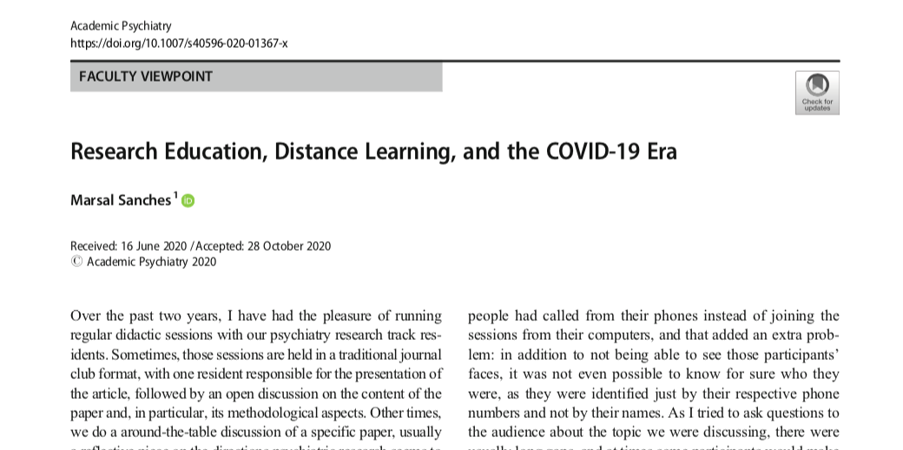
Post COVID-19
Learning Etiquette and Guidelines
Distractions: 1/3
Multi-tasking

Slide 20
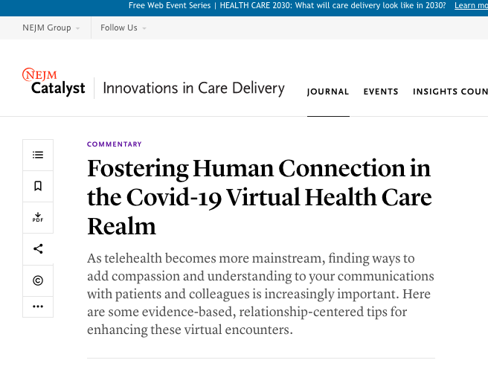
Post COVID-19
Fostering Connection
Remote learning lit
Active learning
Cameras, Action!
Trust Generators
Storytelling
Remote - medium

Slide 21
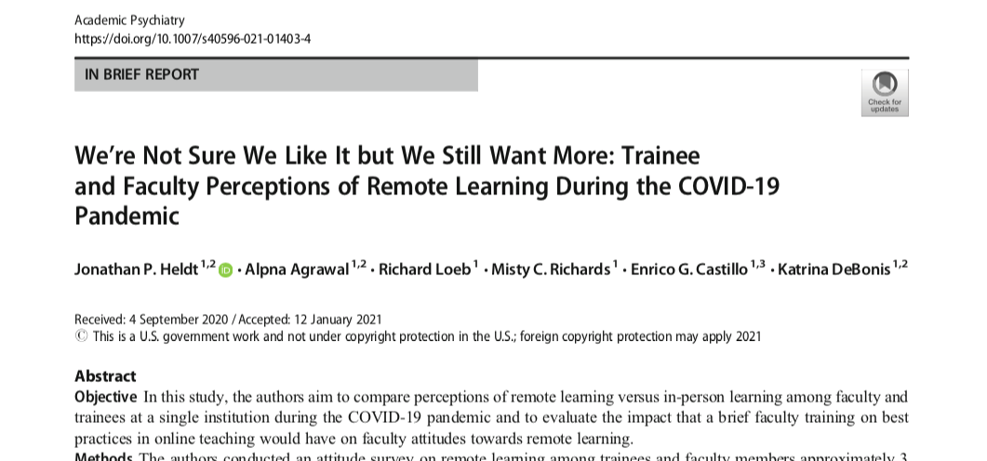
Post COVID-19
Return to in-person learning
10%, 14%

Slide 22
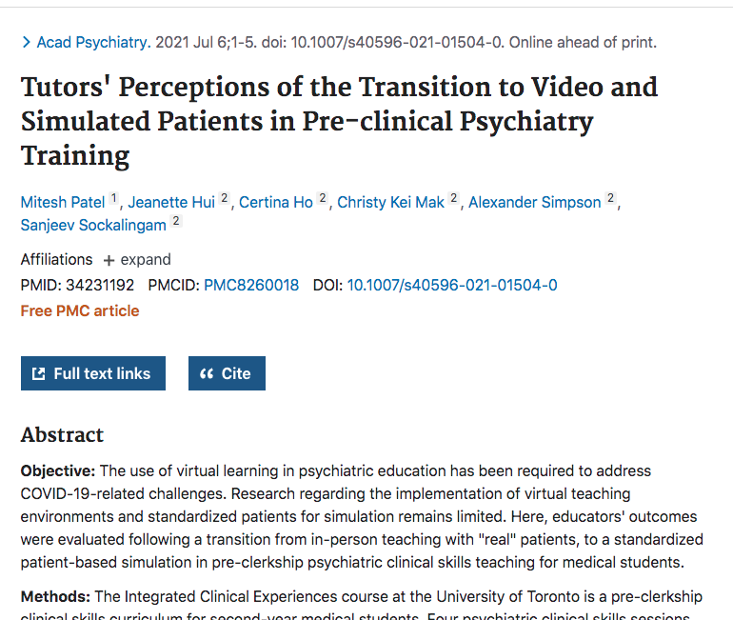
Post COVID-19
Simulated Learning

Slide 23
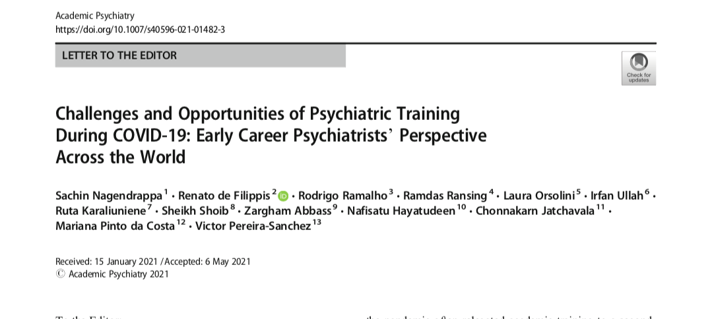
Post COVID-19
Opportunities
DEI

Slide 24
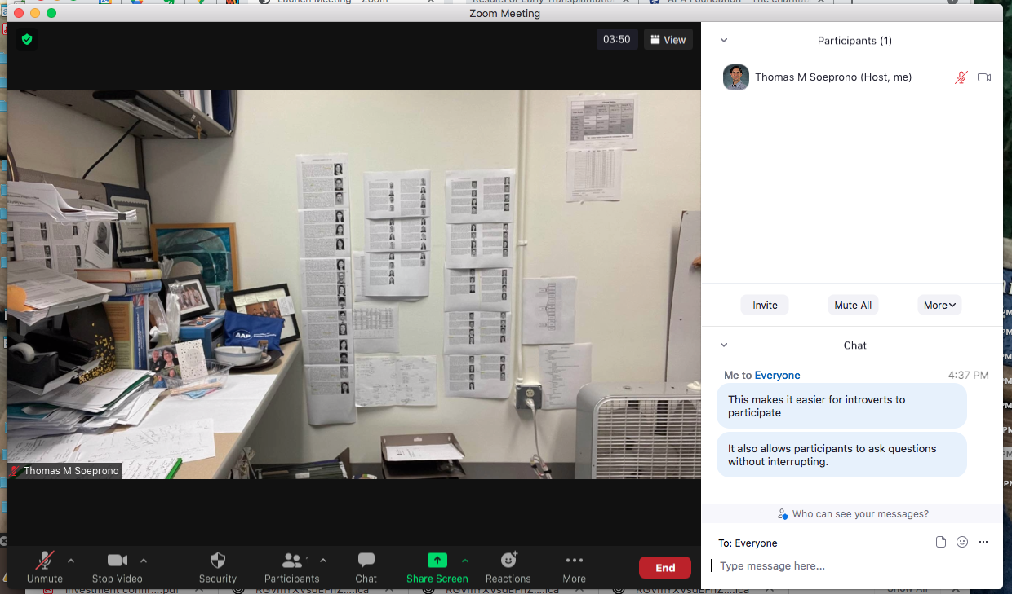
Post COVID-19
Zoom
As effective

Slide 25
Post COVID-19
Zoom
Participants
Chat

Slide 26
Post COVID-19
Zoom
Breakout groups
Record

Slide 27
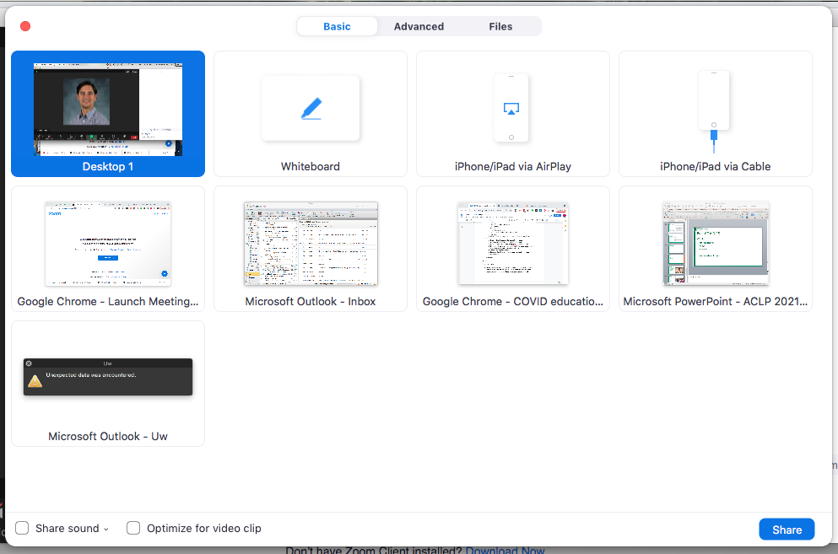
Post COVID-19
Tools
Screen sharing

Slide 28
Beyond COVID-19
Avoid
Waiting
Neglect
Extremes

Slide 29
Beyond COVID-19
Recommendations for preparation
Ground rules (for educators and learners)
Co-teaching
Use tools as tools (not solutions) (note limitations)
“AND” instead of “OR”
Break the paradigm
Space, time, resources (be your own catalyst)

Slide 30
Beyond COVID-19
BIG picture
Technology (and pandemics) don’t move education forward
Supporting Faculty AND Learners moves education forward
We have the tools but participants have the have the support, safety and resources

