Slide 1
“When should involuntary psychiatric commitment be considered?”
Xavier Jimenez, MD, FACLP
Long Island Jewish Medical Center/Northwell

Slide 2
Disclosures
No financial or commercial disclosures

Slide 3
What are our management options?
32 case reports + 13 case series
Results: no difference in confrontation vs non-confrontation; no singular psychotherapy/treatment that stands apart (Eastwood and Bisson, 2008)
“No robust research evidence is available to support the effectiveness of a management strategy for factitious illness” (Bass and Halligan, 2014)

Slide 4
Case vignette
40 year old F PMH Behcet’s disease (unsubstantiated), recurrent venous thromboemboli (DVT), on Coumadin and followed by vascular medicine, admitted with right upper chest pain and diagnosed with right subclavian DVT.
Found to have subtherapeutic INR but denied noncompliance with Coumadin.
Records reveal numerous admissions for either sub- or supratherapeutic Coumadin levels and suspicion of factitious disorder.

Slide 5
Case vignette
PPH bipolar disorder “NOS” without overt evidence of severe manic or depressive symptoms. Noncompliant with medications (gabapentin, quetiapine) and outpatient visits. Also hx of vague/inconsistent hallucinations, often linked to transient bouts of stress and/or various behaviors (such as pulling out IV lines or inappropriate use of medications). One parasuicidal gesture during adolescence (OD) but no other suicide attempts, substance abuse history, or legal issues.
Social hx: high school graduate, married (living with husband in their own home) with two children, unemployed (former retirement home aid), on disability for her Behcet’s. She has applied for disability for her son and at one point was rejected due to her husband’s income; she once asked a social worker for legal aid in order to divorce and thereby qualify for social security for said son.

Slide 6
Case vignette
Stressors: mother-in-law was disabled post-stroke with 24-hour care needs and lived with the patient and husband; in past notes, the patient had confided that at times she felt her husband “chose” between her and his mother, and admitted not getting along with her mother-in-law “at all.” Also, one child has autism, who’s care had been described as “very stressful.” Husband is a trucker who disappears for days on end.

Slide 7
Hospital Course
After 10 days of dramatically-fluctuating, unexplained INR measurements, CL Psych is consulted for “depression and INR changes.” The primary team is annoyed by her, calling her “manipulative” and difficult, certain of the fact that she is inducing her own INR changes.
Psych exam: engages appropriately, affect full-range, though concrete/simple. She offers no explanation for fluctuating INR measures, though does admit that sometimes she “spaces out” or feels “too depressed” at home and loses track of her Coumadin counts. She denied depressive, anxious, psychotic, manic, or other overtly-psychiatric symptoms; she hoped to “get better soon and go home.”

Slide 8
Hospital Course
Sitter/bedside companion and mouth checks were ordered, and it was discovered that the patient had been “cheeking” her Coumadin. She quickly complied with doses, achieved a therapeutic INR, and was medically cleared.
Primary team was compelled to discharge her home with “a verbal warning” vs admit to inpatient psychiatry per our discretion (what would you do at this juncture?)
CL felt compelled to address the readmission cycle: gathered medical team, vascular medicine consultant, and psychiatric social worker to draft an interdisciplinary behavioral contract

Slide 9
Hospital Course
Document based on previous behavioral contract used in FD and other behavioral cases. It included language regarding use of a bedside companion, mouth checks, room sweeps, and other interventions should the patient be readmitted with a medically-unexplained INR change.
Then presented to both patient and husband, and explained that if she didn’t sign, she would be admitted to inpatient psych on grounds of inability to care for self (given that her environmental, family, medical, and psychiatric situations had not changed)

Slide 10
Behavioral Contract
Three main areas:
Use of 1:1/bedside companion/sitter
Mouth/belongings checks
Treatment dictated by primary medical team (not patient)

Slide 14
Behavioral Contract – teeth?
Requires buy-in from medicine, nursing, security, etc.

Slide 15
Hospital Course
Contract presented to both patient and husband, and explained that if she didn’t sign, she would be admitted to inpatient psych on grounds of inability to care for self (given that her environmental, family, medical, and psychiatric situations had not changed).
The husband was terrified of his wife being committed and pleaded with her to agree, crying that he simply wanted her “back home.” The patient agreed to the behavioral plan, went home and remained out of the hospital for over a 6 months, attending outpatient vascular as well as psychiatric appointments.

Slide 16
What is the role for behavioral modification interventions?
By behavioral, conceptualizing FD behaviors as amenable to negative/positive reinforcement, via certain interventions
Some basic definitions…
Contingency planning: basic “if-then” planning for scenarios before they arise (anticipating problems)
Operant conditioning (BF Skinner): formal method of learning occurring via rewards/punishments (“operants”)

Slide 17
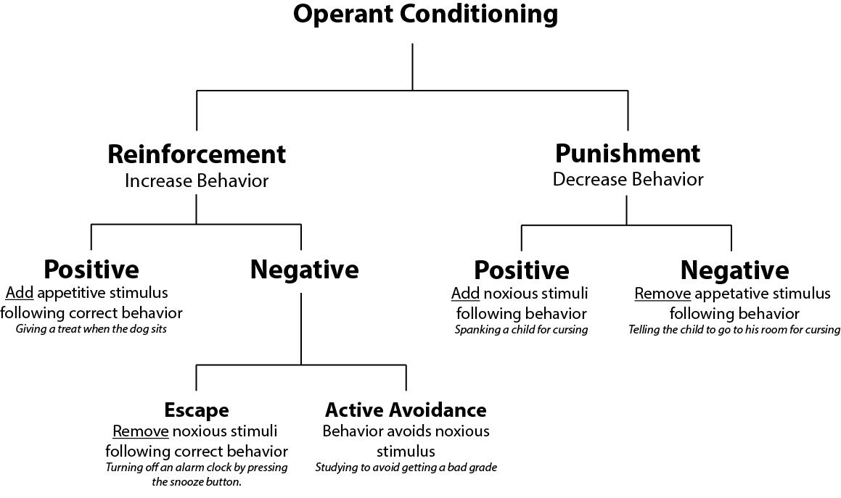
Behavioral Interventions: Conditioning and Contracts
Operant conditioning: illness is made up largely of behaviors and that chronicity ensures the need for behavior change by both patient and family
“without family and patient behavioral changes, treatment effectiveness will be diminished and sometimes eradicated altogether” (Fordyce WE, 1976)

Slide 18
Behavioral Interventions: Conditioning and Contracts
Older model (1970’s-1980’s), mostly applied to medical compliance
Smoking/ETOH/Drug use, med compliance, weight mgmt most studied (Janz et al, 1984)

Slide 19
Examples in FD
33 F with factitious symptoms and behaviors (picking nose, inserting substances into urethra) x years (Yassa, 1978)
Behavioral intervention designed
Reinforced positive attributes by rewarding acceptable social behavior with praise/approval
Unwanted behaviors (acting out, pseudoepileptic fits, passive aggression) led to loss of privileges.
Weekly sessions x 1 hour
Result: gradual improvement over 3 years, eliminating frequent hospitalizations

Slide 20
Examples in FD
64 M with factitial dermatitis admitted 80% of the year for the past several year (Simmons et al, 1987)
Behavioral intervention designed
1) assess frequency of patient’s scratching behavior
2) increase patient’s awareness of behavior
3) redirect patient’s attention away from illness behavior such as asking staff and family members their perceptions of his condition
Given two self-monitoring forms daily (“Scratches” and “Catches”, the latter rewarded with preferred activities)
Result: 80% of skin lesions cleared after several weeks.
Relapsed when went home and structure was lost…

Slide 21
Inpatient Tx and FD
One study: 100 consecutive inpatient psych admissions reviewed (Gregory and Jindal, 2006)
6 (6%) had FD diagnosis (as well as mood/anxiety/personality disorders)
Higher prevalence in inpatient psych settings than usually expected
Literature: not much information on the use of inpatient psych for FD, though many patients have been admitted if illness behavior dangerous enough
Questions remain…

Slide 22
Inpatient Tx, Behavioral strategies, and FD
Is inpatient psychiatry (or the “threat” of it) really an option? If so, when/how?
Is negative reinforcement a justified form of operant/behavioral conditioning? Or is this just threatening/punitive? Is this even ethical?
Are behavioral contracts…worth it? Significant time, effort… Individual question for CL teams to ponder…
What is the role of family in leveraging this form of care?
How do you work w/ inpatient psych colleagues to be agreeable to seeing/working with these patients?

Slide 23
References
Bass C and Halligan P. Factitious disorders and malingering: challenges for clinical assessment and management. Lancet. 2014;383:1422-32.
Eastwood S and Bisson JI. Management of Factitious Disorders: A Systematic Review. Psychother Psychosom. 2008;77:209-218.
Fordyce WE. Behavioral Models for Chronic Pain and Illness. St Louis Mosby, 1976.
Gregory RJ and Jindal S. Factitious Disorder on an Inpatient Psychiatry Ward. American Journal of Orthopsychiatry. 2006;76(1):31-36.
Janz NK, Becker MH, Hartman PE. Contingency contracting to enhance patient compliance: a review. Patient Education and Counseling. 1984;5(4):165-178.
Simmons DA, Daamen MJ, Harrison JW, Weishaar ME. Hospital Management of a Patient with Factitial Dermatitis. General Hospital Psychiatry. 1987;9:147-150.
Yassa R. Munchausen’s syndrome: A successfully treated case. Psychosomatics. 1978;19(4):242-243.

