Slide 1
A Patient’s Perspective
2021 ACLP Lipsitt Award
Video recording: Friday, October 22, 2021
Jamie Zahlaway Belsito
2021 Don R. Lipsitt Award recipient

Slide 2
A Patient’s Perspective
Mother to Hadia, age 11 and Rose, age 8
Former Commissioner on the (MA) Ellen Story Special Commission on Postpartum Depression.
Trustee at Salem State University.
Board member of the Massachusetts March of Dimes.
Former Advocacy Chair for the National Coalition for Maternal Mental Health.
Former candidate for United States Congress.
Current candidate for the Massachusetts Statehouse
Founder of the Maternal Mental Health Leadership Alliance
Policy Director for the Maternal Mental Leadership Alliance

Slide 3
A Patient’s Perspective
After the birth of my first daughter, I was the happiest I had ever been. I also thought that if I never woke up ever again, it would be the best thing for her and my husband.

Slide 4
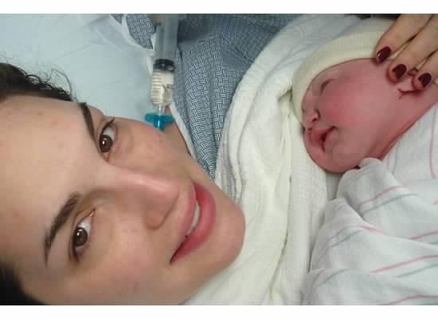
A Patient’s Perspective
After a traumatic birthing experience, and a previous miscarriage, there were warning signs that providers could have identified ahead of time to support me and my mental wellness.

Slide 5
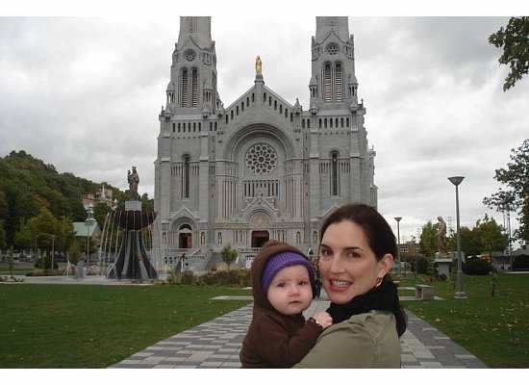
A Patient’s Perspective
This is a photo of me in Sainte Anne De Beaupré, Quebec, in front of the Saint Anne Basilica, the oldest shrine in North America. The shrine is dedicated to Saint Anne, the grandmother of Jesus. This basilica is hailed as site of miracles and healing. I was so desperate for help and forgiveness, that I came here, hoping it would help me.

Slide 6
A Patient’s Perspective
THE BOTTOM LINE
Childbearing people are captive in the healthcare system
during the perinatal timeframe
visiting a healthcare provider an average
25 times
during a healthy pregnancy and first year of baby’s life
Obstetric and primary care providers serving pregnant and postpartum women are uniquely positioned to intervene effectively
by screening and assessing women for mental health disorders

Slide 7
A Patient’s Perspective:
We are failing as a society when a mother dies from mental health complications
On October 3, 2013, 4 days before my second daughter turned 1, a young mother of Miriam Carey was shot to death by the Capitol Hill police. She was suffering from postpartum psychosis and was unable to find help. Her daughter was with her when she was killed.

Slide 8
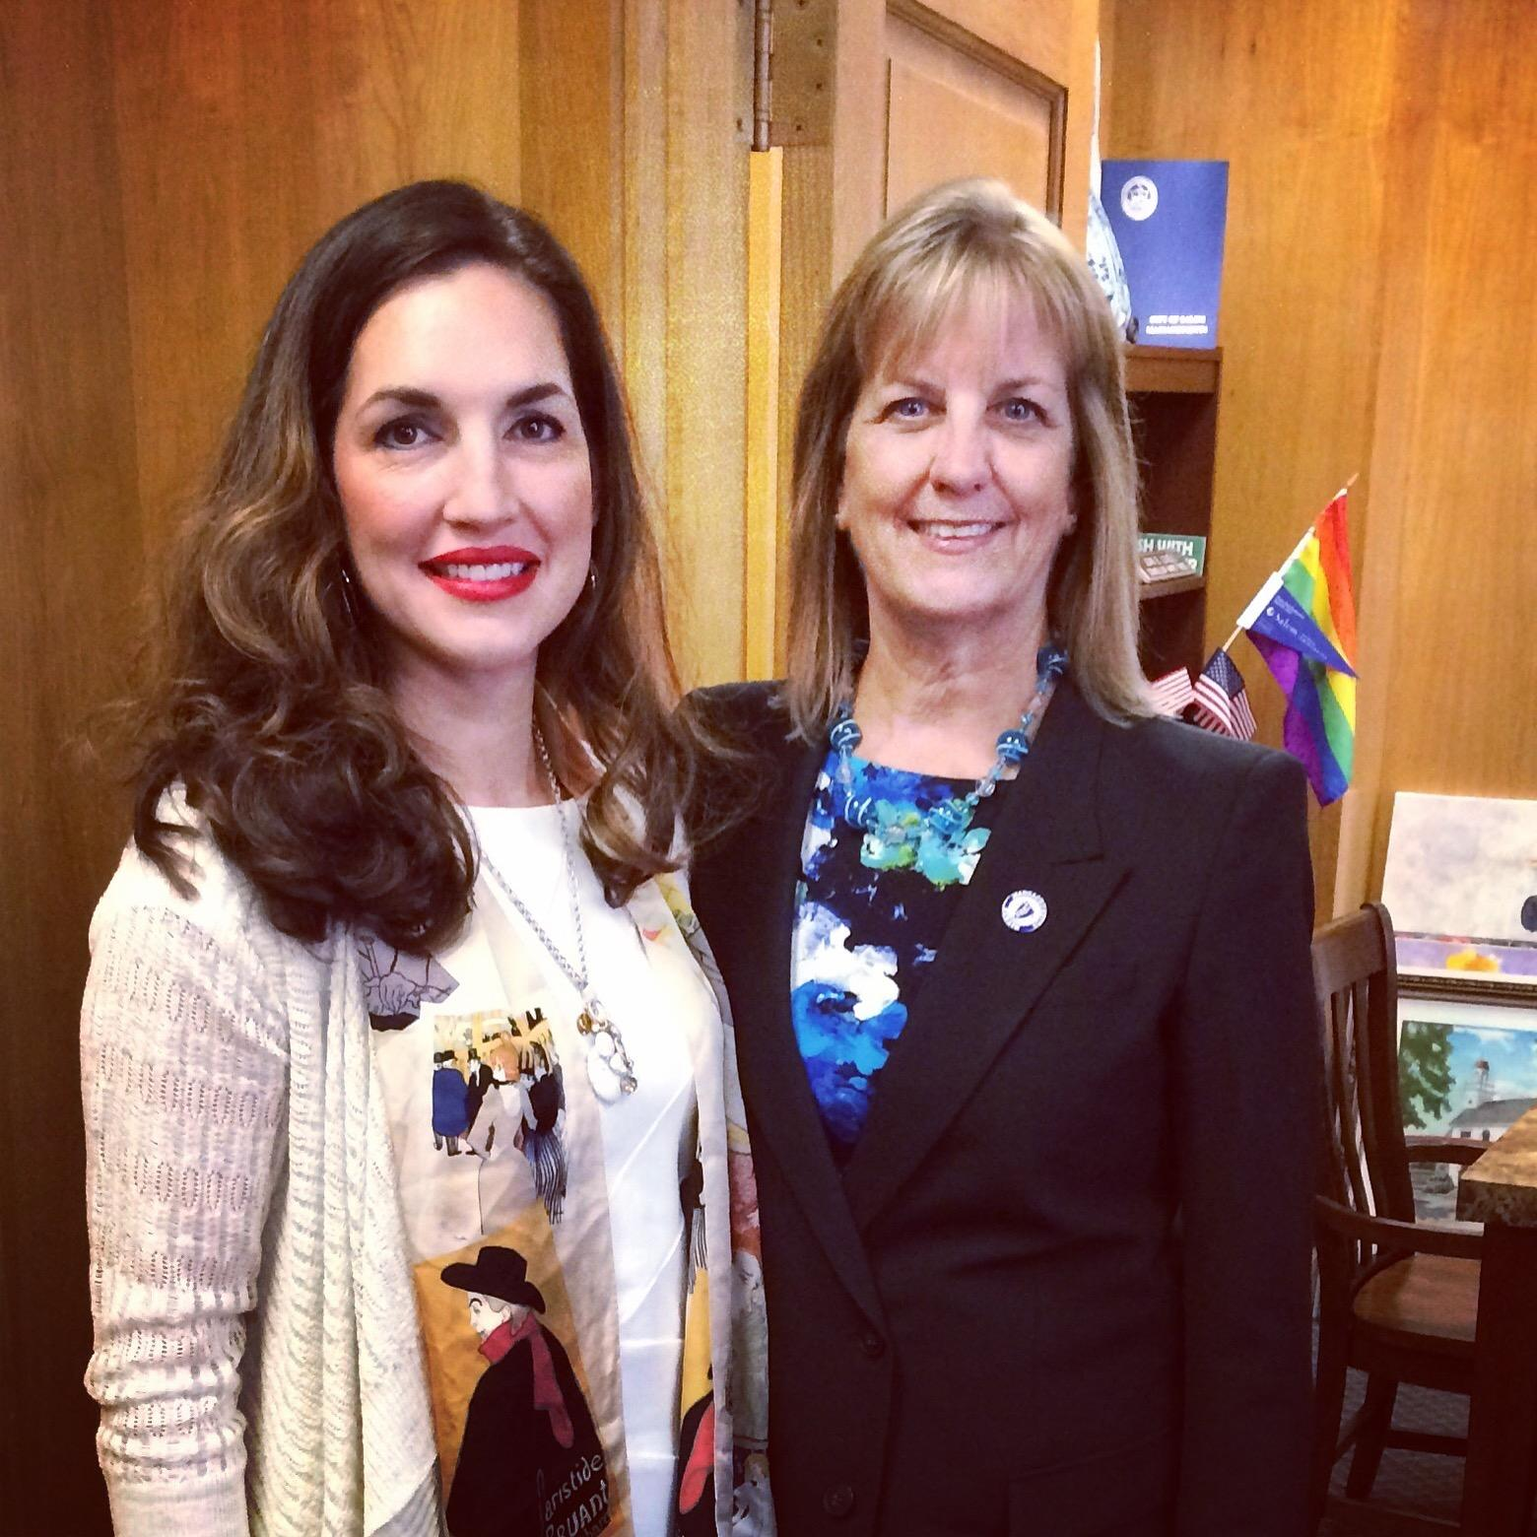
A Patient’s Perspective
I called my state Senator, Joan Lovely, and set up a meeting with her during constituent service hours in my hometown.
I asked her what she knew about postpartum depression, I shared my story and told her that if one more mother dies because of lack of care, we are failing as a society.

Slide 9
A Patient’s Perspective
In partnership with Senator Lovely, I helped create the first ever Postpartum Depression Advocacy Day on Beacon Hill. The Senator is now the chair of the postpartum commission.
Advocates all across the Commonwealth have changed the way our state screens for maternal mental health conditions, addresses racial equity within services and support comorbidities like substance use and MMH.

Slide 10
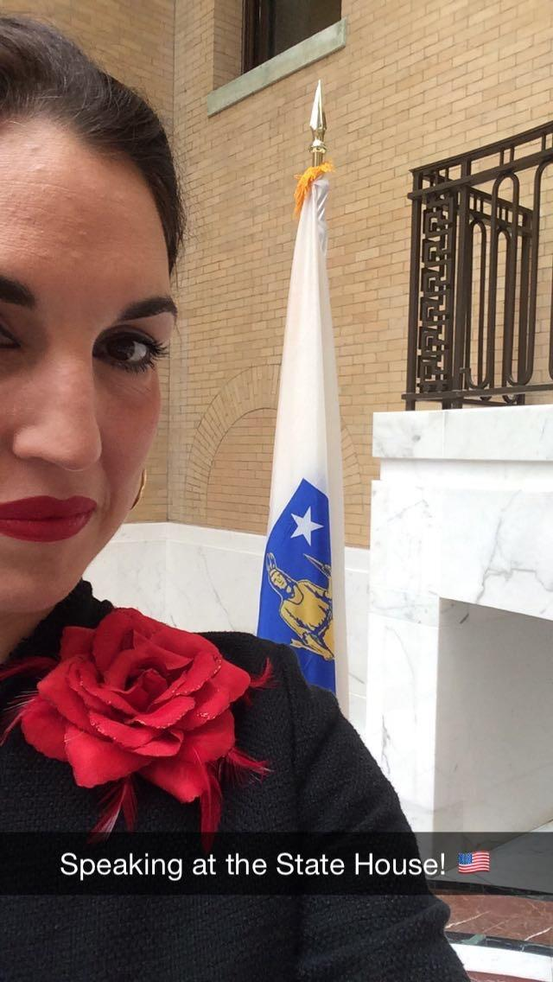
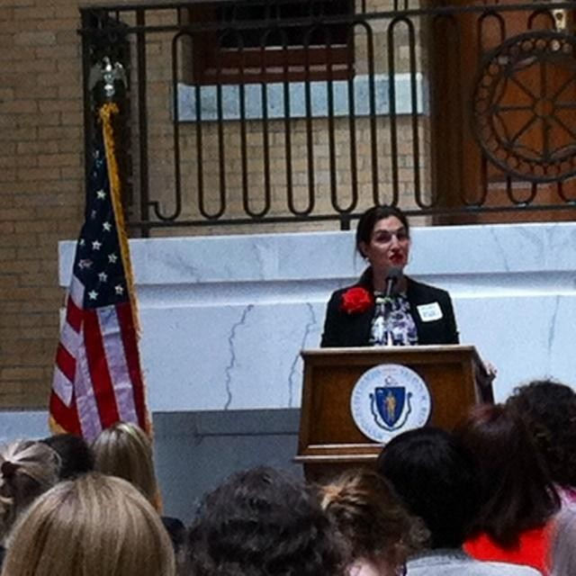
One Voice Can Make a Difference.
These photos are from the 2015 inaugural Statehouse Advocacy Day. I shared my story hoping to destigmatize the most common complication of all pregnancies.
The Lieutenant Governor announced at this event, that postpartum depression screenings would be covered by MassHealth.

Slide 11
MASSACHUSETTS: Pregnancy related deaths
2005-2014, pregnancy-associated deaths
SUBSTANCE USE
38%
Related to substance use
Deaths related to substance use increased from
8% to 40%
MENTAL HEALTH
50%
Had documented
mental health diagnosis
92%
Were documented
prior to delivery
Maternal mental health & pregnancy-associated deaths, Massachusetts Department of Public Health, Sept 2017

Slide 12
Special Commission on PPD for the Commonwealth of Massachusetts: Screening of Dark Side of the Full Moon

Slide 13
Annual PPD Advocacy Day 2016: Massachusetts Statehouse

Slide 14
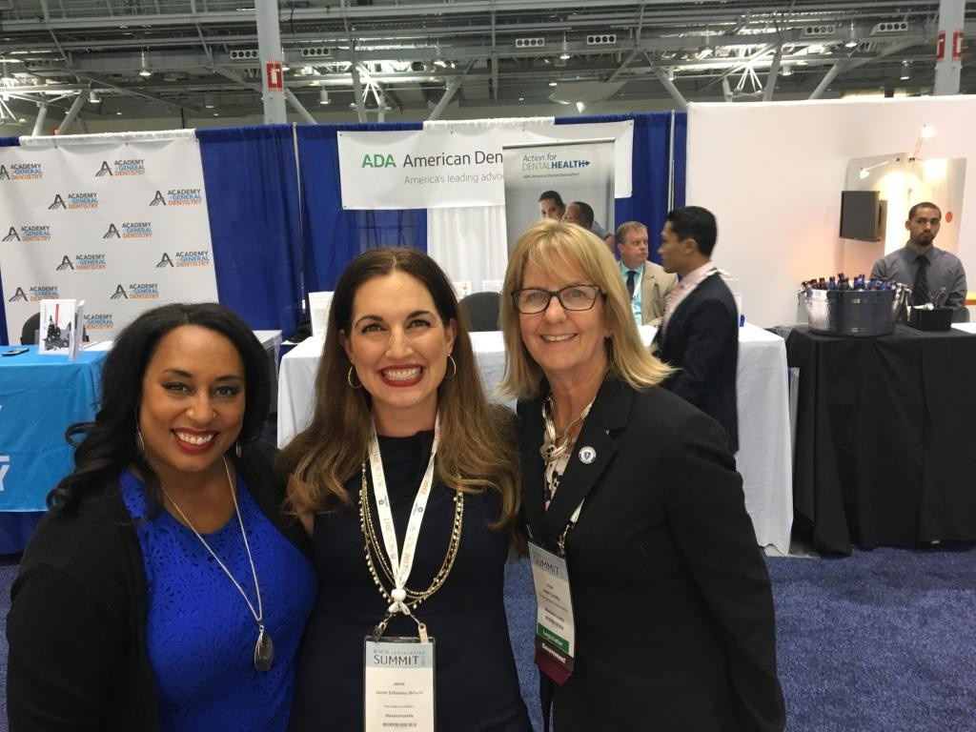
A Patient’s Perspective
Began outreach to different state legislators on the topic of mental health and maternal health
Researched online what other states where doing/what had been done
Commissions
Task Forces
Advocacy Groups (industry specific)

Slide 15
STATE SUCCESSES
Require Screening
California
Delaware
Florida
Illinois
New Jersey
Pennsylvania
Texas
Utah
West Virginia
Require Educating Providers and/or Mothers
California
Delaware
Illinois
Minnesota
Oklahoma
Oregon
Pennsylvania
Tennessee
Texas
Utah
Virginia
Public Awareness Campaigns
California
Colorado
Florida
Michigan
New York
Oregon
Utah
Washington
Task Forces / Commissions
Arizona
California
Colorado
DC
Florida
Maine
Massachusetts
Maryland
Oregon
Utah
MMH Awareness Proclamations
Arizona
California
Illinois
Indiana
Michigan
Minnesota
Montana
New Jersey
North Carolina
North Dakota
Pennsylvania
Texas
Tennessee
Utah
Virginia

Slide 16
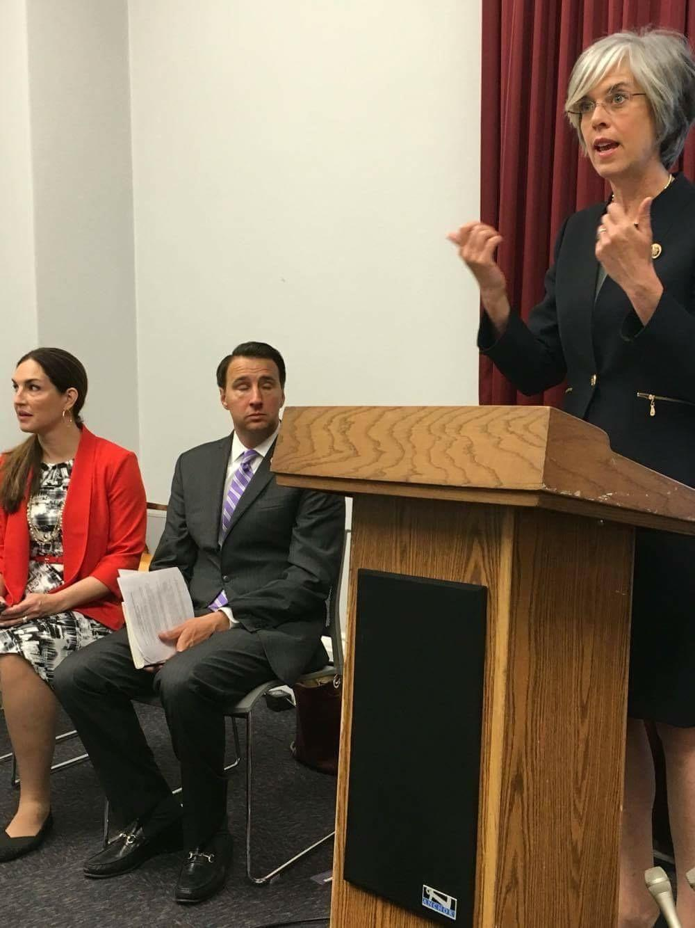
A Patient’s Perspective
Washington D.C., May 2016
In May 2016, I created the 1st ever Capitol Hill advocacy day focused on Maternal Mental Health.
The NCMMH (National Coalition for Maternal Mental Health) brought me on to create this inaugural event.
Brought survivors and families in from all over the United States.
Hosted a congressional briefing with the sponsors of the “Bringing Postpartum Out of the Shadows Act”
Representative Katherine Clark (D-MA)
Representative Ryan Costello (R-PA)
Walked away with 10 new co-sponsors by the end of the day.

Slide 17
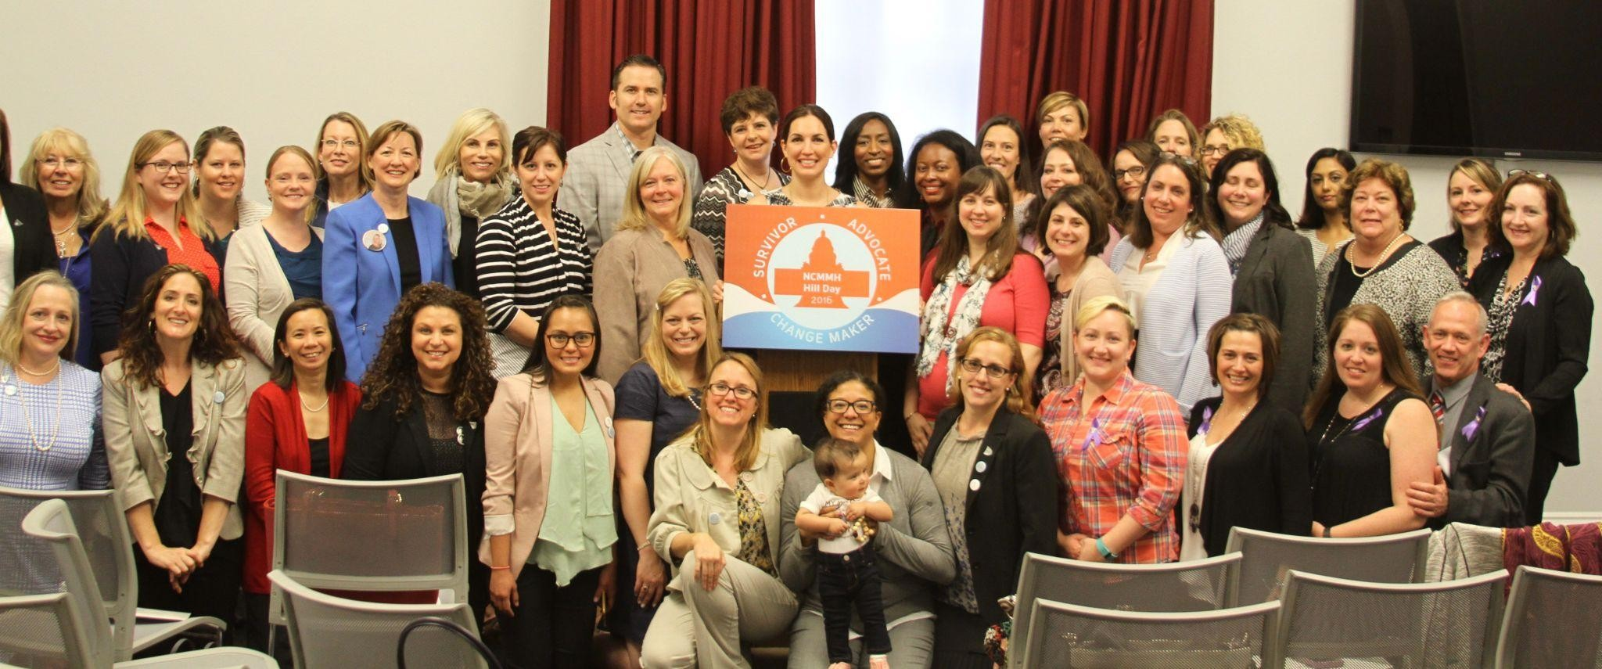
A Patient’s Perspective
Washington D.C., May 2016

Slide 18
Capitol Hill: Maryland constituents with Senator Ben Cardin

Slide 19
Capitol Hill: Tennessee and Alabama constituents

Slide 20
Capitol Hill: Tennessee Constituent Kristina Dulaney with Senators Alexander and Corker
Notes:
This was a Tennessee only invitational breakfast.

Slide 21
Anchorage, Alaska: Senator Sullivan

Slide 22
Spokane, Washington: Congresswoman Cathy McMorris Rodger’s office

Slide 23
Gainsville, Florida: Congressman Ted Yoho

Slide 24
Capitol Hill: Fallen Officer Shelane Gaydos’ family: Congresswoman Comstock [Virginia]

Slide 25
Capitol Hill: Congresswoman Ileana Ros-Lehitinen [Florida]

Slide 26
Capitol Hill: North Carolina Moms

Slide 27
Capitol Hill: UNC Center for Women’s Mood Disorders

Slide 28
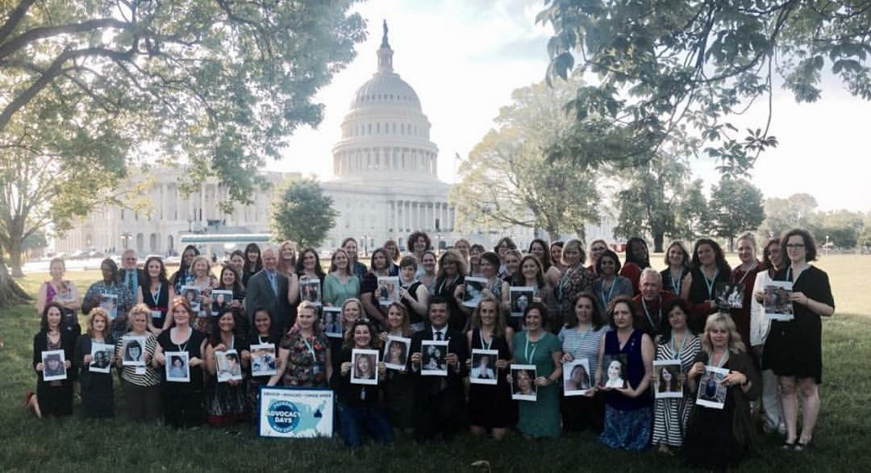
A Patient’s Perspective
2017 Advocacy Day

Slide 29
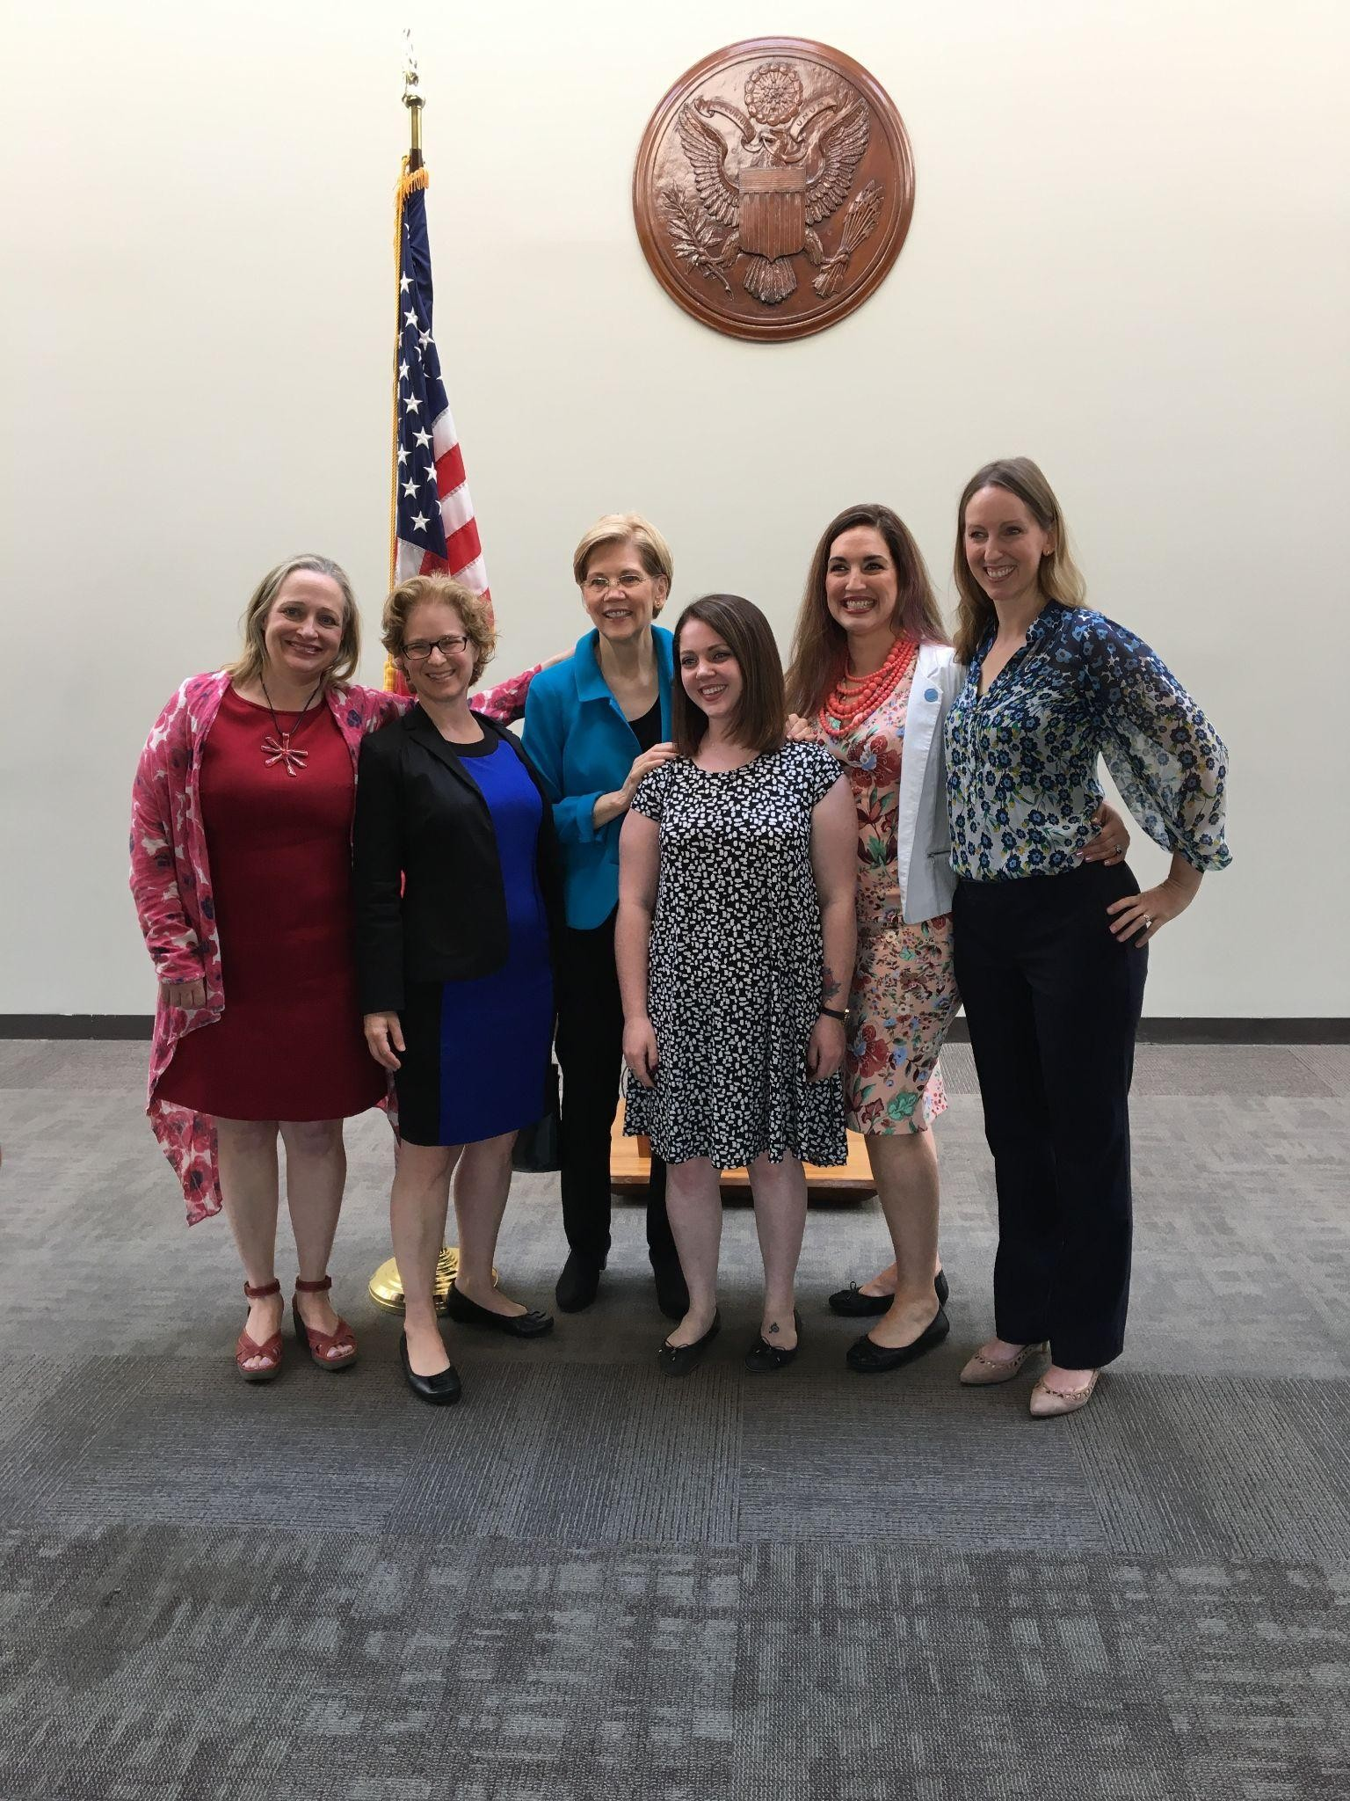
A Patient’s Perspective
Senator Elizabeth Warren had heard about the work we were doing and asked to meet with us in Capitol Hill.

Slide 30
A Patient’s Perspective
FEDERAL LEGISLATION
Typically takes 5-7 years for a bill to become law
In the last Congress, over 30 bills addressing maternal health were introduced but NONE passed
MMH SUCCESSES
Bringing Postpartum Depression Out of the Shadows Act passed in its first year
Maternal mental health hotline received funding in just two years
PROBLEM STREAM
POLICY
WINDOW
OPENS
AGENDA
POLICY STREAM
POLITICS STREAM

Slide 31
A Patient’s Perspective
FEDERAL LEGISLATION: ENACTED
Melanie Blocker Stokes Act (2010)
First legislation about MMH (no $$$)
Research and education initiatives
Federal Stimulus Package (2019)
Provided $3 million to create Maternal Mental Health Hotline
Bringing Postpartum Depression
Out of the Shadows Act (2016)
Provided $20 million in grants to states
Create innovative access programs
President’s Budget (2021)
Provided $5 million for MMH hotline
Study of MMH among military
Pilot project: doulas in the military
Preventing Maternal Deaths Act (2018)
Provided $40 million in grants to states
Establish maternal mortality review committees (MMRCs)
American Rescue Plan Act (2021)
Allows states to extend pregnancy-related Medicaid coverage to a full year postpartum

Slide 32
A Patient’s Perspective
FEDERAL LEGISLATION: PROPOSED
Black Maternal Health Momnibus (2021)
Collection of 12 bills
Address all aspects of maternal mortality
TRIUMPH for New Moms Act (2021)
Federal task force
National strategic plan
Moms MATTER Act (2021)
Address MMH and substance use
Focus on racial & ethnic minority groups
Into the Light (Nov 2021)
Reauthorize and expand grants to states
Authorize and fund MMH hotline

Slide 33
A Patient’s Perspective
HOW RESEARCH IMPACTS POLICY
Maternal mental health (MMH) conditions are the most common complications of pregnancy and childbirth, affecting 1 in 5 women (800,000 people each year in the United States).¹ Recent studies show that suicide and overdose combined are the leading cause of death for mothers in the postpartum period, contributing to the distressingly high maternal mortality rate in the United States.² Sadly, 75% of those experiencing MMH conditions remain untreated, increasing the risk of multigenerational, long-term impact on the physical, emotional, and developmental health of both the mother and child.³ The cost of not treating MMH conditions is $32,000 per mother-infant pair, or $14.2 billion in accounting for lost wages and productivity of the mother and addressing poor health outcomes of the mother and infant.⁴ The COVID-19 pandemic has exacerbated MMH conditions with a recent study showing that pregnant women and new mothers are experiencing anxiety and depression during the pandemic at 3-4 times the rate prior to the pandemic.⁵ Women facing racial or economic inequities are disproportionately impacted by both the pandemic and MMH conditions, experiencing both at rates 2-3 times higher than White women.⁶
Metz, T., et al (2016). Maternal Deaths From Suicide and Overdose in Colorado, 2004-2012. Obstetrics Gynecol.
Davis N., et al (2019). Pregnancy-Related Deaths: Data From 14 U.S. Maternal Mortality Review Committees, 2008-2017. Atlanta, GA: Centers for Disease Control and Prevention, U.S. Department of Health and Human Services.
Byatt, N., et al (2015). Enhancing Participation in Depression Care in Outpatient Perinatal Care Settings: A Systematic Review. Obstet Gynecol.
Luca, D., et al (2019). Societal Costs of Untreated Perinatal Mood and Anxiety Disorders in the United States. Mathematic Policy Research.
Lebel, C., et al (2020). Elevated Depression and Anxiety Among Pregnant Individuals During The COVID-19 Pandemic. Journal of Affective Disorders.
Howell, E., et al. (2005). Racial and Ethnic Differences in Factors Associated With Early Postpartum Depressive Symptoms. Obstet Gynecol.

Slide 34
A Patient’s Perspective
RECOMMENDED SCREENING GUIDELINES
GOLD STANDARD
Conception to baby’s 1st birthday
PREGNANCY
1st prenatal visit
Late pregnancy
DELIVERY
Prior to discharge
Fourth Trimester
POSTPARTUM
All well-baby visits
Starting at 2 weeks
1, 2, 4, 6 months
American Academy of Pediatricians
American Academy of Family Physicians
American College of Obstetricians and Gynecologists
American Psychiatric Association
Association of Women’s Health, Obstetric, and Neonatal Nurses
United States Preventive Services Task Force
STATE MEDICAID POLICIES
37 states allow, recommend, or require screening at pediatric visits Learn more HERE

Slide 35
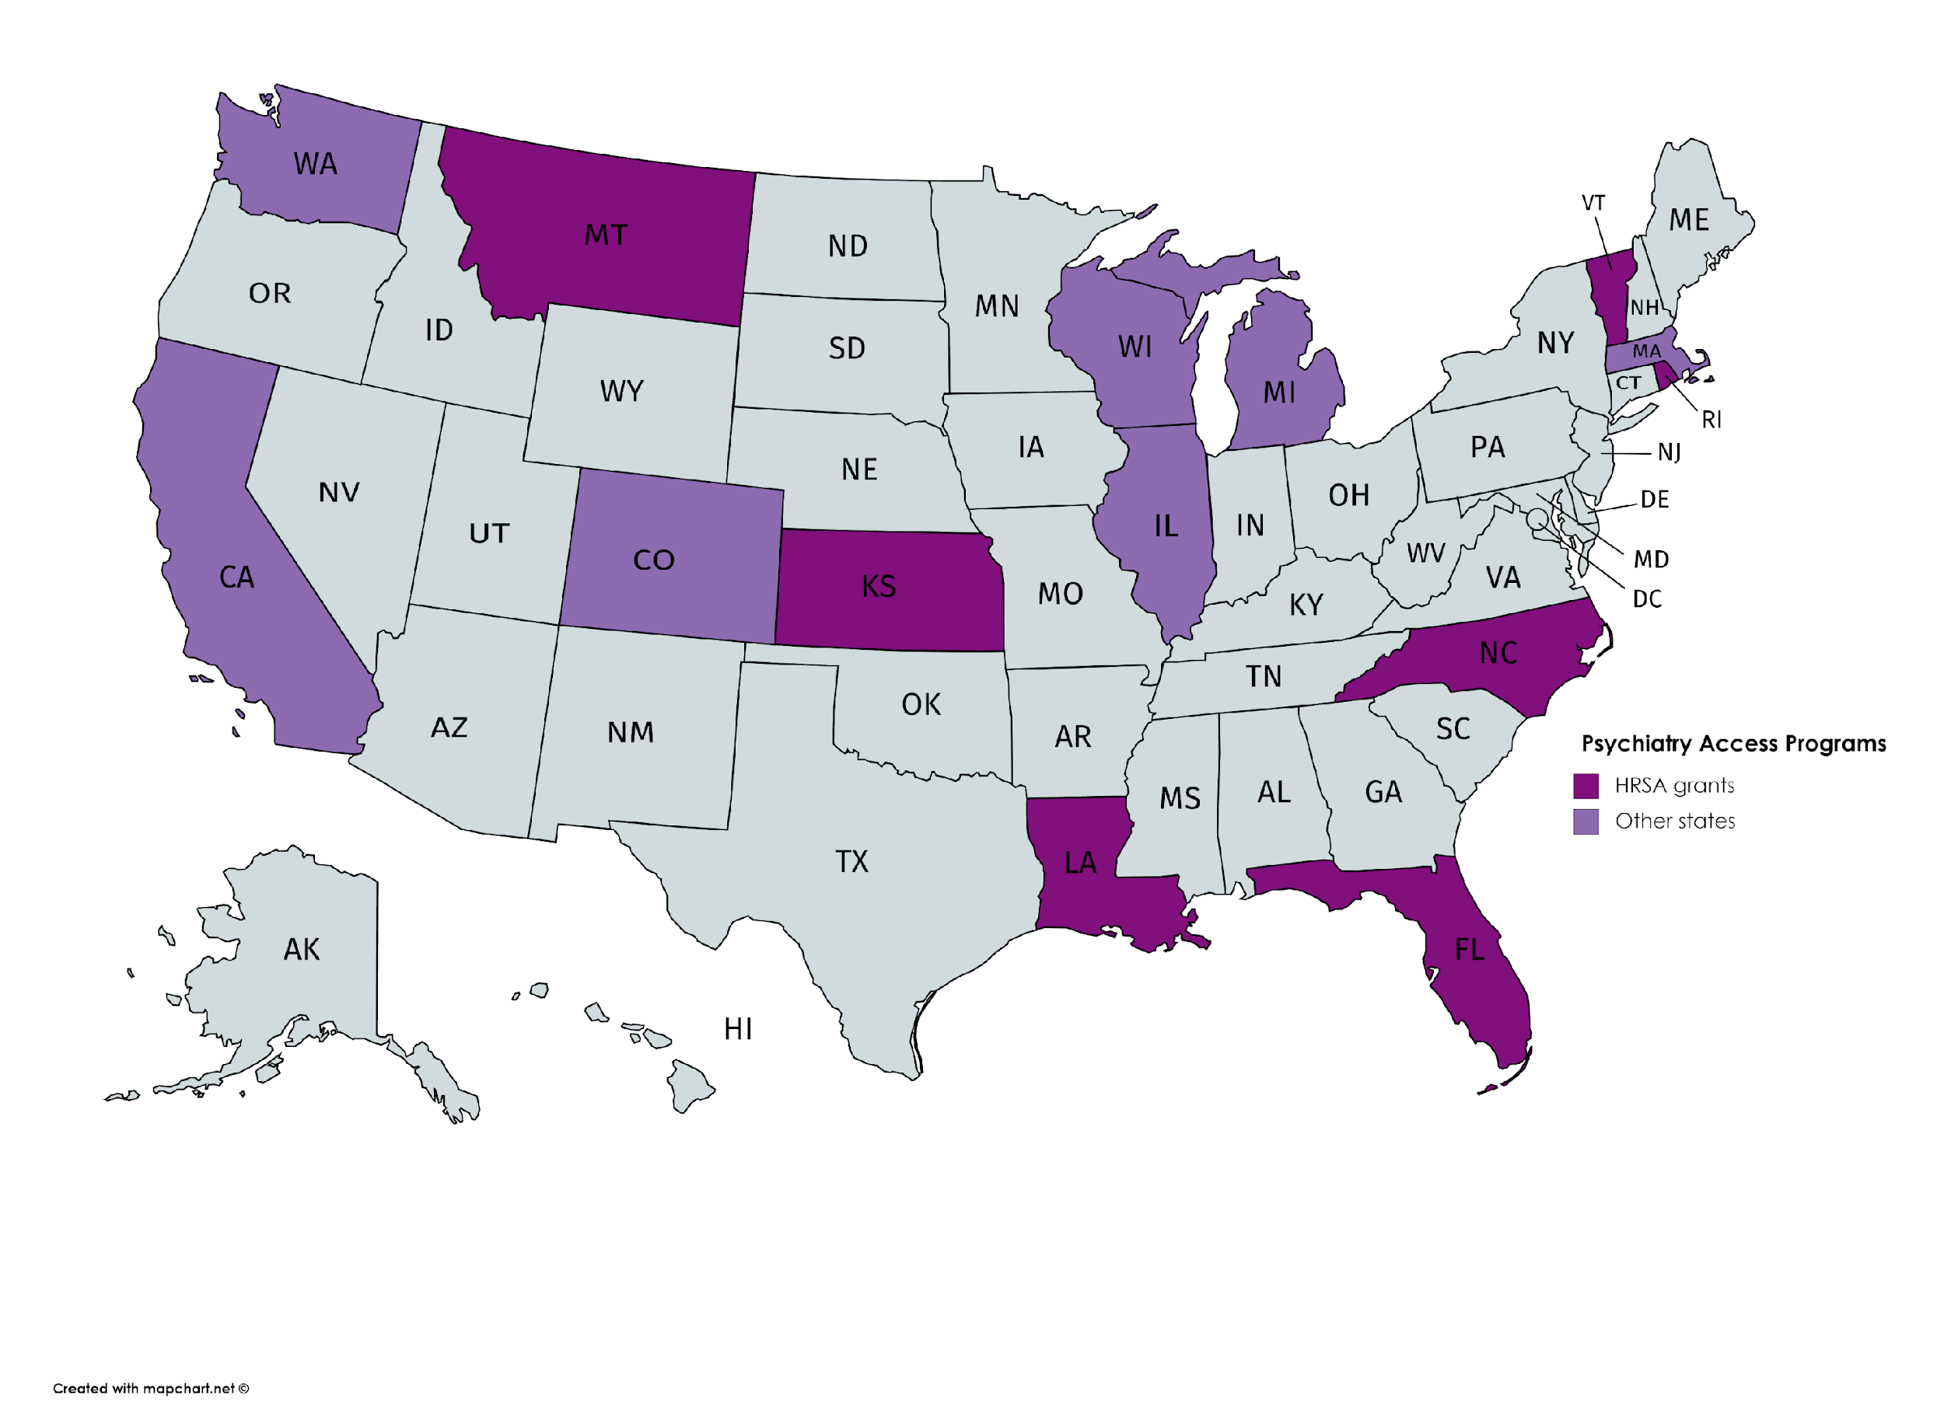
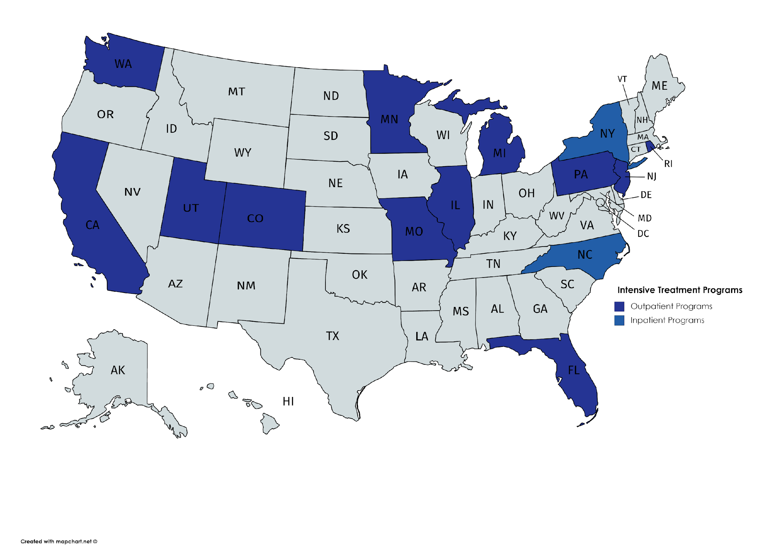
A Patient’s Perspective
TREATMENT PROGRAMS
Psychiatry Access Programs
Intensive Outpatient Programs
California
Colorado
Florida*
Georgia
Illinois
Kansas*
Louisiana*
Massachusetts
Michigan
Montana*
North Carolina*
Rhode Island*
South Carolina
Vermont*
Washington
Wisconsin
California
Florida
Illinois
Michigan
Minnesota
Missouri
New Jersey
New York
Pennsylvania
Rhode Island
Utah
Washington
Inpatient Treatment Programs
Postpartum Support International
* HRSA grants
Arkansas, Colorado, New York, North Carolina

Slide 36
A Patient’s Perspective:
One Voice Can Make a Difference
I am the best Mom. Being a parent was the best decision I have ever made.
I will take my experience and use it to create legacy for my daughters and for every future parent out there. They deserve it.

