Slide 1
Ten Important Papers in Consultation-Liaison Psychiatry for the 2020-2021 Academic Year,
Sahil Munjal, MD
10.15.2021 | Department of Psychiatry and Behavioral Health

Slide 2
Association of Lithium Use and a Higher Serum Concentration of Lithium With the Risk of Declining Renal Function in Older Adults: A Population-Based Cohort Study
Notes:
Rej S, Herrmann N, Gruneir A et al Association of Lithium Use and a Higher Serum Concentration of Lithium With the Risk of Declining Renal Function in Older Adults: A Population-Based Cohort Study. J Clin Psychiatry. 2020 Aug 18;81(5):19m13045. PMID: 32841553.

Slide 3
Study Type
Cohort study

Slide 4
Background
Li is gold standard for bipolar disorder & used as an adjunct for TRD
1.5- to 2.5-fold higher risk of incident CKD among Li users have been reported.
CKD can also sometimes necessitate discontinuation, which often leads to relapse.
Previous studies have not focused on geriatric population.
Notes:
1. Li is gold standard for the use in bipolar disorder- 30-40% responding preferentially to this medication
2. Neuroprotective effects(at lower doses) in dementia and stroke and anti suicide action.
3. Lithium has been considered by the OABD research community as a first-line medication in the maintenance of OABD because of its effectiveness in both phases of the illness, considerable evidence base from the adult literature, and being the agent with the most number of geriatric studies.
4. With over 50% of patients treated for bipolar disorder and depression expected to be over the age of 60 by 2030,⁷ and 35%–45% of older adults(65+) having pre-morbid moderate chronic kidney disease (CKD),⁸ the renal safety of lithium is an important consideration. 15% of adult population have CKD.
5. Fears of renal disease has let lower Li prescribing in North America <8-15% vs 30-50% in Europe.
6. Most studies in the field have not focused on geriatric patients and have had limited geriatric sample sizes (often n<50–100).¹⁷ It is difficult to extrapolate the findings of studies of younger adults, since older adults often have premorbid renal decline, multiple cardiovascular comorbidities, and concurrent pharmacotherapies (eg, diuretics, anti-inflammatories) that may affect risk.¹⁸

Slide 5
Study
Whether Li is associated with increased risk of renal decline compared to valproate in older adults
Whether this association differs with higher vs lower baseline Li levels
Whether baseline CKD affected the association between Li use and the incidence of renal decline
Notes:
Took into account various confounding factors.
First for primary outcome, rest were secondary outcomes

Slide 6
Study
Large-scale population-based cohort study
Canadian patients ≥ 66 years
Linked health care database
Primary outcome (30% or greater decrease in eGFR from baseline)
High Li levels defined as >0.7 mmol/L was based on ISBD consensus recommendations for geriatric Li prescribing.
Average follow-up of about 3 yrs.
Notes:
1. Total N- 10,000; Li- 3857; VPA- 6257
2. Mean age- 71y old
3. In Ontario, residents have universal health insurance coverage for hospital and medically necessary physician services. In addition, people aged ≥ 65 years obtain outpatient prescription drug coverage from the Ontario Drug Benefit program.

Slide 7
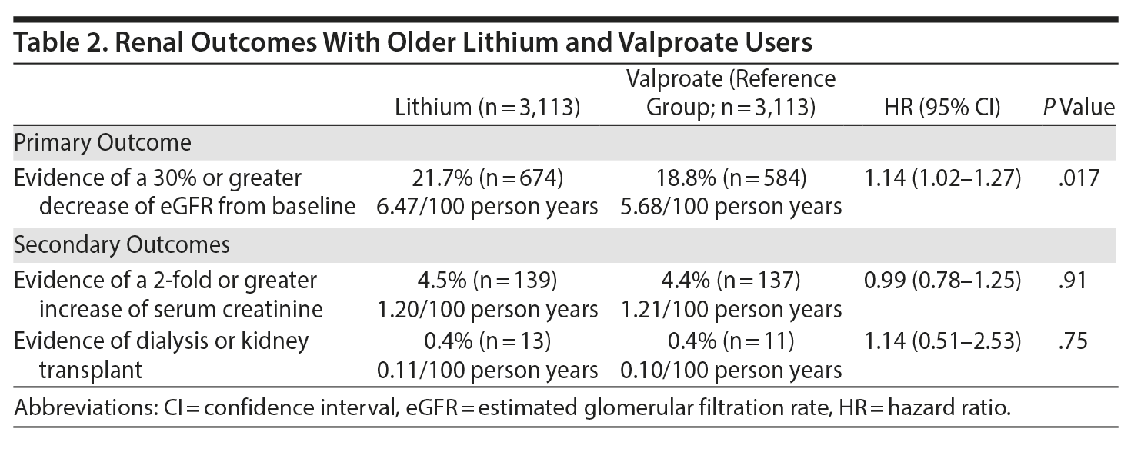
Findings
Notes:
1. Lithium was associated with a 14% increased risk of clinically important decrease in renal function compared to valproate users
2. These estimates are more modest than previous studies with similar follow-up duration, which have suggested a 1.5-2.5 times increased risk of CKD and/or renal decline in older lithium users. These discrepancies may be due in large part to our use of a valproate-using control group with propensity-score matching to control for many important covariates due to methodological differences such as varied parameters to assess renal function and definitions of renal impairment, short-term follow-up, a lack of patients on long-term lithium therapy, combining high-risk and low-risk groups, choice of control group (healthy v. psychiatric patients), and an inability to control the confounding variables

Slide 8
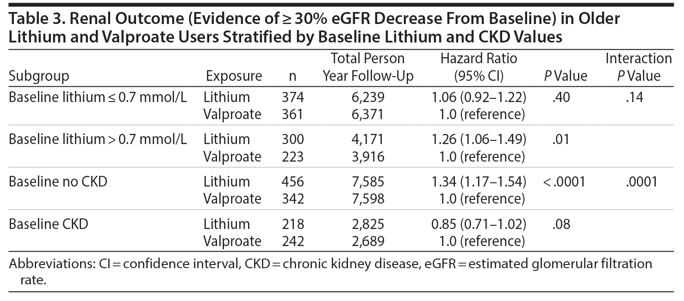
Findings
Notes:
1. Higher lithium levels (> 0.7 mmol/L) may be associated with subsequent risk of renal decline (HR 1.26) which was not observed with lower levels.
2. CKD at baseline (eGFR < 60 mL/min/1.73 m2) was not associated with greater subsequent decreases in renal function during follow-up (HR = 0.85 [95% CI = 0.71-1.02], P = .08). In contrast, patients who did not have CKD at baseline had a higher risk (HR = 1.34 [95% CI = 1.17-1.54], P < .0001) Baseline CKD did significantly interact with our observed association between lithium use and renal outcome: patients who did not have CKD at baseline had a significantly higher risk of declined renal function (P value for interaction .0001).

Slide 9
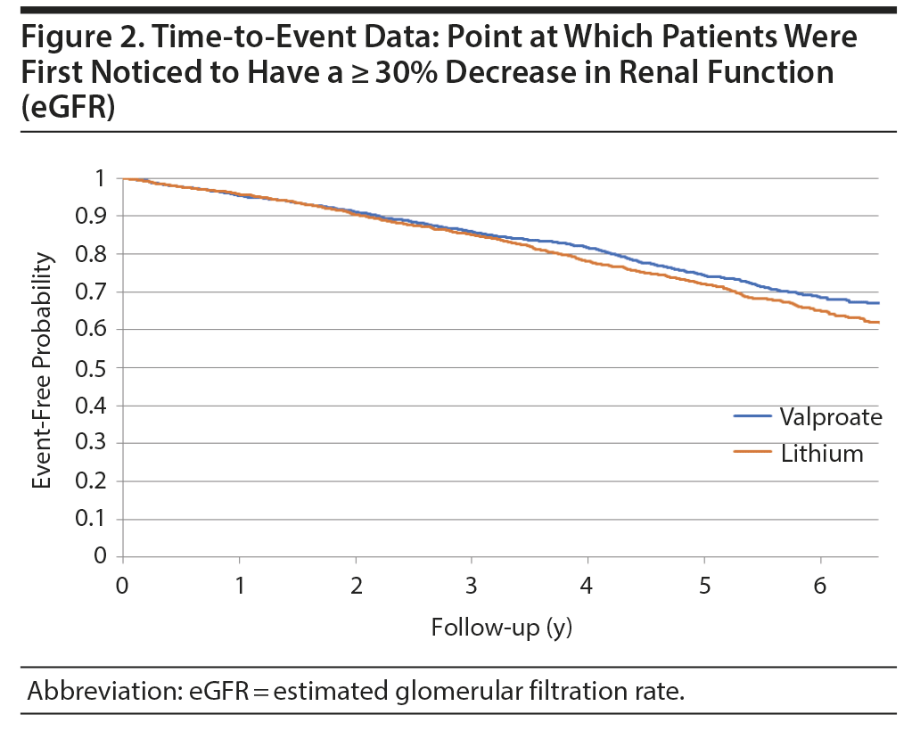
Findings
Notes:
Lithium use was associated with an increased risk of renal decline compared to valproate use (HR=1.14 [95% CI=1.02–1.27]) over a median follow-up of 3.1 years (IQR, 1.4–5.2) years (maximum 8.3 years)
Kaplan Meyer curve

Slide 10
Strengths
First large study to examine the effects of serum Li levels on renal outcomes.
Study was five times larger and focused on geriatric patients.
VPA users were chosen as a control to reduce confounding by indication and relevant physical comorbidities.
Notes:
1. Mitigation of various confounding factors
2. Valproate users were chosen as a comparator group (1) lithium and valproate are prescribed for similar indications, (2) users both have high rates of relevant physical comorbidities compared to the general population (eg, hypertension, diabetes mellitus),³⁵ and (3) valproate use has not been associated with renal problems after controlling for potential confounders.
^{3.} Propensity score matching- demographics, comorbidities, concurrent medication use, no. of health care contacts, lab values.

Slide 11
Weakness
Despite the use of a propensity score, there may be residual confounding.
Secondary analysis (lithium levels and renal decline) may have been underpowered.

Slide 12
Relevance
Substantial association between Li use and clinically important decrease in renal function
Association appears smaller than previously reported.
Lower levels (≤ 0.7 mmol/L) may be helpful at mitigating the risk.
Psychiatric stability and neuroprotective effects with Li are likely observed at < 0.7 mmol/L for most older adults.
Lower levels (0.4–0.7 mmol/L) have been recommended to minimize toxicity, while having clinical effectiveness in OABD and late-life depression).
GERI-BD trial Li head-to-head utility was confirmed vs valproate for mania/hypomania, with mean maximum lithium level of 0.76 mmol/L.
Levels of 0.3–0.6 mmol/L have been helpful for geriatric bipolar depression and maintenance.
Notes:
1. Much of the renal risk in lithium patients is likely attributable to physical health comorbidities such as hypertension and diabetes, which should be monitored and managed in primary care.
2. Unlike its tubular adverse effects, which more commonly present with polyuria and polydipsia, the glomerular adverse effects of lithium therapy appear after long-term use and might not normalize or improve after its discontinuation.
3. once-daily dosing might be safer than multiple daily doses.
4. In many jurisdictions, laboratory test centers use a serum lithium level target range of 0.6-1.2 mmol/L based on the initial treatment trials of lithium in the 1960s-1980s with geriatric-specific lithium levels not being reported.
5. GERI- BD- RCT, NIMH sponsored, 3 wk same outcome, 9wk li better, same safety/tolerability

Slide 13
Relevance
Study reinforces the need for increased monitoring of Li levels and eGFR in older adults.
APA guidelines
Li levels- 5days after initiating and after each dose adjustment. Minimum every 6 months in stable patients
Renal function- every 2–3 months for the first 6 months, then every 6–12 months thereafter
CKD patients continued Li may not necessarily have an increased risk of developing end-stage CKD.
The decision to discontinue Li should thus only be taken after careful assessment of the benefits and risks.
Notes:
Reinforces the need for increased monitoring of lithium levels and eGFR in older adults. This is especially important because (1) psychiatrists still often do not use eGFR, even though it is more precise than creatinine for measuring renal function (2) AKI can commonly lead to lithium level elevations in older age, which in our study is associated with worse renal outcomes; and (3) internationally only < 25%-30% of older adult lithium users meet NICE and ISBD guidelines to screen for lithium levels and renal function every 3 months
Shifting to an anticonvulsant per se may not be associated with an advantage; however, this requires further investigation. Kessing et al Continuation of lithium after a diagnosis of chronic kidney disease
^{3.} Clinicians should screen older patients for lithium levels and renal function every 3 months consistent with NICE and ISBD guidelines.
4. The decision to continue or discontinue lithium treatment should thus only be taken after careful assessment of the benefits and risks, and because of uncertainties surrounding these, it is essential that the decision-making process should include patients and all of the professionals involved, including nephrologists.
5. Many psychiatric patients may prefer to maintain their mental stability against the unknown risk of further deterioration in renal function
6. Recent NICE guidelines on managing CKD suggest using the CKD Epidemiology Collaboration (CKD-EPI) equation. They also suggest using the CKD-EPI equation based on cystatin C levels if accurate GFR estimates are necessary.33 Psychiatry guidelines do not recommend any particular method for calculating the eGFR.
It remains unknown whether the potential association between lithium and renal function decline is mostly due to unsafe lithium prescribing and monitoring practices, for example using lithium levels>0.7 mmol/L in geriatric patients,²⁸ continuing lithium use after baseline CKD has been diagnosed,^{29,30} and infrequent monitoring of serum lithium levels and renal function, prescribing (including avoiding drug–drug interactions), preventing cardiovascular disease,

Slide 14
SSRI/SNRI Therapy is Associated With a Higher Risk of Gastrointestinal Bleeding in LVAD Patients
Notes:
Mawardi G, Markman TM, Muslem R et al SSRI/SNRI Therapy is Associated With a Higher Risk of Gastrointestinal Bleeding in LVAD Patients. Heart Lung Circ. 2020 Aug;29(8):1241-1246. Epub 2019 Aug 8. PMID: 31635997.
Timothy King

Slide 15
Type of study
Cohort study

Slide 16
Background
LVADs are the most common type of mechanical circulatory support device used for management of HF.
Destination therapy vs BTT
GIB is common complication(15%–61%). Most common cause of 30-day readmission
Risk factors-
Antiplatelet
Anticoagulant therapy
Arteriovenous malformations
Hepatic dysfunction from post-implant RV failure
Acquired von Willebrand syndrome
Increased shear stress/intraluminal pressure → angiodysplasia.
Notes:
In 2019 alone, 3198 LVADs were implanted in the UnitedStates.
2. average survival of patients with LVAD is close to 5 years
3. Patients who suffer a GIB while LVAD-supported may incur subsequent risk for thromboembolic events
4. Acquired von Willebrand syndrome (AvWS) secondary to mechanical damage on red blood cells within the pump. It is believed that the rotating components of CF-LVADs may cause von Willebrand factor (vWF) deformity and subsequent cleavage of the high-molecular-weight multimers into smaller ones that are cleared from the bloodstream, resulting in the loss or reduction of the large vWF multimers that are essential for promoting platelet
5. Angiodysplasia of the colon is swollen, fragile blood vessels in the colon.
6. Efforts to reduce the bleeding rate are imperative and urgently needed. Strategies for lowering the incidence and severity of bleeding complications include: lowering the international normalised ratio (INR) goals, reducing the use of antiplatelet agents, and altering pump speed to allow pulsatile flow.
The ideal approach in a patient at an increased bleeding risk remains elusive and will always depend heavily on a combination of patient-related and device-related factors and the weighing of risks of bleeding risk against thrombotic risks. A patient’s clinical status will often necessitate a temporary change in INR target, often by decreasing the target INR or temporarily holding anticoagulation to stop significant or even life-threatening bleeding

Slide 17
Background
Serotonin is a platelet activator and potentiator of ADP-induced aggregation.
Inhibition of platelet serotonin uptake and subsequent reduction in intra-cellular serotonin stored in granules is thought to lead to platelet dysfunction.
Downregulation of serotonin signaling may lead to a hemorrhagic, or anti-thrombotic, diathesis.
SRIs increased risk of bleeding OR 1.16- to 2.36 . The risk is synergistic between SRIs and NSAIDs, OR range 3.17-10.9.
Notes:
1. In human studies, SSRIs have induced a decrease of 80–90% in platelet serotonin content after several weeks of treatment
2. SSRI may also increase gastric acidity. PPI can decrease risk
3. The 5-HTT structure is identical in both neurons and platelets

Slide 18
Study
Primary outcome- post-LVAD GIB
Secondary outcome- GIB due to AVMs.
GIB - medical record confirmed by +ve stool Hemoccult test or endoscopic study.
GI bleeding by AVM- visualization of an AVM on endoscopic procedure or capsule endoscopy without other documented source of GIB.
Notes:
1. All patients were initiated on standard recommended antiplatelet (aspirin) and anticoagulation (warfarin) per institutional protocols (aspirin 81 mg for Heartmate II and 325 mg for Heartware HVAD; INR initial goal 2–3).
After exclusions, 248 patients were included for analysis—105 from MUSC, 143 from Johns Hopkins Hospital (JHH). The mean age was 52 years. Males comprised 57.3% of the cohort and 30.2% had ischaemic cardiomyopathy.

Slide 19
Findings
RR 1.46
P=0.03
Percent with GIB or GIB-AVM
Notes:
Unadjusted risk for total GI bleed and AVM-related GIB in SSRI/SNRI versus non-SSRI/SNRI cohorts.
Abbreviations: GIB, gastrointestinal bleeding; AVM, arteriovenous malformations; SSRI, selective serotonin reuptake
inhibitor; SNRI, serotonin/norepinephrine reuptake inhibitor.

Slide 20
Findings
In total, GIB occurred in 85 patients (35%) with 55% of all first GIBs due to AVMs.
SSRI/SNRI status remained independently associated with GIB risk (OR 1.78, p = 0.045)
For total GIB, the number needed to harm (NNH) was 7.6 in the SSRI/SNRI arm
Proportion of total bleeds due to AVMs was similar in the SSRI/SNRI and non-SSRI/SNRI groups.
SSRI/SNRI therapy was associated with AVM-related GIB, non significant after adjustment

Slide 21
Strength & Weakness
Multi-institutional analysis
N was small
Unable to quantify time in therapeutic range for INR in each study arm
Preponderance of patients with axial- flow Heartmate II LVAD.
All SSRI was considered equal
Notes:
1. N=248

Slide 22
Relevance
GIB is the most common adverse event and a frequent cause for early postimplant readmission.
Careful discussion of risks and benefits should be had prior to starting on SSRI/SNRI therapy.
Discussion should emphasize the possible increased risk of GI bleeds: NNH 7.6 in LVAD patients vs NNH 3,177 in the general population using an SSRI in prior studies.
Notes:
In the largest study by Anglin et al., a meta-analysis including 19 studies and 393,269 participants, an increased risk of upper GI bleeding with SSRIs was noted in both the included case–control (OR = 1.66, 95% CI = 1.44– 1.92) and cohort studies (OR = 1.68, 95% CI = 1.13–2.50) [23]. This risk was significantly elevated when SSRIs were used in combination with NSAID medications (OR = 4.25, 95% CI = 2.82–6.42 for case–control studies).
Patients with heart failure often experience depressive symptoms, with 20% meeting diagnostic criteria for major depressive disorder.. There are no publications assessing the prevalence of specific psychiatric disorders in large numbers of LVAD recipients, although some studies found varying rates of adjustment disorder (37–66%), delirium (19–30%), and depression (3–20%).

Slide 23
References
Rej S, Herrmann N, Gruneir A et al Association of Lithium Use and a Higher Serum Concentration of Lithium With the Risk of Declining Renal Function in Older Adults: A Population-Based Cohort Study. J Clin Psychiatry. 2020 Aug 18;81(5):19m13045. PMID: 32841553.
Mawardi G, Markman TM, Muslem R et al SSRI/SNRI Therapy is Associated With a Higher Risk of Gastrointestinal Bleeding in LVAD Patients. Heart Lung Circ. 2020 Aug;29(8):1241-1246. Epub 2019 Aug 8. PMID: 31635997.

Slide 24
Thank you!
With Subhead or Supporting Thought

