Slide 1
Psychedelics and substance use disorders
Joji Suzuki MD
Director, Division of Addiction Psychiatry, Brigham and Women’s Hospital
Program Director, BWH Addiction Medicine Fellowship Program
Assistant Professor of Psychiatry, Harvard Medical School

Slide 2
CLP 2021 Disclosure: Joji Suzuki, MD
With respect to the following presentation, there has been no relevant (direct or indirect) financial relationship between the party listed above (and/or spouse/partner) and any for-profit company which could be considered a conflict of interest.

Slide 3
Psychedelics (or Hallucinogens) are the 3rd most used class of drugs in the general population
NSDUH 2020

Slide 4
Increasing use of LSD and psilocybin in the general population
LSD
Psilocybin
Mescaline
Peyote
NSDUH 2019

Slide 5
But the relative harm may be less compared to other substances
DAWN 2014

Slide 6
What are psychedelics aka hallucinogens?
“Classic” → serotonergic
“Novel” → varied mechanisms
Dissociative → NMDA antagonist
Empathogen → serotonergic/Noradrenergic
LSD, Psilocybin, Mescaline, 5-MeO-Dimethyl-tryptamine (5-MeO-DMT)
Tryptamines/phenethylamines (2CI, NBOMe, Ibogaine, etc) / Salvia Divinorum
Phencyclidine, Ketamine, Dextromethorphan
Deliriant → cholinergic
Scopolamine, Atropine, Muscimol
MDMA, Cathinone, DOM/DOB

Slide 7
Pharmacology of classic psychedelics
5-HT2A agonists
Affinity at 5-HT2A receptor correlates with potency
5-HT2A antagonists blocks all effects
5-HT2A maximally expressed in cerebral cortex, particularly dense in the visual and association cortices

Slide 8
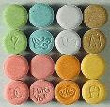
Pharmacology of other psychedelics
Ketamine/PCP
NMDA-antagonist
MDMA
Increased serotonin release and reuptake inhibition
Salvia divinorum / Ibogaine
Kappa-opioid agonist
Deliriants
Anti-cholinergic (scopolamine)
GABA (muscimol)

Slide 9
Psychological effects
Often referred to as “tripping”
Importance of “set” and “setting”
Experience is highly dependent on both the psychological and physical context
Illusions / Hallucinations
True hallucinations not common, both closed and open-eyed visuals
Alterations in mood → ranging from euphoria to panic reactions or “bad trip”
Difficulty with concentration Distorted sense of time and space
Distortions in perception
Depersonalization, derealization
Sense of “losing oneself” → ego loss
Synesthesias
Mystical-type experiences → spiritual awakening?

Slide 10
Biological effects
Dilated pupils
Tachycardia
Nausea
Hypertension
Hyperthermia
Ataxia
Dizziness
Anorexia
Insomnia
Sweating

Slide 11
Classic psychedelics and ketamine may enhance neuroplasticity
Kadriu et al Int J Neuropsychopharm 2021

Slide 12
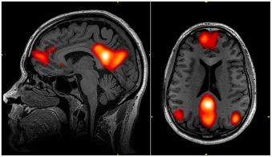
Psychedelics disrupt the default mode network (DMN)
Involved in the experience of “self”, retrieve autobiographical memory, daydreaming, thinking into the future, thinking about others, no explicit tasks or goals
Psychedelics→
Decrease coupling of DMN hubs
Increase connectivity of visual cortex with other cortical regions
Inhibit our “normal” habitual way of thinking and permits other connections to form
Degree of mystical-type experience correlated with the decrease in DMN activity
Carhart-Harris et al PNAS 2012

Slide 13
Carhart-Harris et al 2013

Slide 14
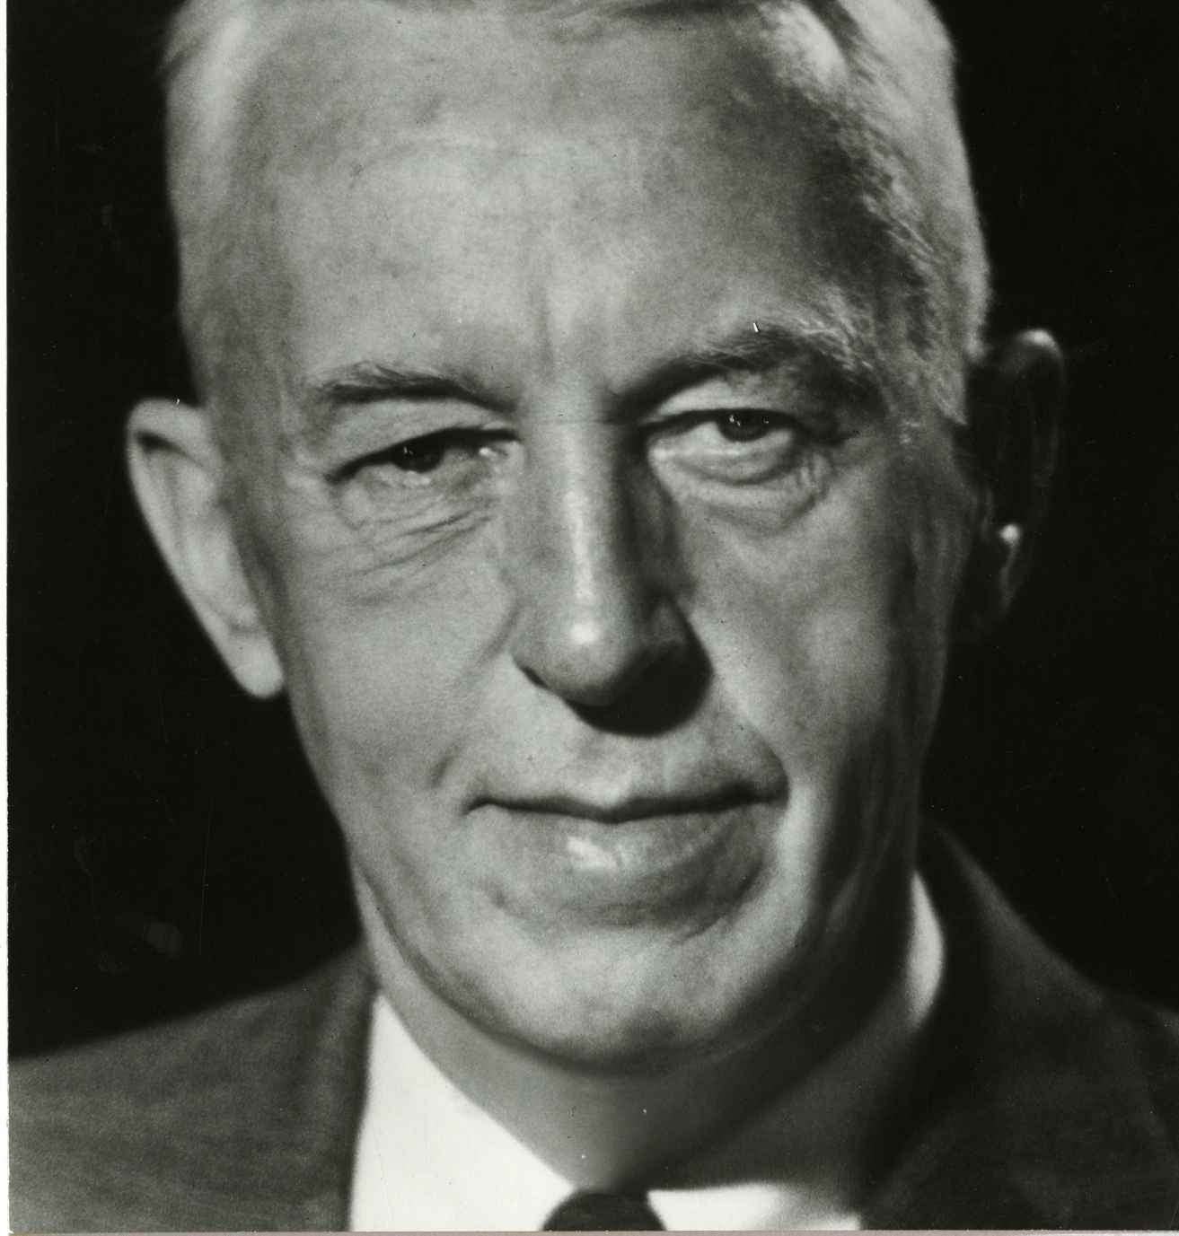
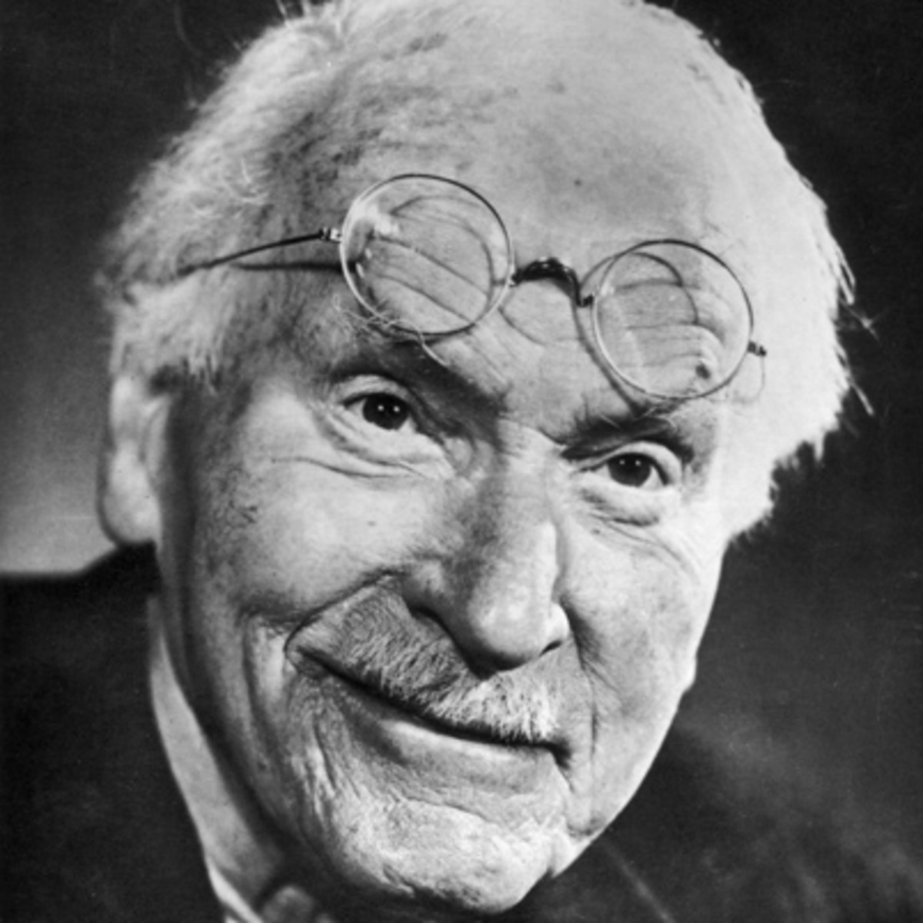
Bill Wilson and his experience with psychedelics
Bill’s letter to Carl Jung on January 23 1961
Certain that you were his …last resort, he … returned to your care. Then followed the conversation…that was to become….the founding of Alcoholics Anonymous.
...When he … asked …if there was any … hope, you told him that there might be, provided he could become the subject of a spiritual or religious experience—…a genuine conversion.
Carl Jung’s response to Bill on January 30 1961
You see, “alcohol” in Latin is spiritus, and you use the same word for the highest religious experience as well as for the most depraving poison. The helpful formula therefore is: spiritus contra spiritum.
Bill’s letter to Carl Jung on March 29 1961
Some of my AA friends and I have taken the material (LSD) frequently and with much benefit, …[sparking] a great broadening and deepening and heightening of consciousness…. My original spontaneous spiritual experience of twenty-five years before was enacted with wonderful splendor and conviction.

Slide 15
Hallucinogen-related disorders in DSM5
Hallucinogen intoxication
PCP/Other Hallucinogen use disorder
Hallucinogen persisting perceptual disorder
Hallucinogen-induced psychotic disorder

Slide 16
Hallucinogen Intoxication
Most common reason for those on psychedelics to come to clinical attention
Typically characterized by self-limited anxiety or fears of “going insane”
Most patients are discharged to home once stable
Rarely severe reactions such as suicide attempt or completion
Reactions typically less than 24hrs, and rarely longer
NBOMe, DOM/DOB, PCP ingestion in particular can cause a prolonged toxidrome, presenting with severe agitation and delirium, and even death
Longer duration require investigation of other etiologies
Leonard et al 2018; Johnson et al 2020; Suzuki et al 2014; Suzuki et al 2015

Slide 17
Hallucinogen intoxication
Treatment of choice for most cases is the “talk through”
Dimmed lights, minimal distractions with sitter (non-intoxicated person)
Reassurance that experience is time-limited and drug induce
Should not be left alone, and avoid restraints if possible
If “talk through” is not sufficient, or if patient is severely agitated, benzodiazepines are treatment of choice, generally NOT antipsychotics but can be used if needed
For NBOMe and other newer potent psychedelics, aggressive sedation, fluid resuscitation, and symptomatic treatment may be needed for several days or more.
Paradoxical effects seen with chlorpromazine but haloperidol may be beneficial
NMS offers a NPS panel 1 and 2 that tests dozens of psychedelics on blood and urine
Tacke and Ebert 2005; Abraham et al 2002; Strassman et al 1984

Slide 18
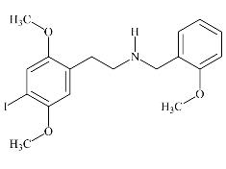
Review of the literature of NBOMe associated toxicity
NBOMes (aka 25I, 25C, 25B) are structural analogs of the 2C family of mescaline-like substances. It was synthesized as a highly specific brain imaging marker for 5-HT2A receptors.
10 citations with analytically confirmed ingestion
20 individual patients
Typical profile:
Young male 18-25
Prior history of using marijuana, LSD, MDMA
Oral ingestion is most common, but some insufflate or inject
Majority thought they were ingesting LSD or something else
Suzuki et al 2016

Slide 19
Hallucinogen use disorder
DSM5 has 2 categories: “PCP and related compounds” vs “Others”
Tolerance builds rapidly to classic psychedelics, therefore report of daily classic psychedelic use is not likely to be accurate (other than “micro-dosing”)
Ketamine or PCP use are the most likely reasons for HUD diagnosis
Classic physiologic dependence syndromes are uncommon with hallucinogens with no clear emergence of withdrawal
Consider HUD when a patient reports regular use of hallucinogens despite knowledge of harm, or when the pattern of use appears to be out of control
Always important to assess for other drug use
No evidence-based treatment options
Johnson 2020; O’Brien 2001

Slide 20
Hallucinogen persisting perceptual disorder (HPPD)
The reexperiencing of one or more of the perceptual symptoms that were experienced while intoxicated with the hallucinogen following cessation of use of a hallucinogen.
Type I
Short, reversible and favorable disease course
Usually starts with “aura” and mild depersonalization/derealization
No significant discomfort associated
Usually not requiring treatment
Type II
Long, slowly reversible or irreversible course
Acute onset, sudden sense of detachment and severe symptoms
Can increase in intensity over time
High recurrence rates
Skryabin et al 2018

Slide 21
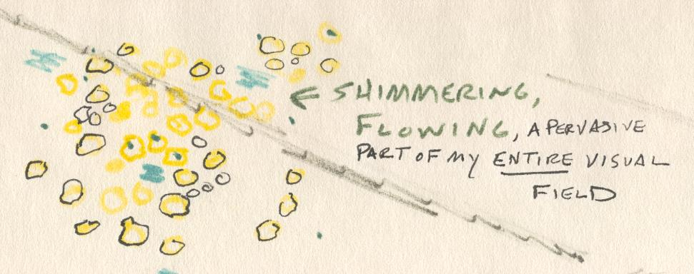
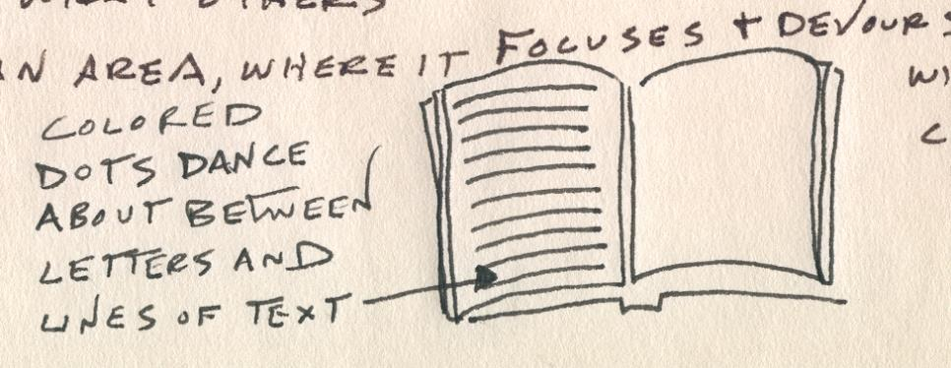
Hallucinogen persisting perceptual disorder (HPPD)
Can be triggered by using other drugs (notably cannabis and stimulants), alcohol withdrawal, anxiety, and extreme physical exertion
More likely to occur in those who have used large quantities of hallucinogens, specifically LSD
Various case reports: Clonidine, benzodiazepines, haloperidol, olanzapine, carbamezapine, gabapentin, psychotherapy, sunglasses
SSRIs, risperidone and phenothiazines (chlorpromazine, fluphenazine, etc) have been reported to worsen symptoms
Halpern and Pope 2003; Skryabin et al 2018; Abraham and Mamen 1996; Abraham 1983, Markel et al 1994

Slide 22
Hallucinogen induced psychotic disorder
Consider when symptoms persist days or weeks after resolution of intoxication.
Alcohol by far the most commonly associated substance, then cannabis and stimulants
Treat as in the case of hallucinogen intoxication, and search for underlying etiologies, but no evidence-based treatments.
Based on a meta-analysis and systematic review, 25% will eventually receive formal psychotic disorder diagnosis, therefore early evaluation by psychiatry strongly recommended
Murrie et al Schizophrenia Bulletin 2020

Slide 23
Therapeutic use of psychedelics for substance use disorders?

Slide 24
LSD for alcohol use disorder
Systematic Review of all RCTs in which LSD was given to those with Alcohol Use Disorder
Six double-blind, placebo-controlled studies (1966-1970)
Total of 536 treatment seekers for alcohol
61% receiving single dose of LSD (median=500mcg)
Control (ephedrine, amphetamine, low dose LSD)
Fairly strict inclusion criteria for the meta-analysis
Numerous methodological issues: attrition, varying drug-sessions, minimal preparation, no integration sessions except in one, only self-report for primary outcome
Krebs and Johansen 2012

Slide 25
LSD for alcohol use disorder
Krebs and Johansen 2012

Slide 26
LSD for opioid use disorder
RCT of 74 parolees with OUD, 37 to LSD, 37 to TAU
Daily urine tests and weekly groups as condition of parole (incarceration if violate)
Single high dose LSD (300-450microg)
Preparatory and follow-up integration sessions
Followed for up to 12-months
Savage and McCabe 1973

Slide 27
Psilocybin for tobacco use disorder
Tobacco
One open label pilot of 15 subjects received 3 sessions of psilocybin (20mg/70kg or 30mg/70kg) with 15-week structured smoking cessation mindfulness training.
Abstinence confirmed weekly with exhaled CO and urinary cotinine.
80% confirmed abstinence
Johnson et al 2014

Slide 28
Psilocybin for alcohol use disorder
Alcohol
One open-label pilot of 10 subjects with at least 2 heavy drinking days in the past 30 days, received 2 sessions of psilocybin (0.4mg/kg) with 12-week structured motivational enhancement therapy
Primary outcomes:
Drinking days
Heavy drinking days (i.e. binge drinking)
Bogenschutz et al 2015

Slide 29
Ketamine for cocaine use disorder
55 cocaine dependent individuals, randomized to ketamine (0.5mg/kg) or midazolam
Both received 5-weeks of mindfulness relapse prevention
HR for dropout: 0.47 95% CI 0.24, 092, p=0.03
Abstinence in last 2 weeks of study:
Ketamine 48.2%
Placebo 10.7%
6-month f/u: 44% vs 0%
Dakwar et al 2019

Slide 30
Ketamine for alcohol use disorder
3 non-controlled studies; 1 RCT
RCT (n=40)
Single 52-min IV ketamine (0.7m/kg) vs midazolam
Everybody received 5-weeks of MET
Outcome: TLFB and ethyl-glucuronide
Results: Ketamine increased likelihood of abstinence and delayed time to relapse during 21-day follow-up
Dakwar et al AJP 2020

Slide 31
Summary of studies so far on psychedelics for SUD
 | SUD | Quality
LSD | Alcohol | Fair: Methodological issues even though RCTs
 | Opioid | Fair: Study of parolees, but daily urines a strength
Psilocybin | Alcohol | Poor: Only open-label (waiting for phase 2 RCT results)
 | Tobacco | Poor: Only open-label (waiting for phase 2 RCT results)
Ketamine | Cocaine | Promising: Multiple RCTs
 | Opioids | Poor: Two RCTs but for drug-free, not as adjunct to MOUD
 | Alcohol | Promising: One RCT, three uncontrolled trials
Ibogaine | Opioid | Poor: Uncontrolled studies only; cardiac arrythmias and death

Slide 32
The role of therapy in treating SUDs with psychedelics
Ketamine for depression follows a pure pharmacologic model of treatment
Psychedelics for SUD have generally been conducted as psychedelic-assisted psychotherapy model, with intentional combinations with therapy
CL psychiatrists or hospital-based mental health clinicians may be called to provide this added layer of treatment?
Psychedelics as pharmacotherapy
Psychedelic-assisted psychotherapy

Slide 33
What does this all mean for CL psychiatrists?
We see the medical consequences of psychedelics far more often than anyone else in medicine (maybe except medical toxicologists?), requiring the inclusion in the differential DSM hallucinogen-related diagnoses
The emerging evidence does indicate ketamine and psilocybin may have promise in the treating SUDs.
What if they could become therapeutic agents we can employ in the CL setting?
Ketamine in the ED/hospital for AUD (and co-morbid depression and/or SI)?
Psilocybin in the hospital for OUD during prolonged hospitalizations for infections?

Slide 34
Patient demand is growing, as is interest in the general population, with the possibility that expectations are outpacing the current data on what outcomes can be confidently foreseen. Psychedelics are neither a cure for mental disorders nor a quick fix for an unfulfilled life and should not be portrayed as a panacea.
Yaden et al 2020

Slide 35
Reasons for seeking medical care
Leonard et al J Psychopharm 2018

