Slide 1
Management of Opioid Use Disorder in the Hospital Setting
S. Alex Sidelnik, MD
Director, Addiction Psychiatry Consultation-Liaison Service
NYU Langone Health, Manhattan Campus
Assistant Professor, NYU Grossman School of Medicine

Slide 2
CLP 2021
Disclosure: S. Alex Sidelnik, MD
With respect to the following presentation, there has been no relevant (direct or indirect) financial relationship between the party listed above (and/or spouse/partner) and any for-profit company which could be considered a conflict of interest.

Slide 3
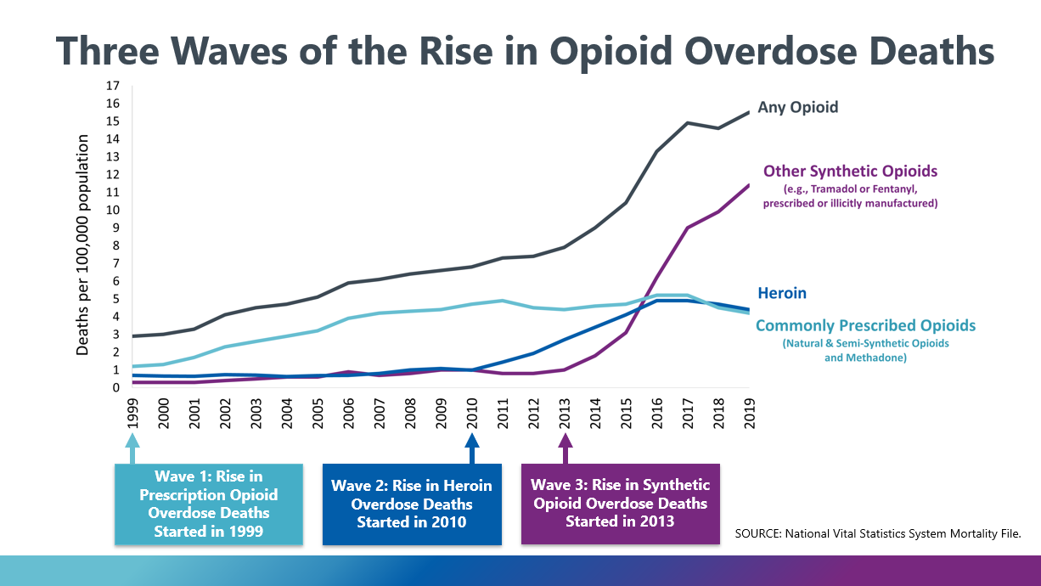
Overdose Crisis

Slide 4
Overdose Crisis
From 1999 to 2019 nearly 841,000 people have died of a drug overdose
Opioid Prescribing Peaked in 2012 yet overdose deaths continue to increase
  High potency synthetic opioids (found in ~70% overdose deaths)
  Access to life-saving, evidence-based treatments
  Racial disparities: more recent increased rate of overdose death in NHB/AA, lower access to evidence-based treatments, limited culturally sensitive care
During COVID19 Pandemic, ~30% increase in overdose deaths
  CDC, MMWR, 2021
  Lippold, et al. MMWR 2019

Slide 5
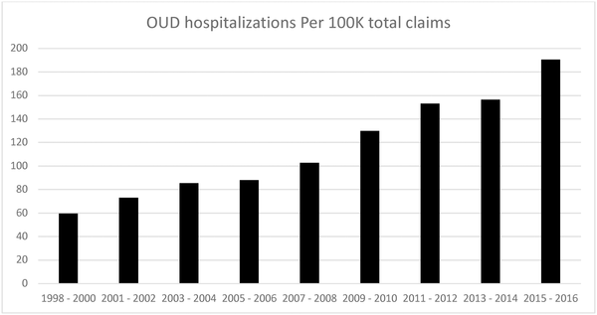
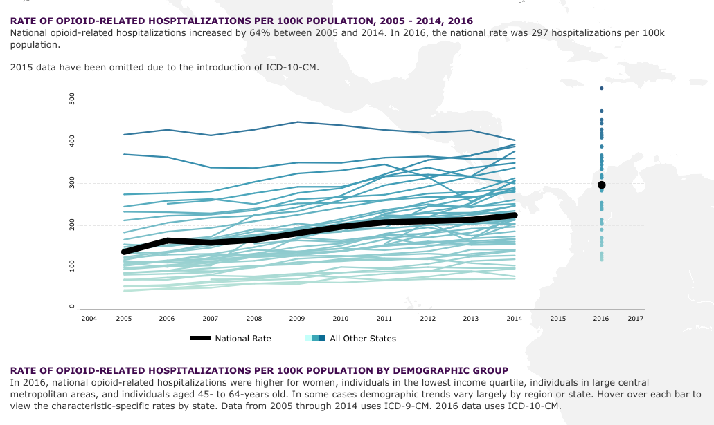
Rates of OUD and OUD-related Hospitalizations Increasing
  Sing et al. 2020 PLOS ONE
  AHRQ, 2019

Slide 6
Treatment of Acute Pain in Patients with OUD

Slide 7
Treatment Challenges in Treating Acute Pain
Patient factors:
  Biologic factors
  Learned behaviors from prior hospitalizations
  Comorbid treatment with medication for opioid use disorder
  Fear that asking for treatment of pain may be viewed as non-medical use
Provider factors
  Fear of inappropriate administration of opioid
  Lack of knowledge in managing pain with opioid use disorder
  Learned behaviors associated with prior experiences

Slide 8
Poor pain control
Tolerance
Withdrawal
Fear of honest disclosure
Hyperalgesia
Slide Courtesy of Suzuki, J, 2019

Slide 9
Null hypothesis = patient is in pain
Null hypothesis = patient is not in pain
Allow the possibility that some patients will receive opioids they shouldn’t have, but ensures all patients receive opioids when they needed it and reduces risk of disengagement in care
Allow some patients to go untreated with opioids (who could have benefited from it), but ensures that no one receives opioids inappropriately
Patients must prove pain truly needs opioids
Clinicians must prove pain does not require opioids before withholding opioids
Unnecessary dosing of opioids is harmful.
Untreated pain is harmful
Slide Courtesy of Suzuki, J, 2019

Slide 11
Treatment of Acute Pain in Patients taking Medications for OUD

Slide 12
Myths
MOUD should provide adequate analgesia
Adding opioids on top of methadone or buprenorphine will lead to an overdose
Patients in MOUD requesting pain medications are always ‘drug seeking’
Even if it’s for acute pain, giving opioids to patients on MOUD is harmful because it will result in a relapse

Slide 13
Methadone and Acute Pain management
Patient taking methadone
Pre- or immediately on admission:
Contact methadone clinic to (i) confirm dosing, and (ii) discuss potential adjustments
Inpatient:
Continue methadone at home dose, OR
Consider methadone dose increase, OR
Consider fractionating methadone while inpatient for better pain control
Always consider adjunct non-opioid +/- short-acting opioids for pain control
Discharge:
Ensure methadone dose consolidated
Ensure last dose verification letter provided to patient/also clinic
Ensure clear instructions for short-acting opioid taper in-place
Wenzel et al., 2016
Harrison et al. 2018.
Courtesy Nisavic M

Slide 14
Naltrexone and Acute Pain management
Patient taking naltrexone
Pre-Admission:
If possible [e.g. elective surgery] consider holding naltrexone prior to admission – 72+h for tablet, ~4 weeks for IM injection
Inpatient:
Hold naltrexone
Consider potential higher opioid dose requirements
In emergency, consider regional anesthesia, systemic non-opioid agents for pain control
Discharge:
Ensure close coordination with prescribing provider
Wenzel et al., 2016
Harrison et al. 2018.
Courtesy Nisavic M

Slide 15
Buprenorphine and Acute Pain Management
Historically recommended discontinuation of BUP during periods of acute pain
  Fears of antagonistic effects with full opioid agonists
  Need for re-induction after period of acute pain
  Risks of relapse if BUP discontinued prior to anticipated acute pain/procedure
MGH Protocol for Perioperative BUP Management
  Continuation of low-dosage BUP through perioperative period
  BUP at dosages <8mg can act synergistically with FOA
  Opioid withdrawal suppressed at dosages <16mg
  After period of acute pain, can restart BUP without tapers or wash-out period
Acampora, Nisavic et al, 2020

Slide 16
Perioperative Buprenorphine Management
  Acampora et al. 2020, J. Clinical Psychiatry

Slide 17
Micro-induction Initiation of Buprenorphine
Initiating buprenorphine in patients with acute pain and/or from fentanyl or methadone can be challenging
Micro-induction of buprenorphine
  Gradual and small dosages of buprenorphine taken concurrently with FOA
  Titration schedules include: Butrans, Belbuca, IV buprenorphine and splitting buprenorphine-naloxone
Hospital-setting, Belbuca:
  Ahmeed et al., 2021, Am J Addict
  Weimer et al. 2020, J Addic Med

Slide 18
Non-opioid Pharmacologic Treatments
Anti-epileptics
  Neuropathic pains, fibromyalgia, migraine prophylaxis
  Gabapentin and anti-epileptics
SNRIs and TCAs
  Neuropathic pain, migraine, fibromyalgia, chronic low back pain
Topical analgesics
  Capsaicin, diclofenac gel, transdermal lidocaine
Acetaminophen, ibuprofen
Newer use of ketamine, IV lidocaine
Opioids: no evidence that treatment of acute pain with opioids worsens long-term course of opioid use disorder. Untreated pain can lead to recurrence of opioid use

Slide 19
Opioid Prescribing in High-Risk Hospitalized Patients
Therapeutic Alliance
  Work collaboratively with patients to openly discuss assess for cravings, withdrawal, inadequate pain relief, and prior lived experience with medical treatment
In patients with active misuse can consider:
  Utilizing methadone and buprenorphine
  Liquid formulations of full-opioid agonists
  Optimize non-opioid analgesics (while addressing withdrawal, cravings)
  Risk-benefit framework to help facilitate medical treatment

Slide 20
Patient-initiated Discharges in Patients Who Inject Drugs
Patients with SUD have 3x risk of leaving AMA (PID)
Increased mortality:
  Associated with 2x increased 30 day mortality, adjusting for disease severity and comorbidities
High readmission risk:
  2-20x increased risk of readmission
Ti et al., 2015 Am J Pub Health.
Southern et al., 2012, Am J Med.
Simon et al., 2019 Subs Abuse

Slide 21
Patient-initiated Discharges in Patients Who Inject Drugs
Four Core Issues:
  Undertreated opioid withdrawal and undertreated opioid use disorder
  Uncontrolled acute and chronic pain
  Stigma and discrimination by hospital staff
  Hospital restrictions
In-hospital methadone and social supports reduce risk of discharge
Simon et al., 2019 Subs Abuse

Slide 22
Harm Reduction for Opioid Use Disorder
Patient-centered approach focused on reducing negative consequences of drug use
Recognizes some people will continue to use despite prevention and treatment
Evidence-based interventions: naloxone, syringe exchange programs, supervised consumption sites, low threshold pharmacotherapy
Reduce infectious complications, reduce overdose, engage vulnerable patients, improve access to tx
Wakeman SE, 2019, Treating Opioid Addiction

Slide 23
OUD in Hospital Setting – General Strategies
Hospital policies can have detrimental impact on PWID during acute medical illness
Strategies:
  Examine role of security services and personal searches
  Examine restrictive hospital policies
  Inclusion of PWID in policy development
  Non-judgmental approach for use of substances in hospital, assess for etiology
  Discharge with naloxone, education around safe injection use and overdose prevention, provision of syringes (if permissible)
  Utilize risk-benefit framework in discussions around interventions needed to facilitate medical treatment
  Support for Addiction Consultation Services
Lennox et al., 2021 Int J Drug Pol

