Slide 1
JACLP Article Types
Joseph Cerimele MD MPH
Deputy Editor, JACLP
Assistant Professor, Department of Psychiatry and Behavioral Sciences
University of Washington School of Medicine

Slide 2
CLP 2021 Disclosure: Joseph Cerimele MD, MPH
With respect to the following presentation, there has been no relevant (direct or indirect) financial relationship between the party listed above (and/or spouse/partner) and any for-profit company which could be considered a conflict of interest.

Slide 3
Objectives
Describe article types in JACLP
Review example articles published in JACLP

Slide 4
Article Types in JACLP
Original Research Report
Reviews
Cases (Brief Case Report, Literature review with case report, C-L Case Conference) – discussed by Dr. Scott Beach later
Letter to the Editor –
Editorial
Special Article

Slide 5
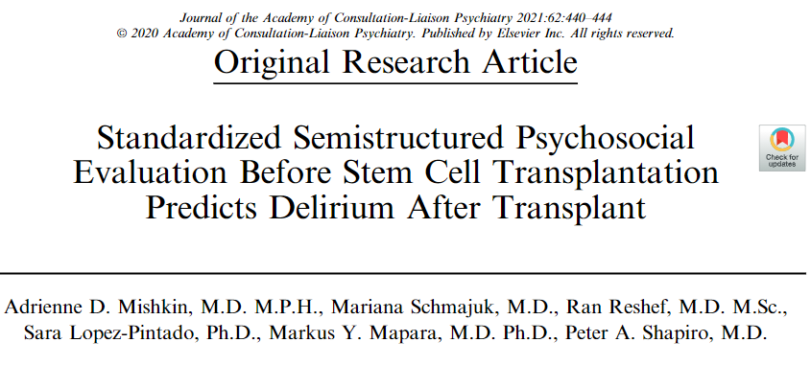
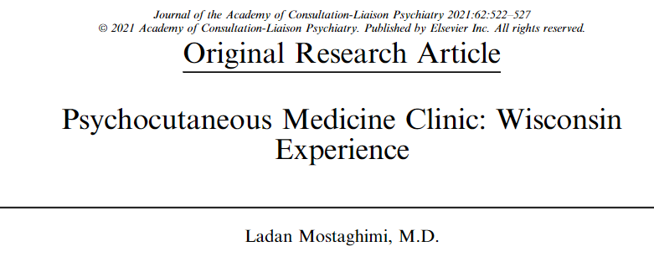
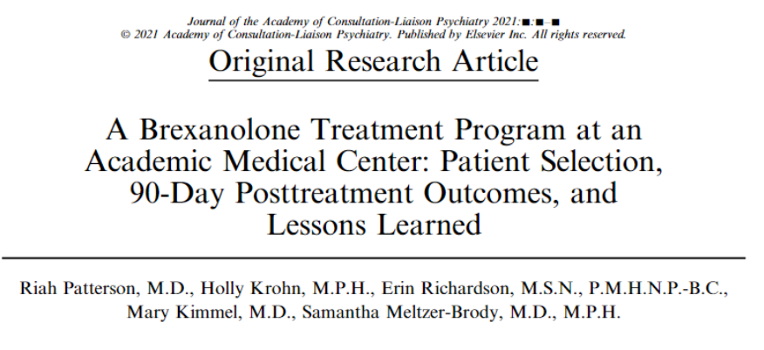
Original Research Report
Original reports – Research, observations
3500 word max,
Also, observational data reports and scholarly evaluations of clinical programs:

Slide 6
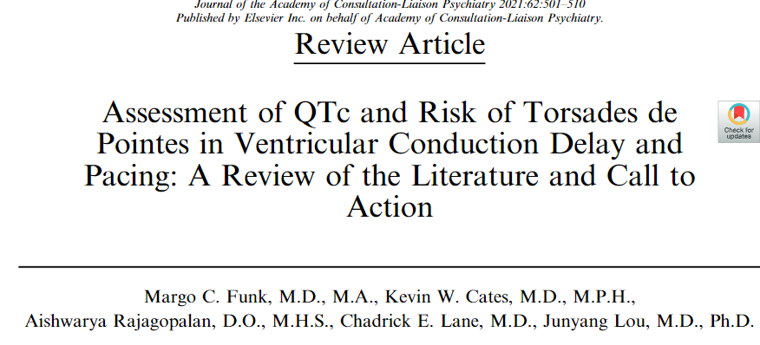
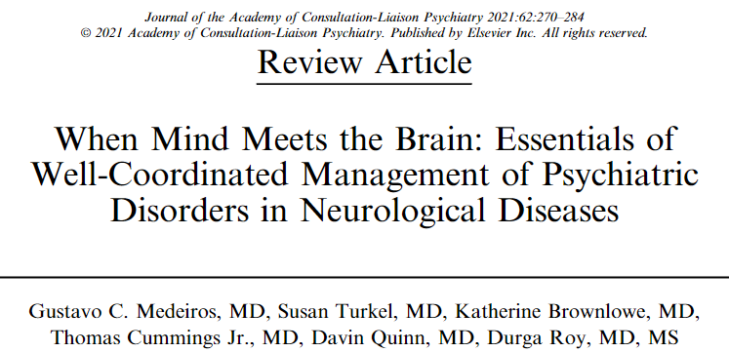
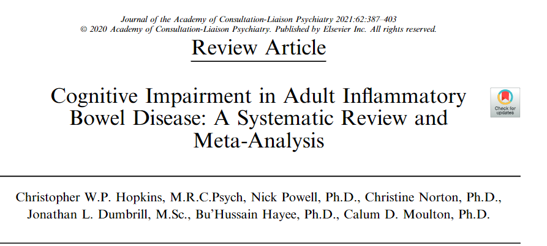
Reviews
Clinically-focused (3000 word max)
Narrative reviews
“We reviewed the current literature on…”
Systematic reviews (priority)
“We performed a systematic multidatabase search…”

Slide 7
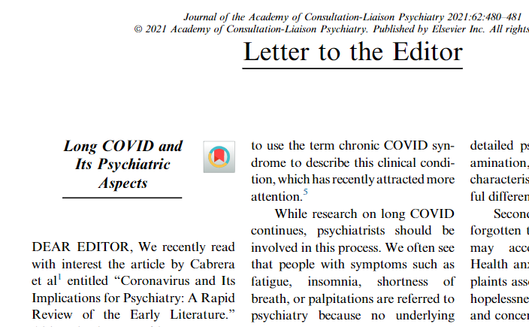
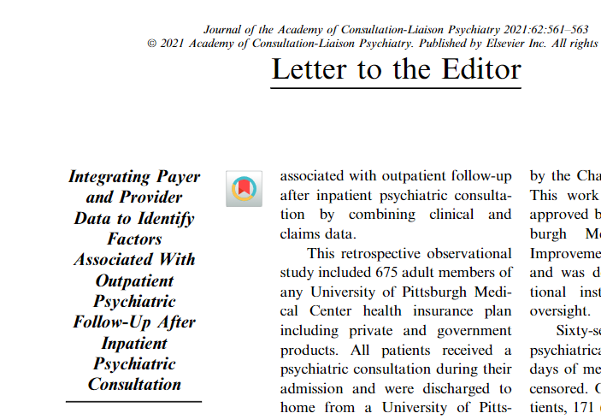
Letter to the Editor
Comment on published articles
750 word max
Research letter
750 word max

Slide 8
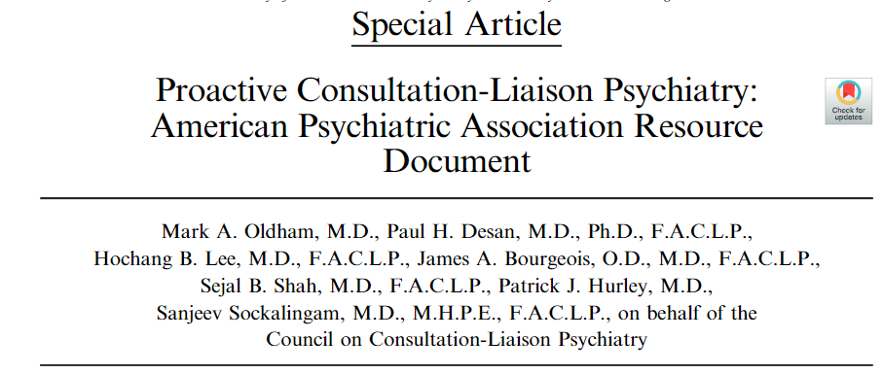
Special Article
Reports from workgroups, commentaries on policy, scholarly discussion of contemporary topics,
“…do not fit into the other article types”
Usually invited

Slide 9
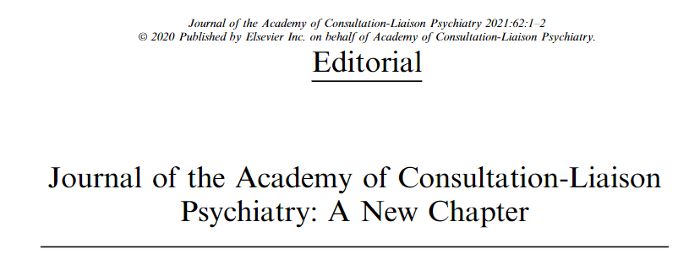
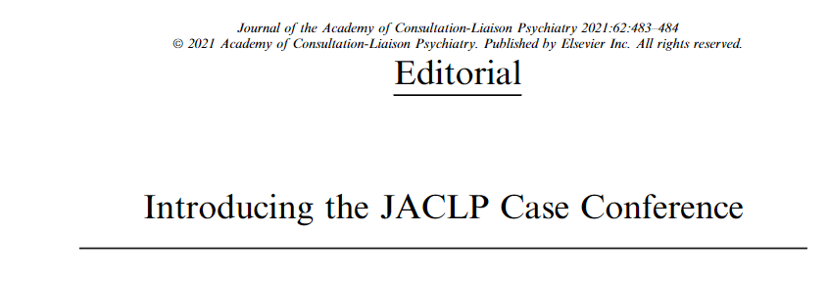
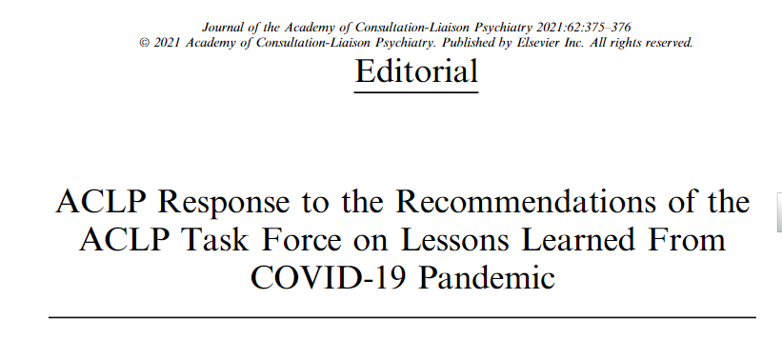
Editorial
Written by editors, or invited
Comment on published articles
Or comment on major occurrences

