Slide 1
“I’ve submitted my manuscript, what happens next?”
Mark Oldham, MD
Assistant Professor of Psychiatry
University of Rochester Medical Center
Deputy Editor, JACLP

Slide 2
Disclosures – Mark Oldham
With respect to the following presentation, there has been no relevant (direct or indirect) financial relationship between the party listed above (and/or spouse/partner) and any for-profit company which could be considered a conflict of interest.

Slide 3
Learning objectives
By the end of this session, attendees will be able to:
Understand the key steps of editorial review
Interpret the basic results of peer review

Slide 4
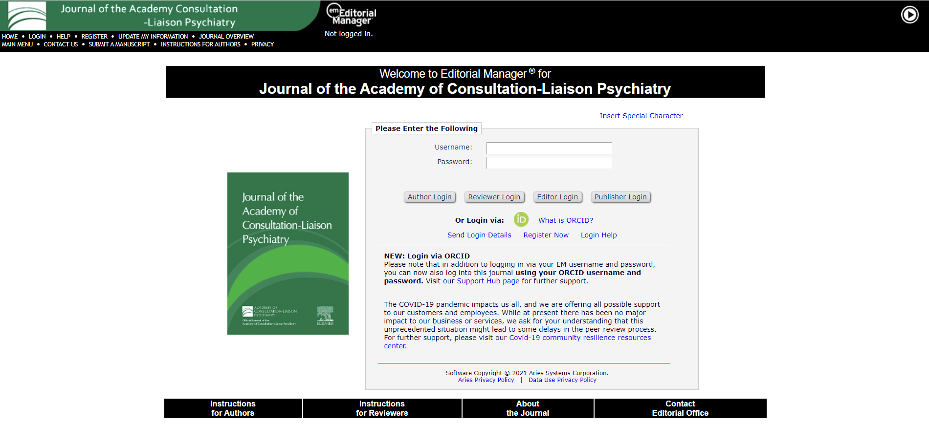

Slide 6
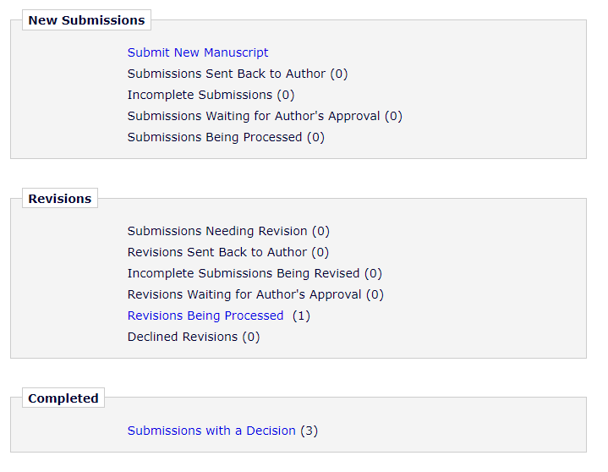

Slide 8
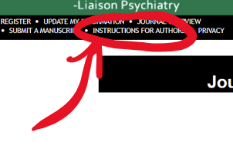
Notes:
David Newcombe, managing editor

Slide 9
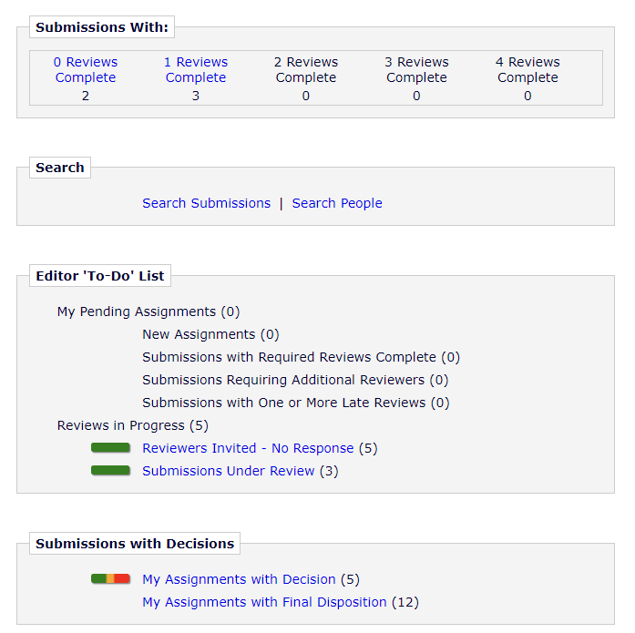

Slide 10
Nested triage process
Editor-in-Chief reviews submissions
Reject without review (“desk triage”)
Assigns to Deputy or Section Editor
Reject without review (“desk triage”)
Submit decision back to EIC
Editor-in-Chief makes final decision
Manage as the handling editor
Manage as the handling editor

Slide 11
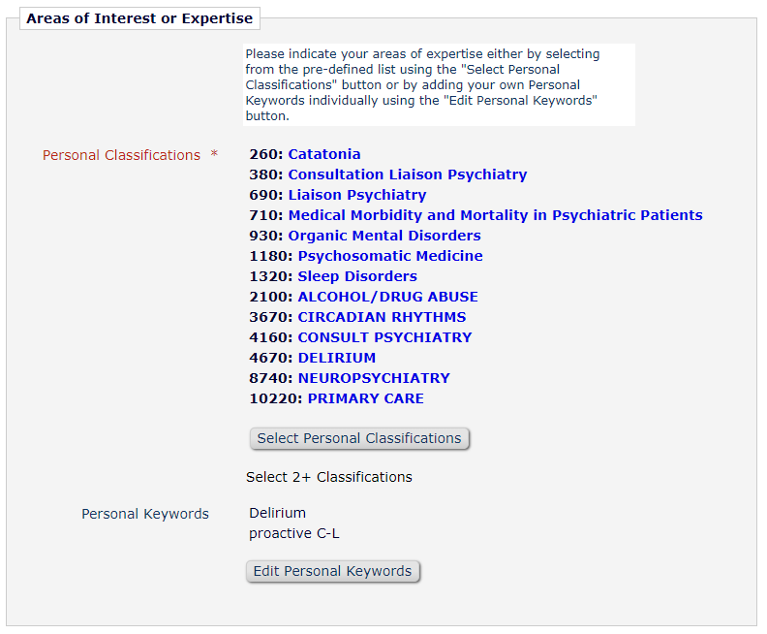
Handling editor
Selects reviewers for the paper and submits a preliminary decision
Editorial Board members have priority
Appreciate quality reviewer suggestions
Should have topical interest/expertise
Please don’t suggest all residents
Avoid others from your institution
Remember that reviews are confidential
If you want to serve as a reviewer, update your profile in Editorial Manager

Slide 12
Possible decisions
Accept
“I am pleased to inform you that your manuscript has been accepted for publication.”
Minor/major revision
“The reviewers recommend reconsideration…following minor/major revision”
“We cannot accept your manuscript in its current form…” is code for “revise and resubmit”
Reject
“I regret to inform you that we have decided not to accept your manuscript.”

Slide 13
Tips on responding to reviewers
Reviewer comments should not be seen as personal attacks.
Write not so you can be understood but so that you cannot be misunderstood.
Respond to each comment one. by. one.
Be direct, gracious, and succinct.
…but not obsequious.
Where you disagree, justify your decision agreeably.
Explain where changes were made.
Expect to upload a “tracked changes” version & “clean” version.
In general, if you can respond effectively to reviewer comments, there’s a very good chance your paper will be accepted.

Slide 14
After acceptance
Expect to complete authorship forms shortly after acceptance
Option for open access (ACLP members get a 20% discount)
Accepted proofs posted online first, typically within a few weeks of acceptance
You will have an opportunity to review the proof before the published version is posted, generally with a handful of author queries
REVIEW YOUR PROOF CAREFULLY!
You will receive a ‘share link’ for your article from Elsevier once online

Slide 15
“I’ve submitted my manuscript, what happens next?”
Mark Oldham, MD
Assistant Professor of Psychiatry
University of Rochester Medical Center
Deputy Editor, JACLP

