Slide 1
Navigating Forks in the Road: Divergent Career Paths of Women Leaders in C-L Psychiatry

Slide 2
Disclosure ACLP Annual Meeting 2021: Madeleine Becker, MD, Sejal Shah, MD, Linda Worley, MD, Cornelia Cremens, MD
With respect to the following presentation, there has been no relevant (direct or With respect to the following presentation, there has been no relevant (direct or indirect) financial relationship between the party listed above (and/or spouse/partner) and any for-profit company which could be considered a conflict of interest.
financial relationship between the party listed above (and/or spouse/partner) and any for-profit company which could be considered a conflict of interest.

Slide 3
Agenda:
Women in medicine. Mentorship and how to use it to navigate career paths. Madeleine A. Becker, MD, MA, FACLP
Navigating Early Career Leadership and Utilizing the CL Lens
Sejal B. Shah, MD, FACLP
Midcareer Challenges and Opportunities
Leena P. Mittal, MD, FACLP
Achieving a Life / Career You’re Delighted With
Linda LM. Worley, MD, FACLP
Sustaining a Career in Academic CL Psychiatry
M. Cornelia Cremens, MD, MPH, FACLP
Notes:
Here is the outline of the program. I am joined today by my esteemed colleagues, Dr. Sejal Shah, Dr. Leena Mittal, Dr. Linda Worley and Dr. Cornelia Cremens.
We hope that by the end of this talk you feel inspired and empowered from our sharing of our own experiences and lessons to help navigate steps along the way of your own career path.

Slide 4
Women in Medicine. Mentorship and how to use it to navigate career paths. Madeleine Becker MD, MA, FACLP Professor, Dept. of Psychiatry and Human Behavior Dept. of Integrative Medicine and Nutritional Sciences Director, Graduate Medical Education Assoc. Director, Integrative Medicine Fellowship Thomas Jefferson University Hospital, Philadelphia PA

Slide 5
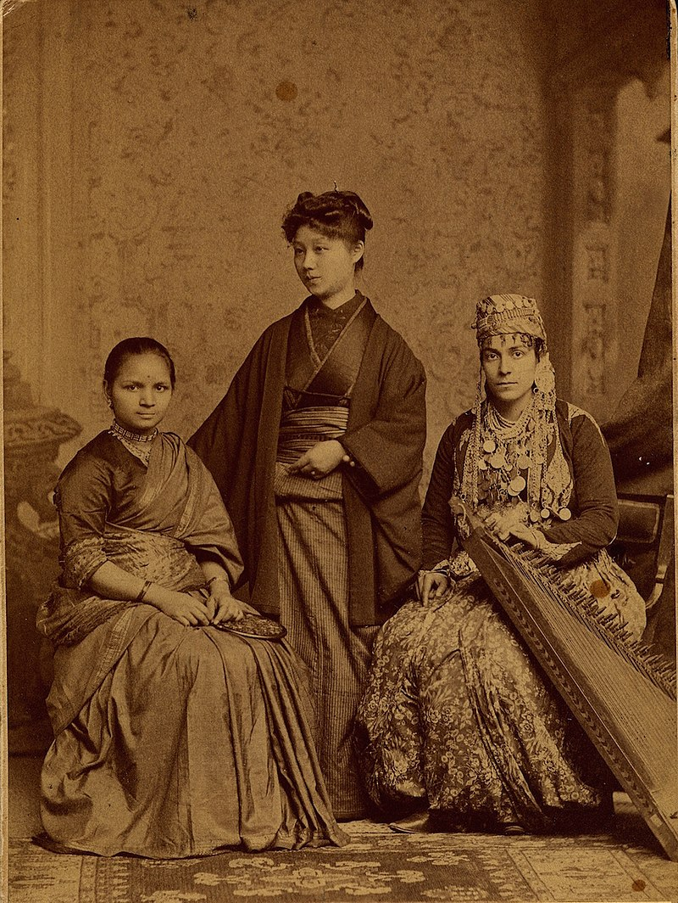
Women in Medicine
1st Medical School in the US: The University of Pennsylvania, est 1765
Elizabeth Blackwell, 1st woman to receive MD, Geneva Medical College in 1849
New England Female Medical College, est 1848
American Medical Association, established in 1847
1st woman member in 1876
1st woman board member in 1989
Jefferson Medical College est 1847 last medical school
to deny women admission 1961.
Notes:
First, I want to start with a little history of women in medicine. Because women have always had to run hard in this field.
Elizabeth Blackwell was the first women to receive a medical degree from an American medical school.
She graduated from Geneva Medical College in 1849, this was 84 years after the University of Pennsylvania School of Medicine, the first medical school in the United States, was established in 1765
The University of Pennsylvania, admitted only male students to its medical school, as was the case for most American medical schools in all of the 18th, and most of the 19th, century.
. After reading more about Dr. Blackwell, I learned that she was admitted as an experiment, and the school subsequently did not take any women after.
But In 1848, nearly 85 years after UPEnn was established, the New England Female Medical College was founded and became the first institution to train women in medicine.
The AMA, or American Medical Association, which was established in 1847 - did not accept its first woman member until 1876 and did not have its first woman board member until 1989
My own alma mater, Jefferson Medical College, was founded in 1824 and only started accepting women in 1961. Notably, it was the last medical school to deny women entry.
this year would mark the only 60th anniversary of this event.
----------------------------------------------------------------------------------------------------------------------------------------------------------------------
The photo in the corner shows 3 women that completed their medical studies at the womens college of PA, and each of them was the first woman from their respective countries to obtain a degree in Western medicine. (from India, Japan, Syria)
Geneva medical College, is in Geneva, NY, part of the former Geneva College, which is currently known as Hobart and William Smith College, now the medical school has been transferred to Syracuse University
1850, 85 years after the founding of Penn's medical school, the Women's Medical College of Pennsylvania was founded .

Slide 6
2018-2019 The State of Women in Academic Medicine: Exploring Pathways to Equity
Only for the past 20 years have women and men been graduating from medical school at the same rate.
Women physicians are still paid less
Specialty choices contribute to this disparity
Disproportion of women in leadership positions also contributes
(But women are paid less than their male counterparts for the same work).
Leadership in academic medicine does not reflect the gender representation in medical schools.
Women greatly underrepresented in senior academic rank, leadership positions
https://www.aamc.org/data-reports
Notes:
It has only been for the past 20yrs that women and men have been applying, entering and graduating from medical school at about the same rate.
Women however, are still not considered equal to their male counterparts, at least that is not what the data is showing from the AAMC.
Women are still paid significantly less than male physicians. Why this continued discrepancy? Well, the specialty choices made by women contribute, at least to some degree
Another reason for this disparity is the relative disproportion of women in leadership positions, which command higher salaries.
But this aside, women continue to be paid less than their male counterparts for the same work, receiving 20% to 30% smaller salaries than do male physicians.
So, Leadership and salary in academic medicine does not reflect the gender representation in medical schools. Women are still underpaid, and greatly underrepresented in senior academic rank, and leadership positions. So, part of why we are doing this presentation today, is to bring some ACLP women physicians together and talk about their own trajectories and what has helped to guide them through their own successful career paths.
----------------------------------------------------------
Assoc of Amer Medical Colleges. AACMC. https://www.aamc.org/data-reports/data/2018-2019-state-women-academic-medicine-exploring-pathways-equity

Slide 7
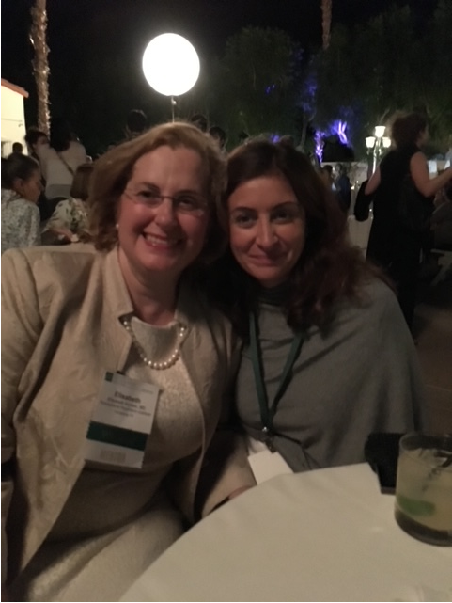
My own divergent path:
Graduate school, Masters in Psychology at NYU, Started PhD in Clinical Health Psychology at Yeshiva University Albert Einstein School of Medicine
University of Pennsylvania for Post-Bac
Jefferson Medical College (married after my 2nd year)
University of Pennsylvania for Residency (had kids; one during internship)
Accepted job at Jefferson as Associate Director of the Psychiatry Consult Service and to create fellowship in Psychosomatic Medicine (had another kid)

Slide 8
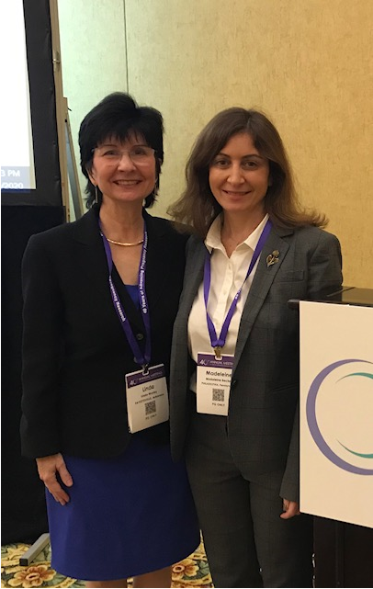
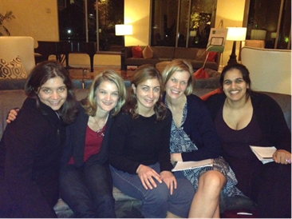
Opportunities opened and interests develop through mentorship
ACLP meetings, APA opportunities
AAMC women's leadership conference
Service on local and national committees
Continued work experience led to leadership opportunities
Development of my interests and expertise in areas of education and women's health
Expanded my personal interests leading to new
opportunities and experiences.

Slide 9
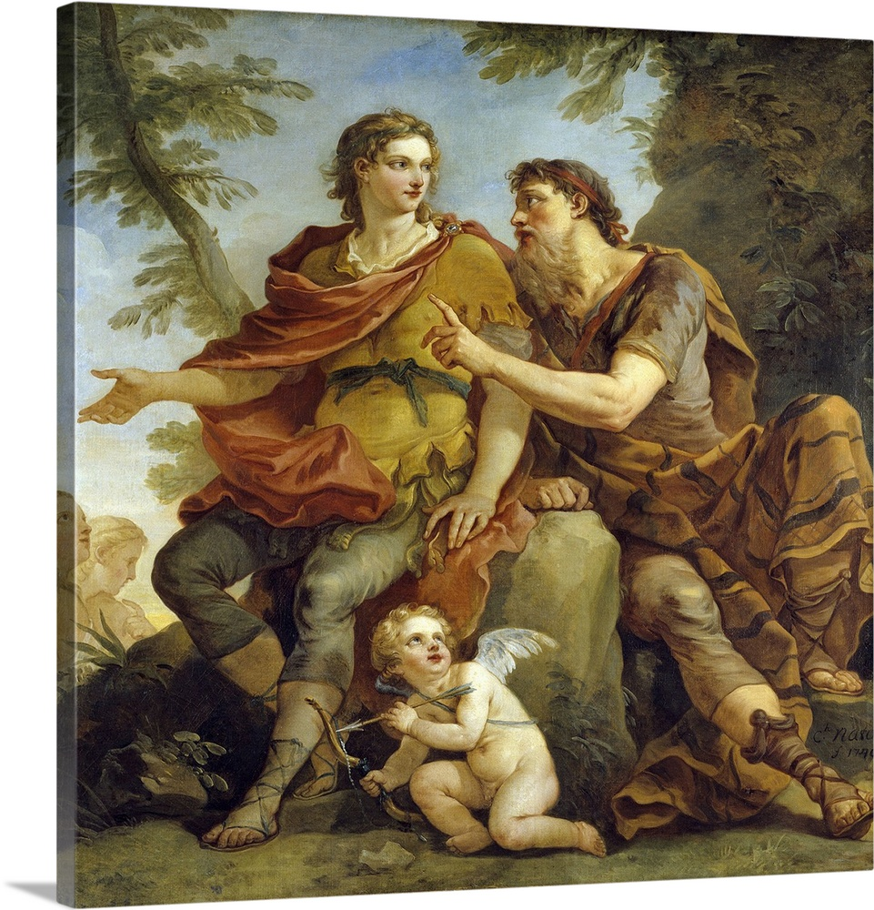
Mentor Greek Literature “trusted counselor or guide”
Networking - building relationships
Scholarly work, publications, presentations, building a scholarly foundation
Life and career support:
Finding solutions to common problems: balancing roles, trade offs and flexibility, professional development
Career advice: finding a path to a ideal position, negotiating the right job (salary, benefits).
Shared common experiences
Friendships

Slide 10
Mentors: empower others with your generosity
Can be formal or informal
Schedule and protect the time
Be open to what each individual brings to you
Agree upon goals
Be generous with your wisdom
Be generous with your work, find opportunities for mentees to collaborate
Support your colleagues in the workplace; this helps define the work environment; Women empower other women.

Slide 11
Mentees: opportunity to navigate career
Use time allotted constructively
Mutually agree on goals
Inquire about opportunities
Find something valuable to take from each mentor
Self reflect - what was really helpful in past mentoring experiences
Pay forward and mentor others

Slide 12
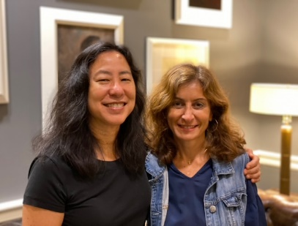
Mentoring for success and leadership in medicine
Mentorship for women in medicine can be utilized at all times through an academic career from medical school to senior faculty
Peer mentoring and having female role models are important aspects of a career in medicine
Gender concordance between mentor and mentee does not impact satisfaction of mentorship experience
Women face different work-related stresses (sexual harassment, verbal abuse, underestimation of skills, having children and work-life balancing issues)
Mentoring is paying back to others, the gift that mentors have given you in your career.

Slide 13
References:
DeAngelis CD. Women's contribution to the health of the American population. Milbank Q. 2015 Mar;93(1):28-31. doi: 10.1111/1468-0009.12102. PMID: 25752347; PMCID: PMC4364428.
Farkas AH, Bonifacino E, Turner R, Tilstra SA, Corbelli JA. Mentorship of Women in Academic Medicine: a Systematic Review. J Gen Intern Med. 2019 Jul;34(7):1322-1329. doi: 10.1007/s11606-019-04955-2.PMID: 31037545
Pope JE. Mentoring women in medicine: a personal perspective. Lancet. 2018 Feb 10;391(10120):520-521. doi: 10.1016/S0140-6736(18)30243-5.PMID: 29617225
Ford J. Mentoring Women Psychiatry Residents: Implications for Academic Leaders and Educators. Acad Psychiatry. 2016 Jun;40(3):448-50. doi: 10.1007/s40596-014-0237-1. Epub 2014 Nov 11. PMID: 25384511.
Abramson EL, Naifeh MM, Stevenson MD, Li ST. Scholarly Collaboration, Mentorship, and Friendship: A New Model for Success in Academic Medicine. Acad Pediatr. 2019 Nov-Dec;19(8):860-864. doi: 10.1016/j.acap.2019.07.010. Epub 2019 Aug 2.PMID: 31382043
Weavind L, McGrane TJ. Women Mentoring Women in Academic Medicine: Pathways to Success. Int Anesthesiol Clin. Summer 2018;56(3):110-120

