Slide 1
How to Make Research Findings Impact
Clinical Practice and Policy
Nancy Byatt, DO, MS, MBA, FACLP
Executive Director, Lifeline for Families Center and Lifeline for Moms Program
Professor of Psychiatry, Ob/Gyn, PQHS at UMass Chan Medical School
Medical Director, MCPAP for Moms

Slide 2
Disclosure: Nancy Byatt, DO, MS, MBA
With respect to the following presentation, there has been no relevant (direct or indirect) financial relationship between the party listed above (and/or spouse/partner) and any for-profit company which could be considered a conflict of interest.

Slide 3
The scientific method can provide a vehicle for change
Exploration/Hypothesis Generation
Independent
Replication &
Validation
Data Sharing
Meta Analysis
Hypothesis
Formulation
(Clinical Equipoise)
Study Design
Study Conclusions
Publications
Data Sharing
Pilot Study
Study Execution
(Fidelity)
Slide adapted from Helena Chmura Kraemer, Ph.D., Stanford University (Emerita)

Slide 4
Exploration/Hypothesis Generation
Independent
Replication &
Validation
Data Sharing
Meta Analysis
Hypothesis
Formulation
(Clinical Equipoise)
Study Design
Study Conclusions
Publications
Data Sharing
Pilot Study
Study Execution
(Fidelity)
Slide adapted from Helena Chmura Kraemer, Ph.D., Stanford University (Emerita)

Slide 5
Our clinical work can facilitate exploration and hypothesis generation

Slide 6
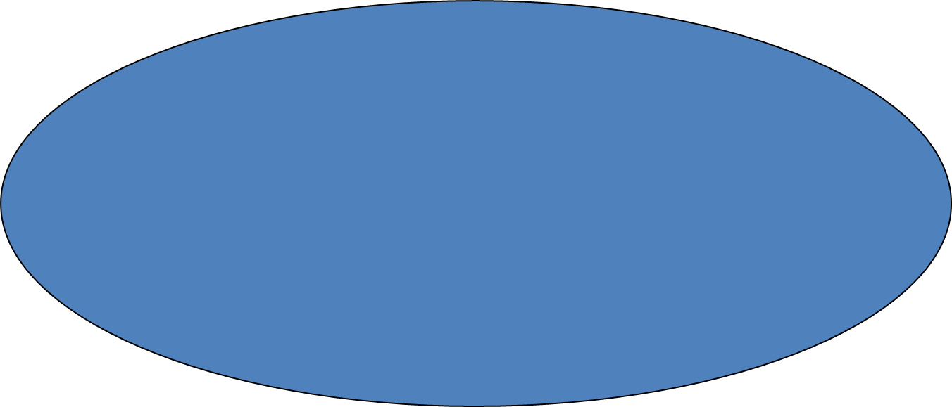
Qualitative studies are a critical step in hypothesis generation
Barriers to Treatment
Patient | Provider | Systems
Lack of detection | Lack of training | Lack of integrated care
Fear/stigma | Discomfort | Screening not routine
Limited access | Few resources | Isolated providers
Women do not
disclose symptoms
or seek care
Unprepared providers,
With limited resources
Underutilization
of Treatment
Poor Outcomes
www.chroniccare.org
Notes:
In our pilot work, we found that barriers occurring at the patient, provider, and systems-level prevent perinatal women and obstetric providers from addressing depression. While the majority of obstetric providers want to address depression,^{17,18} fear of liability, discomfort, and lack of knowledge/resources present barriers. These barriers are magnified by stigma, fear, and discomfort among mothers.¹⁹ There is a critical need to develop and test new approaches that can be broadly disseminated in low resource real-world settings.²⁰
Barriers exist on multiple levels:
Individual-level barriers
Provider-level barriers
Systems-level barriers
Policy-level barriers
Never underestimate the concerns of a woman about:
Concerns of being judged as a mother
Stigma – Shame & Guilt – The BIG THREE
“this is supposed to be the happiest time in my life”
Shame of being perceived by others as a failure or “bad mother”
Concerns about losing parental rights
Provider level barriers:
Insufficient training
Lack of experience in mental health assessment
Lack of time for assessment and referral
Limited mental health resources
Little system-wide support
System level barriers:
Limited training among mental health providers
Limited mental health resources
OB and mental health care not integrated
Lack of collaboration with mental health providers
Policies
Policy barriers:
Insurance coverage for services
Universal recommendations and policies
Leadership
Legislation
Cost of pilot testing, research and implementation

Slide 7
Exploration/Hypothesis Generation
Independent
Replication &
Validation
Data Sharing
Meta Analysis
Hypothesis
Formulation
(Clinical Equipoise)
Study Design
Study Conclusions
Publications
Data Sharing
Pilot Study
Study Execution
(Fidelity)
Slide adapted from Helena Chmura Kraemer, Ph.D., Stanford University (Emerita)

Slide 8
I hypothesized that a population-based approach to building provider capacity would improve outcomes
Resources and Referrals
Education
Consultation
z
Byatt et al. (2016). General Hospital Psychiatry.
Notes:
So practically speaking, what is this MCPAP for Moms program of which I speak?
Through the MCPAP for Moms programs, the MCPAP for Moms team proactively reaches out across the state to enroll perinatal care practices.
Enrollment is free for the practices and all providers.
With enrollment comes access to all aspects of the program which predominantly includes 3 components.
First, we will come to your office, your grand rounds, your society conference, what have you and do trainings.
Secondly, there is pubic access to our website and on-line resources which include a comprehensive tool kit including algorithms for screening, treatment engagement, and medication management.
And finally, the part that I think is most exciting is that enrolled practices get access to care coordination and real time perinatal psychiatric expert guidance through a live toll-free line.

Slide 9
Exploration/Hypothesis Generation
Independent
Replication &
Validation
Data Sharing
Meta Analysis
Hypothesis
Formulation
(Clinical Equipoise)
Study Design
(intervention development)
Study Conclusions
Publications
Data Sharing
Pilot Study
Study Execution
(Fidelity)
Slide adapted from Helena Chmura Kraemer, Ph.D., Stanford University (Emerita)

Slide 10
Multi-level engagement and feedback from
end-users is critical
Legislature
MCPAP teams
MA DPH/DMH
Obstetric partners
Beta testing & end-user feedback
Prior research
System-level partners
Individuals with lived experience
Notes:
--discuss how no evidence for it
--No RCTs

Slide 11
The relationship between science and policy is complex
Science
Implementation before evidence
Policy
Urgent need to increase treatment
Women cannot access care
No RCTs
Evidence based treatments exist

Slide 12
Exploration/Hypothesis Generation
Independent
Replication &
Validation
Data Sharing
Meta Analysis
Hypothesis
Formulation
(Clinical Equipoise)
Study Design
Study Conclusions
Publications
Data Sharing
Pilot Study
Study Execution
(Fidelity)
Slide adapted from Helena Chmura Kraemer, Ph.D., Stanford University (Emerita)

Slide 13
We revised our hypothesis to PRISM and MCPAP for Moms would differentially improve perinatal depression
Vs.
Byatt et al. (2017). Journal of Psychosomatics Obstetrics and Gynecology; Moore Simas et al. (2019). BMC Preg & Childbirth.
Notes:
We will start by discussing how common perinatal depression is and its negative impacts on outcomes for mom and baby. We will also talk about barriers to care and how they can be overcome.

Slide 14
The scientific method can provide a vehicle for change
Exploration/Hypothesis Generation
Independent
Replication &
Validation
Data Sharing
Meta Analysis
Hypothesis
Formulation
(Clinical Equipoise)
Study Design
Study Conclusions
Publications
Data Sharing
Pilot Study
Study Execution
(Fidelity)
Slide adapted from Helena Chmura Kraemer, Ph.D., Stanford University (Emerita)

Slide 15
In our pilot study, depression scores improved over time in both PRISM and MCPAP for Moms
Byatt et al. (2017). Journal of Psychosomatics Obstetrics and Gynecology.

Slide 16
Exploration/Hypothesis Generation
Independent
Replication &
Validation
Data Sharing
Meta Analysis
Hypothesis
Formulation
(Clinical Equipoise)
Study Design
Study Conclusions
Publications
Data Sharing
Pilot Study
Study Execution
(Fidelity)
Slide adapted from Helena Chmura Kraemer, Ph.D., Stanford University (Emerita)

Slide 17
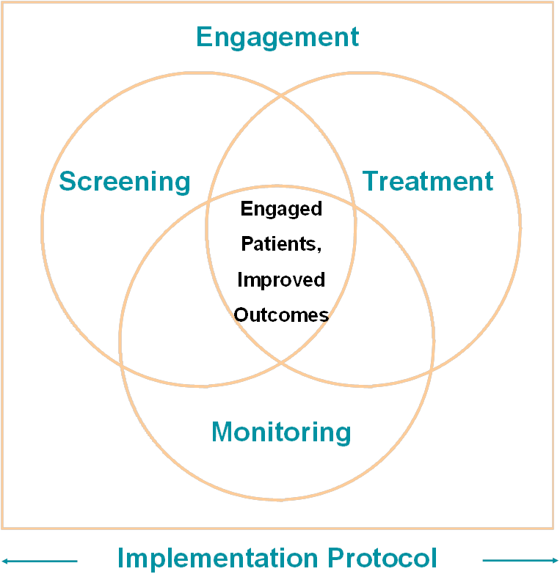
We refined PRISM to help practices more proactively integrate depression into obstetric care

Slide 18
We are comparing the effectiveness of PRISM vs. MCPAP for Moms to improve depression and treatment rates
Cluster RCT in progress
Recruited target N (312)
Following women until 1 year postpartum
Examining fidelity to PRISM
Vs.
Notes:
Aim 2A (Phase 2) To compare the effectiveness of RAPPID vs. enhanced usual care to improve depression severity and treatment participation in pregnancy through 12 months postpartum (primary outcomes) among 300 patients (n=150 per group) via a cluster RCT. Hypothesis 1: Perinatal patients receiving care from clinics enrolled in RAPPID will experience more improvement in depression symptoms than patients receiving care from the enhanced usual care clinics (2 point difference-of-difference in Edinburgh Postnatal Depression Scale). Hypothesis 2: Depressed perinatal patients receiving care from clinics enrolled in RAPPID will have improved treatment participation (as measured by treatment initiation and sustainment) as compared with patients receiving care from enhanced usual care clinics.
Aim 2B: To examine provider/staff fidelity to RAPPID (secondary outcome).
Aim 2C: To estimate costs of RAPPID and enhanced usual care and indicators of potential savings

Slide 19
Exploration/Hypothesis Generation
Independent
Replication &
Validation
Data Sharing
Meta Analysis
Hypothesis
Formulation
(Clinical Equipoise)
Study Design
Study Conclusions
Publications
Data Sharing
Pilot Study
Study Execution
(Fidelity)
Slide adapted from Helena Chmura Kraemer, Ph.D., Stanford University (Emerita)

Slide 20
With CDC-funding and in collaboration with ACOG, we revised PRISM to be broader and scalable

Slide 21
19 Access Programs now cover > 1.7 M (45%) US births
Active
Aspiring
https://www.umassmed.edu/lifeline4moms/Access-Programs/network-members-us/
Notes:
Membership is 18 active Perinatal Psychiatry Access Programs at various stages of development across the U.S.
All 7 HRSA-funded MDRBD programs
Opportunity for BH IMPACT to learn from other developing programs

Slide 22
Relationships matter

Slide 23
Infusing practicality into the scientific method is critical
Exploration/Hypothesis Generation
Independent
Replication &
Validation
Data Sharing
Meta Analysis
Hypothesis
Formulation
(Clinical Equipoise)
Study Design
Study Conclusions
Publications
Data Sharing
Pilot Study
Study Execution
(Fidelity)
Slide adapted from Helena Chmura Kraemer, Ph.D., Stanford University (Emerita)

Slide 24
In summary, the relationship between science, clinical practice, and policy can create synergy

Slide 25
Thank you!
Jean Ko, PhD
Cheryl Robbins, PhD
CDC Maternal Mortality Team
Participating Women and Obstetric Practices
ACOG
CDC Foundation 999
CDC 1U01 DP006093
NIMH 1R41 MH113381-01
NIMH 2R42 MH113381-02
ACOG 6 NU380T000287-02-01
PCORI IHS-2019C2-17367
Perigee Fund
MCPAP for Moms team
Lifeline4Moms team
Tiffany Moore Simas, MD, MPH, MEd
Jeroan Allison, MD, MS
Sharina Person, PhD
Melissa Maslin, MA
Dane Netherton, PhD
Padma Sankaran, MA
Linda Brenckle, PMP
Grace Masters, MPH
Aaron Bergman, PhD
Josephine Boateng
Carolyn Friedhoff

Slide 26
Please contact me with questions
www.mcpapformoms.org
www.lifeline4moms.org
Nancy Byatt, DO, MS, MBA, FACLP
Nancy.Byatt@umassmemorial.org
Thank you!

Slide 27
QUESTIONS?
Nancy.Byatt@umassmemorial.org
Thank you!

