Slide 1
Disclosing a Diagnosis of Factitious Disorder to Family Members
Shamik Mukherji, MD
Consultation Liason Psychiatry
Long Island Jewish Medical Center
Monter Cancer Center
Northwell Health

Slide 2
Disclosures:
None

Slide 3
Learning Objectives
What is the ethical framework for disclosure of FD diagnosis to family members?
When might it beneficial or harmful to involve family members during the “therapeutic confrontation” of factitious disorder?
How does the psychiatrist disclose suspicion of FD to family members tactfully?

Slide 4
Case Presentation
Consult Question: Rule out Factitious Disorder / Malingering
Placed on 1:1
HPI: 25 yo F, PPH of PTSD, PMH of pheochromocytoma s/p resection in 2018, now with relapse, getting active chemo+radiation, asthma, hypothyroidism, endometriosis, celiac disease, nocturnal seizures. Pt admitted for r/o sepsis from own fever measurement at home.
Pt had been experiencing nausea at home due to self-described radiation esophagitis. She is a pediatric PA and started an IV on herself at home for hydration. Also placed and NG tube at home, had been feeding herself tube feeds. Condition worsened, brought herself to hospital.
Notes:
Relapse into malignancy
Pediatric tube feeds
Pediatric NGT

Slide 5
Case - Arousing suspicion
Patient labile, evasive, and demanding with medical team
Oddly circuitous in her explanation of even simple symptoms
Every time simple answers are sought, patient response with increasingly elaborate narrative
Demanding pain medications for throat pain, complaining that pain is interfering with ability to speak yet yelling
Inconsistencies in narrative arise
CT chest imaging is unremarkable, Barium swallow normal, patient refuses EGD saying she “already had one done”
Primary team concerned

Slide 6
Case - Confirming suspicion
Primary team and pain service called MSKCC, Hillman center and other various institutions to gather treatment history
None of the institutions patient mentioned had ever treated patient
Called PMD - did not know about cancer diagnosis
Patient likely did not receive chemo or radiation, no records of this

Slide 7
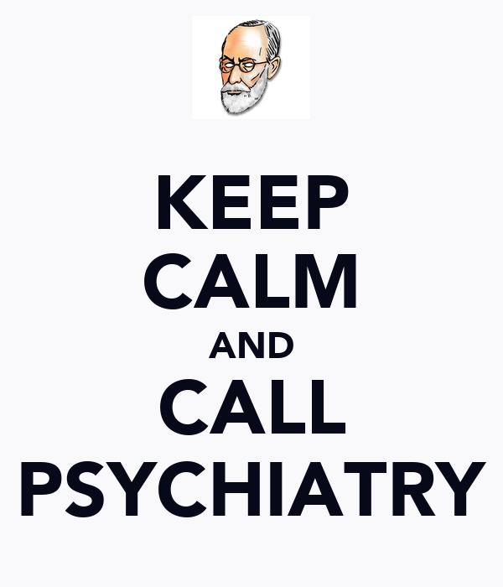
Notes:
Psych called, 1:1 placed

Slide 8
On Psych Exam:
Patient evasive about all questions
Heavy use of medical jargon
Denies all psychiatric symptoms currently
Acknowledged past sexual trauma from trusted pastor
Patient repeatedly calls boyfriend, uncle, and friend (who is an MD) so as to get support in telling hospital team that her condition is “real”
Pseudologia Fantastica
Notes:
Patient evasive about all questions
Classic Pseudologia Fantastica - made ever increase elaborate stories about simple questions
Heavy use of medical jargon
Denies all psychiatric symptoms currently
Acknowledged past sexual trauma from trusted pastor
Patient repeatedly calls boyfriend, uncle, and friend (who is an MD) so as to get support in telling hospital team that her condition is “real”
Patient confronted by psychiatrist and medical team about suspicions

Slide 9
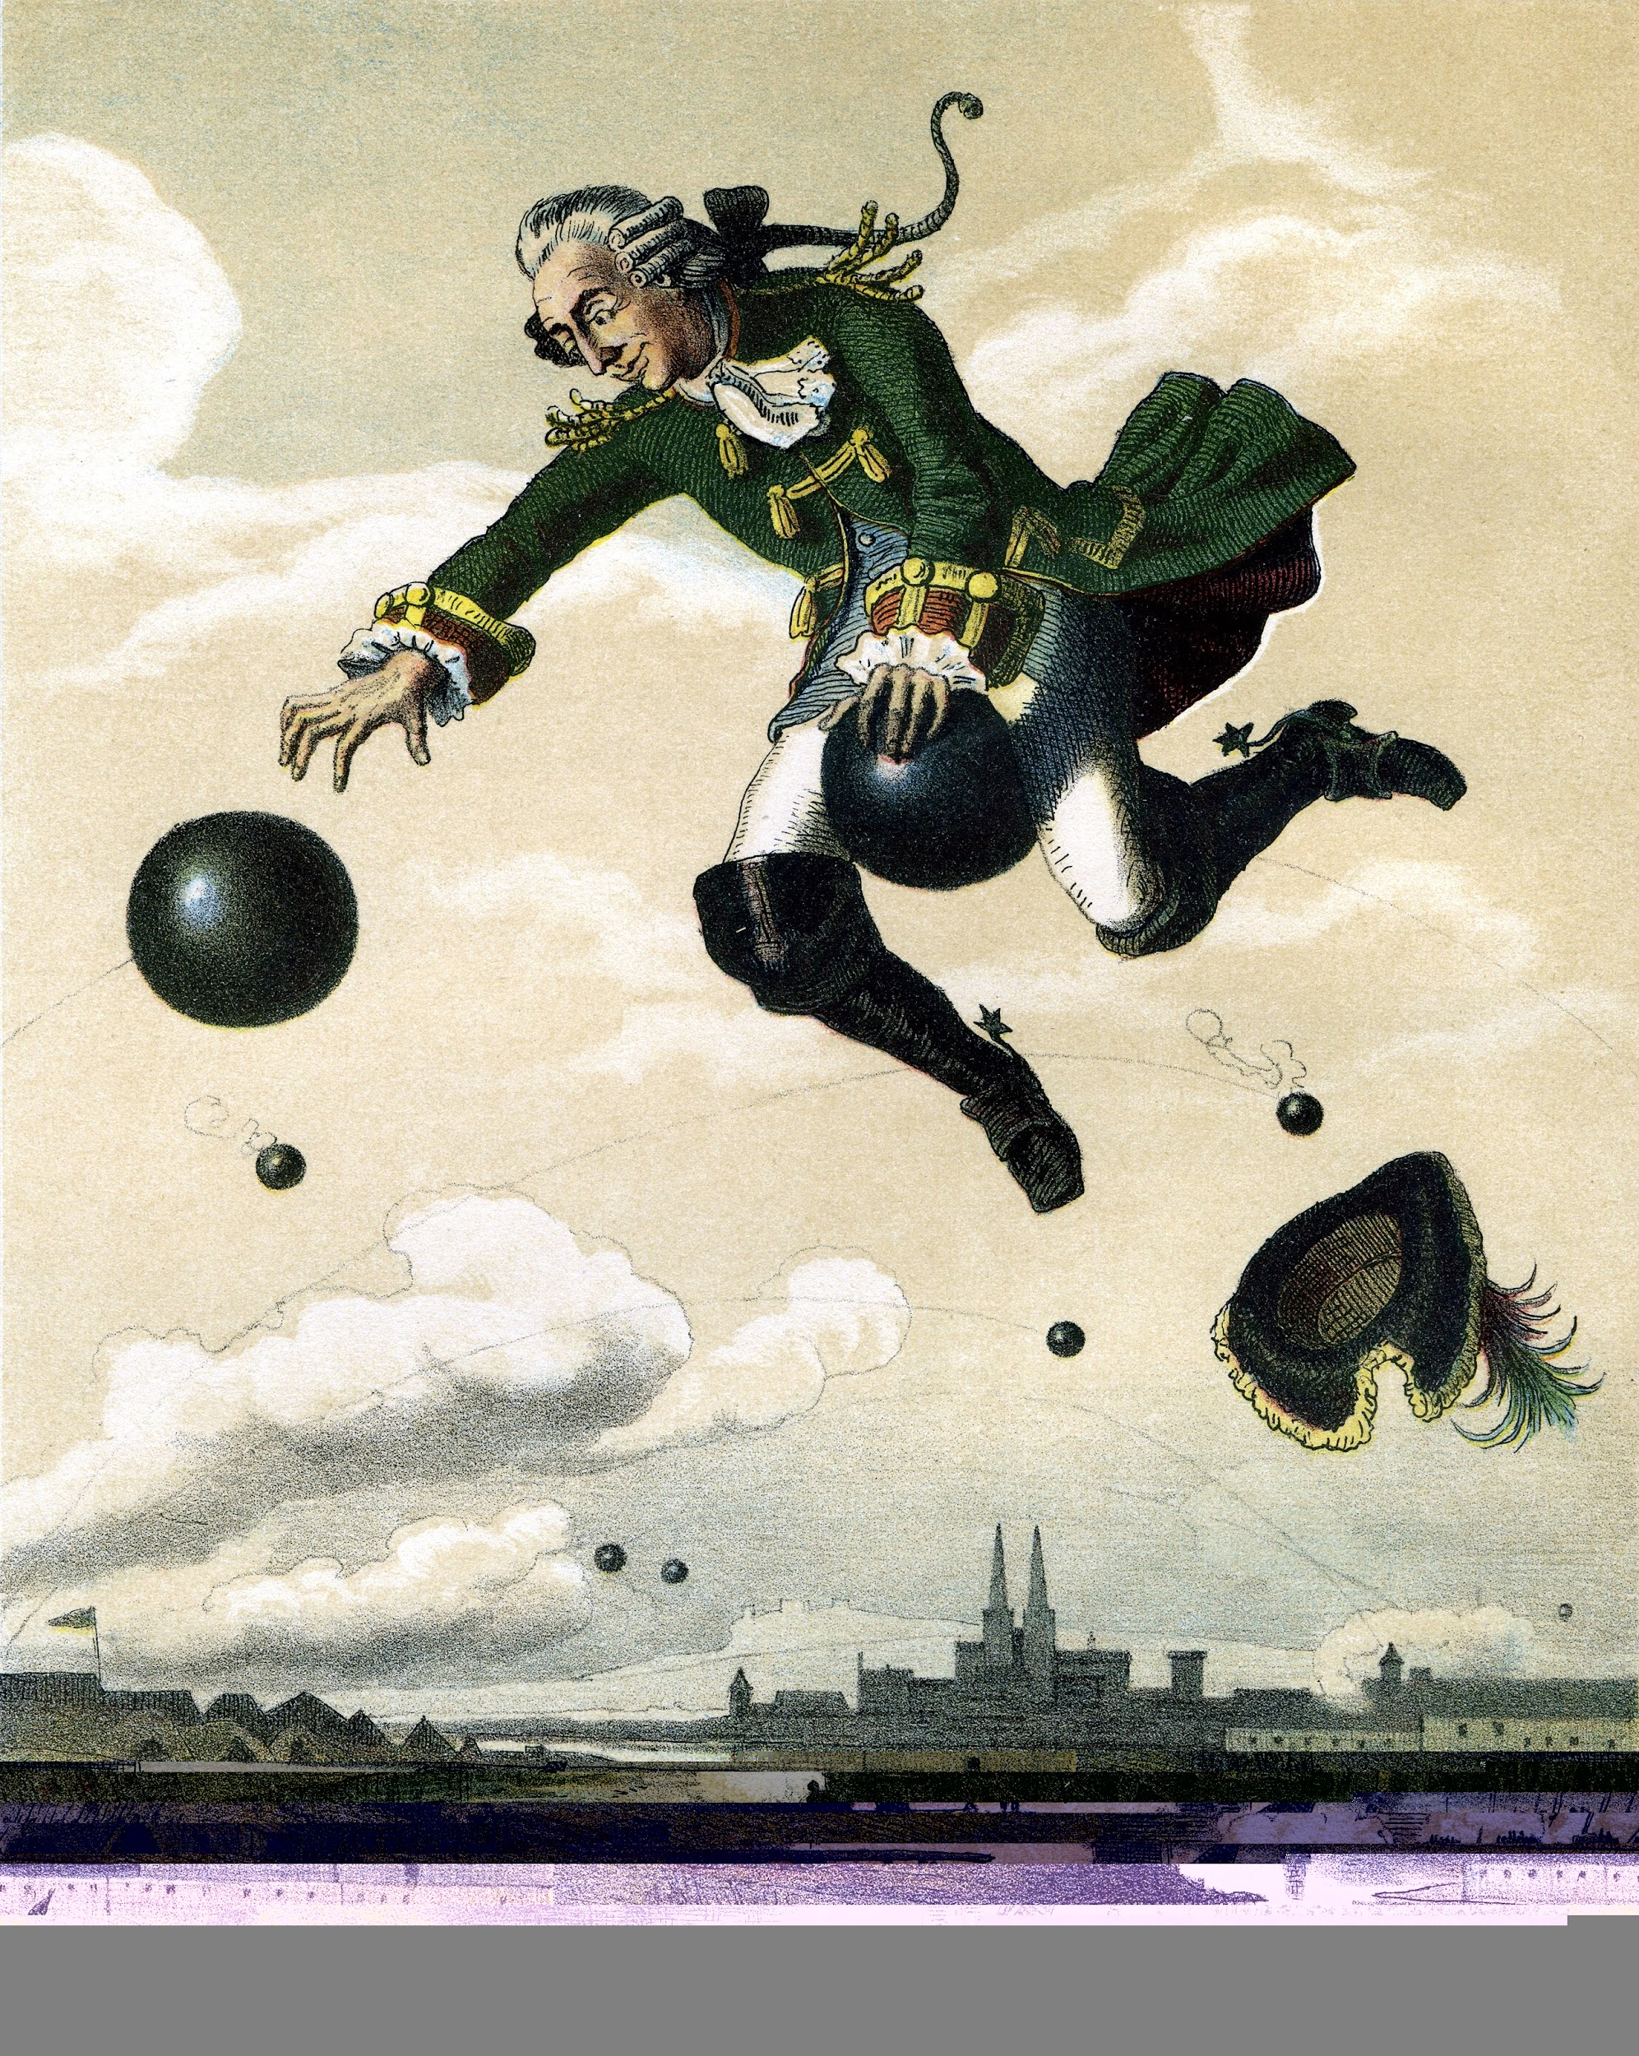
Notes:
Patient had pseudologia fantastica much like the great baron von munchausen himself -
And thus we and medical team confronted the patient about suspicions

Slide 10
Diagnosing: Arousing Suspicion
Treatment in many hospitals/clinics
Lots of medical treatment
Inconsistent information, lies, manipulations
Resists physicians corresponding with each other
Many tests, many procedures, no answers
Symptoms out of proportion to medical/objective pathology
Atypical disease course
Noncompliance, disruption of care at odd moments
Eager for invasive treatment moreso than conservative measures
Opposes psychiatric assessment
Bass C, Halligan P. Factitious disorders and malingering: challenges for clinical assessment and management. Lancet. 2014 Apr 19;383(9926): Review.
Notes:
Bass C, Halligan P. Factitious disorders and malingering: challenges for clinical assessment and management. Lancet. 2014 Apr 19;383(9926): Review.
The manner in which we diagnosed her fell into the classic pattern of FD, we noted that she had
Treatment in many hospitals/clinics
Lots of meds/interventions, “fascinoma”,
Inconsistent information
Resists physicians corresponding to each other
Many tests, many procedures, no answers
Symptoms out of proportion to medical/objective pathology
Atypical disease course (does not follow natural history of disease or respond to appropriate measures)
Noncompliance, disruption of care at odd moments (like right before discharge)
Eager for invasive treatment moreso than conservative measures
Opposes psych though wants everything else done

Slide 11
Supportive / Therapeutic Confrontation
Tell patient your suspicions without accusations
Support suspicion with facts
Allow patient to “save face”
Avoid probing for underlying feelings/motivations
Assure patient of confidentiality, but also those that need to know must know
Encourage but do not force psychiatric help
Ensure that staff demonstrate empathy
Avoid having medical team abandon patient
We involved family in discussion
Feldman MD. Playing Sick. :218–227. || Savino AC, Fordtran JS. Factitious disease: clinical lessons from case studies at Baylor University Medical Center. Proc (Bayl Univ Med Cent). 2006 Jul;19(3):195-208.
Notes:
Similarly used classic model for therapeutic confrontation
Let the patient know what you suspect but without outright accusation.
• Support the suspicion with facts.
• Provide empathetic and face-saving comments such as “Maybe you took it in your sleep,” “What you did was a cry for help, and we understand,” “We realize you must be in great distress,” and “We want to continue to take care of you.”
• Avoid probing to uncover the patient's underlying feelings and motivations so as to minimize disruption of emotional defenses that are essential to her function.
• Assure the patient that only those who need to know will be informed of the suspicion of factitious disease.
• Make sure the staff demonstrate continued acceptance of the patient as a person worthy of their help. The attending physician should not abandon the patient but should continue to show interest and concern.
• Encourage psychiatric help, but if the patient resists, do not force the issue.

Slide 12
Confrontation (continued)
To Confront or Not to Confront? (Eastwood et al., 2008)
No consensus, case by case basis
No difference on GIS with/without confrontation (n=32)
If family can be involved, then confrontation may be of particular benefit.
Eastwood S, Bisson JI. Management of factitious disorders: a systematic review. Psychother Psychosom. 2008;77(4):209-18. Review.
Notes:
Limited consensus on whether or not confrontation is necessary or even beneficial to a patient in prior studies. We would contend, however, that if family can be involved, then confrontation may be of particular benefit.
Eastwood S, Bisson JI. Management of factitious disorders: a systematic review. Psychother Psychosom. 2008;77(4):209-18. doi: 10.1159/000126072. Epub 2008 Apr 16. Review.
n=32, systematic review, 53% confronted, 44% not (one not reported), no difference in global improvement scores between groups
Mostly non-punitive (83%), 2 accusative (angry approach), 1 of them was on locked psych unit pt was “repeatedly and vigorously confronted” in a psych ward where she was “unable to escape”.
Of participants who followed up, longer duration of treatment = better GIS (nonsig), no differnce between types of therapeutics due to heterogeneity (CBT, psychoanalytic PT, open access to hospital bed for 1y, OT, antidepressant)

Slide 13
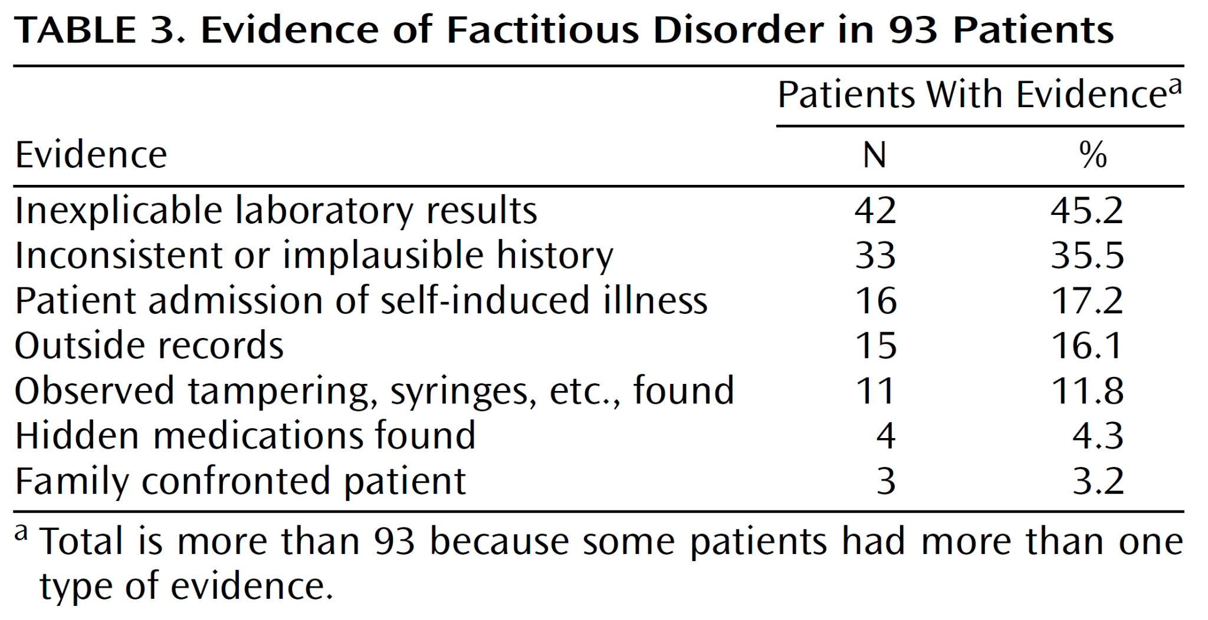
Krahn LE, Li H, O'Connor MK. Patients who strive to be ill: factitious disorder with physical symptoms. Am J Psychiatry. 2003 Jun;160(6):1163-8. doi: 10.1176/appi.ajp.160.6.1163. PMID: 12777276.
Notes:
Family confrontation least likely to be involved in diagnosing FD, though we felt that this should not be the case for such a vulnerable patient. Rare enough that the newer and larger Yates systematic review does not mention family involvement.

Slide 14
General Principles of Management
Early Psychiatric consultation
Risk assessment
Management of countertransference with team
Establishing one point person
Setting limits
Management of comorbidities
Interface into future psychiatric and regular medical follow up
Reduction in iatrogenic harm
Huffman JC, Stern TA. The diagnosis and treatment of Munchausen's syndrome. Gen Hosp Psychiatry. 2003 Sep-Oct;25(5):358-63.
Notes:
J.C. Huffman, T.A. Stern / General Hospital Psychiatry 25 (2003) 358–363
Mgmt of countertransferrence - may also include advocating for tests that ARE indicated, diagnosis does NOT exclude “any” real medical pathology
Consistant communication, reducing splitting, agree on plan
Team had previously been on “the chase” with a fascinating case, now will feel angry and betrayed
Get team interested in “discovering” the wrongdoing (new chase)
Avoid having team treat pt poorly
Establishing point person, allows focus on building rapport, avoids splitting/confusion/ diagnostic entropy
Team should only perform procedures based on ‘objective’ data, use treatments only when objective data indicates its use
May have to use 1:1 observation
Setting limits - be consistant firm but compassionate, team is devoted to best care possible, showing pt data to refute claims (effusions getting worse? CXR shows otherwise so no thoracocentesis)
Management of comorbidities
Regular visits (problems with abandonment, object constancy (mahler)

Slide 15
What is our ethical responsibility?
Talcott Parsons Model - Duty of patient:
Be motivated to get well
Seek competent care
Trust the doctor
Doctor Patient Relationship may be severed in FD because patients:
Seek to be more ill
Seek unwitting care providers
Deceive the doctor
Kass FC. Identification of persons with Munchausen's syndrome: ethical problems. Gen Hosp Psychiatry. 1985 Jul;7(3):195-200. doi: 10.1016/0163-8343(85)90066-0. PMID: 4018573.
Notes:
This does beg the question, however, of what is our responsibility to the patient when the patient is not fulfilling their responsibility?
Talcott Parsons “Functionalist” Model - Duty of patient:
Be motivated to get well
Seek competent care
Trust the doctor
Doctor Patient Relationship may be severed in FD because patients:
Seek to be more ill
Seek unwitting care providers
Deceive the doctor

Slide 16
Ethical Benefits of Disclosure
Doctor - Patient relationship is “special”
Patient benefit of disclosure vs. patient confidentiality
Beneficence vs. Autonomy
Largely may not be feasible / legal to contact other hospitals
Should contact patient’s own providers such as PMD
If we cannot prophylactically tell other hospitals, how do we prevent further harm to the patient?
Kass Ethical
Notes:
But the doctor patient relationship is “special” and may supersed other competing constructions including that of being the “decieved” and thus agrieved
The benefits of disclosure of the patient’s factitious disorder is clear - to prevent further iatrogenic harm, this however is at direct odds the maintenance of a patient’s confidentiality, as a patient with FD is incentivized to limit cooperation between treating parties so as to be able to continue to deceive them all.
Current legal framework values patient autonomy and privacy, however one shold note that HIPAA laws are not specifically meant to constrain doctors from conferring with each other.
How are we accomplishing that important “general principle of management”

Slide 17
Benefits of Family Involvement
Continuity - outside 3rd party can surveil patient’s symptoms and inform medical providers
Prevention of reinforcement of factitious claims
Help to garner support for patient
Prevents future harm from iatrogenic means

Slide 18
Drawbacks of Family Involvement
FD patients have history of trauma 1
Family may be perpetrators of this trauma
Family might be enabling or “in on it”
Limited evidence about family involvement tactics 2
Yates GP, Feldman MD. Factitious disorder: a systematic review of 455 cases in the professional literature. Gen Hosp Psychiatry. 2016 Jul-Aug;41:20-8.
Savino AC, Fordtran JS. Factitious disease: clinical lessons from case studies at Baylor University Medical Center. Proc (Bayl Univ Med Cent). 2006 Jul;19(3):195-208. doi: 10.1080/08998280.2006.11928162. PMID: 17252033; PMCID: PMC1484524.
Notes:
FD patients have history of trauma
Family may be perpetrators of this trauma
Family might be enabling or “in on it”, may be invested in the perception of having a sick family member
Limited evidence about family involvement tactics
Only one case series found that mentioned this at all, in which the confrontation was done with a woman’s and her husband simultaneously

Slide 19
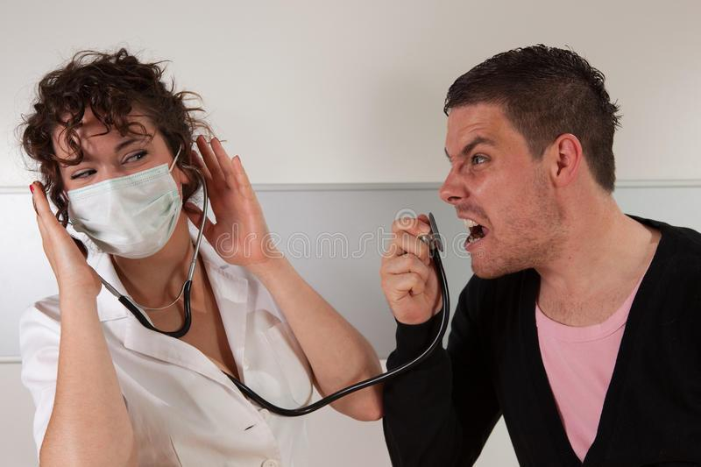

Slide 20
Verbal Tactics to allow for disclosure
Avoid getting pulled into unnecessary conflict
Acknowledge that patient is suffering
Find a point to agree upon
Put the mirror to the patient via the Talcott Parsons model of “role as the patient” :
IF patient is interested in improving, THEN he/she should engage family supports
IF patient is interested in getting competent care, THEN he/she should be amenable to MD’s speaking with one another which is the “standard of care”
IF patient is seeking medical care then presumably he/she trusts medical providers, THEN it is only fair that be open and transparent about our suspicions
Notes:
Talcott Parsons “Functionalist” Model - Duty of patient:
Be motivated to get well
Seek competent care
Trust the doctor

