Slide 1
QTc Prolongation and Psychiatric Medications: An In-Depth Guide for the CL Psychiatrist
Scott Beach, MD, FACLP
Christopher Celano, MD, FACLP
Margo Funk, MD, MA, FACLP
Notes:
In the past 10-15 years there has been increasing attention paid to the relationship between psychotropic medications and QTc prolongation, however it’s been confusing to know what is safe, what isn’t.
We’ve seen shifts back and forth between worrying about it too much vs. not enough.

Slide 2
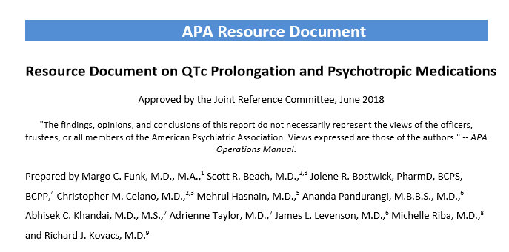
INTRODUCTION
Notes:
To address this conundrum, in the Fall of 2016 the APA Council on Consultation Liaison Psychiatry convened a workgroup to create an official resource document to address the issues surrounding QTc prolongation and psychotropic medications.
The workgroup consisted of experts in the field both from a clinical and research perspective, two APA resident fellows interested in topic and some senior advisors to make sure we were thoughtful in considering of all the angles.
To ensure that we were approaching the topic from the most up to date cardiology standards, we successfully approached the American College of Cardiology to participate in and endorse the project.
Two years later, we have created Resource Document which has been accepted by the APA, officially endorsed by the ACC and is available on the APA website.
The goal of our course today is to provide a deeper dive into the concepts addressed in the resource document and to do a lot of hands-on, interactive practice.

Slide 3

COURSE FACULTY
Scott Beach, MD, FACLP
Program Director, MGH/McLean Psychiatry Residency
Associate Professor of Psychiatry, Harvard Medical School
Attending Psychiatrist on Consultation Liaison and Acute Psychiatry Services at MGH
Member, APA Workgroup on QTc Prolongation and Psychotropic Medications
Interests: QTc prolongation, catatonia, deception syndromes, COVID-19

Slide 4

COURSE FACULTY
Christopher Celano, MD, FACLP
Associate Director, Cardiac Psychiatry
Research Program, MGH
Assistant Professor of Psychiatry, Harvard
Medical School
Member, APA Workgroup on QTc Prolongation and Psychotropic Medications
Interests: cardiac psychiatry, collaborative care, positive psychology, health behavior promotion

Slide 5

COURSE FACULTY
Margo Funk, MD, MA
Program Director, BWH Psychiatry Residency
Consultation Liaison Psychiatrist
Chair, APA Workgroup on QTc Prolongation and Psychotropic Medications
Member, APA Council on Consultation Liaison Psychiatry
Interests: cardiovascular psychiatry, medical education, advancement of women in healthcare leadership

Slide 6
COURSE OBJECTIVES
Confidently measure the QT interval, choose the most appropriate correction formula and calculate the QTc.
List medications and common drug interactions that confer high risk of TdP.
Correlate components of the 12-lead ECG with cardiac electrophysiologic mechanisms.
Describe high-yield strategies for various practice settings and populations, including the intensive care unit, substance-use disorders, and resource-poor clinics.
Describe an approach to comprehensive risk-benefit analysis, including risk mitigation strategies, in patients who require control of high-risk psychopathology and may be at risk for TdP.

Slide 7
AGENDA
Overview of TdP and QTc Prolongation
Psychopharmacology and QTc Prolongation
Basics of Cardiac Electrophysiology & ECG Interpretation
Approach to Risk Stratification and Mitigation
Interactive ECG Practice Cases

Slide 8
FACULTY DISCLOSURES
Scott Beach, MD, FACLP
Company | The Psychopharmacology Institute
Employment
Management
Independent Contractor
Research Support
Speaking & Teaching | D
Board, Panel or Committee Membership
D – Relationship is considered directly relevant to the presentation
I – Relationship is NOT considered directly relevant to the presentation

Slide 9
Torsades De Pointes and QTc Prolongation

Slide 10
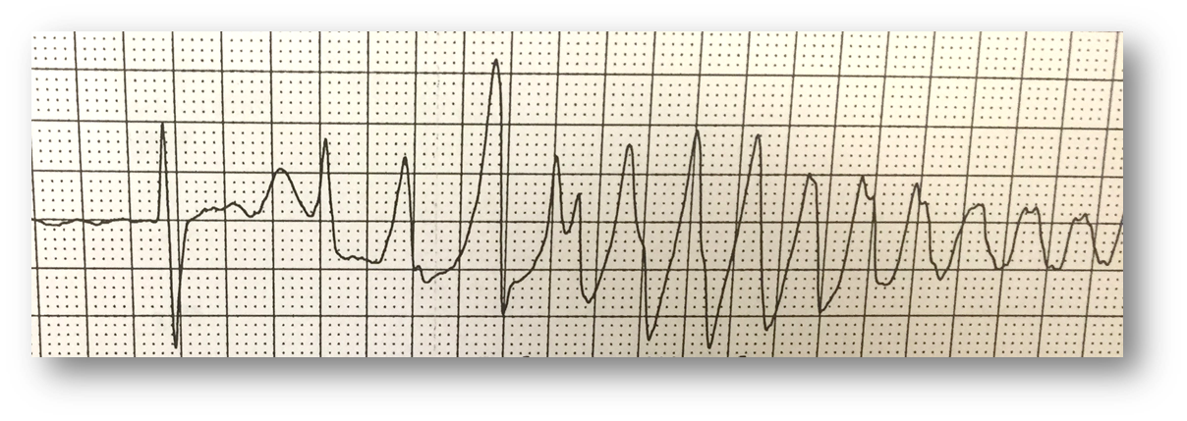
Torsades de Pointes (TdP)
A malignant polymorphic ventricular tachycardia (PMVT)
  Lightheadedness, syncope
  “Seizures” and sudden cardiac death
“VT associated with a long QT or QTc”
“Ventricular tachycardia with 2 variable opposing foci”
American Heart Association

Slide 11
Torsades de Pointes (TdP)
12,000 cases per year in the U.S.
1 per 12,000 to 120,000 patients
Estimated morbidity and mortality up to 31%
Most cases occur in setting of congenital vs. acquired long QT syndrome
  cLQTS: genetic syndromes with characteristic QT morphology and sudden cardiac death (VT, VF, TdP)
  aLQTs: QT prolongation occurs under certain clinical conditions, leading to TdP
Go et al., 2013; Faber et al., 1994

Slide 12
Medications & Risk of TdP
QTc prolongation is only a marker of risk for TdP
In the absence of other risk factors, drug-induced QTc prolongation rarely leads to TdP
  229 cases of drug-associated TdP, 96% had ≥ 1 risk factors in addition to the drug (Viskin, 2003)
Hasnain and Vieweg, CNS Drugs, 2014; Viskin et al., Prog Cardiovasc Dis, 2003

Slide 13
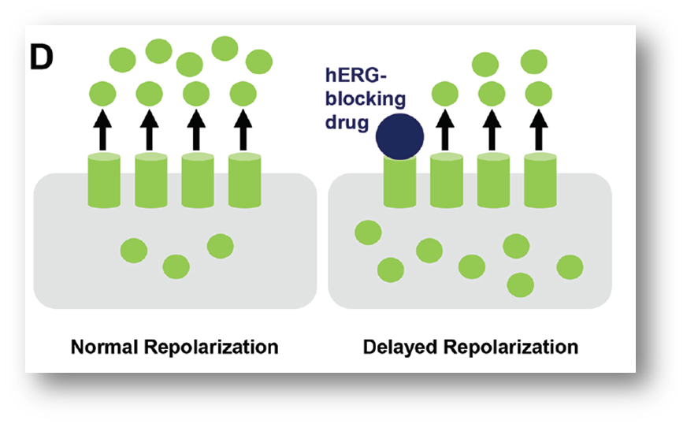
Mechanism Drug-Induced TdP
Direct blockade of Ikr channel
Disruption of K+ efflux delays repolarization of ventricle
  Widening and distortion of T-wave
  Manifests as prolongation of QT interval on 12-lead ECG
FDA, 2005; Sanguinetti, Tristani-Firouzi. Nature. 2006; Funk et al. 2020

Slide 14
Risk Factors for TdP
Non-modifiable risk factors | Modifiable risk factors
Female sex Advanced age Metabolizer status Congenital long QT syndrome Personal history of drug-induced QTc prolongation Personal history of structural or functional cardiac disease Family history of sudden cardiac death | Use of ≥1 QTc prolonging drug(s) Pharmacokinetic drug-drug interactions Drug toxicity Severe acute illness Bradycardia Starvation Hepatic impairment Renal impairment Risk or presence of hypokalemia, hypomagnesemia or hypocalcemia

Slide 15
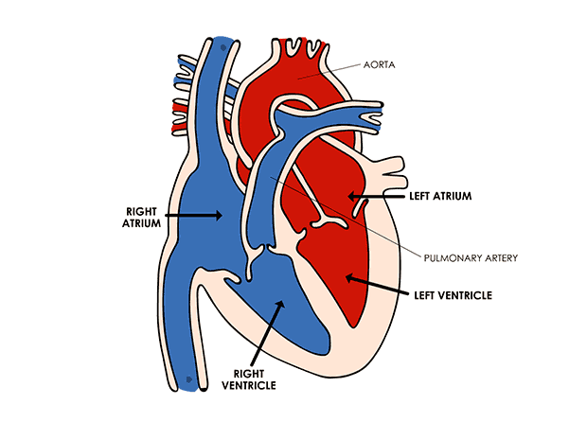
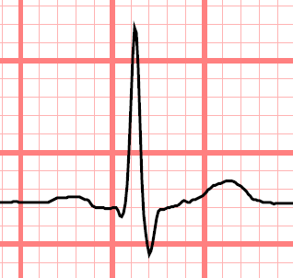
QT Interval: What is it?
QT
T
P
T
P
QRS

Slide 16
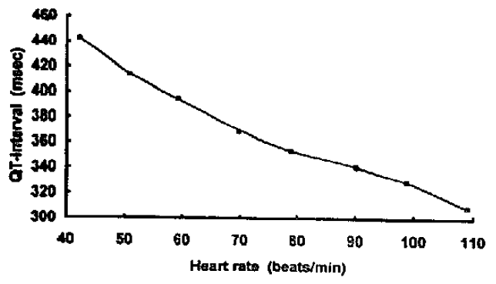
QT Interval is HR Dependent
J Am Coll Cardiol. 1994

Slide 17




QTc Correction Formulas
QT is heart-rate-dependent and must be corrected for rate
Method | Formula
Nomogram | plot of QT vs rate
Bazett
$$QTc=QT/√RR$$
Fridericia
$$QTc=QT/∛RR$$
Framingham
$$QTc=QT+0.154 (1000−RR)$$
Hodges
$$QTc=QT+1.75(HR−60)$$

Slide 18
QTc Nomogram
Above the line = Risk
Below the line = No Risk
Chan 2007, Isbister 2012

Slide 19
QTc Correction Methods
Bazett correction tends to overcorrect at higher heart rates and under-correct at lower heart rates
  Has the widest correction range of formulas
Other formulas tend to group together when plotted, whereas Bazett formula deviates significantly as heart rate increases
Patel 2016

Slide 20
QTc Correction Methods
Patel 2016

Slide 21
QTc Correction Methods
Dogan 2005

Slide 22
QTc Normal Ranges
Rating | Adult Men | Adult Women
Normal | < 430 msec | < 450 msec
Borderline | 431-450 msec | 451-470 msec
Prolonged | > 450 msec | > 470 msec
Moss 2003

Slide 23
Ventricular Arrhythmias
As a general rule, the risk of ventricular arrhythmias increases by 1.052^{x}, where x is every 10 msec above a QTc of 400 msec.
For example:
  QTc of 450 msec increases the risk of ventricular arrhythmias by 1.052⁵, or 1.29.
  So, an individual with a QTc of 450 msec has a 1.29-fold increased risk of ventricular arrhythmias compared to a person with a QTc of 400 msec.
Moss 1993

Slide 24
Brugada Syndrome
Channelopathy that may represent up to 20% of cases of sudden cardiac death in patients with structurally normal hearts
Incidence of 1 in 5000 to 1 in 2000 but may be up to 11% in schizophrenia
Can also manifest as A Fib, AV block and syncope
Diagnosis made by ECG showing coved ST-segment elevation > 2mm in V1 or V2 (Type 1)
QT interval is normal
Can be unmasked by fever, metabolic disorders and medications such as sodium-channel blockers
Mutations mostly involve different genes from LQTS and affect sodium and calcium channels
Psychiatric medications with strong association: TCAs, loxapine, trifluoperazine, lithium
Psychiatric medications with weak association: Paroxetine, fluoxetine, fluvoxamine, bupropion, perphenazine, thioridazine, lamotrigine, carbamazepine
Rastogi 2020

Slide 25
Psychopharmacology

Slide 26
Limitations of Available Data
Study population
Method of QTc measurement
Timing of measurement
Medication dose
Concomitant medications
Reported QTc: mean or clinically meaningful change?
Evaluate Credible Meds data

Slide 27
Antidepressants

Slide 28
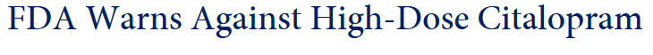
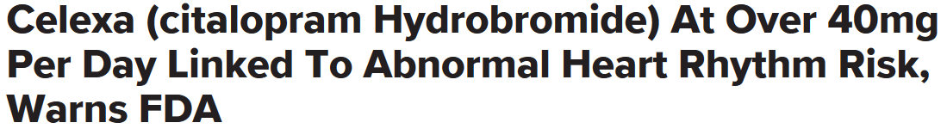


Antidepressants
The Citalopram Controversy

Slide 29
Antidepressants
The Citalopram Controversy
8/24/11: FDA Drug Safety Communication
  Citalopram should not be prescribed at doses >40mg
  Citalopram should not be used at doses > 20mg in those with liver dysfunction or over age 60

Slide 30
Antidepressants
The Citalopram Controversy
3/28/12: FDA Revised Recommendation
  Citalopram is not recommended at doses greater than 40mg
  Citalopram should be discontinued in anyone with QTc>500 ms
  Recommendations based on a single study showing increase of 8.5 msec at 20mg and 18.5 msec at 60mg
  FDA asserts that 60mg of citalopram no more efficacious than 40mg
  Similar study conducted with escitalopram (4.5 msec at 10mg and 10.7 msec at 30mg) but no recommendations from FDA
  MHRA did issue warning for escitalopram as well

Slide 31
Antidepressants
Is Citalopram Unique?
Evidence Since the 2011 Warning
Cross-sectional study of ECGs in >38,000 patients
  Citalopram associated with dose-dependent QTc increase of similar magnitude to FDA study
Systematic review and meta-analysis of 16 prospective studies (4292 patients)
  Citalopram (11 ms) & escitalopram (7 ms) had statistically greater QTc prolongation than placebo
  Citalopram separated from all agents except escitalopram
  Castro et al 2013, Beach et al 2014, Drye et al 2014, Maljuric et al 2015, Girardin et al 2013

Slide 32
Antidepressants
Is Citalopram Unique? Evidence Since the 2011 Warning
Subanalysis of citalopram for agitation in Alzheimer’s
  Mean increase of 18.1 ms after 3 weeks of 30mg daily
Subanalysis of Rotterdam study
  Citalopram had the longest QT increase (12.8 ms) of any antidepressant during use as compared to non-use
Retrospective study of drug-induced QT prolongation
  Association with citalopram after controlling for other risk factors
Small retrospective study of older patients on citalopram and escitalopram
  No association found with QT prolongation
  Castro et al 2013, Beach et al 2014, Drye et al 2014, Maljuric et al 2015, Girardin et al 2013, Crepeau-Gendron 2019

Slide 33
Antidepressants
What About Citalopram and TdP?
Evidence is less clear
VA cohort study of 975,000 patients prescribed citalopram or sertraline 2004-2009
  Citalopram doses >40mg associated with lower risk of ventricular arrhythmia, noncardiac and all-cause mortality than doses 1-20mg
Tennessee Medicaid cohort study
  High-dose citalopram does not differ form other agents in terms of sudden cardiac death or mortality
Perhaps citalopram increases the QT interval but the actual risk of TdP associated with this increase is not clinically significant
  Zivin et al 2013, Ray et al 2016

Slide 34
Antidepressants
Prescribing Lower Doses of Citalopram Has Risks Too
50-65% of patients prescribed doses of greater than 40mg at the time of the warning were prescribed 40mg or less within 2 years
  Increased prescriptions for interacting medications
  ECG monitoring did not change over time
Older adults were less likely to have their doses reduced to comply with guidelines recommending <20mg daily, with 30% remaining on higher doses after 1 year
Austin et al 2014, Friesen et al 2015, Rector et al 2016, Gerlach et al 2016, Gerlach 2018

Slide 35
Antidepressants
Prescribing Lower Doses of Citalopram Has Risks Too
FDA citalopram warning may result in increased rates of psychiatric hospitalization and mortality
  All cause hospitalizations or death significantly increased after dosage reductions (adjusted HR 4.5; 95%CI 4.1-5.0) as did hospitalizations for depression or all-cause death (adjusted HR 2.2, 95%CI 1.8-2.6)
  Hospitalizations for arrhythmias did not decline and all-cause death remained stable
Austin et al 2014, Friesen et al 2015, Rector et al 2016, Gerlach et al 2016, Gerlach et al 2018

Slide 36
Antidepressants
Prescribing Lower Doses of Citalopram Has Risks Too
Patients with citalopram reflexively reduced are more likely to be prescribed sedatives or anxiolytics and had higher healthcare utilization
Austin et al 2014, Friesen et al 2015, Rector et al 2016, Gerlach et al 2016

Slide 37
Antidepressants
What About Escitalopram?
Similar pattern of dose-related QT-lengthening in thorough QT study, but no FDA warning
Escitalopram does separate out in some studies
Not associated with greater mortality in Tennessee Medicaid cohort
Thase et al 2013, Ray et al 2016

Slide 38
Antidepressants
What About Escitalopram?
Meta-analysis of patient level data
  2407 patients prescribed escitalopram compared to 1952 patients on placebo
  Mean QTc increase of 3.5 msec
  1 patient had QTc >500msec and baseline change >60msec
  Incidence and types of cardiac adverse events similar between escitalopram and placebo
May carry some risk of mild prolongation but unlikely to be clinically significant
Thase et al 2013, Ray et al 2016

Slide 39
Antidepressants
SSRIs are largely considered safe
  Most studied in cardiac populations
  Case reports for all agents except paroxetine linked to QT prolongation or TdP existed prior to 2011
Tricyclics are sodium-channel blockers
  Pose danger at therapeutic doses primarily in patients with pre-existing bundle branch disease or ischemic heart disease
  Amitriptyline and maprotiline most commonly implicated in TdP
Funk & Bostwick 2013, Vieweg & Wood 2004

Slide 40
Antidepressants
Venlafaxine
  Most evidence for QT prolongation of antidepressants other than citalopram or escitalopram, but most cases occurring in setting of overdose or other risk factors
  Recent cross-over study showing no significant effect even at supratherapeutic levels
Bupropion
  Reports in setting of overdose but confounded by tachycardia
Abbas 2021, Spindelegger et al 2014, Jasiak & Bostwick 2014, Danielsson et al 2016, Leonard et al 2011, Waring et al 2008

Slide 41
Antidepressants
Mirtazapine
  Recent study suggesting no change with mirtazapine in hospitalized patients
  In overdose, 0 of 103 patients had QTc>500ms
  One study linked with increased sudden death but authors hesitated to make causal association
  Another study showed significantly lower risk of cardiac events than other antidepressants
Duloxetine, vilazodone, desvenlafaxine, vortioxetine, levomilnacipran, brexpiprazole and esketamine have no association with clinically-meaningful QT prolongation
Allen 2020, Spindelegger et al 2014, Jasiak & Bostwick 2014, Danielsson et al 2016, Leonard et al 2011, Waring et al 2008

Slide 42
Antidepressants
Using Antidepressants in Patients w/TdP Risk
Overall magnitude of QTc increase w/ SSRIs is small
No indication for baseline ECG with all antidepressant initiations
  Consider baseline ECG for patients with significant risk factors being started on non-citalopram antidepressant

Slide 43
Antidepressants
Using Antidepressants in Patients w/TdP Risk
Citalopram appears to be the worst offender (and escitalopram to a lesser extent) but actual QT prolongation remains minimal
Citalopram not first choice for patients with pre-existing cardiac disease (sertraline remains first-line)
Consider baseline ECG for patients being started on citalopram with no risk factors
2018 Dutch guidelines recommend ECG monitoring for patients with 2 or more risk factors (>65 years, female, cardiac disease, electrolyte disturbance, concomitant use of QT-prolonging agent, excessive dose) being started on citalopram or escitalopram
Simoons et al. 2018

Slide 44
Antidepressants
Using Antidepressants in Patients w/TdP Risk
Consider cardiology consult when starting citalopram in a patient with significant risk factors
Do not reflexively reduce citalopram dose without careful risk/benefit evaluation
Compelling case can be made for using higher doses of citalopram in specific patients, but needs to be done judiciously and employing ECG monitoring

Slide 45
FACULTY DISCLOSURES
Christopher Celano, MD, FACLP
Company | Sunovion Pharmaceuticals | BioXcel Pharmaceuticals
Employment
Management
Independent Contractor
Research Support |  | D
Speaking & Teaching | D
Board, Panel or Committee Membership
D – Relationship is considered directly relevant to the presentation
I – Relationship is NOT considered directly relevant to the presentation

Slide 46
Typical Antipsychotics
Notes:
Thank you very much Scott. Today I'm going to speak about QT prolongation in other psychiatric medications, including antipsychotic medicatinos, mood stabilizers, stimulants, and others.
Before I get started, I should mention that I have received research funding from BioXcel pharmaceuticals for research not related to this work, and I also have received honoraria from Sunovion pharmaceuticals for topics unrelated to this work as well. Sunovion Pharmaceuticals makes lurasidone, which will come in this presentation.
So continuing onwards from where Scott left off with the antidepressants, I'm going to talk a little bit about antipsychotic medications.

Slide 47
Typical Antipsychotics
As a group, typical antipsychotics lead to modest (< 5ms) QT prolongation compared to placebo, but this effect is likely primarily driven by phenothiazines.
Low-potency phenothiazines (thioridazine, chlorpromazine, mesoridazine) are most associated with QT prolongation.
  Also over-represented in cases of SCD
  Thioridazine causes greatest prolongation (30 ms) of any antipsychotic
  Risk is likely dose-dependent
Pimozide, fluphenazine, droperidol and loxapine have also been associated with QT prolongation.
Carra et al 2016, Leucht et al 2013, Ozeki et al 2010, Nielsen et al 2011
Notes:
In general, both typical and atypical antipsychotics have been associated with QT prolongation When we think about typical antipsychotic medications as a group typical antisychotics lead to less than five milliseconds of QT prolongation compared to placebo.
This effect is likely primarily driven by phenothiazines. Low-potency phenothiazines in particular are the antipsychotic medications most strongly associated with QT prolongation. Thioridazine in particular is the first antipsychotic medication that was linked to QT prolongation and probably is the worst offender in terms of QT prolongation of the difference medications that we think about.
Phenothiazines are also over-represented in cases of sudden cardiac death, suggesting that these medications can cause not just QT prolongation but also ventricular arrhythmias, such as TdP. The risk associated with phenothiazines may be dose-dependent, though the evidence issomewhat mixed on this front.
Higher potency typical antipsychotics and non-phenothiazeines have also been linked to QT prolongation. Recently there have been a few studies looking at intranasal loxapine, for example, and it does cause mild QT prolongation of around 5msec.

Slide 48
Typical Antipsychotics
Haloperidol
Recent meta-analysis (N=15,467) found effects of oral haloperidol on QT similar to several atypical agents.
Huhn et al 2019
Notes:
Now one medication that frequently comes up in terms of QT prolongation is haloperidol. Though there is much concern about this medication—particularly in the intravenous formulation—the oral formulation typically leads to mild QT prolongation. In 2019, Huhn and colleagues performed a systematic review and network meta-analysis examining QT prolongation in adults with schizophrenia. The study population here is important, as they were likely generally physically healthy and so may be different from individuals hospitalized and receiving antipsychotic medications for delirium.
In this analysis, haloperidol caused approximately 2 msec of QT prolongation. This was not significantly different from placebo, and it was similar to many of the atypical antipsychotic medications. This suggests that haloperidol is comparable to other similar medications.

Slide 49
Haloperidol
Most studies suggest QT prolongation of 5-8 ms for oral and IM haloperidol (less than most atypical agents).
Some studies continue to suggest greater risk for ventricular arrhythmias or SCD.
    Compared to olanzapine, haloperidol conferred a 1.72-fold increased risk of sudden death or VA.
    Haloperidol linked to increased risk of VA or sudden cardiac death (OR 1.46).
    Each controlled for a limited number of covariates.
Howland 2014, Leonard 2013, Wu 2015, Salvo 2016, Meyer-Massetti 2010
Notes:
When you look at studies comparing haloperidol to other antipsychotic medications, they suggest that there is about five to eight milliseconds of QT prolongation with the IM or PO formulations, and this is less or similar to many of the atypical antipsychotic medications.
That being said, there is still potentially some risk particularly for ventricular arrhythmias, sudden cardiac death, or other kinds of poor outcomes. For example, Leonard and colleagues analyzed data from two retrospective cohort studies to identify the risks of VA and SCD from antipsychotic medications. Compared to olanzapine, haloperidol was associated with a 1.72-fold increased risk of sudden death or ventricular arrhythmias and a 2.79-fold increased risk of all-cause mortality. However, all of the observational studies that have really looked at death this tend to have different kinds of limitations, with some controlling for a limited number of covariates, such as medical severity or other medications. So it can be a little bit challenging to really kind of parse out what medications are highest risk.
Leonard 2013
Among 459,614 incident antipsychotic users, the incidences of SD/VA and death were 3.4 and 35.1 per 1,000 person-years, respectively. Compared to olanzapine as the referent, adjusted hazard ratios (HRs) for SD/VA were 2.06 (95% CI, 1.20–3.53) for chlorpromazine, 1.72 (1.28–2.31) for haloperidol, and 0.73 (0.57–0.93) for quetiapine. Adjusted HRs for perphenazine and risperidone were consistent with unity. In a subanalysis limited to first prescription exposures, HRs for chlorpromazine and haloperidol were further elevated (2.54 [1.07–5.99] and 2.68 [1.59–
4.53], respectively), with the latter exhibiting a dose-response relationship. Results for death were similar.
Covariates included age, sex, race, state of residence, nursing home residence, prior diagnosis of organic psychosis, and current exposure to cyclic and related antidepressant.
Wu 2015
We conducted a case-crossover study using a nation-wide population-based sample obtained from Taiwan’s National Health Insurance Research Database. A total of 17 718 patients with incident VA and/or SCD were enrolled. Conditional logistic regression models were applied to examine the effects of antipsychotic drug use on the risk of VA/SCD during various case and control time windows of 7, 14, and 28 days. The effect of the potency of a human ether-a-go-go-related gene (hERG) potassium channel blockade was also assessed. Antipsychotic drug use was associated with a 1.53-fold increased risk of VA and/or SCD. Antipsychotic drugs with increased risk included clothiapine, haloperidol, prochlorperazine, thioridazine, olanzapine, quetiapine, risperidone, and sulpiride. The association was significantly higher among those with short-term use. Antipsychotics with a high potency of the hERG potassium channel blockade had the highest risk of VA and/or SCD.
Covariates included antidiabetic agents, diuretics, antithrombotic agents, antihypertensive agents, lipid-modifying agents, antidepressants, and number of inpatient and outpatient visits.

Slide 50
Intravenous Haloperidol
2007 FDA warning suggesting increased risk and recommending telemetry for patients on IV haloperidol
2010 systematic review of 70 case reports involving QT prolongation or TdP
  68 (97%) of these cases had other risk factors (39 on other QT-prolonging medications; 32 with underlying cardiac conditions; 17 with electrolyte disturbances)
  54 (77%) experienced TdP.
Meyer-Massetti et al 2010
Notes:
Now intravenous haloperidol has been associated with potentially greater risk of QT prolongation than PO haloperidol, though as with the PO haloperidol studies there also are limitations related to controlling for confounding variables.
In 2007 the FDA did release a warning suggesting that there was an increased risk associated with intravenous haloperidol, and they recommended telemetry for patients who were on intravenous haloperidol.
And there are some instances where intravenous haloperidol may contribute to poor outcomes and QT prolongation. Meyer-Massetti and colleagues in 2010 performed a systematic review of case reports and found that there are a number of case reports that implicated haloperidol in QT prolongation and TdP. There was good news and bad news related to this study. The bad news was that 77% of cases found haloperidol to be associated with TdP, though this is not very surprising, as those types of cases are more likely to be reported in a case report. The good news was that in nearly all instances, other QTc risk factors were present.
And I think this is really gets to one of the main challenges with clarifying the risk of intravenous haloperidol. If you think about the people who are getting intravenous haloperidol they tend to much sicker, they are more likely to have delirium, and they likely are unable to take medications by mouth. So, they have many other comorbidities that may be increasing risk for QT prolongation. It is very hard to control for these other factors in studies.

Slide 51
Intravenous Haloperidol’s Unclear Risks
Ten of 11 prospective studies, involving >1500 patients and doses up to 20mg, found no evidence of QT prolongation.
No clear evidence that IV haloperidol causes greater QT prolongation than atypical agents or oral haloperidol.
  Retrospective analysis of 1017 inpatients with schizophrenia found IV haloperidol (but not PO haloperidol, risperidone, olanzapine, or quetiapine) to be associated with QTc prolongation.
    Did not control for other QTc risk factors, medical comorbidity, or other relevant variables.
Beach 2020, Ozeki 2010
Notes:
Based on the available information, the risks associated with haloperidol really remain unclear. In a recent review of intravenous haloperidol and its relationship to QT prolongation and other kinds of poor outcomes, 10 of 11 prospective studies involving over 1,500 patients found no evidence of QT prolongation.
Furthermore, the evidence linking IV haloperidol to greater QT prolongation than PO haloperidol or atypical antipsychotics has limitations. As an example one study looked at inpatients with schizophrenia and though this study did find that intravenous haloperidol was associated with QT prolongation while oral haloperidol and other agents were not, the authors were unable to control for medical comorbidity and other relevant variables.
This is mainly to reiterate the idea that identifying the risk of IV haloperidol is quite difficult, and so we remain somewhat in the dark regarding its risk.
Ozeki 2010 controlled for age, sex, antipsychotic dose, benzodiazepine dose, and antiparkinsonian dose. No control for medical comorbidity or other risk factors.

Slide 52
Recommendations for the Use of Intravenous Haloperidol
Ensure repletion of electrolytes (Mg and K to 2 mEq/L and 4 mEq/L, respectively), and minimize other risk factors.
Use a linear correction formula such as Framingham (QT_{Fr}) or Hodges (QT_{H}).
  QT_{Fr} > 480 ms or uncorrected QT > 436 ms may be better predictors of TdP in patients treated with IVH than QT_{B.}
No ECG monitoring required if total dose <5 mg daily and less than 2 other risk factors present.
Check a baseline ECG in a non-emergent situation and at least one follow-up ECG, preferably 30-60 minutes following administration, for doses >5 mg daily OR 2 or more risk factors.
Consider daily ECG for total cumulative dose >25 mg.
Consider continuous monitoring and/or alternative agents for QT_{c} > 500 ms OR total dose >100 mg.
If there is enough concern about QT prolongation to stop using IVH, use a non-antipsychotic agent.
Beach 2020
Notes:
With than in mind, Scott made some recommendations for monitoring and minimizing risk of QT prolongation when using IV haloperidol.
1.) Minimize other risk factors.
2.) Use a linear correction formula.
3.) If you are using a very small dose of IV haloperidol and there are no other risk factors present, then ECG monitoring is not needed.
4.) If there are 2 or more risk factors or if you are using higher doses of haloperidol, there are increasing levels of monitoring that you can perform.
I think this really gets as how I think about psychiatric medications and QT prolongation, and that is that they really reflect one of many risk factors. When I think about QTc monitoring, I usually think about checking an ECG if risk factors are changing.

Slide 53
Atypical Antipsychotics

Slide 54
Atypical Antipsychotics
Most atypical antipsychotics cause QTc prolongation
  Systematic review and network meta-analysis of 15,467 patients with schizophrenia.
  Placebo-controlled or head-to-head trials
Huhn et al 2019
Notes:
Similar to typical antipsychotics, atypical antipsychotics have also been associated with QT prolongation. This was illustrated in a systematic review and network meta analysis of over 15,000 people with schizophrenia.

Slide 55
Atypical Antipsychotics
Notes:
In this analysis, you can see that some atypical antipsychotics such as lurasidone and aripiprazole cause little QT prolongation or in fact may cause some QT shortening.

Slide 56
Atypical Antipsychotics
Notes:
In contrast, other atypical antipsychotics lead to significant QT prolongation, typically ranging from a few milliseconds up to about 10 milliseconds in duration. In this particular analysis, iloperidone, asenapine, and ziprasidone were most likely to cause greater QT prolongation, though even in those cases it would be difficult to detect on an ECG.

Slide 57
Atypical Antipsychotics
Ziprasidone
2002 – FDA issues warning for QT prolongation
  Avoid use in combination with other QT-prolonging agents, history of cardiac arrhythmia
Average QT prolongation of 10-21 ms; 20% experience >60 ms increase
Ziprasidone performs worst in 2019 meta-analysis (similar to iloperidone)
Nielsen et al 2011, FDA 2000, Leucht et al 2013, Huhn et al 2019
Notes:
One of the medications that has received particular attention from the FDA is ziprasidone. In 2002 the FDA issued a warning for QT prolongation and recommended that clinicians avoid the use of ziprasidone in combination with other QT prolonging agents and in people with other risk factors for QT prolongation. In most studies ziprasidone leads to an average of 10 to 20 milliseconds of QT prolongation and in some studies up to 20% of individuals experience greater than 60 milliseconds of QT prolongation, which is clinically significant. Finally, as I mentioned in the last slide, ziprasidone performed worst in the 2019 meta analysis by Huhn and colleagues.

Slide 58
Atypical Antipsychotics
Quetiapine
In 2011, the FDA strengthened quetiapine warning
  Avoid use with other QT-prolonging agents, history of arrhythmias, metabolic deficits
Based on 12 reports, mostly in overdose or use in combination with other agents (4 cases of TdP)
Data on quetiapine remains mixed
  Most studies suggest mild effects, but some report 12% of people experience prolongation > 20ms
Also associated with an increased risk of out of hospital cardiac arrest (OR=3.64; CI: 1.59-8.30)
Nielsen et al 2015, Leucht et al, 2013, Hasnain and Vieweg 2014, Weeke 2014, Fukushi 2020
Notes:
In terms of other ones, quetiapine has been specifically mentioned by the FDA as being linked to QT prolongation. The FDA has given a warning for quetiapine recommending to avoid its use with other QT prolonging agents people with a history of arrhythmias and people with other metabolic deficits. Most of this was really based on case reports, and this generally occurs mostly in overdose or in use with common in combination with other agents.
If you look at the studies that compare quetiapine to other kinds of medications most studies really suggest that quetiapine causes somewhere in the range of three to six milliseconds of QT prolongation. While this is degree of QT prolongation is not clinically significant, there are some reports that about 12% of people experience prolongation greater than 20 milliseconds which is more clinically significant.
And this kind of gets to a good point I think that sometimes looking just at the mean QT prolongation is not really the most important number to be examining in these studies. It may give you some indication of medications that are at higher risk or lower risk, but what we are really interested in and why we monitor is to identify those people who are at greater risk for QT prolongation and who may have 60 or a hundred milliseconds of prolongation with one of these medications where that that really can make a big difference.
Quetiapine also has been associated with an increased risk of out of hospital cardiac arrest, suggesting that QT prolongation can lead to adverse cardiac events.

Slide 59
Atypical Antipsychotics
Aripiprazole and lurasidone
  Perform best in 2019 meta-analysis
Olanzapine, risperidone, quetiapine & (?)clozapine
  Likely similar and somewhere in the middle
Newest antipsychotic
  Lumateperone – 4.9msec at typical dose (42mg)
Huhn et al 2019, Barbui et al 2016, FDA 2019
Notes:
Finally, in terms of other medications, aripiprazole and lurasidone appeared to be the least likely to cause QT prolongation and the network meta analysis performed in 2019, and olanzapine, risperidone, quetiapine, and clozapine appeared to be similar and somewhere in the middle.
https://www.accessdata.fda.gov/drugsatfda_docs/label/2019/209500s000lbl.pdf

Slide 60
Antipsychotics
Summary: QT Prolongation Risk w/Antipsychotics
Antipsychotics with minimal risk
  Aripiprazole and lurasidone
Antipsychotics with similar “mid-range” risk
  Haloperidol, olanzapine, risperidone, and quetiapine
Antipsychotics with the greatest risk
  Ziprasidone, iloperidone, thioridazine
Mixed data about whether antipsychotic polypharmacy leads to greater QT prolongation
  If true, possibly mediated by cumulative dose
Leucht et al 2013, Huhn et al 2019
Notes:
In summary, most antipsychotic medications cause some degree of QT prolongation. However different antipsychotics tend to confer different levels of risk for QT prolongation. Aripiprazole and lurasidone appear to cause minimal risk of QT prolongation. Haloperidol, olanzapine, risperidone, and quetiapine confer a moderate amount of risk, and ziprasidone, iloperidone, and thioridazine cause the greatest risk of QT prolongation. Finally, in terms of antipsychotic polypharmacy, there is really mixed data about weather polypharmacy leads to greater QT prolongation. If it does, this may be mediated by the cumulative dose of antipsychotic medications that people are taking.

Slide 61
Antipsychotics
Using Antipsychotics in Outpatient Settings
  No monitoring for patients without risk factors unless prescribing thioridazine, ziprasidone or iloperidone
  For patients with multiple risk factors receiving any medication or patients with no risk factors taking a high-risk agent, obtain ECG at baseline and again at steady-state
  For patients with multiple risk factors receiving a high-risk medication, consider cardiology consultation
Notes:
So how would I approach the monitoring of QT intervals when using antipsychotic medications in outpatient settings? Well, for people without risk factors who are not taking a high risk medication, I typically wouldn't necessarily monitor the QT interval. For people who do have multiple risk factors who are receiving an antipsychotic medication, or for people with no risk factors who are taking a high risk agent, I would probably obtain an ECG at baseline, at steady state, and whenever I was changing the dose of the medication or another risk factor changes. Finally for people with multiple risk factors who are receiving a high risk medication, I would consider consultation with a cardiologist who might give you a better sense of risks, as this might help facilitate a discussion with the patient about the risks and benefits of using these medications.

Slide 62
Mood Stabilizers

Slide 63
Mood Stabilizers
Antiepileptic Medications
Major antiepileptic drugs have not been found to significantly precipitate prolongation of QT interval
  Valproate was found to lower QT dispersion indicating it may have some preventative effects and stabilization in cardiac conduction
  There is no evidence to suggest QTc prolongation with:
    Carbamazepine
    Oxcarbazepine
    Topiramate
    Gabapentin
Kurt et al 2009, Kwan et al 2004, Dixon et al 2008, Saetre et al 2009, Chen et al 2012
Notes:
In contrast to antipsychotic medications, anti-epileptic medications like Valproic acid, carbamazepine, gabapentin, and topiramate typically do not cause QT prolongation, and there is even some evidence that certain medications, such as valproic acid, may have cardioprotective effects.
As such, valproic acid could be certainly an option for someone who has delirium and is agitated and responding to antipsychotic medications or is responding but is having a lot of QT prolongation.

Slide 64
Mood Stabilizers
Antiepileptic Medications
Lamotrigine
  3/31/21 FDA Drug Safety Communication
  Potential increased risk of arrythmia in people with clinically important structural or functional heart disorders
  Risk may increase further if used in combination with other sodium channel blockers
  Other sodium blocker mood stabilizers (carbamazepine, oxcarbazepine) should not be considered safe until there is additional information
FDA 2021
Notes:
While there is no clear evidence that anti-epileptic medications lead to QT prolongation, there is some suggestion that certain anti-epileptic medications may be associated with arrhythmias. In March 2021, the FDA released a safety communication related to lamotrigine, which is a sodium channel blocker that may potentially increase the risk of arrhythmia in people with structural or functional heart disorders. The FDA noted that this risk may be increased further if it is used in combination with other sodium channel blockers, and they noted that other sodium channel blocking mood stabilizers may also have this risk.
https://www.fda.gov/drugs/drug-safety-and-availability/studies-show-increased-risk-heart-rhythm-problems-seizure-and-mental-health-medicine-lamotrigine

Slide 65
Mood Stabilizers
Antiepileptic Medications
Lamotrigine
  In vitro studies demonstrate that lamotrigine acts as a Class IB antiarrhythmic agent (blocks sodium channels).
  A thorough QT study found that lamotrigine did not widen QRS or QTc.
  There are case reports of lamotrigine leading to ECG changes (e.g., Brugada pattern, QTc prolongation, QRS widening), usually in overdose or individuals with other risk factors.
FDA 2021, Dixon 2008, Chavez 2015, Banfi 2020, Rodrigues 2013, Moore 2013
Notes:
While there is no clear evidence that anti-epileptic medications lead to QT prolongation, there is some suggestion that certain anti-epileptic medications may be associated with arrhythmias. In March 2021, the FDA released a safety communication related to lamotrigine, which is a sodium channel blocker that may potentially increase the risk of arrhythmia in people with structural or functional heart disorders. The FDA noted that this risk may be increased further if it is used in combination with other sodium channel blockers, and they noted that other sodium channel blocking mood stabilizers may also have this risk.
https://www.accessdata.fda.gov/drugsatfda_docs/label/2021/020241s064,020764s057,022251s028lbl.pdf
Dixon (18662287)
Healthy subjects received a single oral dose of moxifloxacin (400 mg) or placebo in crossover design, followed by a dose-escalating regimen of lamotrigine (n = 76) over a 77-day period, or matched placebo (n = 76). Blood samples were taken for determination of moxifloxacin and lamotrigine concentrations and digital 12-lead ECGs were recorded. The relationships between individual QT values and respective individual moxifloxacin or lamotrigine concentrations were explored using population pharmacokinetic-pharmacodynamic (PK-PD) modelling.
Results: Moxifloxacin was associated with a maximum mean increase from baseline in QTcF of 14.81 ms [90% confidence interval (CI) 13.50, 16.11] 2.5 h after dosing. Steady-state exposure to lamotrigine (50, 150 or 200 mg b.d.) was not associated with an increase in QTc interval. Small reductions in QTcF (maximum mean difference from placebo -7.48 ms, 90% CI -10.49, -4.46) and small increases in heart rate (maximum mean difference from placebo 5.94 bpm, 90% CI 3.81, 8.06) were observed with lamotrigine 200 mg b.d. vs. placebo. No effect of lamotrigine on QRS duration or blood pressure was observed. No outliers with QTcF > 450 ms, or with an increase from baseline of >60 ms were observed in the lamotrigine group. PK-PD modelling indicated statistically significant decreases in individually corrected QT intervals for lamotrigine and statistically significant increases in individually corrected QT intervals for moxifloxacin over the concentration ranges studied.
Chavez (25448877)
A 36-year-old male with bipolar disorder ingested 13.5 g of lamotrigine in a suicidal attempt. The lamotrigine level was 78.0 μg/mL. Comprehensive drug screen was negative for all screened compounds. The electrocardiogram demonstrated a prolonged QRS complex and signs suggestive of sodium channel blockade. Refractory to treatment with sodium bicarbonate was treated with intravenous lipid emulsion, with immediate resolution of the electrocardiographic changes. Lamotrigine inhibits the voltage-gated sodium channel opening, attenuating the release of excitatory neurotransmitters.
Banfi (32531456)
A 30-year-old man presented with intellectual disability associated with epilepsy. The epilepsy was initially treated with sodium valproate and since he was 28 years-old with lamotrigine. With the addition of lamotrigine, a pattern of Brugada syndrome appeared on the electrocardiogram. Genetic analyses in the family identified a de novo duplication of 1.3 Mb in 8p21.3 as well as two novel heterozygous rare variants in SCN9A and AKAP9 genes, both inherited from the mother.
Rodrigues (24051210
52-year-old woman with depressive syndrome, treated with lamotrigine for about five months, who went to the emergency department for atypical precordial pain. The electrocardiogram (ECG) revealed a 2-mm downsloping ST-segment elevation and negative T waves in V1 and V2. Due to suspicion of ST-elevation acute coronary syndrome, cardiac catheterization was performed, which revealed normal coronary arteries. The initial ECG was suggestive of type 1 Brugada pattern, but subsequent serial ECGs were less typical. A flecainide test showed the same pattern. After discontinuation of lamotrigine reversal of the typical Brugada ECG pattern was observed.
Moore (23869656)
This retrospective case series from 2003 to 2012 studies the effects of lamotrigine toxicity when not confounded by coingestants. Admission records at an inpatient toxicology center were reviewed for lamotrigine-only exposure based on history with supporting laboratory data when available. After identification, these charts were reviewed again to characterize vital signs, neurological examination findings, specific laboratory and electrocardiography parameters, and complications.
Results: Fifty-seven patients were identified with possible lamotrigine toxicity. Nine patients, including three toddlers, had lamotrigine-only ingestions. Three of these patients had seizures, four were hypertensive, five were tachycardic, and four experienced tachypnea. Mental status was altered in all nine (depressed (n = 4), agitated (n = 5) or both (n = 3)). Five patients were hyperreflexic and experienced intermittent myoclonus, and two had inducible clonus. On electrocardiogram, two patients experienced QRS prolongation (114-116 ms), and four had QTc prolongation (463-586 ms). No patient had life-threatening symptoms or signs. Serum levels of lamotrigine were available in seven patients, and averaged 35.4 mg/L (17-90 mg/L). The therapeutic range for sLTG is 3-14 mg/L.

Slide 66
Mood Stabilizers
Lithium’s effects on QT remain uncertain
Only a few small studies have examined the relationship between lithium and QTc prolongation
Serum lithium concentrations within the therapeutic range of 0.6-1.2 mEq/L do not appear to prolong the QTc
There appears to be a positive correlation between increasing serum lithium concentrations and prolongation of the QTc, however QTc increases are modest and may not be clinically significant
Reilly 2000, Hsu 2005, Mamiya 2005, Chen 2020
Notes:
Data regarding the relationship between lithium and QT prolongation isless clear, but there does not appear to be a strong relationship between lithium and QTc. There is some evidence that lithium toxicity may lead to QT prolongation, but therapeutic doses should not lead to clinically significant QT prolongation.

Slide 67
Stimulants and Stimulant-Like Medications

Slide 68
Stimulants and Stimulant-Like Medications
Stimulants
Stimulants cause increases in catecholamines resulting in increased HR and BP
Stimulants have been shown to have multifactorial arrythmogenic potential along with QT prolongation
Methylphenidate and amphetamine drugs
  No statistically or clinically significant changes to QT interval with both short and long-term treatment
Adler et al 2011, Weisler et al 2005, Schelleman et al 2012, FDA
Notes:
Stimulants can increase HR and BP through their effects on catecholamines, and they have been associated with some arrhythmias and or cardiovascular outcomes. However, they have not been shown to cause QT prolongation in the short- or long-term.
https://www.accessdata.fda.gov/drugsatfda_docs/label/2010/021278s013lbl.pdf

Slide 69
Stimulants and Stimulant-Like Medications
Other Medications Used for Attention
Atomoxetine
  Exerts dose-dependent inhibition of cardiac potassium channel current in vitro which may be clinically relevant in cases of overdose
  At least 3 case reports have linked atomoxetine to prolonged QTc however each case had other contributing variables
  Pooled analysis of five randomized double-blind trials show no clinically significant increase in QT prolongation
Scherer 2009, Weisler 2005, Wernicke 2003, Sawant 2004, Barker 2004
Notes:
Now we will mention some other medications used for ADHD. First is atomoxetine. Atomoxetine exerts dose-dependent inhibition of cardiac potassium channels in vitro, which may be clinically relevant in overdose. There have been at least 3 case reports linking atomoxetine to QTc prolongation. However, there were other contributing factors in all three cases. Finally, a pooled analysis of five randomized double-blind trials in children and adolescents found that atomoxetine led to QT prolongation when QTc was measured with the Bazzett formula but not when it was corrected with other formulas. To me, this suggests that the QT prolongation is probably being driven by heart rate because we know that the Bazett formula tends to overestimate QT C at higher heart rates.

Slide 70
Stimulants and Stimulant-Like Medications
Other Medications Used for Attention
Viloxazine
  No significant QT prolongation
Modafinil
  Infrequently causes significant increases in BP and HR
  No evidence that this has any clinically significant effect on QT prolongation
Clonidine and Guanfacine
  No statistically or clinically significant increases in QTc
Scherer et al 2009, Yamaguchi et al 2014, Wernicke et al 2003, Roth et al 2007, Martinez-Raga et al 2013
Notes:
Viloxazine, a newly approved ADHD medication that may selectively inhibit norepinephrine reuptake, did not lead to QT prolongation in healthy volunteers at doses 4.5 times the maximum recommended dose. Modafinil infrequently leads to increases in BP and HR, but it does not cause significant QT prolongation. Clonidine and guanfacine also don't appear to cause statistically significant or clinically significant increases in QTc.
https://www.accessdata.fda.gov/drugsatfda_docs/label/2021/211964s000lbl.pdf

Slide 71
Stimulants and Stimulant-Like Medications
Monitoring for Patients Prescribed Stimulants
No cardiovascular impact in healthy patients
Use caution in patients with:
  Underlying heart disease
  Atrial or ventricular arrhythmias
  Symptoms of undiagnosed disease
  Prescribed cardiac medications
Given effects on sympathetic nervous system, patient should have routine monitoring of HR and BP
Notes:
Given the lack of relationship between stimulants and QT, there really is no need for QTc monitoring. However, HR and blood pressure should be monitored, given its effects on HR and blood pressure.
Given the effects of stimulants on HR and blood pressure, as well as the possibility of causing other arrhythmias, stimulants should be used with caution in individuals with heart disease, arrhythmias, other cardiac medications, or symptoms of other cardiovascular disease.

Slide 72
Other Psychotropics

Slide 73
Other Psychotropics
Trazodone
  Few case reports showing risk of transient QT prolongation with trazodone overdose
  Modest dose-dependent increase of QTc is likely clinically insignificant but warrants caution with increased trazodone exposure
Benzodiazepines
  No effect on QT
Buspirone
  Associated with an increased risk for QT prolongation in 1 study using classification tree modeling
Antihistamines
  Diphenhydramine and hydroxyzine linked to QT prolongation and TdP in case reports and pharmacovigilance studies, typically at toxic doses or in patients with other risk factors.
Levenson 1999, Dattilo & Nordin 2007, Stock 2018, Ali 2020, Ali 2021, Shah 2015, Schlit 2017, Vigne 2015
Notes:
There are a few case reports that show risk of transient QT prolongation in cases of trazodone overdose. There is a modest dose dependent increase of the QTc, however this is likely clinically insignificant, except in cases of increased trazodone exposure. Benzodiazepines have no effect on the QT interval. Buspirone was association with an increased risk for QT prolongation in a single study using classification tree modeling. Finally, antihistamine medications such as diphenhydramine and hydroxyzine have been linked to cutey prolongation and TdP in both case reports and pharmacovigilance studies. However this typically occurs at toxic doses or in patients with other risk factors for QT prolongation. So while there is some risk, the risk is likely not very large at therapeutic doses.

Slide 74
Other Psychotropics
Orexin receptor antagonists
  Not associated with QT prolongation
Acetylcholinesterase Inhibitors
  Donepezil has cholinergic effects and inhibits hERG potassium channel at supratherapeutic concentrations
  Donepezil has been linked to QT prolongation in a cross-sectional study and case reports, though data are mixed.
  Galantamine and rivastigmine have been linked to QT prolongation in rare case reports.
  Memantine has been linked to QT prolongation in rare case reports but not in an observational study.
Amantadine
  Found to induce TdP in setting of overdose and co-ingestions
FDA 2019, Kitt et al 2015, Sartori et al 1984, Manini et al 2007, Chae et al 2015, Kuwahata 2021, Malone 2020, Park 2021, Takehara 2015, Kajitani 2016
Notes:
Acetylcholinesterase inhibitors can cause QT prolongation, and donepezil can cause adverse cardiac effects due to its actions both at potassium channels and its blockade of cholinergic receptors. Of the acetylcholinesterase inhibitors, donepezil has most consistently been associated with QT prolongation, though data are still mixed. Galantamine and rivastigmine have in rare instances been linked to QT prolongation in case reports, and memantine has been linked to QT prolongation in case reports but not an observational study. Clarifying the relationships between acetylcholinesterase inhibitors and QT prolongation is particularly difficult given the population of patients who are typically taking acetylcholinesterase inhibitors, as these patients frequently have other medical comorbidities and are taking multiple other medications.
Amantadine has been found to induce Torsades de Pointes in the setting of overdose and co-ingestion of other QTc-prolonging medications.
Orexin antagonists:
https://www.accessdata.fda.gov/drugsatfda_docs/label/2021/211964s000lbl.pdf
https://www.accessdata.fda.gov/drugsatfda_docs/label/2019/212028s000lbl.pdf

Slide 75
Opioids

Slide 76
Opioids
Methadone
  Prolongs the QTc and is in highest risk categories for TdP
  Data is equivocal regarding dose-dependent effect on QTc prolongation
  Potent inhibitor of hERG IKr channels
  2006: FDA issued black box warning “cases of QT interval prolongation and serious arrhythmia (TdP) have been observed during treatment with methadone”
Romero 2016, Martell 2005, Eap 2007, Fanoe 2007, Cruciani 2005, Maremani 2005, Peles 2006, Katchman 2002
Notes:
Now we'll talk briefly about opioid medications. Methadone, which is a potent inhibitor of the HERG inward rectifier potassium channel, is well known to prolong the QTc and is in the highest risk category for risk of Torsades de Pointes. The data is equivocal regarding dose-dependent effects on QTc prolongation, however cases of Torsades de Pointes have been reported even at low doses. In 2006 the FDA issued a black box warning on methadone stating that “cases of QT interval prolongation and serious arrhythmia have been observed during treatment wit methadone.” Of all medications used by psychiatrists, methadone is one to give a careful risk-benefit analysis, while keeping in mind the potentially high risk of not treating an opioid use disorder.
---
Methadone, which is a potent inhibitor of the HERG inward rectifier potassium channel, is well known to prolong the QTc and is in the highest risk category for risk of Torsades de Pointes. The data is equivocal regarding dose-dependent effects on QTc prolongation, however cases of Torsades de Pointes have been reported even at low doses. In 2006 the FDA issued a black box warning on methadone stating that “cases of QT interval prolongation and serious arrhythmia have been observed during treatment wit methadone.” Of all medications used by psychiatrists, methadone is one to give a careful risk-benefit analysis, while keeping in mind the potentially high risk of not treating an opioid use disorder.

Slide 77
Opioids
Methadone
  2011: SAMHSA recommended that all methadone Outpatient Treatment Programs should have a cardiac risk management plan, including:
    Baseline ECG and within 30 days for patients with significant risk factors for QTc prolongation
    Annual ECGs performed annually or when methadone dose exceeds 120mg daily
    If QTc prolongation > 500mg strongly consider adoption of risk minimization strategies (reducing dose, eliminating other contributing factors, transitioning to alternative treatment such as buprenorphine, or discontinuing methadone)
Martin 2011
Notes:
To give more guidance about QTc monitoring with methadone, SAMHSA in 2011 recommended that all methadone treatment programs should have a cardiac risk management plan. This includes:
For all patients with significant risk factors for QTc prolongation, a baseline ECG and again within 30 days of initiation of methadone. Then, annual ECGs or when methadone dose exceeds 120mg daily. In cases where the QTc is greater than 500ms, one should strongly consider adoption of any possible risk mitigation strategies, which may include reducing the dose, eliminating other contributing factors, transitioning to alternative treatment such as buprenorphine, or discontinuing methadone.

Slide 78
Opioids
Buprenorphine
  Safer alternative to methadone from cardiac standpoint
  Not shown to prolong the QT interval or have an association with TdP
  Buprenorphine does block hERG IKr potassium channels but is a hundred times less potent of an inhibitor than methadone
Katchman 2002, Ilback 2008, Baker 2006, Demarie 2011, Wedam 2007, Kao 2015, Fareed 2013, Hanon 2010, Ancherson 2009, Stallvik 2013, Athanasos 2008, Esses 2008
Notes:
Now buprenorphine is a much safer medication from a cardiovascular standpoint has not really been shown to prolong the QT interval or to be associated with ventricular arrhythmias. Notably, it does block hERG IKr potassium channels, but it is 100 times less potent than methadone.

Slide 79
Non-Psychotropic Medications

Slide 80
Non-Psychotropic Medications
Prevalence of QT Prolonging, Non-Psychotropic Medications
Over 100 non-psychiatric medications have been shown to prolong QT interval and/or be associated with TdP
ICU: 3-30% of patients receive QT prolonging medications and 1 in 5 are co-administered 2 or more (e.g. amiodarone, haloperidol and antibiotics)
ED: Top 9 medications administered or prescribed have effects on QT
Outpatient: ¼ of prescriptions and 10% of patients involve 2 or more QT-prolonging medications
Freeman et al 2008, Tisdale et al, Tay et al 2014, Danielsson et al 2016.
Notes:
And then finally we wanted to discuss non-psychiatric medications. This really is because we tend to think a lot about psychiatric medications in terms of causing QT prolongation and the medical teams who are seeing our patients oftentimes think of psychiatric medications as causing QT prolongation. However, the truth is that many non-psychiatric medications can also prolong QTc.
Over a hundred non-psychiatric medications have been shown to prolong QT and or be associated with TdP. In intensive care settings three to thirty percent of patients receiving QT prolonging agents and twenty percent of code administered two or more medications at once. In the emergency room, the 9 most commonly administered medications have effects on QT. In an outpatient setting, ¼ of prescriptions and 10% of patients receive 2 or QT prolonging medications at the same time.

Slide 81
Non-Psychotropic Medications
Screening for QT Prolonging, Non-Psychotropic Medications
Clinicians should inquire about over-the-counter medications, supplements and imported drugs
Common offenders
  Anti-arrhythmics
  Antibiotics (e.g., macrolides and fluoroquinolones)
  Antivirals (HIV medications)
  Anti-emetics (e.g., ondansetron)
  Acid blockers
  Anti-cancer medications
  Disease-modifying agents (e.g., hydroxychloroquine)
Notes:
So how do we kind of screen for this? Clinicians should always inquire about all medications, including over-the-counter medications supplements and imported medications. We also should review the electronic health record for common offenders, including antiarrhythmic medications like amiodarone or a sotalol, antibiotic medications like the macrolides and fluoroquinolones, antivirals, antiemetics, acid blockers, anti-cancer medications, and disease-modifying agents, such as hydroxychloroquine.

Slide 82
Psychopharmacology
Summary
Medications are only one of the several possible risk factors for QTc prolongation
Co-administration of two or more QT-prolonging medications is of particular concern; be aware of non-psychotropic medications that can increase this risk
Avoid “high-risk” psychotropics when lower risk options are available
Careful review of risk-benefit is critical and must consider both symptom control along with risk for TdP
Notes:
In summary, psychiatric medications are one of many risk factors for QT prolongation, and you always should be aware of non-psychiatric medications that also may be contributing.
I would try to avoid high avoid high risk psychiatric medications when lower risk options are available.
Really all of this is to kind of get you to really think about the risk- benefit analysis that you're performing whenever you're thinking about prescribing medications to a patient.

Slide 83
Faculty disclosures
Margo Funk, MD, MA
Company | Acadia Pharmaceuticals
Research
Editorial work
Independent Contractor
Expert Testimony
Speaking & Teaching | I
Board, Panel or Committee Membership
D – Relationship is considered directly relevant to the presentation
I – Relationship is NOT considered directly relevant to the presentation
Notes:
Dr. Celano’s disclosures can be seen here.

Slide 84
Basics of Cardiac Electrophysiology and ECG Interpretation
Notes:
CHRIS → MARGO

Slide 85
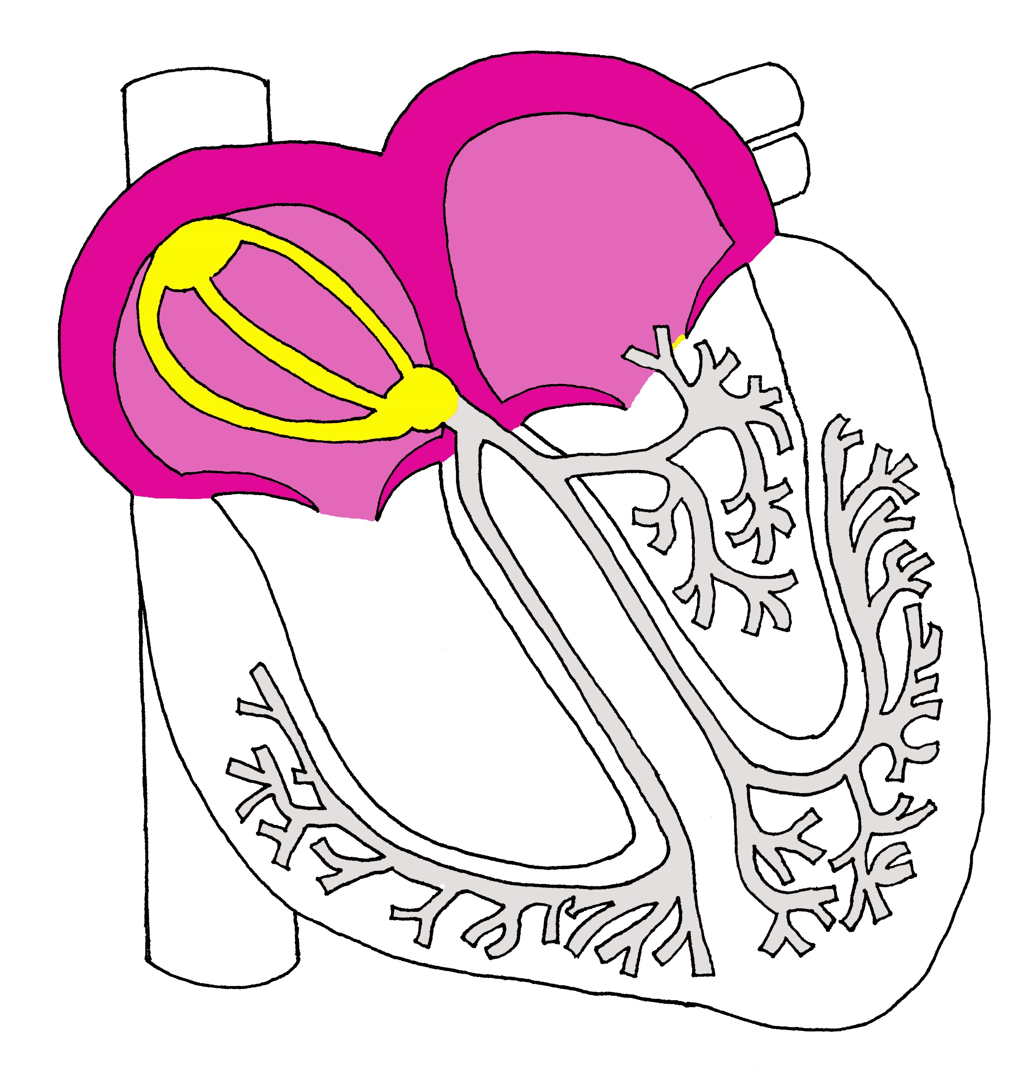
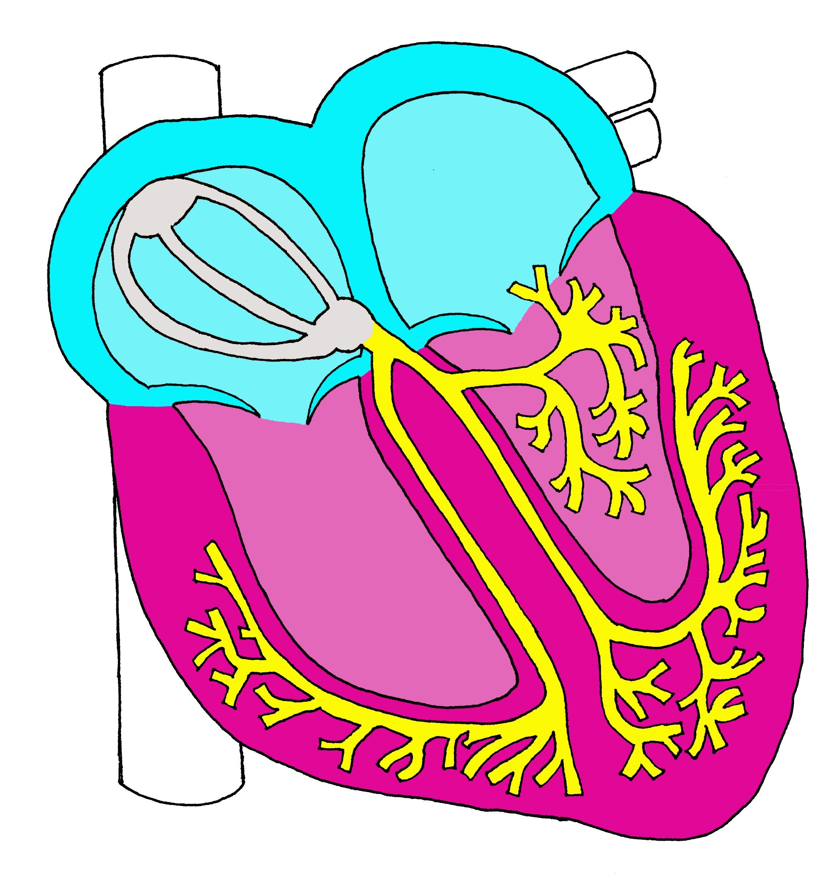
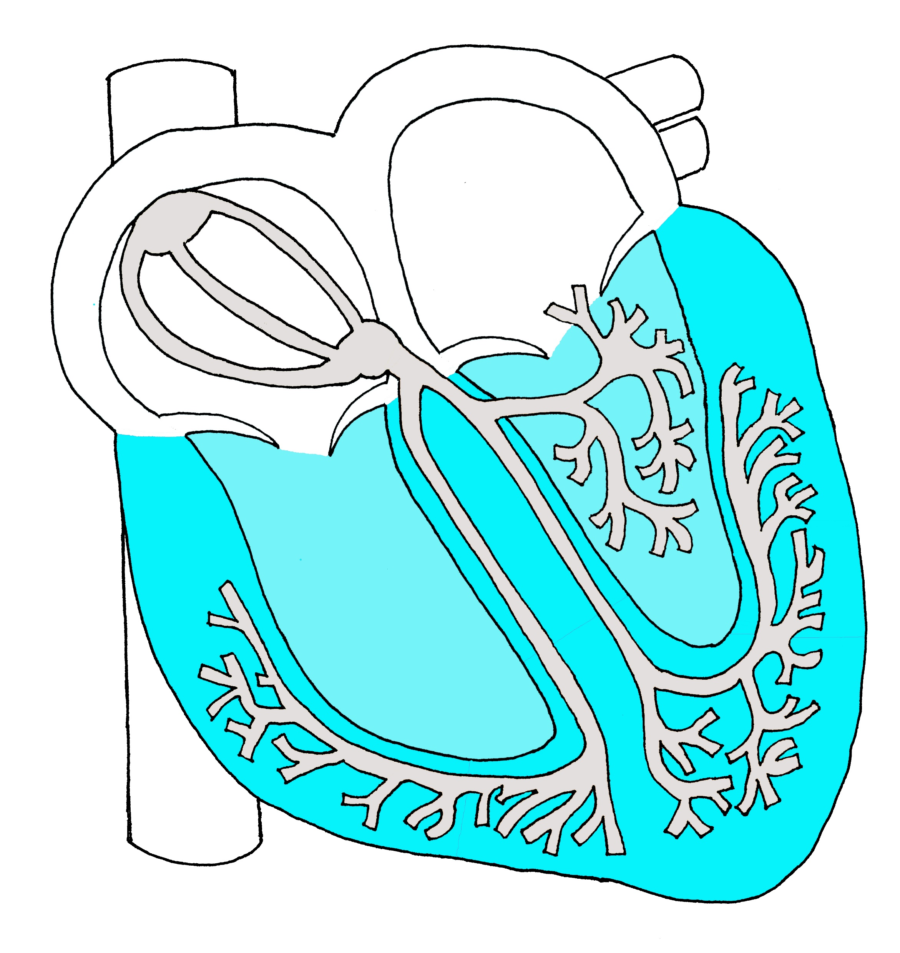

ELECTROPHYSIOLOGY and ECG
Bundle of His
LBB
Left anterior fascicle
SA node
Internodal pathways
AV node
RBB
Left posterior fascicle
P
QRS
JT
Funk et al., 2021
Notes:
Now that we’ve discussed pharmacology, let’s dive a little deeper into understanding the electrophysiology of the heart and how that correlates with the ECG
This diagram correlates what is happening electrophysiologically in the heart with one cycle length, or one complete systole and diastole, on the ECG. Looking at the figure on the left and recalling the cardiac conduction system, transmission of the electrical signal from the SA node to the AV node marks atrial depolarization which is represented by the P wave. In the middle figure, rapid conduction then continues from the AV node into the bundle of his, Right and left bundle branches and purkinje fibers marking ventricular depolarization which is represented on the ECG by the QRS complex. Repolarization of the atria is occurring concurrently. Looking at the figure on the right, Ventricular repolarization is marked from the end of the QRS complex, the Jpoint, to the end of the T-wave. Notably, though it is the QT interval that has been historically used as the best electrophysiologic marker of risk of torsades, and is a primary drug-safety benchmark used by the FDA and other international drug regulatory agencies, the QT interval actually represents both depolarization (shown by the pink QRS complex) and repolarization (shown by the aqua JT interval), which are fairly separate events. Torsades de pointes occurs when there is prolongation of repolarization.

Slide 86
When to order an ECG
Variety of physiologic/pharmacologic factors
Measurement should be no more than 1 month prior to the decision point
With substantial changes to medications, electrolytes, cardiovascular status
If there is uncertainty about cardiac status
Consult guidelines for ECG monitoring for specific medications (e.g. methadone)
Funk et al 2020, Am J Psych
Notes:
Knowing when to order an ECG is not an exact science and will depend on a variety of physiologic and pharmacologic factors. When thinking about ordering an ECG prior to starting a medication, it ideally should be no more than month prior to the decision point. Meaning, if a prior ECG is over one month old, you should get a new one. Furthermore, if there have been substantial changes to medications, electrolytes or cardiovascular status since the prior ECG, consider obtaining a new one. Or if there is uncertainly about cardiac status one can obtain and ECG. Some medications have very specific monitoring guidelines, like methadone.

Slide 87
Who can interpret an ECG?
In settings where clinicians do not have access to a cardiology overread, clinicians of any medical specialty should feel comfortable with the measurement, calculation and documentation of the QTc interval
Funk et al 2020, Am J Psych
Notes:
In resource poor areas where clinicians do not have access to a cardiology overread, practitioners should not let the absence of an ECG preclude prescription of a psychotropic medication. If an ECG machine is available, practitioners of any medical specialty should be comfortable with measurement, calculation and documentation of the QTc.

Slide 88
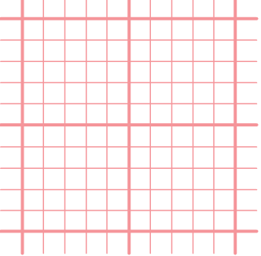
Basics of ECG Interpretation
small box = 40 msec
large box = 200 msec
Notes:
Let’s review some of the basics of ECG interpretation. Remember that one small box on the ECG is equal to 40 ms and one large box is equal to 200ms.

Slide 89
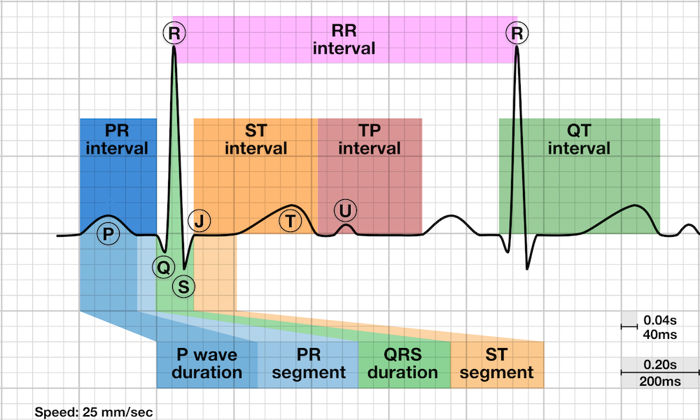
Basics of ECG Interpretation
Interval | Duration (ms)
PR | 120-200
QRS | 80-100
ST | 80
RR | 600-1000
Notes:
It’s also important to be aware of normal durations of intervals other than the QT. This becomes especially true when looking at an ECG of a patient with a pacemaker or bundle branch block, where the QRS interval is prolonged beyond the 80-100ms window.

Slide 90
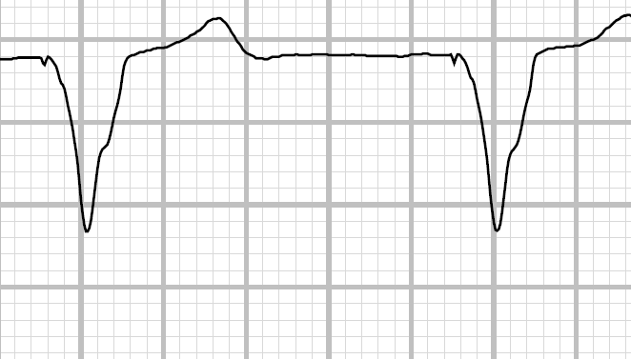
Measuring Heart Rate
300
150
100
75
60
50
Notes:
Heart rate can be measured using a few different methods. With this paradigm, the number of large boxes between beats correlates with a HR of 300 beats per minute for one box, 150 beats per minute for two boxes, and so one.

Slide 91
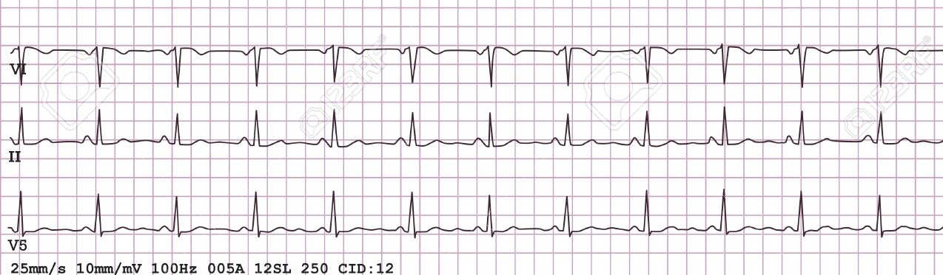
Measuring Heart Rate
Remember: 12 lead ECG = 10 seconds
Count the number of beats
Multiply number of beats x 6 = Beats per minute
Notes:
An easier method is to remember that a 12-lead ECG is equal to 10 seconds. You then count the number of beats and multiply by 6

Slide 92
Measuring Heart Rate
12 Beats x 6 = 72 bpm
Remember: 12 lead ECG = 10 seconds
Count the number of beats
Multiply number of beats x 6 = Beats per minute
Notes:
In this case, we count 12 beats, times 6, is equal to 72 beats per minute.

Slide 93
QT Measurement
QT interval duration can vary from lead to lead
Use the lead showing the longest QT interval
  usually II, V2, or V3
Or, use the lead where it is easiest to distinguish the end of the T wave
Rautaharju 2009, Isbister 2012
Notes:
Focusing in on measurement of the QT interval, we first need to decide which lead to use. There are a number of approaches to this. Typically we would use lead V2, V3 or lead II, which usually contain the longest QT interval. In cases where it is difficult to discern where the T-wave ends, choose the lead where it is easiest to mark the end of the t-wave. Sometimes this may be complicated by the presence of U-waves, which are often considered pathologic T-waves. There is disagreement in the field about whether a U-wave should be included within the T-wave. In general, if the U-wave is less than 1/3 the amplitude of the T-wave, do not include it and look in leads that do not have U-waves. If it is greater than 1/3 the amplitude of the T-wave it is likely a pathologic t-wave and should be included. In any case, a great strategy to find the end of the t-wave is to use the tangent method, marked by the intersection of the tangent to the steepest downward slope of the T-wave with the isoelectric baseline.

Slide 94
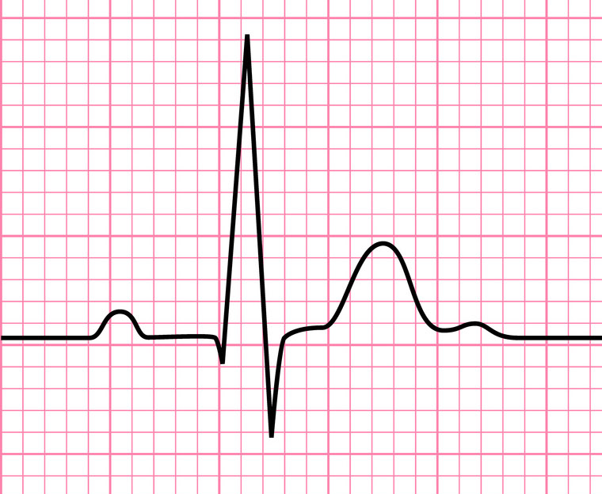
QT Measurement
Beginning of Q-wave
Tangent to the Steepest Downward Slope of T-wave
Isoelectric Baseline
410 ms
End of T-wave
Notes:
Here is an example of the tangent method. We first draw the tangent to the steepest downward slope of the t-wave, then we draw the isoelectric baseline, and that marks the end of the t-wave. We then look for the beginning of the QRS complex and then count the number of boxes. This QT interval is 10 small boxes plus a little bit, so 410ms.

Slide 95
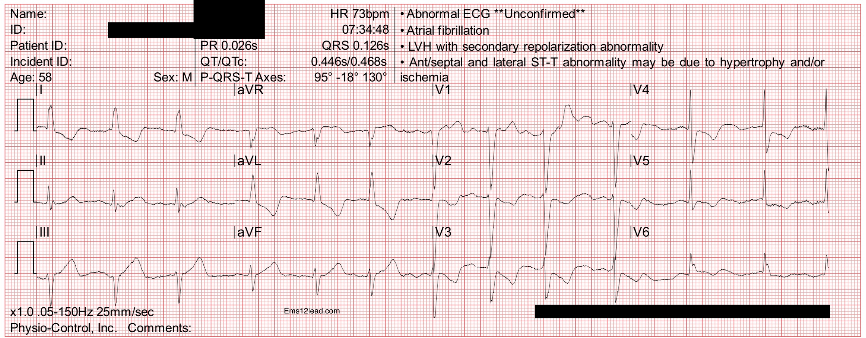
QT Measurement
Notes:
Let’s try an example. We are going to choose a lead where it is easy to discern where the t-wave ends, and in this case it’s lead III.

Slide 96
QT Measurement
QT = 10 boxes + 30ms = 430ms
Notes:
Zooming in, we find the end of the t-wave, the beginning of the QRS complex. We find the QT interval is 10 boxes+ almost an 11th box. This gives us 400ms +an additional 30ms for a total of 430 ms.

Slide 97
Advanced Cardiac Electrophysiology and ECG Interpretation

Slide 98
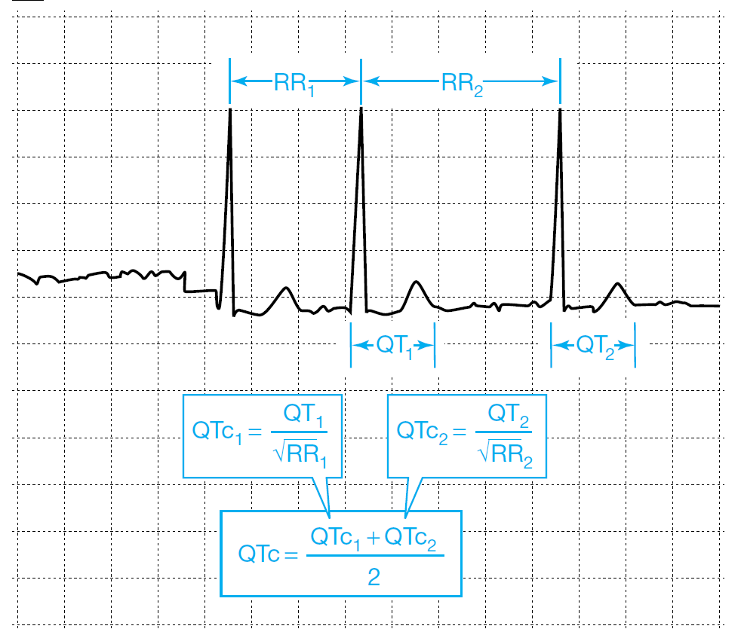
Atrial fibrillation
Difficult to calculate QTc due to variability in RR intervals
Two methods to correct
  Average several complexes (the more the better)
  Average the longest and shortest complex.
Al-Khatib 2003
Notes:
There are some unique circumstances, including what to do in cases of atrial fibrillation. Due to variability in RR intervals, it can be difficult to calculate a QTc. To approach this, one can take the average QTc of the longest, shortest and medium length complexes, or more simply the average QTc of the longest and shortest complex. Notably, the Fridericia heart rate correction formula is recommended in afib.

Slide 99
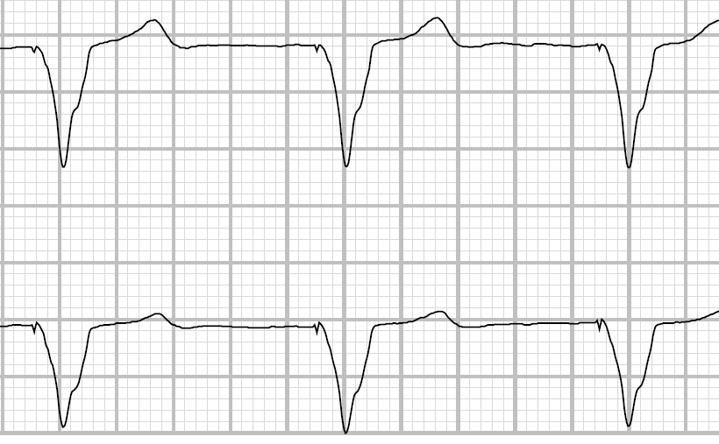
Ventricular Pacing or BBB
Widening of QRS leads to prolongation of QTc without perturbation of repolarization
Correct for Wide QRS:
QRS
JT
Pacing spike
Bogossian Method
QT = (QT-0.50*QRS)
JTc: JTc = QTc-QRS
(upper limit: man = 355ms, woman = 372ms)
Use Linear Regression HR Correction
J-point
QT
Funk et al 2021
Notes:
Thinking back to the cardiac conduction system, recall that the QT interval actually represents both depolarization, represented by the QRS complex, and repolarization, represented by the JT interval. In the case of a widened QRS complex due to ventricular pacing or bundle branch block, it is essential to correct for the wide QRS, otherwise the QTc measurement will appear to be prolonged in the absence of perturbation of repolarization. There are two methods to correct for a wide QRS. The first is to use the Bogossian method, where QT interval corrected for wide QRS equals QT minus half the QRS, followed by a linear heart rate correction such as Hodges. The other method is to use the JT interval instead of the QT interval, and correct with a linear heart rate correction.

Slide 100
Ventricular Pacing or BBB
STEP 1: Obtain ECG Measurements (QT, QRS, RR/HR)
QRS complex ≥ 110ms?
YES
NO
STEP 2: Select Wide QRS Correction Method
STEP 3: Select Heart Rate Correction Method
QTc and JTc Upper Limits of Normal
BOGOSSIAN SIMPLIFIED
QTm = QT – 0.5*QRS
HODGES
QTc = QTm + 1.75 (HR – 60)
QTc
men 450 ms
women 460 ms
JT INTERVAL
JT = QT – QRS
FRAMINGHAM
QTc = QTm + 0.154 (1 – RR)
QTm = QT modified for wide QRS
JTc: substitute JT for QTm
JTc
men 355 ms
women 372 ms
OR
STEP 2: Bivariate Wide QRS + Heart Rate Correction
RAUTAHARJU FORMULA
QTc = QT – 155*(RR – 1) – 0.93*(QRS – 139) + k
k = -22ms, man; -34ms, woman
Funk et al 2021
Notes:
This flowchart is a schematic of how to approach QTc measurement in a patient with ventricular pacing or BBB. The first step is to determine if the QRS complex is greater than or equal to 110ms. If no, you continue straight on to step 3 and apply a HR correction formula, like hodges or Framingham, to your QT or JT interval. But if at Step 1 the QRS complex is greater than or equal to 110ms, you then go to step 2, where you can either select a wide QRS correction method like Bogossian or the JT interval, and then go to step 3 to apply a heart rate correction. OR, you can go to the second option for step2 which is a bivariate correction using both QRS and HR correction (in the form of the RR interval). This is called the Rautaharju formula. As you can see, this formula is quite long and unwieldy and likely not easiest to use in clinical practice.

Slide 101
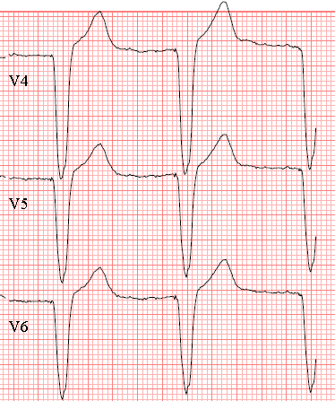
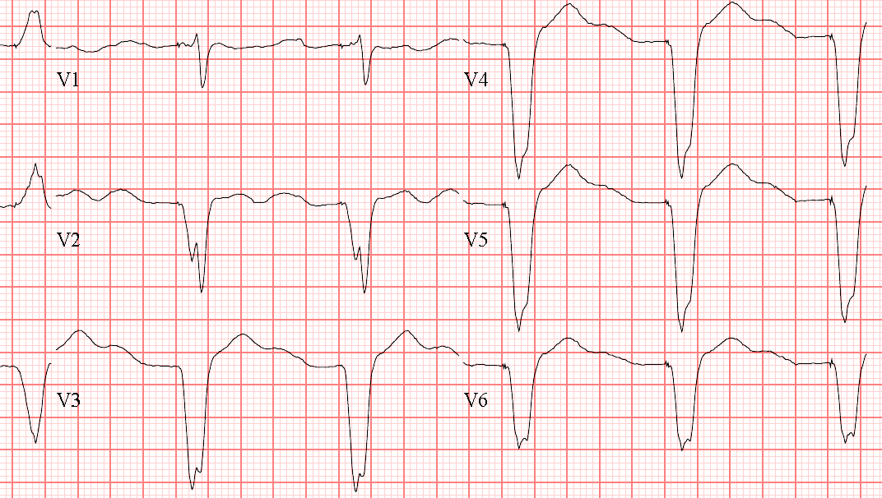
Case
CIPRO

Slide 102
Case
CIPRO

Slide 103
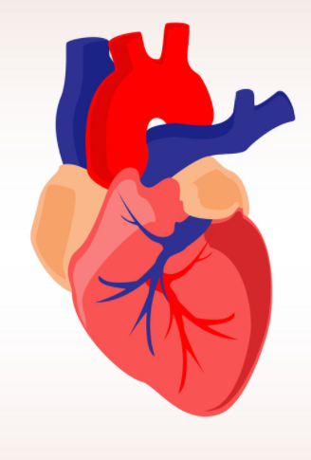
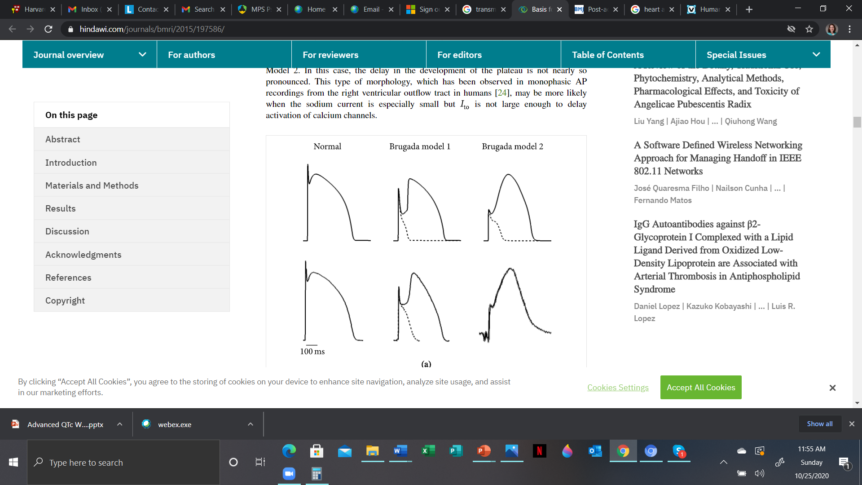

Transmural Dispersion of Repolarization
normal IKr action potential
Epicardium
M-cells
Endocardium
Antzelevitch, 1991; Yan, 1998
Notes:
Transmural voltage gradients contribute to the T-wave. Repolarization of the epicardium is coincident with the peak of the T-wave, the endocardium is intermediate and repolarization of M-cells is coincident with the end of the T-wave.

Slide 104
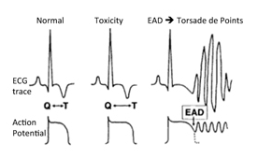
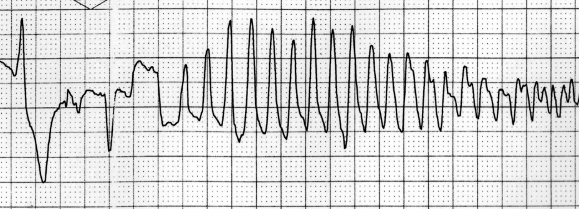
Transmural Dispersion of Repolarization
Early After Depolarizations (EADs)
Epicardium
M-cells
Endocardium
Torsades de Pointes
IKr
blockade
Antzelevitch, 1991; Yan, 1998

Slide 105
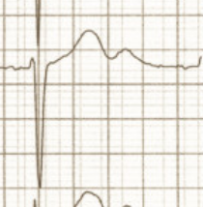
What about U-waves?
The inclusion of superimposed U-waves into the T-wave is controversial
Origin of U-wave hypotheses:
  Ventricular stretch-induced afterdepolarizations
  Repolarization of papillary muscle or M cells
  Repolarization of His-Purkinje system
ACC/AHA/HRS recommends that if U-waves are superimposed on T-waves, either:
  the QT should be measured in a lead without a U wave OR
  use tangent method to steepest downward slope of T-wave
U-wave
Schimpf, 2008; Rautaharju, 2009

Slide 106
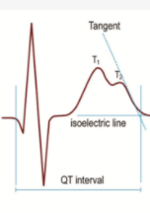
What about U-waves?
Others differentiate “physiologic” U-waves from “pathologic” U-waves, where physiologic U-waves are smaller than the T-wave and separated by the isoelectric line
T-waves + pathologic U-waves may be designated as T1 and T2 to describe two contiguous repolarization waves (aka bifurcated, notched, T-wave humps, pathologic U-waves)
Notched T-waves have been shown to confer increased risk of TdP than broad T-waves
Yan and Antzelevitch, 1998; Viskin, 2004; Topilski, 2007

Slide 107
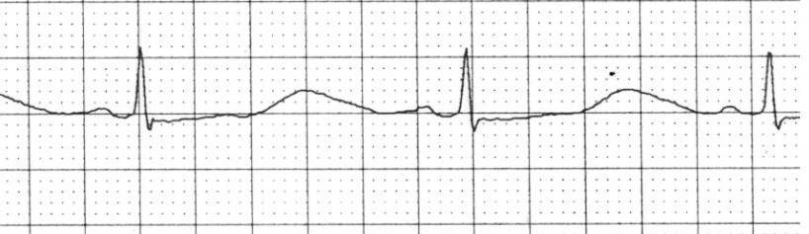
What about U-waves?
Example of notched, tri-phasic T-wave on telemetry in pt w/ TdP

Slide 108
Tpeak-Tend (Tp-Te)
CIPRO
Tp-Te=140ms
Tp-Te=200ms
Tp-Te may be used as adjunctive marker of TdP risk
no consensus on value at which Tp-Te is prolonged (range 74 -113ms)
Antzelevitch, 1991; Yan, 1998; Lubinski, 2000; Tse 2017
Notes:
Transmural dispersion of repolarization is best represented by the Tp-Te

Slide 109
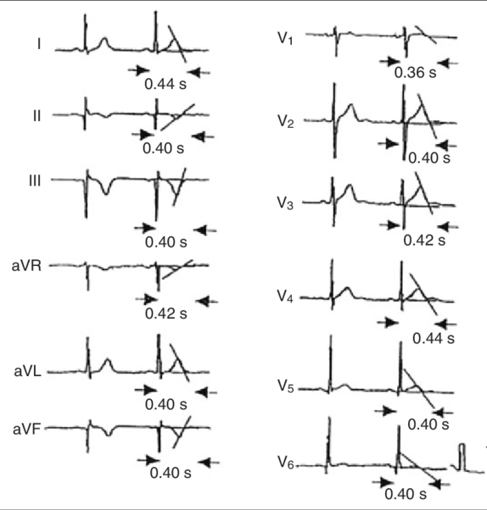
QT Dispersion
Difference in duration between longest and shortest QT intervals for a given set of ECG leads (QTmax-QTmin)
May represent regional variation of ventricular repolarization
Controversy exists whether increased QTD creates conditions for re-entry
ACC/AHA/HRS recommend not commenting on QTD in ECG interpretation
Yamaguchi, 2003; Rautaharju, 2009; Takase et al, 2006

Slide 110

Risk Stratification & Mitigation
Notes:
Now let’s shift gears to discuss how we put all of this information into a clinical context.
So here is a typical scenario that may encountered by a CL psychiatrist:
Agitated delirious patient, on multiple concerning medications, with multiple complex comorbidities, with a QTc > 500ms.
The team is asking if they can use IV haloperidol, with some members strongly opposed.
The astute psychiatrist who has taken this course says “It Depends!”

Slide 111
Risk Stratification & Mitigation
To Prescribe or Not to Prescribe?
Risk of TdP?
Benefit of Psychotropic Medication?
Notes:
It’s important to emphasize that when it comes down to it, determining if and when a psychotropic medication should be prescribed MUST be based on a thoughtful assessment of risks vs. benefits.
What is the Risk of Torsades vs. the Benefit of the Psychotropic Medication?
And is there any way to mitigate the risk and shift the balance?

Slide 112
Risk Stratification & Mitigation
Risk-Benefit Analysis: ICU
Increased risk due to very nature of being in ICU
Increased likelihood of concurrent QT-prolonging medications
Parenteral administration
More susceptible to fluid shifts and electrolyte imbalance
More likely to have renal/hepatic dysfunction
Older Age
Control of Agitation
Protection of patient from injury
Protection of life-sustaining external lines/ devices
Prevent re-intubation and sedation
Prevent use of restraints
Notes:
So looking at this from the perspective of our agitated, delirious patient in the ICU, what do we know about risk of Torsades vs. benefits of a psychotropic?

Slide 113
Risk Stratification & Mitigation
QTc
<500
Prolonged QTc >500, agitated in ICU
Prolonged QTc>500, agitated in ICU, intubated, requires fluconazole, azithromycin, hemodialysis, h/o TdP
Prolonged QTc>500, agitated in ICU, intubated, requires fluconazole, azithromycin
Prolonged QTc>500, agitated in ICU, intubated, requires fluconazole, azithromycin, dofetillide, methadone on-board, hemodialysis, h/o TdP
Risk Stratification

Slide 114
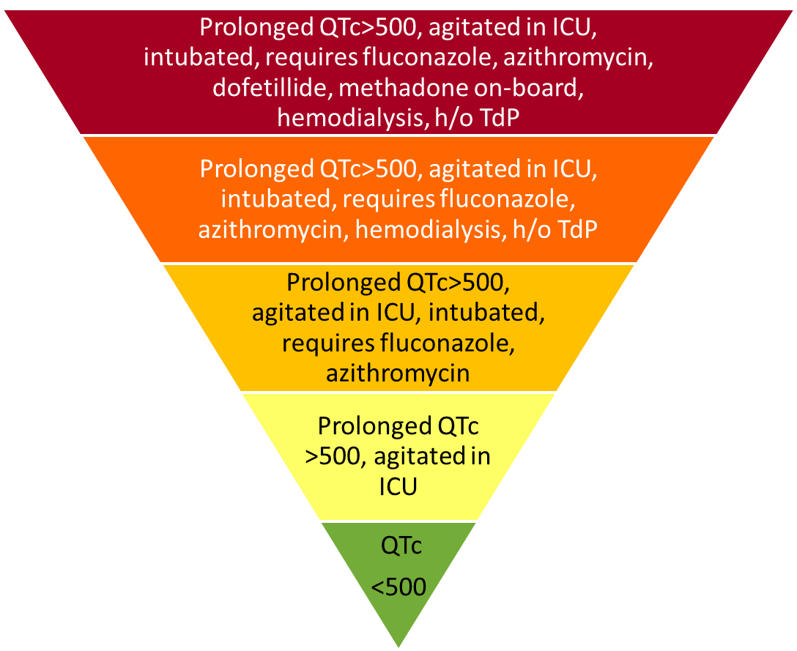
Risk Stratification & Mitigation
Discuss temporary overdrive pacing with Cardiology Team
Risk Mitigation
Discuss optimization of electrolytes with Nephrology Team
Discuss non-QT prolonging antibiotic and antifungal options with ID Team
Continuous telemetry, aggressive repletion of K+ and Mg2+
Notes:
So let’s say that we really want to use IV haloperidol in this patient. Are there ways we could collaborate with our clinical partners to potentially mitigate some of the risk?
This diagram is not meant to communicate a prescribed recommendation for these unique clinical situations.
Rather it is meant to highlight the importance of working with the entire clinical team to assess overall risk stratification and mitigation.

Slide 115
Risk Stratification & Mitigation
Multidisciplinary Collaboration is Essential!
ICU
Nursing
Cards/EP
ID
CL Psych
Outpt
Psych
Nephrol
Notes:
An important take-home is the importance of multidisciplinary collaboration when stratifying risk and thinking about strategies to mitigate risk.
The conversation must involve the ICU team, psychiatry, cardiology and other consultants.
Questions for the team should include:
What are all the options and alternatives?
Do we collectively have any tricks to mitigate ris?

Slide 116
Prescribing a QT-Prolonging Medication: When to Consult Cardiology?
No consultation needed: in absence other risk factors
Consider consultation w/existing cardiologist: known heart disease + risk factor(s)
Refer to cardiology: ⋅co-admin of high-risk meds ⋅QTc > 500ms ⋅sudden increase QTc by 60ms
Immediate cardiology: cardiac symptoms (dizziness, syncope, palpitations) on QT-prolonging drug
Funk et al. 2021. AJP

Slide 117
High-Risk Mitigation Strategies: Cardiac Overdrive Pacing
Torsades de Pointes typically arises from an Early After Depolarization (EAD) in the setting of bradycardia and/or prolonged QT.
Known as the R-on-T phenomenon (QRS of ectopic beat falls on peak of T-wave)
Lankipalli et al., 2005

Slide 118
High-Risk Mitigation Strategies: Cardiac Overdrive Pacing
Overdrive pacing > 70 bpm can mitigate risk of early-after-depolarizations that can lead to a reentrant rhythm
All cardiac implanted electronic devices (e.g. pacemakers, ICDs) have capability for overdrive pacing
Pacing thresholds usually set to HR 40-50 to preserve battery-life and ventricular strain, HOWEVER pacing rates can be increased in high risk patients
Alternatively may consider temporary transvenous pacing or “chemical” overdrive pacing with isoproterenol (less common)
Pinski et al., 2002

Slide 119
High-Risk Mitigation Strategies: Hemodialysis
Sudden cardiac death (SCD) is leading cause of death in hemodialysis
QTc prolongation very common in hemodialysis patients
Contradicting studies regarding impact of dialysate electrolyte concentrations and serum-to-dialysate gradient measures on QTc
2019 PACE Study, Kim et al.
  no significant effect of dialysate concentration on QTc prolongation
  Serum ionized Ca++ and serum K+ levels inversely associated with risk QTc prolongation
  Close attention to serum ionized Ca++ and K+ may mitigate risk for QTc prolongation and SCD
Work closely with nephrology in high-risk patients on HD
Kim et al., 2019, Predictors of Arrhythmic and Cardiovascular Risk in ESRD, BMC Nephrology

Slide 120
Summary

Slide 121
SUMMARY
Bazett is the most widely used correction formula and programmed into most ECG machines
  Not a consistently reliable method of correction
  Overestimates QTc interval at high heart rates and underestimates it in bradycardia
Manual measurement with heart-rate correction using Fridericia or an alternative population-based nomogram is more consistently reliable
Currently available sources that classify drugs according to ‘level of risk’ are based on evidence of variable quality and validity.

Slide 122
SUMMARY
Medications are only one of the several possible risk factors for QTc interval prolongation
Combinations of these risk factors can create cumulative risk for TdP
Co-administration of two or more QTc interval prolonging medications is of particular concern.
Guidelines and warnings vary from country to country
In patients with significant cardiac risk factors, drugs with a known risk to prolong QTc interval or those with a regulatory warning should be avoided when relatively safer alternatives are available

Slide 123
SUMMARY
There is no absolute QTc interval at which a psychotropic drug should not be used
The risk benefit ratio in patients with pretreatment QTc intervals >500ms must be assessed comprehensively with careful attention to risk mitigation strategies
The treatment team must consider risk of failure to control high risk psychopathology or of psychiatric decompensation.
Routine cardiology consultation is not indicated when prescribing QTc interval prolonging medications to a patient without cardiac risk factors
When significant cardiac disease is present and/or when other risk factors for QTc interval prolongation are present, cardiology input should be considered.

Slide 124
Interactive Cases and Q&A at Live Session

