Slide 1
Neuropsychiatric Manifestations of COVID-19
Scott R. Beach, MD, FACLP
Erica Baller, MD, MS
Christian Hicks, MD
Davin Quinn, MD, FACLP

Slide 2
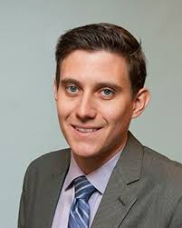
SPEAKERS
Scott Beach, MD, FACLP
Program Director, MGH/McLean Psychiatry Residency
Associate Professor of Psychiatry, Harvard Medical School
Attending Psychiatrist on MGH Psychiatric Consultation and Acute Psychiatry Services
Interests: QTc prolongation, catatonia, deception syndromes, COVID-19
Talk: Acute Neuropsychiatric Manifestations of COVID-19

Slide 3
SPEAKERS
Erica Baller, MD, MS
T32 NRSA Neuropsychiatry Postdoctoral Fellow, University of Pennsylvania
Attending Psychiatrist on CL Teaching Service, Hospital of the University of Pennsylvania
Co-director of Neuroscience Curriculum, Penn Psychiatry Residency
Interests: Neuroimaging, psychopharmacology, delirium, COVID-19
Talk: Delirium in COVID-19: Presentation, Pathophysiology and Pharmacology

Slide 4
SPEAKERS
Christian Hicks, MD
Attending Psychiatrist, Columbia University Medical Center, Comprehensive Psychiatric Emergency Program
Interests: Neuropsychiatry, COVID-19, Long COVID
Talk: Chronic Sequelae of COVID Infection: Focus on LongCOVID

Slide 5
SPEAKERS
Davin Quinn, MD, FACLP
Professor of Psychiatry, University of New Mexico
Vice Chair, Adult Clinical Services
Medical Director, UNM Center for Brain Recovery and Repair
Interests: Neuropsychiatry, neuromodulation, brain injury
Talk: Post-Acute Sequelae of COVID-19 (PASC): Pathophysiology and Workup

Slide 6
Acute Neuropsychiatric Manifestations of COVID-19
Scott R. Beach, MD, FACLP
Program Director, MGH/McLean Adult Psychiatry Residency
Psychiatrist, Avery D. Weisman Psychiatric Consultation Service, MGH
Associate Professor of Psychiatry, Harvard Medical School

Slide 7
FACULTY DISCLOSURES
Scott Beach, MD, FACLP
Company | The Psychopharmacology Institute
Employment
Management
Independent Contractor
Research Support
Speaking & Teaching | D
Board, Panel or Committee Membership
D – Relationship is considered directly relevant to the presentation
I – Relationship is NOT considered directly relevant to the presentation

Slide 8
Acute Neuropsychiatric Sequelae of COVID-19
Anosmia/ageusia
Tinnitus
CVA’s
Guillain-Barre syndrome
Transverse Myelitis
Acute Hemorrhagic Necrotizing Encephalitis
Viral Encephalitis
Acute Disseminated Encephalomyelitis
PRES
Dysautonomia
Delirium
Dementia
Psychosis
Catatonia/Akinetic Mutism
Depression
Mania
Anxiety
Moriguchi 2020; Poyiadji 2020; Dixon 2020; Reichard 2020
Notes:
Association vs. Causality

Slide 9
What is Found During Workup?
EEG
Most reveal non-specific abnormalities, including generalized or frontal slowing
Few have demonstrated evidence of seizure activity
CSF Findings
Oligoclonal bands [inflammation]
Elevated protein [encephalitis]
SARS-CoV-2+ found in 6% of tested patients
Autopsy
At least one case of virus found post-mortem in the frontal lobes
Helms 2020, Ellul 2020, Panis-Mondolfi 2020, Lewis 2021
Notes:
Keep sample in mind

Slide 10
MRI Findings in COVID-19
40% abnormal scans in one study
Severe disease and intubation were predictive of imaging findings
Many distinctive neuroradiologic patterns
Signal abnormalities in medial temporal lobe
Leptomeningeal enhancement
Acute necrotizing encephalopathy
Middle cerebellar peduncle hyperintense lesions
Non-confluent multifocal white matter hyperintense lesions with associated hemorrhagic lesions
White matter microhemorrhages
Confluent supratentorial white matter hyperintensities
Lesions in the splenium of corpus callosum, clinically silent CVA’s
Aragao 2021, Helms 2020, Ellul 2020, Kremer 2020

Slide 11
Workup of COVID-19 Neuropsychiatric Symptoms
Consider altered mental status as a prompt for COVID PCR testing in all patients
WHO now considered it a core symptom
6th most common presenting sign and 37% don’t have associated symptoms
Basic bloodwork, including CRP, for COVID+ patients with delirium
MRI may reveal specific pathology (silent CVA’s, encephalitis, AHNE)
EEG and CSF findings less likely to be helpful
Utility of test must be balanced with risks of further exposure
Kennedy 2021

Slide 12
Psychotic Disorders and COVID-19
Schizophrenia-spectrum illnesses are one of the strongest risk factors for mortality in COVID
Treatment with clozapine associated with increased risk of COVID-19
Lymphopenia common
Higher rates of pneumonia in patients on clozapine
Clozapine levels may increase by 2-fold
Consider cutting dose in half for any patients who develop fever
Dotson 2020, Bilbul 2020

Slide 13
New Psychosis in COVID-19
Early case series in Psychosomatics
Nearly 100 cases reported thus far
Of patients with “altered mental status” in one series, nearly 25% had non-delirium psychosis
Symptoms of psychosis have included delusions, hallucinations, disorganized thinking and behavior, and catatonia
Most common presentation is a brief or reactive psychosis, appearing consistent with Acute and Transient Psychotic Disorder
Mean age is higher than would be expected for new-onset psychosis (40)
Ferrando 2020; Varatharaj 2020; Watson 2021

Slide 14
New Psychosis in COVID-19: Cause or Association
Increasing evidence for infection as a cause of psychosis
GWAS studies localizing to MHC for schizophrenia risk; autoimmune disorders
Epidemiologic studies showing psychosis risk increases with severe infection, maternal infection
Many confounding factors
Other Reasons for psychosis: Delirium; Medication effect (steroids, hydroxychloroquine, antibiotics, antivirals [favipiravir]); Prior psychiatric history; Substance use; Other medical conditions associated with psychosis; Being postpartum
Stress and stigma of the virus, itself
Confirmation of COVID-19 (active vs recent)
Clear selection bias
Risk of a new onset psychosis in the first 90 days after COVID infection was similar to that for other control events (influenza, URI, etc)
When relapses were included, the rate was 1%, which was higher than for control events
Watson 2021; Taquet 2020

Slide 15
Psychosis in COVID-19: A Novel Cause
30yo male presented with new-onset psychosis and hyper-religiosity; progressed to developing insomnia and cognitive slowing
Insufficient response to antipsychotics
Robust response to IVIG
Tested CSF for anti-neural autoantibodies using anatomic mouse brain tissue staining
Novel antibody detected localized to layer II/III callosal cortical neurons, which have been implicated in schizophrenia
McAlpine 2021

Slide 16
Catatonia and Akinetic Mutism in COVID-19
Early reports of catatonia in Psychosomatics and on the ACLP listserv
Anecdotal observation at MGH of patients developing immobility, abulia, alogia that was unresponsive to benzodiazepines
Akinetic mutism
Syndrome in which patients are awake but mute and with a profound motivational deficit
May represent a pure “motor catatonia”
Lacks affective and some behavioral components of catatonia
Waxy flexibility is absent
Classically associated with brain injury but well-described in toxic/metabolic insults
Vulnerability conveyed by states of dopamine depletion
Pro-inflammatory state may impair the dopaminergic mesocorticolimbic pathways required for motivation and movement
Can be a subtype of delayed post-hypoxic leukoencephalopathy (DPHL)
Fisher, 1989; Treadway 2019

Slide 17
Akinetic Mutism in COVID-19
Three main subgroups of patients appear susceptible:
Severe respiratory illness
Meningoencephalitis
Pre-existing neuropsychiatric vulnerability
One study suggested AM in 13% of COVID+ patients, mostly presenting after extubation
Possible mechanisms include systemic inflammation, hypoxic-ischemic injury, coagulopathy and metabolic disturbances
Systemic inflammation may disrupt dopamine synthesis and function
MRS in some COVID+ patients shows patterns similar to delayed post-hypoxic leukoencephalopathy
Most cases appear to be time-limited (1-2 weeks)
Unclear role for pro-dopaminergic medications
LongCOVID apathy?
Nersesjan 2021; Rapalino 2020; Fusunyan 2021

Slide 18
COVID-19 and Dementia
Incidence of first diagnosis of dementia in 14-90 days after infection 1.6% (95% CI 1.2-2.1) in patients > 65 years
2-3 times increased risk for dementia compared with other health events
Incidence of dementia not higher among inpatients
Among hospitalized patients, deficits found in working memory, set-shifting, divided attention and processing speed
Executive dysfunction not associated with intubation length or premorbid disease
UK Biobank study - loss of grey matter in the left parahippocampal gyrus, the left lateral orbitofrontal cortex and the left insula
Results extended to the anterior cingulate cortex, supramarginal gyrus and temporal pole
Taquet 2021; Jaywant 2021; Douaud 2021 (pre-print)

Slide 19
Mood Disorders and Suicidality in COVID-19
Depression has been described as a common outcome
Intermediate timeline somewhere between acute and LongCOVID
Mania has not commonly been reported, though many of the cases of psychosis include maniform features
Rates of presentations for suicidality did not increase early in the pandemic
Among patients presenting with SI, a greater proportion were undomiciled
Patients were more likely to cite structural reasons for SI and less likely to cite psychiatric reasons
Taquet 2021; McDowell 2021; Grossman 2021

Slide 20
Antidepressants
RCT found patients given fluvoxamine 100mg daily x 15 days during mild illness, had a lower likelihood of clinical deterioration compared with those given placebo
152 patients
Clinical deterioration occurred in 0 in the fluvoxamine group and 6 in the placebo group
Observational study found association between receiving antidepressant within 48 hrs of admission and reduced risk of intubation or death in hospitalized patients
Held for SSRI and non-SSRI antidepressants
Particularly significant for fluoxetine, escitalopram, paroxetine, venlafaxine
Prior studies suggest several antidepressants may inhibit sphingomyelinase activity, which may prevent infection of epithelial cells with SARS-CoV-2
Antidepressants may also prevent cytokine storm (Sigma-1 inhibition) and reduce inflammatory mediators
Fluoxetine may have antiviral effects on SARS-CoV-2
Hoertel 2021; Lenze 2020; Zimniak 2020; Carpinteiro 2020

Slide 21
Take Home Points
Among patients with neuropsychiatric features of COVID-19, most findings on workup are non-specific
We must be diligent and thoughtful about considering association, as opposed to causality, in our descriptions of neuropsychiatric sequelae
An acute phenomenon resembling akinetic mutism occurs in some of our sickest patients with COVID
We still have more questions than answers, particularly with regards to important outcomes like new onset psychosis and dementia

Slide 22
Delirium in COVID-19
Presentation, Pathophysiology and Pharmacology
Notes:
Thank you so much to ACLP for allowing me to present and to scott beach for inviting me to be a part of this panel.

Slide 23
Notes:
So I did my CL fellowship at MGH from 2019-2020. In late february 29th, a block from my sweet apartment, in TD garden, the sports stadium was filled with fans watching the celtics.

Slide 24
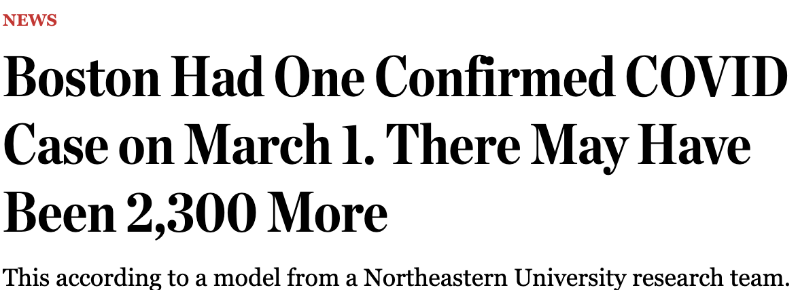
Notes:
[PAUSE} All of sudden, things changed.

Slide 25
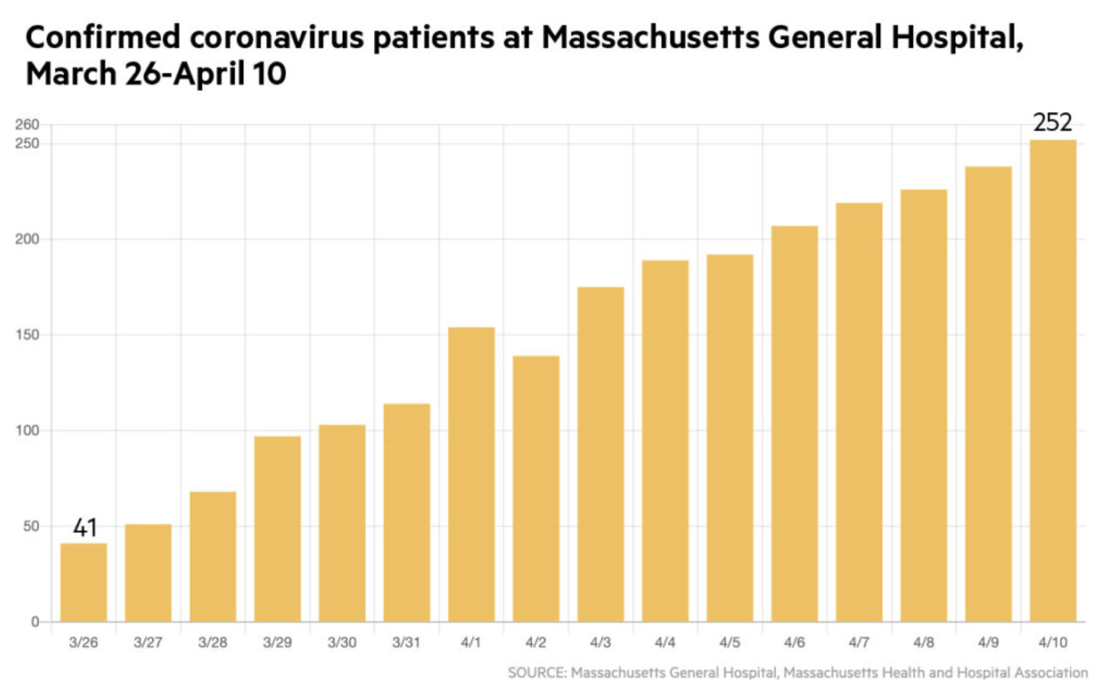
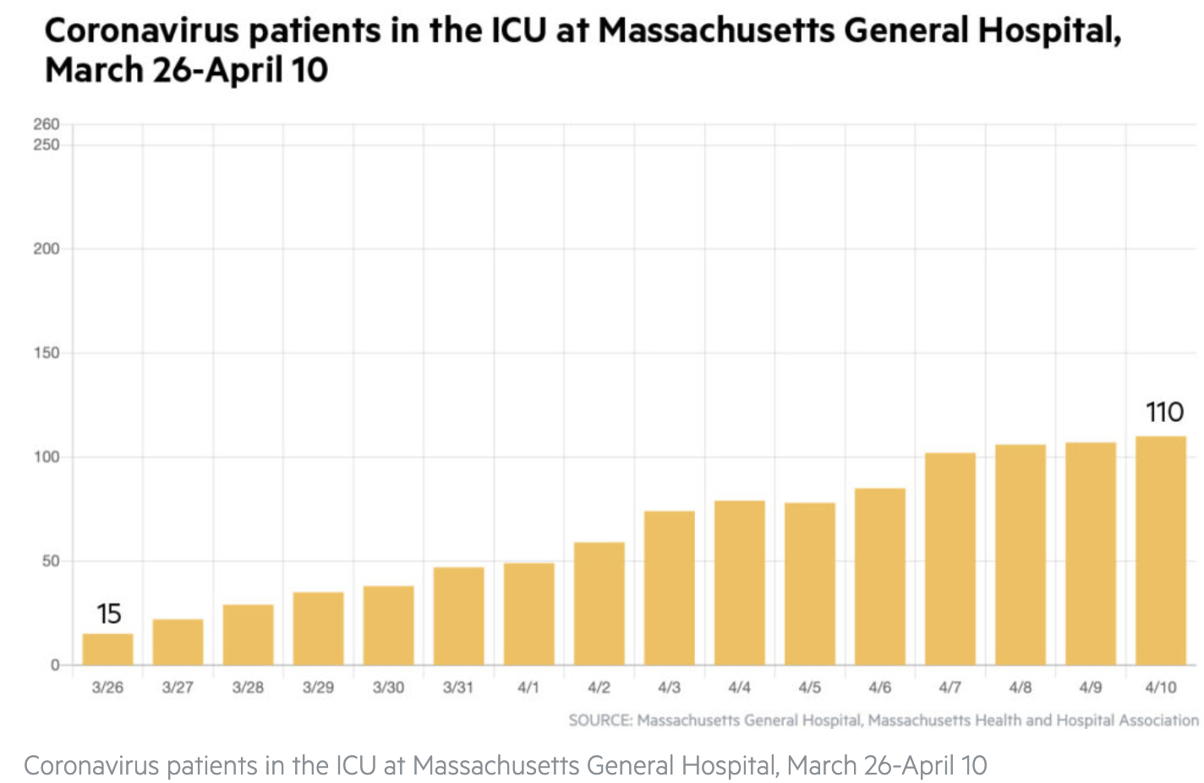
MGH COVID cases March 26th – April 10th
Notes:
This group is all too familiar with how the story went. In Boston, and at MGH specifically, the numbers of confirmed coronavirus patients continued to rise, as well as those in the ICU. What this graph does not show is that about a week later, at our peak, we had about 400 covid patients in the hospital. Not surprisingly, the volume of calls about mental status changes in patients with COVID also started to rise, as did our consults. Most of the experience I gained with covid -19 and its sequela came from these first few months, before we had monoclonal antibodies, or had a handle on steroids and remdesivir.

Slide 26
The Clinical Presentation
Baller et al., Psychosomatics 2020
Notes:
I’m starting with the clinical presentation on purpose - back in March, we knew very little, and really only had the clinical picture to guide us. We knew this clinical syndrome was caused by SARS-Cov-2 and that Wuhan, China had been particularly hit hard. If you can walk yourself back to March and April, you were presumed to be UNLIKELY to have it if you didn’t have a fever. Anosmia and diarrhea were barely characterized as symptoms, and the idea of asymptomatic transmission was completely foreign. But that’s where we were. At first the hospital was only testing for people for COVID if they had the most common symptoms. Once they liberalized testing to every person who came into the ED, we started noticing some patterns.

Slide 27
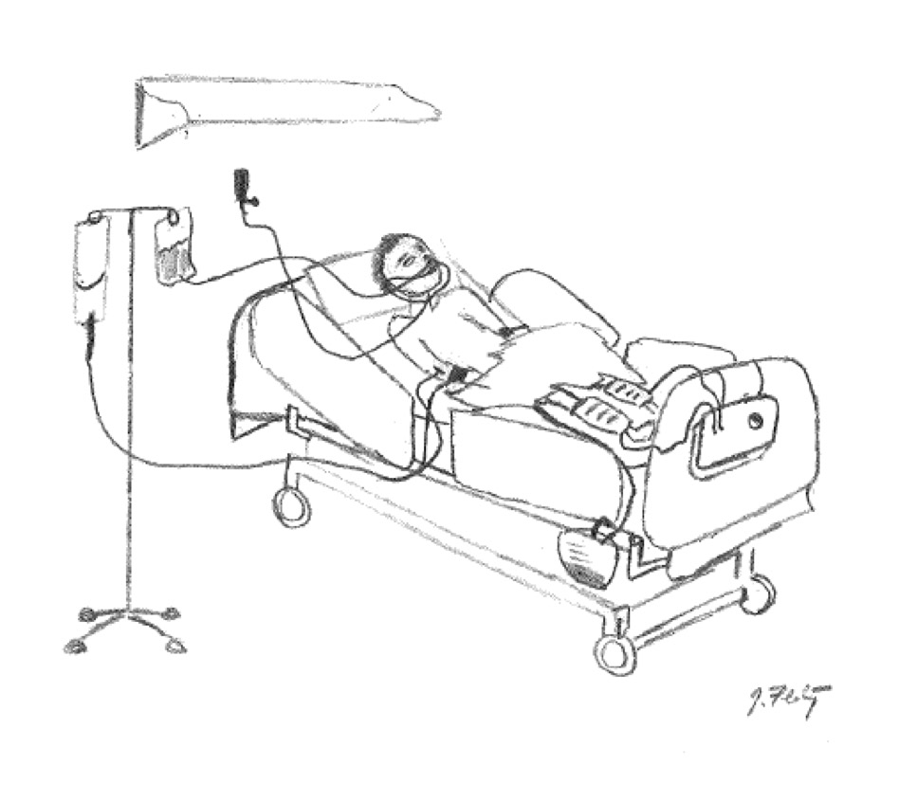
Mental Status
Delirium
Some with respiratory distress
Others, AMS was only symptom
Notes:
We see a lot of sick people in the ED, and sick people are often delirious. But the # of delirious patients seemed to be flying sky high. Some of them had the cardinal symptoms of COVID (fever, cough, sob). But others seemed well enough, with altered mental status being their only presenting symptom

Slide 28
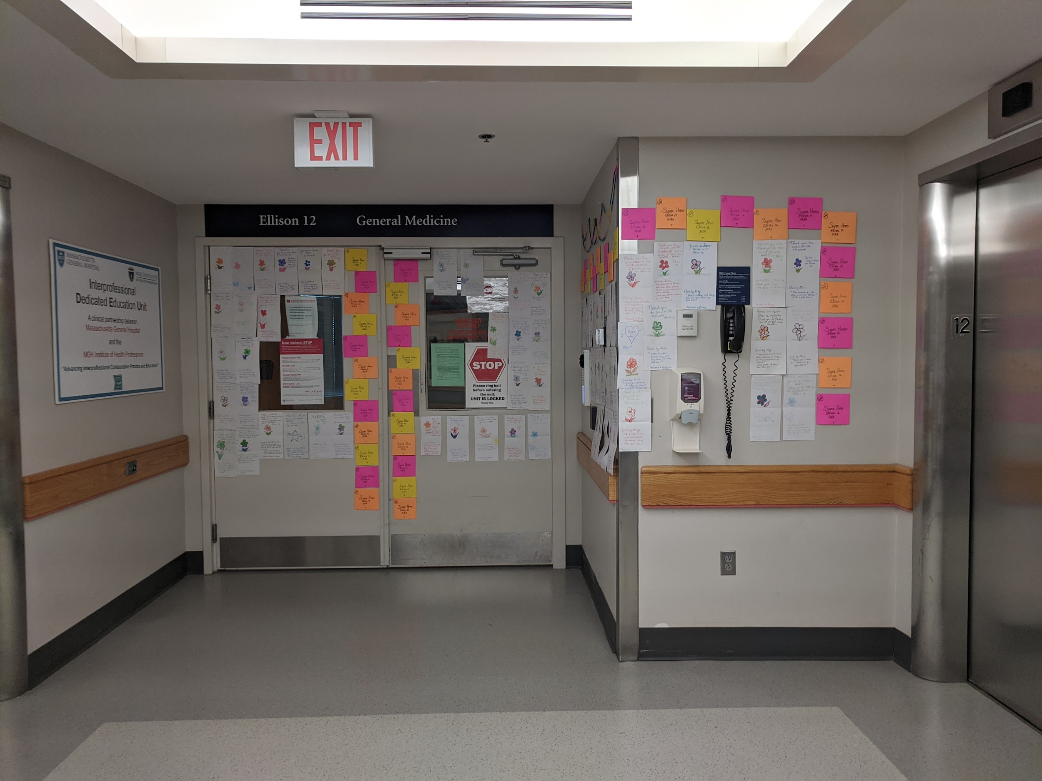
A strange hospital course
Agitated delirium
Catatonia
Difficult vent weaning
Notes:
We then started receiving calls from the floors. This is a picture I took of my first day back, on the entrance to one of our covid wards. I tell you, it is no fun to cross that threshold. Anyway, primary teams were reporting really wild agitation, and catatonia symptoms. Additionally, they were having an incredibly hard time getting people off of vents in the ICUs. We had a challenge at this time - our team was almost entirely quarantined, PPE was short, and we were trying to figure out how to do telepsychiatry. Given these strange signs and symptoms that teams were reporting, we made the decision that we were going to do in person examinations for these patients, with a special focus on the neurological assessment.

Slide 29
Our neurologic exam
Myoclonus
Rigidity
Abulia
Alogia
Normal Motor Exam
Abulia
Akinetic Mutism
Catatonia
Notes:
In addition to significant agitation and attentional impairment, examinations were notable for varying degrees of myoclonus (or involuntary muscle jerks), rigidity or stiffness, alogia or poverty of speech, and abulia, or low motivation. When we consider these symptoms together, they may seem disparate, but they actually lie on a continuum [click] from normal motor exam, to catatonia. And conditions on this continuum are often related to dopamine depletion conditions like Parkinson’s disease or even overblockade at the D2 receptor which we can see when we use high potency neuroleptics like haloperidol. In general, these symptoms were suggestive of two things. First, that COVID-19 somehow involved the nervous system, and the second is that it might involve the dopamine system.

Slide 30
Medications working differently
Alpha-2 agonists were great
Lower potency antipsychotics good
More EPS with higher potency D2 antagonists
Notes:
Interestingly, the covid-19 delirium group seemed to respond to medications differently (click click). Something was going on here.

Slide 31
How does a respiratory virus affect the brain?

Slide 32
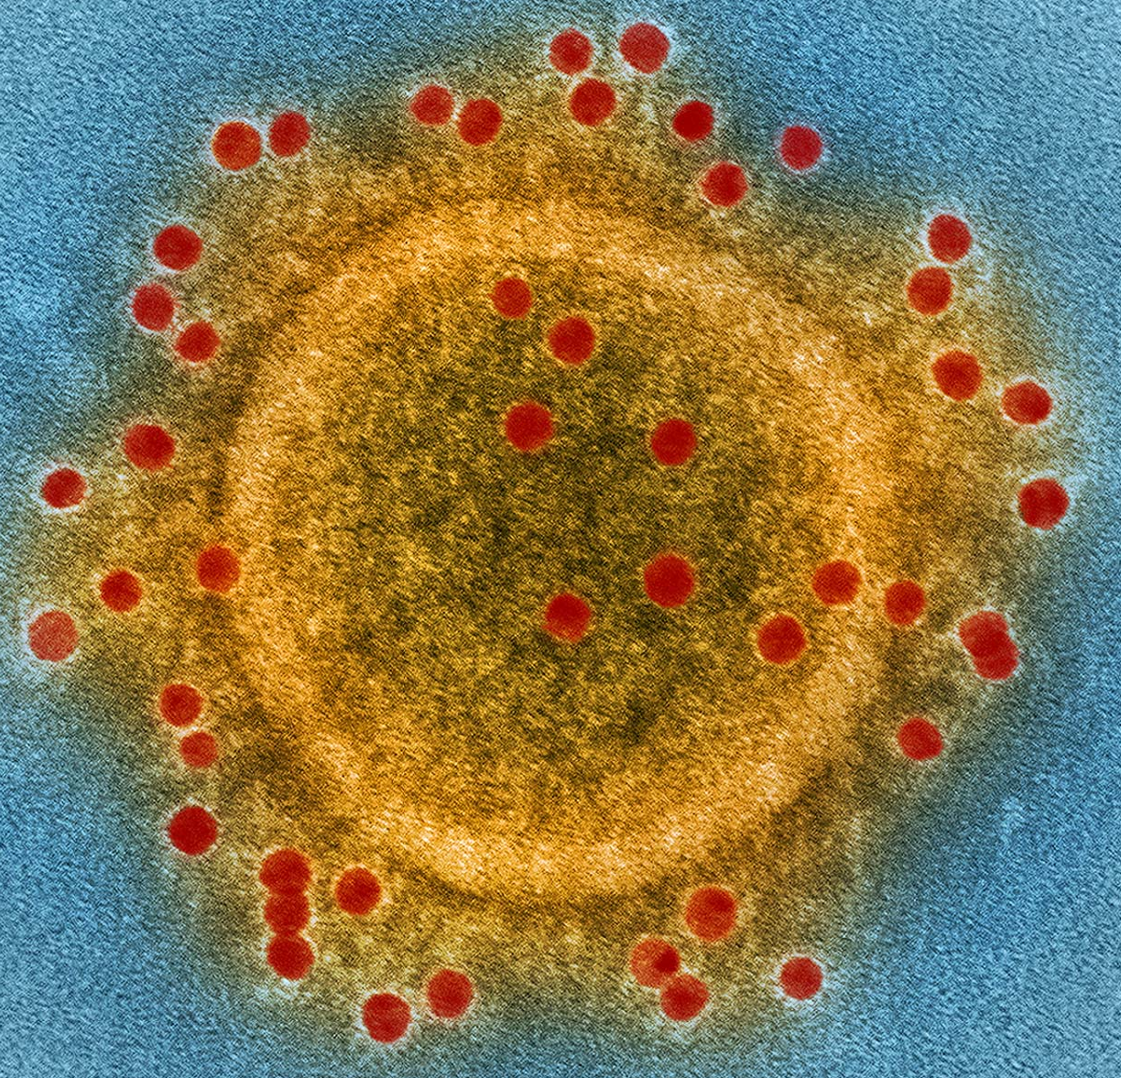
Have previous coronaviruses been associated with the CNS/PNS?
SARS-Cov
MERS-Cov
Polyneuropathy, myopathy and stroke
Autopsy: RNA in cortical neurons
Animal study: RNA in brainstem and hypothalamus
25% AMS, 9% seizures
Coma, ataxia, focal motor weakness
MRI T2 hyperintensities in cortex, basal ganglia, brainstem, cerebellum
Baller et al., Psychosomatics 2020
Notes:
To begin to answer that question, we asked a follow up. Have previous coronoaviruses been associated with the central nervous sytem? We reviewed that literature to see if it could in any way guide us in better understanding what we were seeing. In studies of Severe acute respiratory syndrome (SARS) [click], caused by SARS-Cov (-1): CNS symptoms included polyneuropathy, myopathy and stroke were often observed. [click] An autopsy study showed SARS-Cov RNA in cortical neurons and [click] an animal study, the viral RNA was deposited in brainstem and hypothalamus. In MERS (middle eastern respiratory syndrome coronavirus) [click], a study from Saudi arabia ¼ cases had altered mental status and 9% seizures, coma, motor deficits and weakness. MRI abnormalities throughout the brain were also noted. Taken together, these results strongly suggested the neuroinvasive potential of coronaviruses, though the mechanism of the invasion was not clear.

Slide 33
SARS Cov-2
Wuhan
AMS + stroke in 36% of admitted patients
Strasburg
85% with AMS, 69% with agitation
Corticospinal tract signs
Executive dysfunction
Imaging
Enhancement of leptomeningeal spaces
Hypoperfusion in frontal lobes
University of Michigan
Leptomeningeal enhancement
Baller et al., Psychosomatics 2020
Helms et al., NEJM 2020
Mao et al., JAMA Neurology 2020
Ragheb et al., BMJ Open 2021
Notes:
Early studies were starting to come out of china and Europe. [click] In wuhan, [click] 36% of the people had altered mental status [click] Strasburg [click] - 85% of people w/AMS. 69% agitation. They reported [click] Corticospinal track signs and [click] executive dysfunction, with a [click] subset having [click] leptomeningeal enhancedment and [click] hypoperfusion in frontal lobes on imaging. At this point, it seemed likely that there was CNS invasion, which was confirmed in Follow up studies at [click] university of Michigan. They too showed [click] enhancement of leptomeningeal spaces c/f encephalitis. The question is, how did it get into the CNS?

Slide 34
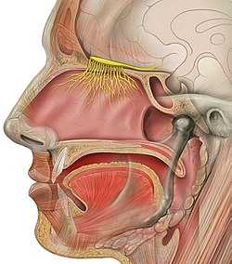
Anosmia
Up to 80% of COVID-19 infections
Autopsy study of 33 patients
1/3 had altered mental status
2/3 SARS-Cov-2 RNA in nasal mucosa
1/3 RNA in olfactory bulb
Lower levels in oral mucosa and carotid artery
Meinhardt et al., Nature Neuroscience 2020
Notes:
Back to Spring 2020. Another weird symptom was starting to crop up in COVID patients, anosmia – or inability to smell. This quickly gained traction [click] as people realized that up to 80% of patients were presenting with loss of smell. Fast forward to a few months ago, in an autopsy study of 33 patients with COVID, 1/3 had experienced altered mental status, 2/3 had virus in nasal mucosa, and 1/3 in olfactory bulb & cerebellum. Interestingly, there were lower levels of virus in the oral mucosa and in the carotid artery, indicating that this was not just hematogenous spread. It strongly suggested that nasal entry might be really important.

Slide 35
CNS Invasion through olfactory bulb
Adapted from Kumar et al., J Mol Neurosci 2021
Notes:
Kumar and colleagues put forth a similar pathophysiologic hypothesis, that the most likely direct path SARS-cov-2 takes to get into the CNS is through the nose.
Specifically, virus in the nose binds to intranasal ace2 receptors on the olfactory mucosa, which sit just a cribriform plate away from the olfactory bulb. [click[. They propose that the virus then crawls up the synapse via retrograde transmission, and makes its way to the CNS.

Slide 36
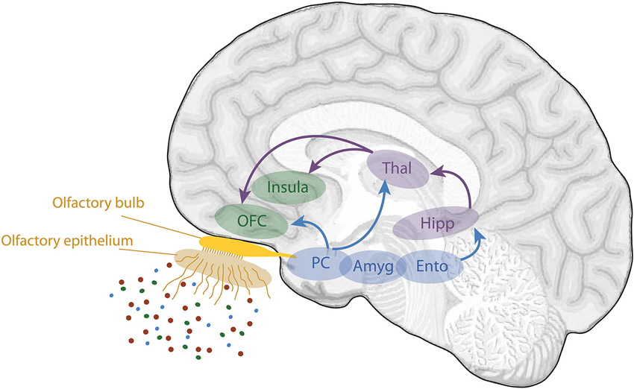
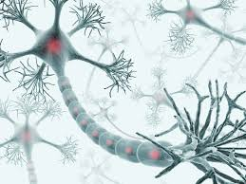
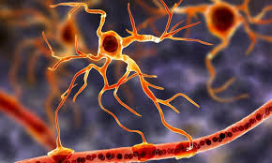
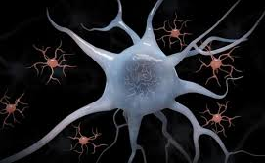
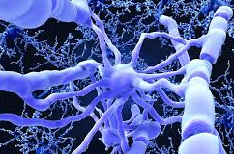
SARS-Cov-2 Attachment in brain
Adapted from Kumar et al., J Mol Neurosci 2021
Notes:
Once in the cns, the virus has free reign. Neurons, astrocytes, microglia and oligodendoctyes all have that ACE2 receptors. Furthermore, the olfactory bulb sends direct projections to hippocampus, amygdala, and [click]. orbitofrontal cortex. I want to pause here for a moment because this is really important. Remember how we talked about the weird exam findings? Catatonia, akinetic mutism, abulia? These motor findings are often associated with lesions to that medial forebrain area, right next to that cribriform plate, where Sars-Cov-2 can directly deposit.

Slide 37
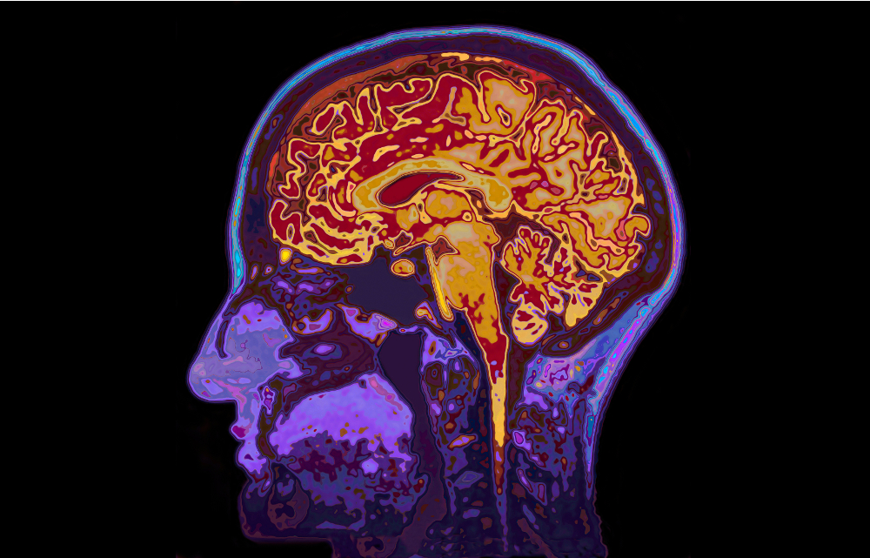
COVID-19 Delirium
Cytokine Storm
Prolonged Intubation
CNS Sequelae
Notes:
But that isn’t the whole story. Not all autopsy samples showed covid 19 in the actual brain, and not all patients have the same exam. For the second part of this talk, I will walk you through other pathophysiologic mechanisms that result in AMS secondary to COVID, including [click] cytokine storm, [click] prolonged intubatation, and [click] cns sequala.

Slide 38
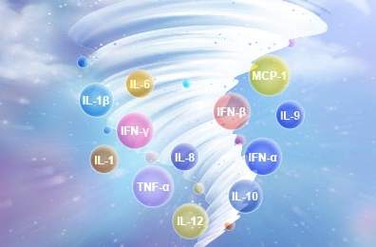
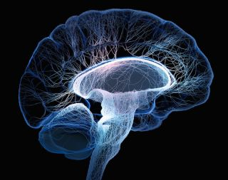
Cytokine Storm
Notes:
Here with have the brain, the blood brain barrier, and the cytokines and immune cells hanging out nicely in the lumen of the vessels. To the right is one of those funny pictures that you get if you google a cytokine storm.

Slide 39
Cytokine Storm
INFECTION ->
Notes:
In the setting of an infection

Slide 40
Cytokine Storm
INFECTION ->
Notes:
The blood-brain-barrier loosens

Slide 41
Cytokine Storm
INFECTION ->
Notes:
Allowing all of those cytokines to flow out of the lumen

Slide 42
Cytokine Storm
INFECTION ->
Notes:
And deposit in the brain. Cytokines then stimulate macrophages, which can also carry virus into the brain as well.

Slide 43
Cytokine Storm
INFECTION ->
Notes:
A quick note about the blood brain barrier – it is especially leaky right here [click], in that medial prefrontal area, that same area that is thought to relate to our motor findings. And, if you recall, that same area that the olfactory bulb sits next to. We suspect that this inflammatory response is also related to our altered mental status findings.

Slide 44
COVID-19 Delirium
Cytokine Storm
Prolonged Intubation
CNS Sequelae
Notes:
And there is more…

Slide 45
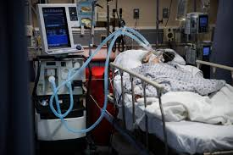
Prolonged Intubation
DEEP sedation (RASS -5)
Sedated for a LONG time
Propofol, midazolam, fentanyl
No family for redirection
Ragheb et al., BMJ Open 2021
Notes:
You’ll remember that there was a huge ventilator shortage early in the pandemic, to the point where GM stopped making cars and started making ventilators. [click] Why the big deal about covid? Well, these people had such profound fluid in their lungs that they needed a really high PEEP or positive end expiratory pressure, to keep them from collapsing. As such, “click” you need DEEP sedation (Richmond agitation sedation scale of -5), which essentially means these patients are paralyzed so their muscles provide no resistance to the ventilator [click]. And they required sedation for a long time. Furthermore, they were often sedated with highly deliriogenic medications such as [click], the gabaergic medications propofol and midazolam, and opiates such as fentanyl drips. This care takes place in the ICU, which is already disruptive. Given the infectious nature of the virus, staff minimize their interactions and there is no family around for reorientation. This is a recipe for protractracted delirium

Slide 46
COVID-19 Delirium
Cytokine Storm
Prolonged Intubation
CNS Sequelae
Notes:
These patients’ brains also experiences sequelae of the peripheral processes occurring in their bodies.

Slide 47
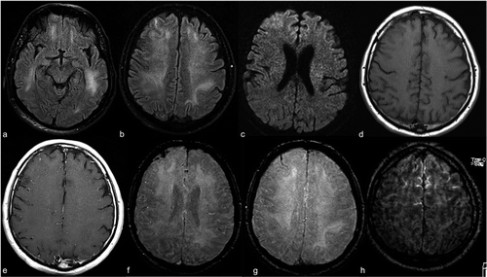
CNS Sequela
Stroke
Hemorrhage
Seizure
Ntaios et al., Stroke 2020
Ragheb et al., BMJ Open 2021
Notes:
COVID-19 is associated with significant hematologic abnormalities, with a high risk of both bleeding and clotting, leading to stroke[click] and hemorrhage[click]. These neural insults greatly increased the risk of seizures, further worsening patients’ mental status.

Slide 48
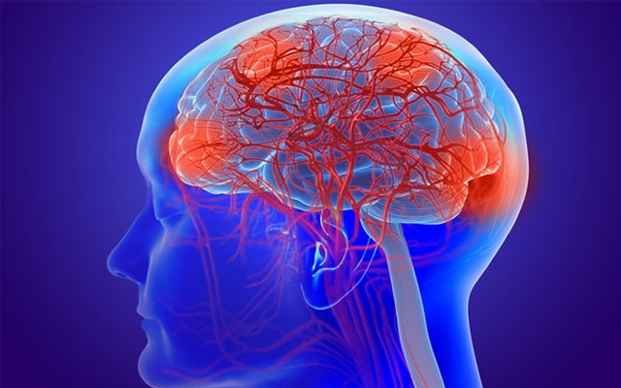
Summary of Pathophysiology
Prolonged Intubation
CNS Invasion
Sleep/wake
Cytokine Storm
Multiorgan disease
Immobilization
CNS Sequelae
Steroids
Hypoxia
Notes:
And this is in addition to the “normal” causes of delirium. In summary, numerous factors converge on the brain to lead to covid delirium.

Slide 49
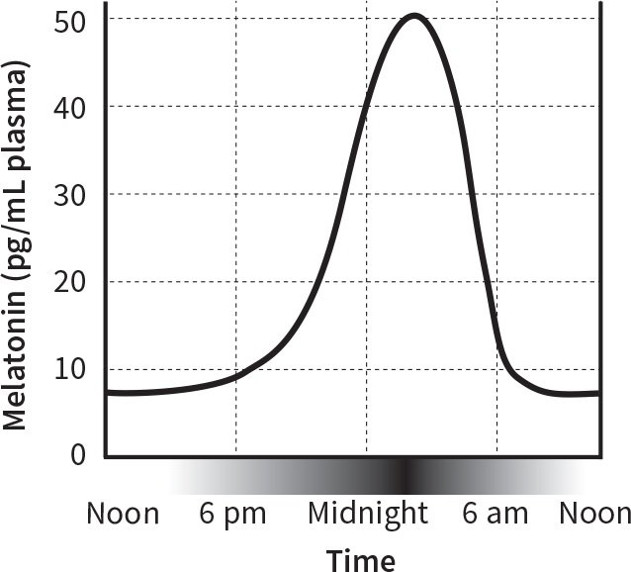
Treatment
Melatonin
Low in delirium
Sleep/wake regulation
Immune modulation *
Notes:
A brief on treatment, which is it’s own whole talk. The meat of the paper I lead focused on unique pharmacologic recommendations for covid delirium. We borrowed from normal delirium literature, and have extrapolated due to what we know re: covid. I will start with Melatonin -> not only is it known to be low in delirious patients, and not only does it help with sleep/wake cycle regulation, it is immune regulating and has even been implicated in the treatment of ebola. Unless someone is severely immunocompromised, we recommend all covid patients be on it.

Slide 50
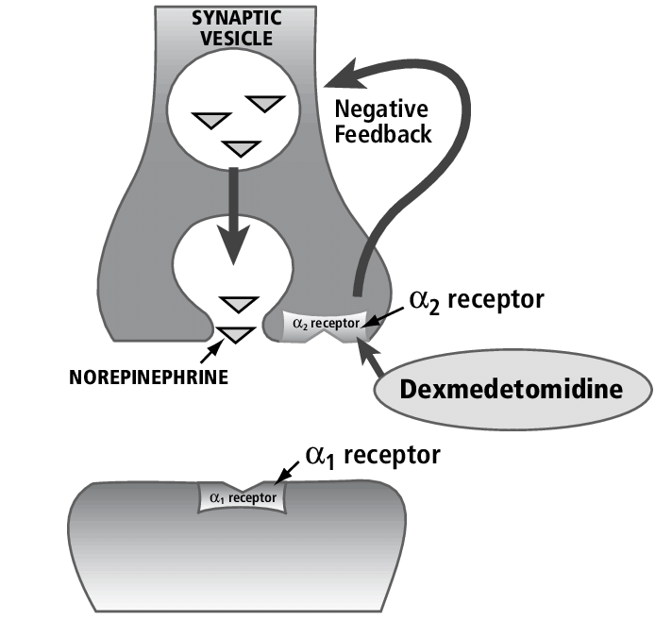
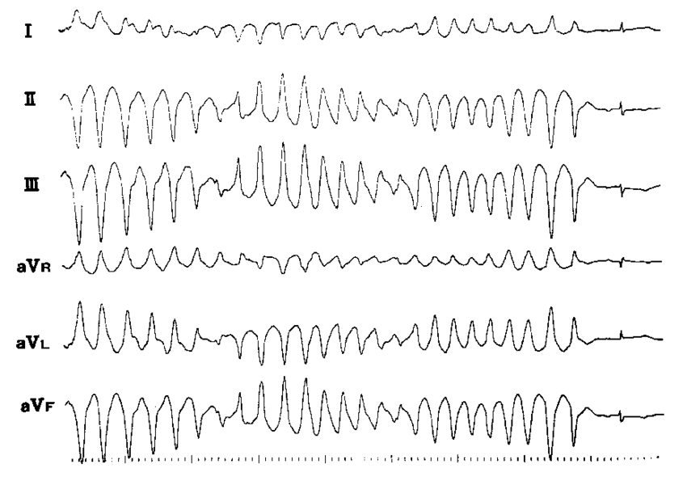
Treatment
Alpha-2 agonists
Dexmedetomidine
Clonidine
Notes:
Alpha-2 agonists, especially dexmedetomidine in the ICU and clonidine on the floors) seemed to be great. Mechanistically, they bind to presynaptic receptors and shut down the secretion of more norepi and epi. They are excellent benzo and opiate sparing sedating medications. [click] They are also great as they do not prolong the qt and increase risk for torsades. The challenges are that you are limited if someone is hypotensive or bradycardic.

Slide 51
Treatment
Antipsychotics
Default to low potency agents
Olanzapine
Quetiapine
Chlorpromazine
If no motor symptoms, IV haloperidol and monitor closely
Notes:
Neuroleptics[click] are also an option and we used them liberally, usually in addition to alpha-2 agents or if patient experienced significant psychosis. We defaulted to [click] low potency agents given the motor symptoms we were observing. If there were no motor signs, IV haloperidol is a good option- it does not have any respiratory sedation associated with it, and also has binding through the sigma receptor, which is known to be related to immune function. If you all recall, earlier this year, there was a study that showed that taking 300 mg of fluvoxamine could reduce the rate of hospitalization for people diagnosed with covid. The mechanism here was also due to fluvoxamine’s action at the sigma 1 receptor. If you do use haloperidol, we recommend monitoring the motor exam closely.

Slide 52
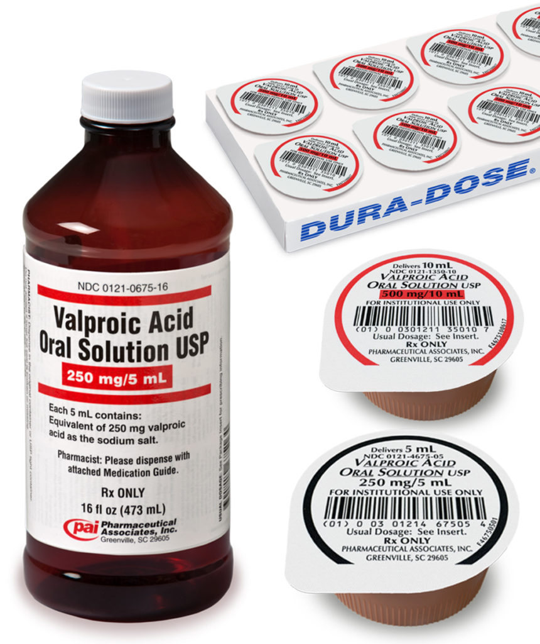
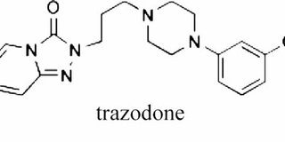
Treatment
Valproic acid
Good for patients with stroke/seizures
Trazodone
Can be useful in elderly patients
Notes:
Valproic acid, assuming the patient has good liver and pancreas function, is another great choice. IT is especially good for people who have had strokes or are seizing. Lastly, trazodone is another option. A lot of the super sick people are elderly, and there is moderate evidence for agitation treatment in elderly patients with neurocognitive disorders. It also spares the respiratory centers and does not work directly through the dopamine system.

Slide 53
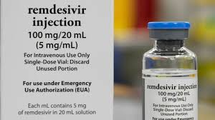
Special consideration: remdesivir
Metabolized by CYP3A4 and 2D6
Always do interaction check
Notes:
A note on Remdesivir, which is used widely now. It is metabolized by 3a4 and 2d6, and can lower the levels of carbamazepine and phenytoin. Recommend doing an interaction check.

Slide 54
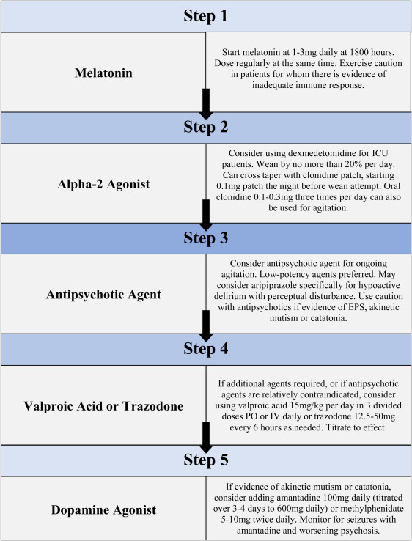
Algorithm
Baller et al., Psychosomatics 2020

Slide 55
Thanks to my MGH COVID-19 Delirium team!
Scott Beach, MD
Charlotte Hogan, MD
Nathan Praschan, MD
Ana Ivkovic, MD
Lizzy Madva, MD
Felicia Smith, MD
Mladen Nisavic, MD
Mark Fusunyan, MD
James Luccarelli, MD
Nadia Quijije, MD

Slide 56
Post-Acute Sequelae of COVID-19 (PASC):
Clinical Findings and Treatment
Christian G. Hicks Puig, MD

Slide 57
CLP 2021 Disclosure: Christian Hicks Puig, MD
With respect to the following presentation, there has been no relevant (direct or indirect) financial relationship between the party listed above (and/or spouse/partner) and any for-profit company which could be considered a conflict of interest.

Slide 58
Outline
Case example
Nomenclature and definitions
What we know about clinical findings
Ideas about treatment
Follow-up on case

Slide 59
Prototypical case
Typical case
57yo married woman, OBGYN RN, history of asthma, seasonal allergies, no psychiatric history except feeling very sad after her 17yo brother died in 1995 which did not significantly impact functioning, never psychiatric medications.
Significant COVID illness in March 2020, admitted two weeks to general medical ward, desat to 70s, 6L NC never more, other treatment included Tocilizumab, discharged to rehab for 1 week, then home. Has not worked since.
New sx include fatigue, dyspnea, pain, subjective cognitive impairment, low mood, anxiety.
54yo married woman, research coordinator, history of seronegative RA, mixed connective tissue disease, fibromyalgia, vague depressive symptoms, one past sub-therapeutic trial of Prozac after divorce in 1995. PMD currently prescribes Cymbalta 20mg daily for pain, Xanax 0.5mg nightly for insomnia.
Since mild COVID illness in November 2020 she has experienced new profound fatigue, headaches, orthostasis, subjective cognitive impairment, anxiety, depressed mood, and insomnia.
Notes:
Randomly happened to be two women

Slide 60
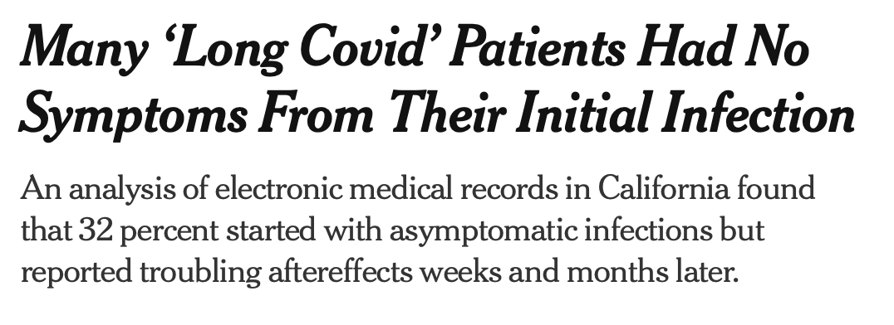
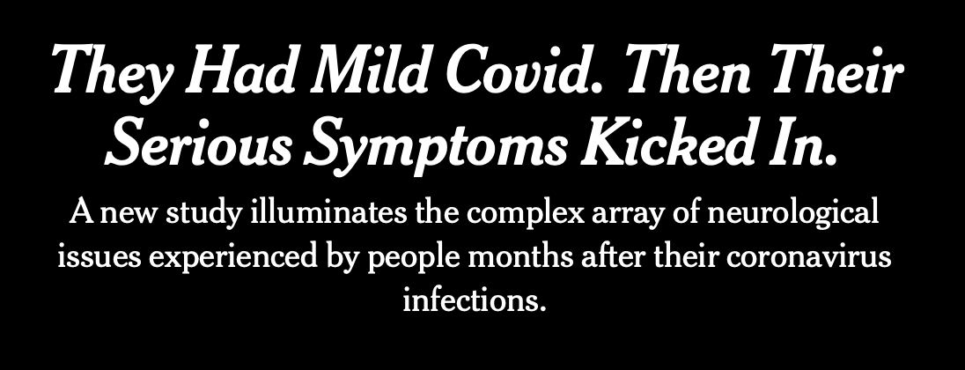
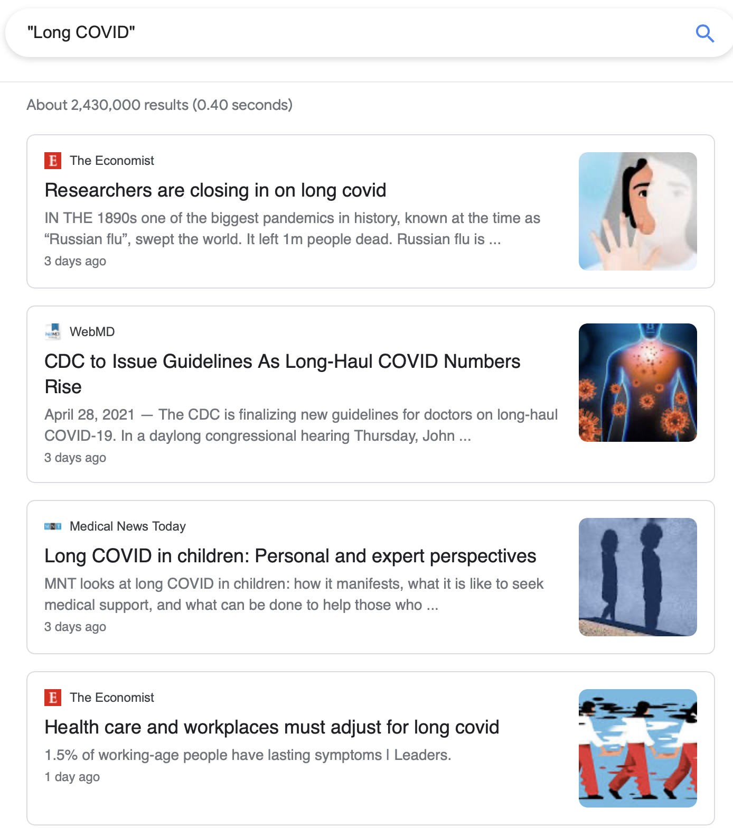

Slide 61
Definitions and Nomenclature
Acute | Less than 3-4 weeks
Post-Acute Sequelae of SARS COV-2 (PASC) Long Haul COVID Long COVID | Greater than 3-4 weeks Chronic: Greater than 12 weeks
CDC definition: “Long COVID is a range of symptoms that can last weeks or months after first being infected with the virus that causes COVID-19 or can appear weeks after infection. Long COVID can happen to anyone who has had COVID-19, even if the illness was mild, or they had no symptoms.”
Notes:
From this point forward I will call all persistent symptoms from COVID-19 infection occuring greater than 3-4 weeks from initial infection, Long COVID

Slide 62
“Discovery” of Long COVID: Epidemiology
 | Location | Design | N | Type of patient | Follow-up | Symptoms
Huang et al. (1/2021) | Wuhan | Prospective No control | 1,733 | Hospitalized | 6 months | Any (76%) Fatigue or muscle weakness (63%) Pain or discomfort (27%) Sleep difficulties (26%) Anxiety or depression (23%)
Conclusion: Many of those hospitalized with COVID-19 experience persistent symptoms
This does not prove that COVID-19 itself was the cause of persistent symptoms. Additional hypotheses included: any respiratory tract infection, hospitalization, social factors etc.
How can we control for these confounding factors?
Huang C, Huang L, Wang Y, et al. 6-month consequences of COVID-19 in patients discharged from hospital: a cohort study. The Lancet. 2021;397(10270):220-232.
Notes:
Introduce a few studies that led us to our current understanding of Long COVID

Slide 63
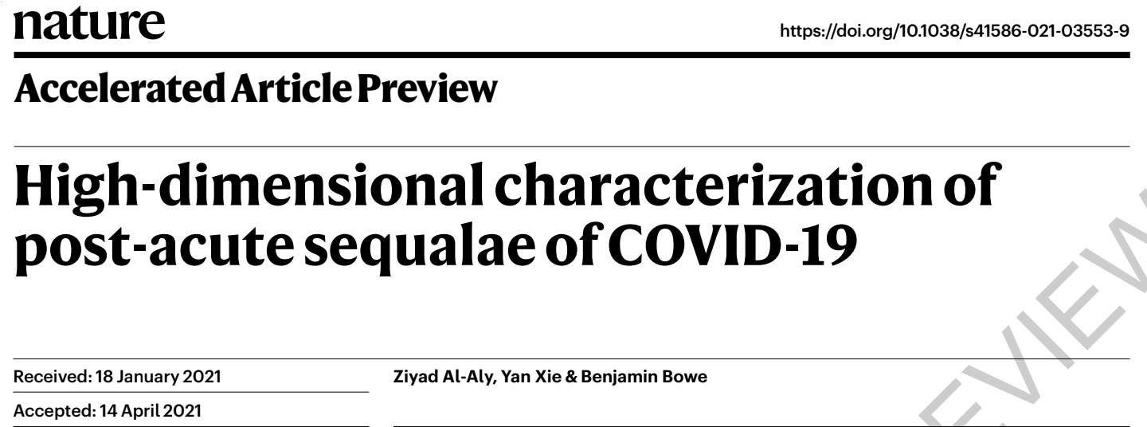
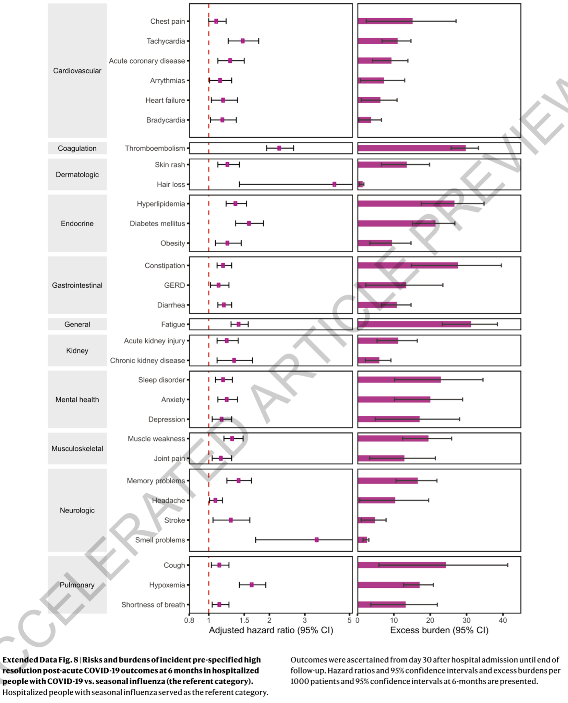
“Discovery” of Long COVID: Epidemiology
 | Location | Design | N | Groups | Follow-up | Symptoms
Al-Aly et al. (4/2021) | US Veterans | Retrospective | 73,435 | Non-hospitalized Hospitalized (floor) ICU Flu COVID-19 | 6 months | Respiratory Hypertension Sleep-wake MSK pain Malaise and fatigue Anxiety or Depression
Conclusions:
Those with COVID-19 experience persistent symptoms statistically significantly more than those with seasonal influenza.
Primary symptoms include: Respiratory symptoms, tachycardia/palpitations, anosmia/parosmia, memory problems, anxiety, depression, sleep difficulties, fatigue, weakness
Al-Aly Z, Xie Y, Bowe B. High-dimensional characterization of post-acute sequalae of COVID-19. Nature. Published online April 22, 2021.
Notes:
This was the highest quality study comparing various groups through the pandemic and the presene of persistent symptoms.
After this study was released “long COVID” gained credibility as a distinct clinical entity separate from the myriad factors affecting those living through the pandemic

Slide 64
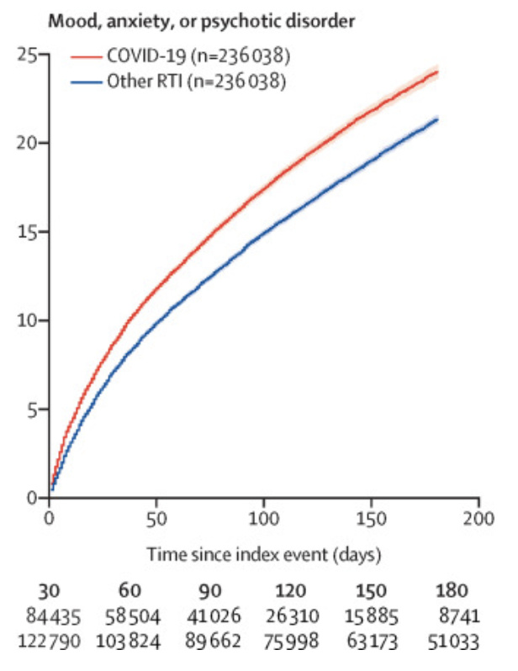
“Discovery” of Long COVID: Epidemiology
 | Location | Design | N | Groups | Follow-up | Symptoms
Taquet et al. (4/2021) | UK group American pts TriNetX EMR | Retrospective cohort COVID: 236,379 Flu: 105,579 RTI: 236,038 | 236,379 | COVID+ Inpts and outputs | 6 months Neuropsych sx | All (33.62%, ICU: 46.42%) Anxiety (17.39%, 6.8% new) Mood (13.6%, 4.22% new) Insomnia (5.4%) Psychosis (2.77%) Any first mood, anxiety, psychosis (8.63%)
Conclusion:
Those with COVID-19 are more likely to suffer chronic neuropsychiatric symptoms such as anxiety, depressed mood, psychosis, and insomnia than those with influenza or other RTI.
Other studies have demonstrated persistent mood and anxiety symptoms.
Zhang et al. Depression by PHQ-9 in 29.2% (N = 205, statistically significant, controls of quarantine, gen public)
Mazza et al. Depression by BDI in 31% (N = 402, non-controlled)
Mazza MG, De Lorenzo R, Conte C, et al. Anxiety and depression in COVID-19 survivors: Role of inflammatory and clinical predictors. Brain, Behavior, and Immunity. 2020;89:594-600.
Zhang J, Lu H, Zeng H, et al. The differential psychological distress of populations affected by the COVID-19 pandemic. Brain, Behavior, and Immunity. 2020;87:49-50.
Taquet M, Geddes JR, Husain M, Luciano S, Harrison PJ. 6-month neurological and psychiatric outcomes in 236 379 survivors of COVID-19: a retrospective cohort study using electronic health records. The Lancet Psychiatry. 2021;8(5):416-427.

Slide 65
Summary of common clinical findings and phenomenology
Persistent Symptom | Proportion of patients affected by symptom | Approximate time to symptom resolution
Common physical symptoms
Fatigue | 15 - 87% | 3 months or longer
Dyspnea | 10 to 71% | 2 to 3 months or longer
Chest discomfort | 12 to 44% | 2 to 3 months
Cough | 17 to 34% | 2 to 3 months or longer
Anosmia | 10 to 13% | 1 month, rarely longer
Less common physical symptoms
Joint pain, headache, sicca syndrome, rhinitis, dysguesia, poor appetite, dizziness, vertigo, myalgias, insomnia, alopecia, sweating, and diarrhea | <10% | Unknown (likely weeks to months)
Psychiatric and neurocognitive
Post-traumatic stress disorder | 7 to 24% | 6 weeks to 3 months or longer
Impaired memory “Brain Fog” | 18 to 21% | Weeks to months
Poor concentration | 16% | Weeks to months
Anxiety/depression | 22 to 23% | Weeks to months
Reduction in quality of life | >50% | Unknown (likely weeks to months)
Multi symptom, multi system syndrome
Risk of Long COVID is proportional to severity of Acute COVID (Dr. Quinn)
Symptoms and deficits also reported in those without hospitalization
Trends seem to show that recovery over time is common
Mikkelsen M, Abramoff B. COVID-19: Evaluation and management of adults following acute viral illness. In: UpToDate, Post TW (Ed), UpToDate, Waltham, MA. (Accessed on September 26, 2021.)

Slide 66
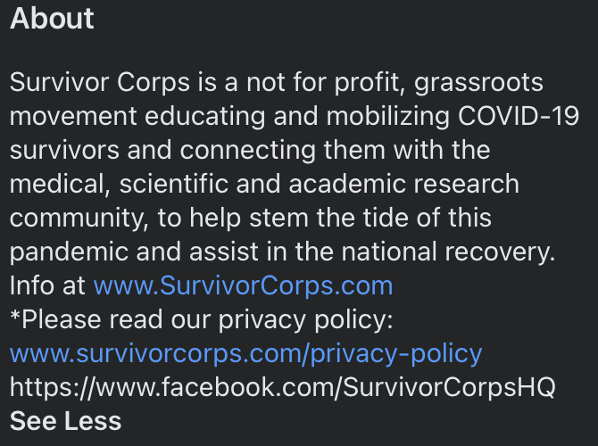
What is known about treatment
Consensus on importance of rehabilitation
System/symptom-specific care
Multidisciplinary care
Support groups
Histamine blockers?
Experimental glaucoma medication?
Anecdotes:
How to talk to patients: Advice from world of chronic lyme
Pharmacology: Start low go slow
Hohberger B, Harrer T, Mardin C, et al. Neutralization of Autoantibodies Targeting G-Protein Coupled Receptors Improves Capillary Impairment and Fatigue Symptoms after Covid-19 Infection. Social Science Research Network; 2021.
Liu K, Zhang W, Yang Y, Zhang J, Li Y, Chen Y. Respiratory rehabilitation in elderly patients with COVID-19: A randomized controlled study. Complementary Therapies in Clinical Practice. 2020;39:101166.
Alper K. Case report: famotidine for neuropsychiatric symptoms in covid-19. Front Med. 2020;7:614393.

Slide 67
Follow-up on case: 2 months later
Very slowly increased Cymbalta up to 50mg daily
Behavioral activation
Participation in online support group
Improved mood, less tearful
More calm, adaptable
Fatigue mildly improved
Cognitive difficulties mildly improved
Improvement in mood, pain

Slide 68
Summary
Future directions for research (per NIH)
Long COVID is a clinically distinct phenomenon, with prominent symptoms including:
Fatigue, dyspnea, changes to mood and anxiety, cognitive changes
Recovery is common
CL psychiatry is positioned within medicine to play an integral part of assessment and care of this population.
Common terminology and case definitions
Characterization of epidemiology (including incidence and prevalence of various phenotypes in the full spectrum of patients and in diverse communities)
Description of clinical spectrum and natural history of various phenotypes
Identification of risk factors, including comorbid conditions, severity of initial disease, viral characteristics, host genetics, and host immune response
Understanding of pathophysiology
Characterization of the influence of therapeutics for acute disease and vaccines in preventing or modulating postacute COVID-19
Identification of therapeutic and preventive strategies for post-acute COVID-19
Lerner AM, Robinson DA, Yang L, et al. Toward understanding covid-19 recovery: national institutes of health workshop on postacute covid-19. Ann Intern Med. Published online March 30, 2021:M21-1043.

