Slide 1
ACLP Diversity, Equity and Inclusion (DEI) Task Force: Promoting Critical Change for Our Trainees, Members, Patients and Field Incorporating DEI into Education
Kristin Beizai, MD, FACLP
HS Clinical Professor of Psychiatry, University of California, San Diego
Program Director, Consultation-Liaison Psychiatry Fellowship, UC San Diego
Medical Director, Integrated Hospital-Based Programs, VA San Diego Health Care System

Slide 2
CLP 2021 Kristin Beizai, M.D.
With respect to the following presentation, there has been no relevant (direct or indirect) financial relationship between the party listed above (and/or spouse/partner) and any for-profit company which could be considered a conflict of interest.

Slide 3
Task Force DEI in Education Review Process
Charge: Develop proposal on how to incorporate DEI into curriculum/webinars/member development resources, including those used by CL Fellowship Program Directors and Faculty
Review Process: Literature, input from ACLP committees and subcommittees, review of ACLP website, AADPRT and AAMC materials

Slide 4
Framework Transition: Cultural Competence to Cultural Humility
Cultural Competence Framework: Developed in response to the rapidly evolving demographic composition of the US, with need to develop increased diversity in the healthcare workforce and skills to deliver quality of care for diverse patient populations
Cultural Competence: The acquisition of cultural knowledge about population subgroups, the adoption of culturally sensitive attitudes, and the acquisition of cross-cultural skills
Framework was housed within ACGME competency domains
Model curricula approached competency across training years, with developmental trajectory; comprehensive training extended to areas of diversity beyond race/ethnicity
Corral et al, 2017
Trinh et al 2020

Slide 5
Critiques of Cultural Competence Framework
Assumed there was a quantifiable set of attitudes and communication skills
Utilized a categorical approach (ascribing values, beliefs, and behaviors to broad cultural groups) that may lead to stereotyping
Implied final and static goal of medical knowledge acquisition
Ignored power dynamics
Ignored more nuanced perspective (intersectionality) including individual, interpersonal, and societal influences
Corral et al, 2017
Trinh et al 2020

Slide 6
Cultural Humility
Cultural Humility: Ability to maintain an interpersonal stance that is open in relation to aspects of cultural identity that are most important to the patient
Continual process, requires self-reflection, self-critique, active listening, relationship-building
Patient-centric: Emphasizes patient-focused interviewing and care
Understand how personal biases and stereotyping may affect treatment
Minimizes power imbalance
Acknowledges the dynamic and multidimensional nature of culture
No assumption of cultural competence
Normalizes the process of not knowing
Culturally humble, with patient care and teamwork with diverse members
Hook et al 2013
Trinh et al 2020
Yeung et al 2018

Slide 7
Questions for the ACLP DEI Education Review
Are there current standards or expectations within CL Psychiatry?
What educational resources specific to CL Psychiatry exist?
Which, including workshops or trainings, should be revised, developed or expanded?
Who is our target population, our community? Members, trainees, program directors…and others?

Slide 8
ACGME Requirements for Consultation-Liaison Psychiatry 7/1/2020
General | Programs must understand the social determinants of health of the populations they serve and incorporate them in the design/implementation of the curriculum, with the goal of addressing these health disparities
Medical Knowledge | American culture and subcultures, including immigrant populations, particularly those found in the patient community associated with the educational program, with specific focus on the cultural elements of the relationship between the fellow and the patient including the dynamics of differences in cultural identity, values and preferences, and power.
Systems-based Practice | Fellows must demonstrate an awareness of and responsiveness to the larger context and system of health care, including the social determinants of health, as well as the ability to call effectively on other resources to provide optimal health care.
Quality Improvement | Fellows must receive training in QI processes, including an understanding of health care disparities and participate in interprofessional QI aimed at reducing health care disparities

Slide 9
Review of ACLP Website Educational Resources
Monthly Webinars
Quarterly Annotations
Bibliography (including specialty bibliographies)
Live Learning Center/MOC Program
Clinical Pearls: Videos
Clinical Monographs
Resident Curriculum (PPTs) - 2014
Resident CL How To Guides - 2020
Program Directors Clinical Vignettes for Fellow Evaluation - 2011

Slide 11
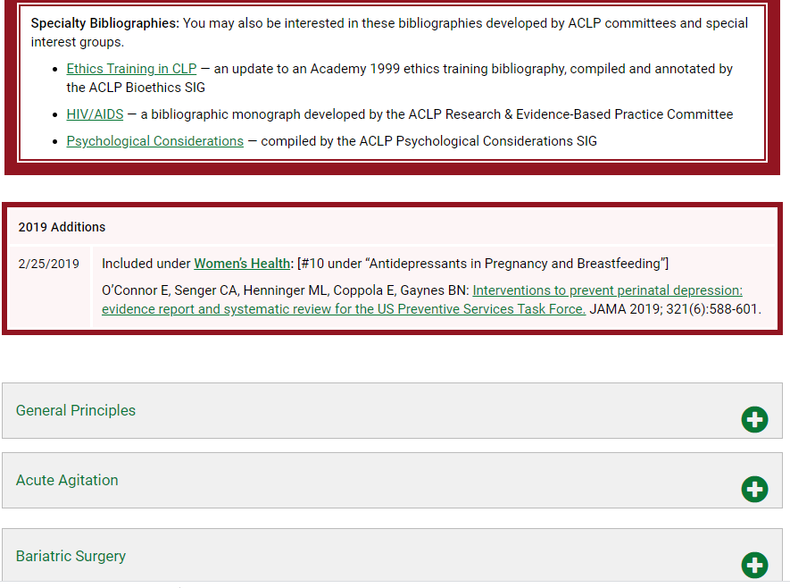

Slide 12
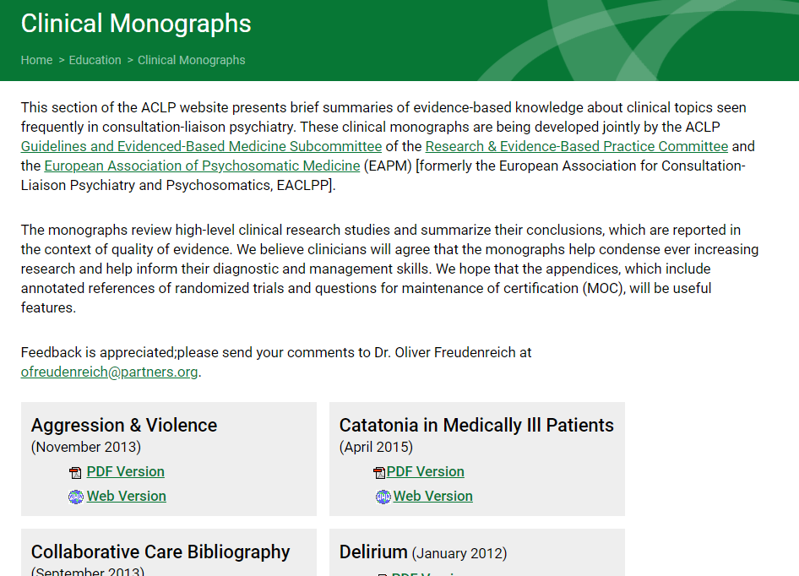

Slide 14
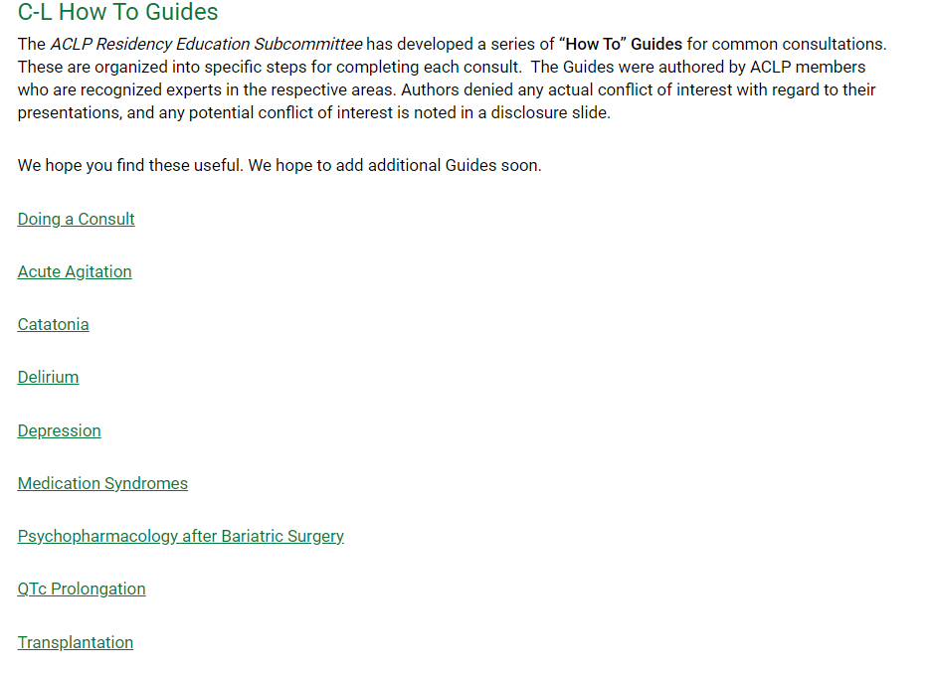

Slide 16
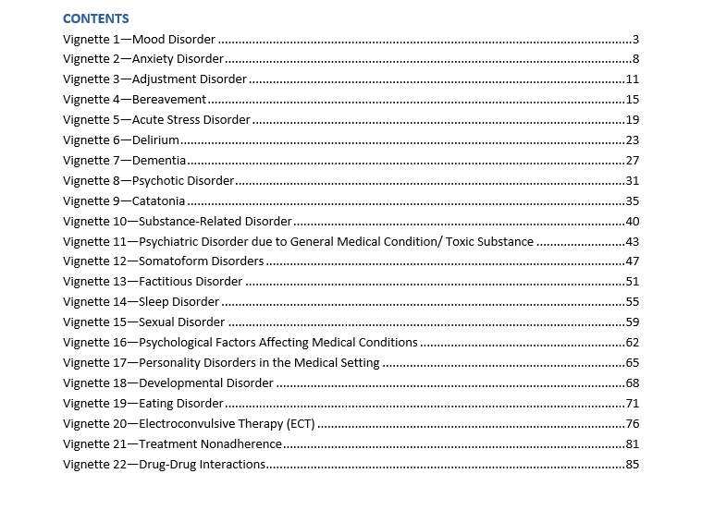

Slide 17
Educational Gaps
Gaps in integration of cultural humility, structural competency and DEI across materials
Individual, interpersonal, and structural barriers that may prevent culturally diverse populations from obtaining mental health services
Implicit biases that may interfere with clinical judgment and working to address biases
The application of knowledge of cultural differences in the symptomatic presentation to clinical formulation
Evaluating and incorporating cultural strengths in treatment interventions
Evidence-based psychological and pharmacologic interventions specific for diversity
Identifying ethno-pharmacologic factors that may influence response

Slide 18
Recommendations
Develop expectations and standards of structural competency, cultural humility, culturally appropriate care, and DEI in C-L psychiatry
Develop a section on the ACLP website with educational, curricular, and member/faculty development resources devoted to DEI, racism, structural competency, cultural humility, culturally appropriate care, and health care disparities, including factors contributing to these disparities, such as language proficiency, health literacy, and other social determinants of health
Develop a bibliography of textbooks and articles relevant to structural competency, cultural humility, culturally appropriate care, DEI, and health care disparities in C-L psychiatry
Review our posted residency C-L curriculum in order to integrate DEI factors

Slide 19
Recommendations
Review our fellowship vignettes to integrate DEI factors
Develop a regularly scheduled webinar dedicated to teaching on racism, bias and health disparities within CL psychiatry
Develop a webinar on critically evaluating the literature on cultural and DEI topics
Sponsor training that addresses racism, discrimination, implicit bias, and microaggressions toward patients and trainees, perhaps with input from training programs that are leaders in developing such curricula
Create faculty development sessions related to diversity that could be used to help meet the ACGME’s diversity requirements for residency and fellowship programs

Slide 20
Acknowledgements
Sejal Shah, M.D. (ACLP DEI Taskforce Education Subgroup)
ACLP DEI Taskforce
ACLP Residency Education Subcommittee with workgroup
ACLP Fellowship Education Subcommittee
ACLP Medical Student Education Subcommittee

Slide 21
References:
Yeung et al. “Cultural Humility for Consultation-Liaison Psychiatrists”. Psychosomatics (2018):59:554-560.
Trinh et al. “Cultural humility and the Practice of Consultation-Liaison Psychiatry”. Psychosomatics 2020:61:313-320.
Corral et al. “Psychiatry Resident Training in Cultural Competence: An Educator’s Toolkit”. Psychiatr Q (2017) 88:295-306.

Slide 22
Thank you!

